Slide 1
MICROCORRUPTION

Slide 2
Premise
There’s a lock
The lock uses programs
It’s your job to hack the programs
If you hack the programs your friends get into stuff

Slide 3
Intro
You’re going to be doing binary exploitation
I’m assuming you know binary / hexadecimal
also hoping you’ve written code before
if you’ve written anything in C that’s great
you might recognize some functions
strcpy is one example
don’t really need it though
There’s a tutorial!
Covering that material a bit more in depth

Slide 4
ASSEMBLY

Slide 5
Architectures
There are different types of assembly
The microcorruption CTF uses MSP430
I’ll be focusing on that

Slide 6
Source Code → Program
When you write a program, typically it gets converted from source code to binary

Slide 7
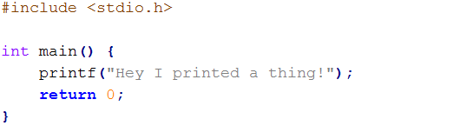
(I wrote this in notepad and used a C compiler which I had on my computer already)

Slide 8
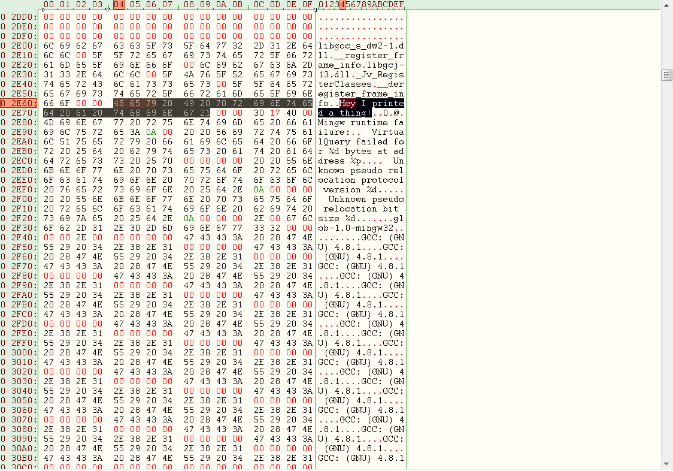
(hexedit)

Slide 9
The compiler does a lot to be able to spit out the instructions in a form the computer can recognize
It’s easy (or at least easier) to go from source to binary but not the other way around
Assembly, on the other hand, is a one-to-one conversion

Slide 10
Example
If you wanted to add the value 0x10 to a register, it would look like this:
3f50 1000
In assembly:
add #0x10, r15

Slide 11
**You don’t need to worry about fully understanding this part
3f50 1000
-The 50 means “add”
-The 3 tells it two things:
-The first number is going to be a raw value
-The second number is going to be in a register
-The f tells it that it should look at register 15 (0xf = 15)
-1000 is 0x0010 (that raw value we mentioned

Slide 12
Assembly ←→ Program
The assembly form of each instruction says exactly the same stuff as the binary form
It’s just easier to read

Slide 13
Some MSP430 instructions
add (add numbers)
sub (subtract numbers)
inc (increment)
dec (decrement)
jmp (jump – start executing instructions elsewhere)
call (call a function)
(there’s a bunch, not all of them make sense at a glance, use Google for those)

Slide 14
One more thing
Instructions usually come in this form:
operator operand, operand
Example:
add #0x10, r15
Not everything has two operands, but for those that do, the second one is the destination in MSP430.

Slide 15
Disassembly UI

Slide 16
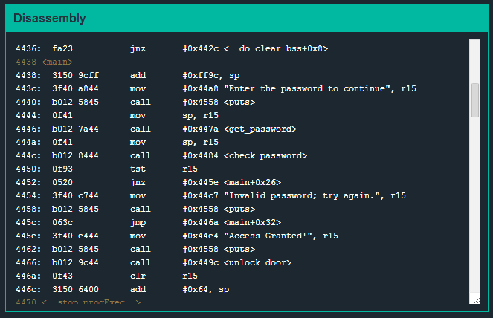

Slide 17
Registers

Slide 18
MSP430 Registers
Different architectures use different sets of registers.
MSP430 has these:
pc | sp | sr | cg
R4 | R5 | R6 | R7
R8 | R9 | R10 | R11
R12 | R13 | R14 | r15

Slide 19
Registers (cont.)
pc (program counter)
Address of next instruction
sp (stack pointer)
Current position on the stack
Easy access to function variables
sr (status register)
Carry flag, zero flag, cpuoff flag, etc.
cg (constant generator)
Spits out commonly-used constants

Slide 20
Registers (cont.)
R4-R15 are general working registers
Helpful for working with local variables and parameters

Slide 21
Register State UI

Slide 22
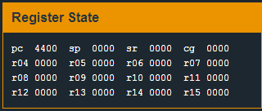

Slide 23
Memory Organization

Slide 24
Simplified Overview
There’s some data in the header which has information for starting the program
Then there’s some empty space which gets reserved for stack data
Then you have the instructions at the end

Slide 25
Live Memory Dump UI

Slide 26
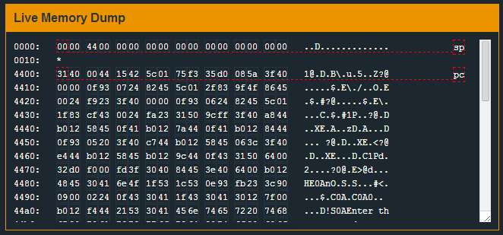

Slide 27
Stacks
Any time a call is made, a new stack frame is formed.
It’s a bit simplified in MSP430
Parameters get pushed onto the stack before the call
When the function is called, the return address also gets pushed
The stack pointer points there so now those parameters can be accessed easily by addressing them relative to the sp register

Slide 28

Demo
Tutorial level
Commands:
b main
b 44a4
c
let pc=449c
s
s
let 43fe=7d

Slide 29
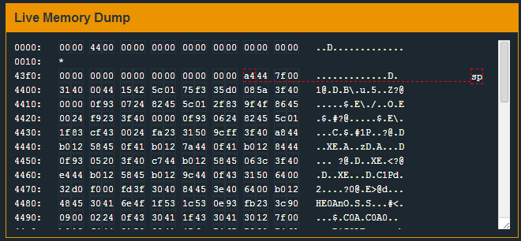
Result

Slide 30
Result (Comparison)

Slide 31
okay we’re actually gonna hack it now
hey future john remember to go over the debugger commands
thanks past john

