Slide 1
ish
Or: How I took the most inefficient route to completing a binary exploitation challenge and ended up needing a little bit of luck with regards to what stuff I actually remembered about the program I was looking at

Slide 2
Be Familiar With:
Socket connections
x86 Assembly
Program memory / The stack
GDB
[Optional but it shouldn't be] IDA

Slide 3
Netcat
Used to handle network connections
One application listens, other connects
Demo?
Relates to the exploit because this is a program running on a server

Slide 4
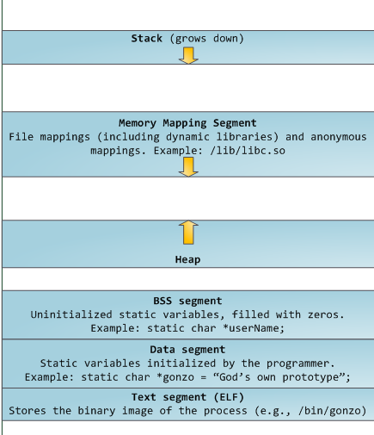
Program memory

Slide 5
x86
Worth knowing about instructions:
  You have an operator (move, add, subtract)
  Then one or two operands
  Example instructions:
    sub esp,0x20
    mov DWORD PTR [esp+0x1c],eax

Slide 6
x86
Intel Syntax
  sub esp,0x20
  mov DWORD PTR [esp+0x1c],eax
AT&T syntax
  sub $0x20,%esp
  movl $0x0,0x1c(%esp)

Slide 7
x86
More info:
  x86 sub instruction
  site:stackoverflow.com rep stos

Slide 8
x86
Registers:
  Eax
  Esp
  Ebp
  Eip

Slide 9
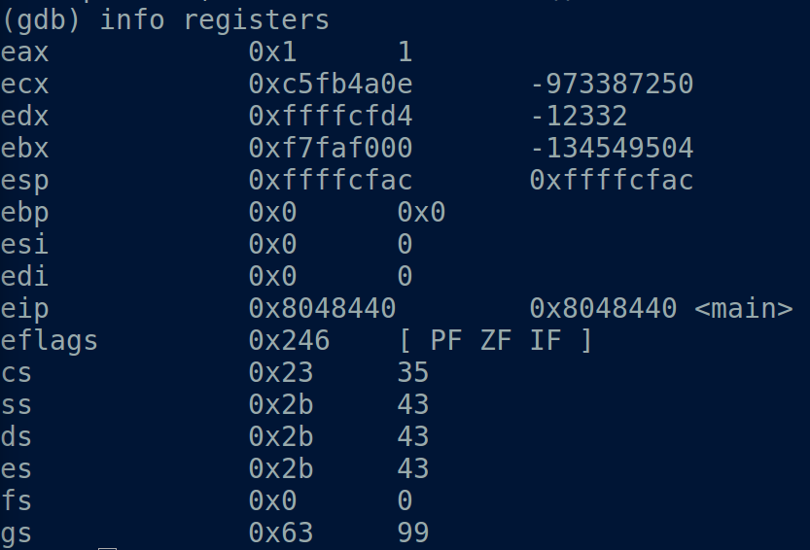
x86
Other registers

Slide 10
x86
More info:
  http://goo.gl/XJbH4w
  “x86 registers”

Slide 11
Program memory

Slide 12
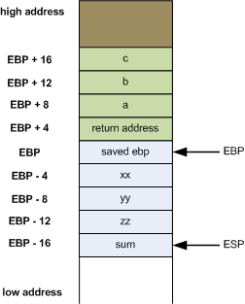
The Stack

Slide 13
The Stack
Demo with stack!

Slide 14
The Stack
Return address
Saved ebp
x
esp

Slide 15
The Stack
Return address
Saved ebp
x
z
Return address
New saved ebp (and ebp)
y

Slide 16
GDB
Demo with stacknp!

Slide 17
BACK TO ISH

Slide 18
Q: What is the program?
A: A vulnerable shell on port 9988
  Lets you ls
  And cat
  And sleep
  And ping
  And run
  And login again
  And ask for a random quote?
  And play the lottery?

Slide 19
How the shell works
1. Get the username
2. Put a null byte at the end of it
3. Expand the stack to accommodate it
4. Check if username is "root" (no newline allowed)
5. Open a file named "key" and read a password
6. Ask for the password from the user
7. Compare the password with the key
8. If their guess is invalid, exit
9. Wipe out the actual password from memory
10. Close the key file
11. Print the shell introduction to the socket
12. Print the shell prompt to the socket
13. Get a command
14. Check the command against a list of allowed commands
15. Set register edi to the address of the appropriate command
16. Call whatever is at edi
17. If the command was actually exit (not in the list in (14)), then exit the shell
18. Go to (12)

Slide 20
How some commands work
Ls always listed files in the folder
Sleep, ping, quote didn't do anything useful
Cat required a flag to be set that was always 0
Run always failed too.
Login called the shell function again
Lotto generated random numbers and had you guess them

Slide 21
So Now What?
I was stuck
Started playing with it
Found a problem with lotto
  If you didn't pick a level, it didn't generate numbers

Slide 22
I can read the stack!
But how do I read exactly what I want?
Probably want that key file...

Slide 23
How the shell works
1. Get the username
2. Put a null byte at the end of it
3. Expand the stack to accommodate it
4. Check if username is "root" (no newline allowed)
5. Open a file named "key" and read a password
6. Ask for the password from the user
7. Compare the password with the key
8. If their guess is invalid, exit
9. Wipe out the actual password from memory
10. Close the key file
11. Print the shell introduction to the socket
12. Print the shell prompt to the socket
13. Get a command
14. Check the command against a list of allowed commands
15. Set register edi to the address of the appropriate command
16. Call whatever is at edi
17. If the command was actually exit (not in the list in (14)), then exit the shell
18. Go to (12)

Slide 24
First: Send the username “root”
Couldn't use netcat anymore
  Sent “root\n”
Python solved that

Slide 25
How the shell works
1. Get the username
2. Put a null byte at the end of it
3. Expand the stack to accommodate it
4. Check if username is "root" (no newline allowed)
5. Open a file named "key" and read a password
6. Ask for the password from the user
7. Compare the password with the key
8. If their guess is invalid, exit
9. Wipe out the actual password from memory
10. Close the key file
11. Print the shell introduction to the socket
12. Print the shell prompt to the socket
13. Get a command
14. Check the command against a list of allowed commands
15. Set register edi to the address of the appropriate command
16. Call whatever is at edi
17. If the command was actually exit (not in the list in (14)), then exit the shell
18. Go to (12)

Slide 26
How some commands work
Ls always listed files in the folder
Sleep, ping, quote didn't do anything useful
Cat required a flag to be set that was always 0
Run always failed too.
Login called the shell function again
Lotto generated random numbers and had you guess them

Slide 27
___(shell) (username: arst)
|
|
|
|
|
|__

Slide 28
___(shell) (username: arst)
|
|
|
|
|
|__(shell) (username: root)
|
|<-password
|
|
|
|__

Slide 29
___(shell)
|
|
|
|
|
|__
.
.<-password

Slide 30
___(shell)
|
|
|
|
|
|__(lotto)
|<-read lotto numbers from here
|<-password
|
|__

Slide 31
How the shell works
1. Get the username
2. Put a null byte at the end of it
3. Expand the stack to accommodate it
4. Check if username is "root" (no newline allowed)
5. Open a file named "key" and read a password
6. Ask for the password from the user
7. Compare the password with the key
8. If their guess is invalid, exit
9. Wipe out the actual password from memory
10. Close the key file
11. Print the shell introduction to the socket
12. Print the shell prompt to the socket
13. Get a command
14. Check the command against a list of allowed commands
15. Set register edi to the address of the appropriate command
16. Call whatever is at edi
17. If the command was actually exit (not in the list in (14)), then exit the shell
18. Go to (12)

Slide 32
___(shell) (username: arst)
|
|
|
|
|
|__

Slide 33
___(shell) (username: arst)
|
|
|
|
|
|__(shell) (username: arst)
|
|
|
|
|
|__

Slide 34
___(shell) (username: arst)
|
|
|
|
|
|__(shell) (username: arst)
|
|
|
|
|
|__(shell) (username: root)
|
|<-password
|
|
|
|__

Slide 35
___(shell) (username: arst)
|
|
|
|
|
|__(shell) (username: arst)
|
|
|
|
|
|__
.
.<-password

Slide 36
___(shell) (username: arst)
|
|
|
|
|
|__
.
.
.
.
.
.
.
.<-password

Slide 37
___(shell) (username: arst)
|
|
|
|
|
|__(shell) (username: arstarstarstarst...)
|
|
|
|
|
|
|__
.<-password

Slide 38
___(shell) (username: arst)
|
|
|
|
|
|__(shell) (username: arstarstarstarst...)
|
|
|
|
|
|
|__(lotto)
|<-password <-read lotto numbers from here
|<-more password as it turns out
|<-even more password :(
|__

Slide 39
Final Demo!
I have made my own key file
  Key is “key!”

