Slide 1
The Moby Scheme Compiler for Smartphones
(Is That a Parenthesis in Your Pocket?)
Danny Yoo
Zhe Zhang
Kathi Fisler
Shriram Krishnamurthi

Slide 2



Slide 3
Vital Statistics
Middle-school, after-school programming course
All teaching by volunteers
Nearly 300 students (average age: 11y9m)
24% female; 70% reporting race are minority;
70% on free or reduced-price lunch
Greater Boston, Bay Area, Austin, New York City

Slide 4
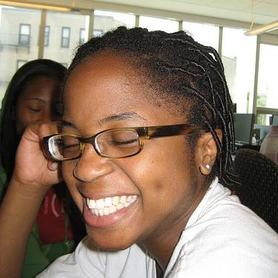
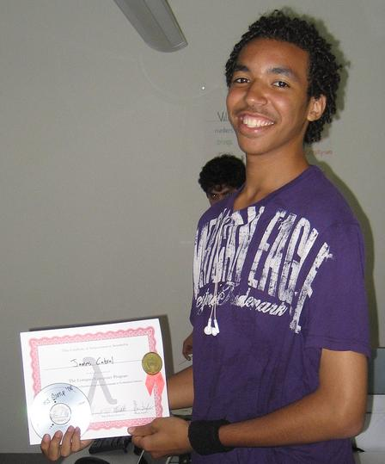
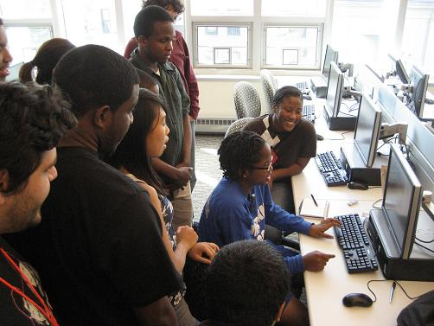

Slide 5
Bad News
The reason they’re smiling
isn’t the parentheses

Slide 7
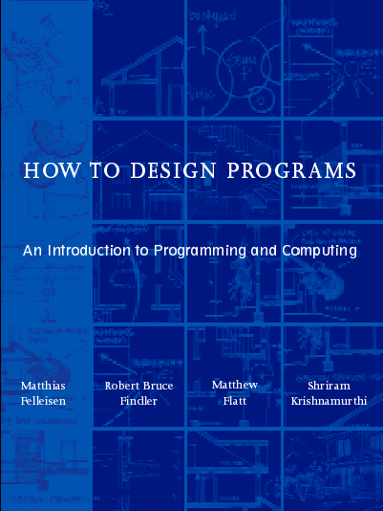

Program = Design
+ Programming System
+ Execution Model

Slide 8
Program Execution Model

Slide 9
Pascal

Slide 10
“Pascal is for building pyramids—imposing, breathtaking, static structures built by armies pushing heavy blocks into place. […] In Pascal the plethora of declarable data structures induces a specialization within functions that inhibits and penalizes casual cooperation.”
—Alan Perlis
“Pascal is part of the same machinery as hall passes, dress codes, advisors’ signatures, single-sex dorms, and so on.”
—Brian Harvey

Slide 11
begin
…
…
…
…
…
…
…
…
…
…
…
…
end.
begin
…
…
…
…
…
…
…
…
…
…
end;
begin
…
…
…
end;
begin
…
…
end;
begin
…
end;
begin
…
…
end;
begin
…
end;
.

Slide 12

flights from PVD to CDG
must remember list of flights
list of flights
the third outward flight
must remember restricted list of return flights
restricted list of return flights
the second return flight
ok

Slide 13

user typed ‘(’
ok
different
kinds of
handlers
user moved mouse
ok
user clicked mouse button
ok

Slide 14
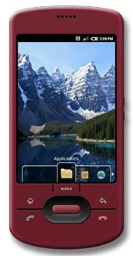
user moved right 10 yards
loc: (0,0)
ok
loc: (10,0)
user tilted phone left
loc: (10,0)
loc: (10,0)
ok
user moved left 10 yards
loc: (10,0)
loc: (0,0)
ok

Slide 15
void
void
void

Slide 16
database,
memory store,
remote
Web
service

Slide 17
database, hidden fields,
cont’ns

Slide 18
Why is this Bad?

Slide 19
What good are functions from
high-school algebra?

Slide 20
A LISP programmer knows the
value of everything, […]
—Alan Perlis
You’ve disappointed Alan Perlis.

Slide 21



2006 PISA scores: USA not in top 20 in math, science, or reading
“Economic Time Bomb”
—June Kronholz, WSJ

Slide 22
Why void?
The hostile
operating
system
void
Why hostile?
Because
it’s neutral
void
But
neutrality ≠ hostility
Neutrals can cooperate (impartially)
void

Slide 23
Callback
User
OS
“World”
“World”
“World”
“World”

Slide 24
Current value of World
Will invoke
event-specific functions
Might be
enriched with additional event information
New value
of World
Phone example: World is current location
(define (on-move w d)
(posn+ w d))
(define (on-tilt w o)
w)

Slide 25

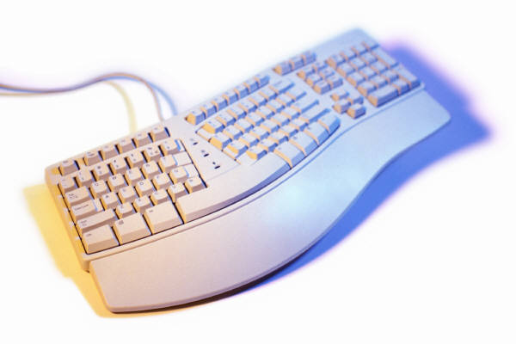

on-click :: w × btn → w
on-key :: w × key → w
on-tilt :: w × incl → w
on-move :: w × dist → w
on-redraw :: w → scene
on-tick :: w → w
stop-when :: w → bool

Slide 26


Slide 27
(define width 400)
(define height 300)
(define initial-world 0)
(define PLANE )
(define (render-world w)
(place-image PLANE
(* w 10)
(image-height PLANE)
(empty-scene width height)))
(define (incr-time w)
(add1 w))
(big-bang width height 1/10
(on-tick incr-time)
(on-redraw render-world))

Slide 28
World
World
World
Scene
World
World

Slide 29
World
World
World
Scene
World
Bool

Slide 30
Moby

Slide 31
What It’s Not
A “Scheme compiler for smartphones”

Slide 32
What It Is
Compiles programs written in
Scheme (Beginner Scheme, for now)
+ World
Currently for Android, partially for J2ME

Slide 33
A Little More
Scheme (Beginner Scheme, for now)
+ World
+ GPS
+ Tilt
+ GUI-World
+ Rudimentary Web Services

Slide 34
Baseline
All student programs will run on phone*
^{* A little legalese elided}

Slide 35
Rolling Out of Time

Slide 36
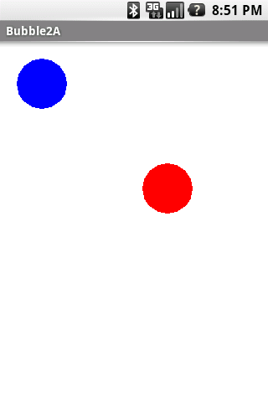
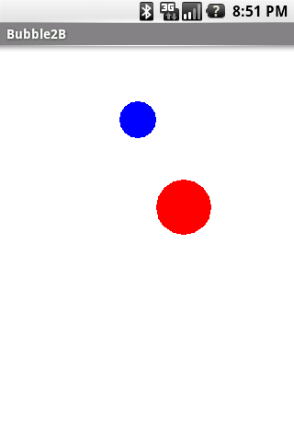
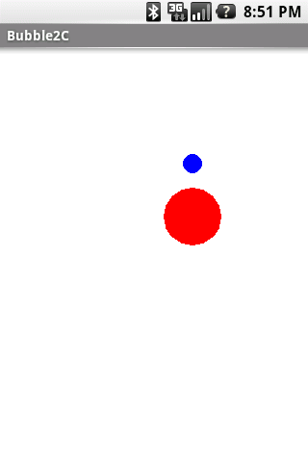

Slide 38
(define WIDTH 300)
(define HEIGHT 300)
(define-struct vel (x y))
(define target (make-posn (random WIDTH) …))
(define-struct world (posn r vel))
(define initial-w
(make-world (make-posn …)
30 (make-vel 0 0)))
;; game-ends?: world -> boolean
(define (game-ends? w)
(or (<= (world-r w) 1) (collide? w)))

Slide 39
;; tick: world -> world
(define (tick w)
(make-world (posn+vel (world-posn w) (world-vel w))
(- (world-r w) 1/3)
(world-vel w)))
(define (tilt w azimuth pitch roll)
(update-world-vel
w
(make-vel roll (- pitch))))
;; tilt: world number number number -> world
(define (tilt w azimuth pitch roll)
(make-world (world-posn w)
(world-r w)
(make-vel roll (- pitch))))
(big-bang WIDTH HEIGHT 1/20 initial-w
(on-redraw render)
(on-tick tick)
(on-tilt tilt)
(stop-when game-ends?))

Slide 40
Minding the Store

Slide 41
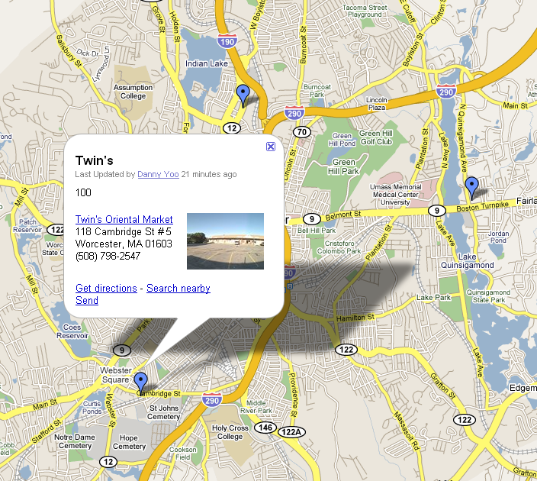

Slide 42
(define mymaps-url
"http://maps.google.com/maps/ms?ie=UTF8&...&msid=...")
(define ALL-PLACES
(parse-places (parse-xml (get-url mymaps-url))))
(define ALL-ITEMS …)
(big-bang ...
(on-redraw render)
(on-location-change update-loc))
;; update-loc: world number number -> world
(define (update-loc w lat long)
(make-loc lat long))

Slide 43
;; render: world -> scene
(define (render w)
... (description w) ...)
;; description: world -> string
(define (description w)
(items->string (matching-items-nearby w)))
;; matching-items-nearby: world -> (listof item)
(define (matching-items-nearby w)
(places-matching-items
(nearby-places ALL-PLACES w)))

Slide 44
Homeward Bound

Slide 45
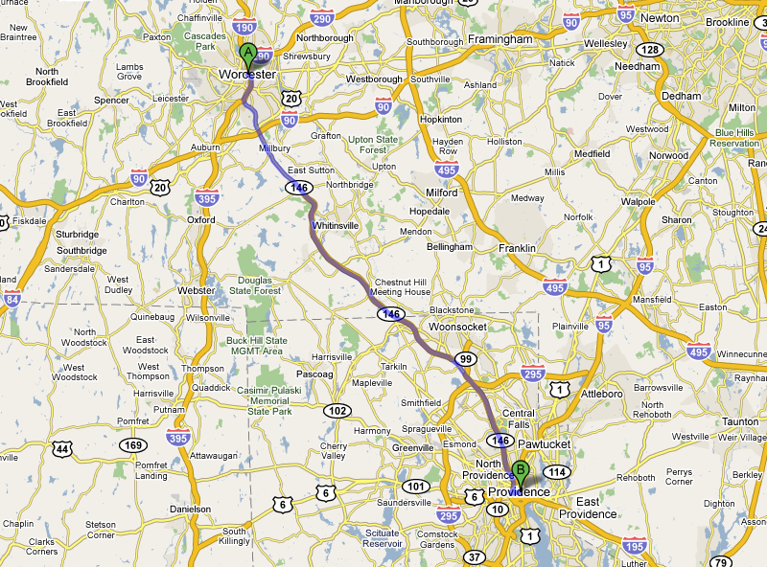

Slide 46
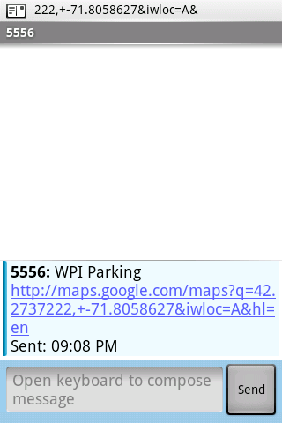
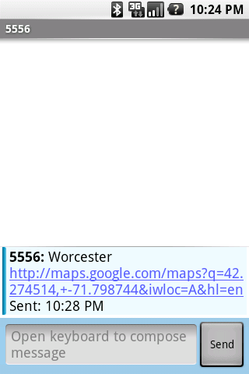
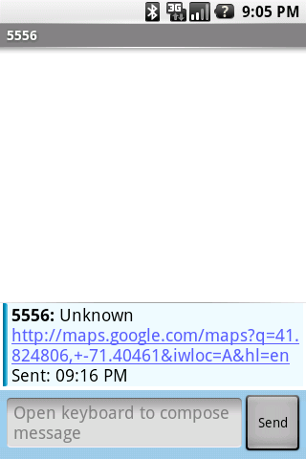
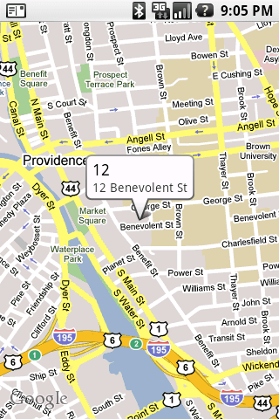

Slide 47
The World is Not Enough

Slide 48
Parallelism/Concurrency
In-place updates
“Safe at any speed”
—John Jannotti
Universe for distributed computing
Moore versus Mealy

Slide 49
{
Design
Programming system
Execution model
J2ME
Java
JavaScript
On the Internet,
nobody knows
you’re a
Scheme program
Processing
Flash/ActionScript
NXT
NXC
RobotC
BricxCC
Objective-C

Slide 50
Port Moby!
sk@cs.brown.edu
Teach Bootstrap!
www.bootstrapworld.org
Thanks:
Danny Yoo
Zhe Zhang
Kathi Fisler
Emmanuel Schanzer
Matthias Felleisen
(rest )

