Slide 1
Boost flexibility in coding exercises by building container in real time
Bachelor Thesis
Romeo Stoll
Notes:
Welcome, to the first presentation of my Bachelor thesis on ….
(Name, Computer Science Student in 6. semester)
After a motivation on what the problem is and why I’m working on it, Present my work until now to find feasible solution and the future plan of my thesis.
The setting of this bachelor thesis are Cloud-based IDE (Code expert in this case) which executes the code of the users in containers.
Allow users to flexibly set up own execution environment:
Preconfigured monolithic image with all possible dependencies
Build at runtime according to needs of user.
First (current) is fast once image built but has tradeoffs

Slide 2

Flexible
Configurable
Pre-baked Image
Notes:
Problem of current solution and motivation of new approach
Lecturer choose pre-baked OS images for students CE (coding env)
Add new package, change version → manually by CX-team → time intensive, every new package creates a new exciting way things can break, not available on RedHat
Huge burden maintain growing images
Ideally: lecturer use any language and install any package with minimal fuss.
Goal: build image at runtime based on the needs of the lecturer and move away from pre-baked images.
Advantages:
Lecturer gets more responsibility and flexibility
Lecturer can quickly iterate over and test different configuration
(Ideally one) Lean base image is maintained and updated.
Preconfigured extensions of this base image for common environments like python, C++, Java etc. to make it easier for lecturer which don't need to customise much.

Slide 3

Nix package manager
Declarative
Reproducible
Notes:
Challenge for building images at runtime is speed. UX not impacted by building.
Nix: declarative, reproducible OS package manager.
highly cacheable package store, Nix store
allows for building environments in a composable way.
purely functional package manager (no side-effects) → key for reproducible.
Nix programming language: user specifies dependencies for repl in Nix expression and Nix will build environment.
Great fit: building environments in a composable way
minimal base image,
+ programming language and libraries and then
++ packages needed by the user
No maintenance of large docker images, only lean minimal base image.
Mimics the the current API for lecturer with predefined images to choose from

Slide 4
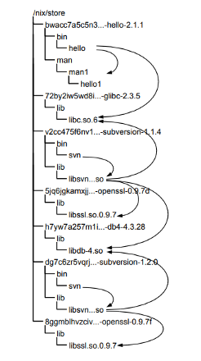
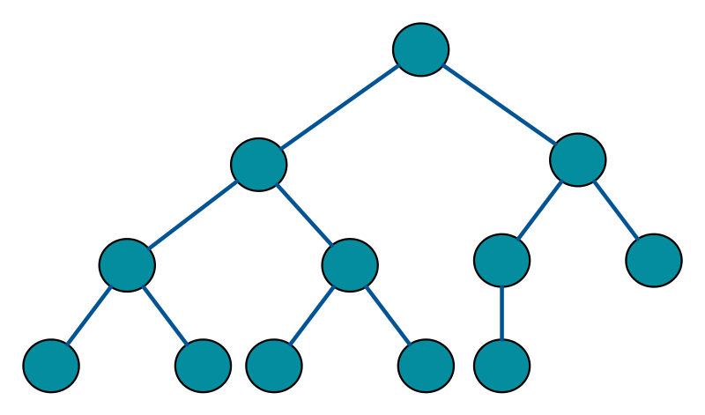
/nix/store
Heap
Object 2
Object 3
Object 1
Notes:
Elaborate on how packages are managed and built:
Packages are build from Nix expressions. (Two step process)
Not built directly but translated into derivations
describes everything that goes into a package build action (analog to compiler: bulk of the work on simpler intermediate representation of the code)
Derivations placed at unique paths in nix store, from these derivations paths one can built derivation outputs (closure).
Nix goes to great length to ensure that Nix expressions are deterministic: building a Nix expression twice should yield the same result.
Easy to support variants of a package (call nix expression as a function with different arguments)
→ No conflict with each other in the Nix store.
Different versions of subversion in separate paths and they depend on versions of openssl which are linked by symlinks
Why? Content addressable store
Package management operations always add new versions in different paths and are therefore atomic.
This means old versions are still there after an upgrade and you can roll back.
Analogy with programming languages: you have the heap with all the objects, that corresponds to the Nix store. You have objects that point to other objects, those correspond to derivations.

Slide 5

Approach 1: Use Nix shell and don’t build new image at runtime
Binary Cache
Running Container
local.nix
$ nix-shell
… Evaluates local.nix
$ nix-shell
… Export env variables ($PATH)
Environment ready!
/mount:
Shared nix/store
nix/store
Notes:
2 feasible approaches to solve challenge:
Talk about High level workflow from start to finish and challenges
Assume Start:
Container from minimal image is running, Nix installed
Local.nix inside container. Let user extend environment
User calls nix-shell to run a script (Run command)
Nix-shell:
Evaluates local.nix
If not in store → Download from binary cache and build the dependencies for the derivations. Not the closure
Store derivations as paths in nix/store
Set environment variables to correct derivations paths in the store, s.t. binaries found by compiler
Environment ready with all dependencies (without building closure) and nix-shell executes the command the user specified by calling.
Want to make sure that if two user use the same config, then after the first has to wait a bit until packages in store for the second one it is really fast!
But with this solution this doesn’t work as container have non-persistent storage.
Mount shared disk image with shared Nix store into every container
Conflict free (many versions of same package) due to Nix content addressable store
Shared store cries for security problem?
Nix; multi-user support to make sharing the store secure
Performance evaluations
Downloading and building
Seeded nix store: prebuilt with most used packages downloaded
Simple: Adding package = adding dependency in local.nix file.
Evalulation of local.nix and exporting the environment variables by nix-shell
Skip evaluation and persist env variables between restarts of nix-shell if config remains
Invalidate cache if config changes

Slide 6
Approach 2: Build new image if config changes
Builder Container
Builder Container
Running Container
Builder Container
New Container
local.nix
Environment ready!
New Image
nix/store
Notes:
Two different directions:
Tool Nixery, build ad-hoc image based on package name, but reduces flexibility significantly, which is not what we want. won’t pursue this direction further:
Nix builder container: Assume Start:
Some container running with local.nix available
Builder container is available with Nix package manager installed
Run builder with local.nix
Builder builds image using Nix (build the closure, both steps and then the Docker image)
Rem: Local.nix is stitched together with minimal base image
Nix can build Docker images very efficiently
Load result of builder into Docker and start new container
Env ready
Performance evaluation
Avoid unnecessary builds by only building new image if config changes
i.e. compute hash over config file or more sophisticated method
For Scaling and simultaneous builds
Run multiple builder container in parallel, use persistent Nix store shared among the builders
Similarity: Approach 1: every repl container has shared nix-store <-> every builder has shared store

Slide 7
Conclusion
 |  | Approach 1 | Approach 2
Optimize consecutive build reuse
Optimize first build after config changes
Isolation
Scaling
Notes:
Based on literature research and some hands on experimentation with both approaches I can compare both approaches side by side on 4 factors:
Scaling: Approach 1: each container needs Nix installed,
Conclude that both are good candidates and I would give a recommendation for approach 2, due to the above factors and the fact that config changes are rather rare.
Later I will have more factors and also measurements, to help you arrive at a decision.

Slide 8
Next steps and Timeline
Activities / Timeline | March | April | Mai | June
Literature Research
Feasible Solutions
1. Presentation
Prototype for both Approaches
Benchmarking
Writing Thesis
Final Presentation
Notes:
Continue both approaches s.t. compare both approaches with each other and to the current approach.
Prototypes (April) for both approaches to make the use cases clear.
predefined base image
some language specific examples
Bencharking (April/Mai): take protoypes and measure two main uses cases
lecturer: starting the container after a config change
student: don't change the configuration
The most important metric will be the time until the container is ready.
Later determine the right hardware in the Cloud for the approaches
disk space usage,
the number of layers used
CPU performance
Large scale simulations.
- 100 people all build container at the same time
- user want huge libraries in terms of space (i.e. pytorch or large C++ gui library).
June: Writing thesis, Final Presentation
Thank you for listening
I will now take any question from you.

