Slide 1


Boost flexibility in coding exercises by building containers at runtime
Romeo Stoll
23.06.22
Advisors: Dr. D. Sichau (co-head), Dr. M. Dahinden (co-head),
Prof. Dr. B. Gärtner
Department of Computer Science, ETH Zürich
Notes:
Thank you all for coming. My name is Romeo.
As a student, I've spent many hours using the browser accessible development environment, called CodeExpert, to solve coding exercises, but I've never worried about what was running in the background to make this work. My ignorance was made possible due to hard-working developers and lecturers which maintain and configure the coding environments for a mostly smooth user experience. To do this for many students who need an isolated environment, CodeExpert uses containers.
So today, I'm going to tell you (guys) about two approaches for building containers at runtime that I designed for boosting the flexibility in configuring coding exercises.

Slide 2




What you need to know
Container engine
Environments:
Container image
Image registry
push pull
runnable
Container
Notes:
To make sure that we're all on the same page, what is a container?
A container is a runnable instance of a container image.
An container image is a standardized and read-only configuration object for creating containers.
Since an image is immutable, you can start many equivalent containers from it and it makes it easy send the image to somewhere else. For example you can push and pull an image to and from a image registry. A *image registry* is just a centralized service that stores a collection of container images.
Another thing to you need to know about images is that they are often extend another image, called the base image, and consist of multiple *layers* that store the image's content. Layers are essential for caching.
Let's turn our attention back to containers; one can connect, for example, a network or persistent storage to a container. Persistent storage is valuable since any state of the container generated at runtime is lost once the container is removed. We manage containers by starting, stopping, or removing them using a *container engine* that runs on the host machine.
To close this background section, I want to emphasize the difference between images and *environments*. An environment is a running instance of an image (as a container) that interacts with the user. In our context, this environment has some software packages installed to run programs of certain programming languages like C++, or Python.

Slide 3
Decide how to set up environments based on user configuration
Provide a fixed set of packages and languages as pre-built images
Set up a flexible environment at runtime to the user's needs
Notes:
Ideally, we want to enable users to set up an environment with any programming language and any package with minimal effort. To allow this flexible setup of an environment, one needs to decide between two main ways of doing this:
- Either one can provide a fixed set of packages and languages as prebuilt images.
- or one can set up a flexible environment at runtime to the user's needs.
The first way is currently used in CodeExpert, and like most decisions, it has tradeoffs, which we will discuss later today. The second way is promising to alleviate these tradeoffs and is really what my thesis is going to be looking at.
(One tradeoff for you to know now is that it allows fast environment startup times once the image has been built at the cost of inflexibility. )

Slide 4
Objectives of my thesis
Find feasible approaches to build images at runtime based on the user configuration
Evaluate prototypes for each approach
Notes:
In my thesis I have the following two objectives.
- First, find feasible approaches to build images at runtime based on the user configuration
Second, evaluate prototypes for each approach
To tackle the first objective, I'm going to take a step back to look at how we can build images at runtime.

Slide 5

Build images at runtime using properties of Nix
Content-addressable package store
Reproducibility
/nix/store
Source code
<…hash…>-<…name…>
bin/hello
Dependencies
72by2iw5wd8i…-glibc-2.3.5
Highly cacheable builds
Cheap images
Compose environments easily
https://devrant.com/rants/2341310/always-works-on-my-machine
Notes:
To do this, I'm going to use a tool called Nix which is among others, a build system for building images and environments. We use Nix because it has features and properties that we need to do this building at runtime. These properties are lacking in standard image build systems like Docker. Docker is basically a containerization solution that is currently used by CodeExpert.
[next]
So what are those properties?
The first is reproducibility, which is useful for repeatable builds such that if it works today, it works the next time you build it. It basically solves the problem of "it worked on my machine."
The Nix system has a package manager at its heart that uses a purely functional programming language. [next] Nix stores all packages in one directory called the Nix store.
The Nix store is content-addressable, meaning that each package is identified by a name and a hash. The hash encodes all the inputs to build the package. [next] For example the inputs are its source code and all its dependencies. Content addressability makes the Nix store conflict-free even with multiple versions of the same package, (as different dependencies will result in a different hash.)
The content-addressable package store together with other properties (read-only store paths) result in highly cacheable builds. [next]
Recall that images are made up of layers for caching reasons? It turns out that Nix can cache these layers in most of our use cases better than standard image build systems like Docker. We will use this property in one of our prototypes.
[next] Nix can build very "cheap" memory-efficient images because with Nix we don’t need to use a base image and we can easily separate build time from runtime dependencies such that the result only contains what's necessary at runtime and nothing else.
[next] Since Nix is a also a package manager it is trivial to compose two environments like Python and C++ into one image.

Slide 6

Nix build process of a package or image
Construct an environment where all the tools and dependencies are available for building the image or package
Execute a build script to run all build steps
nix-shell
Notes:
How does the build process look like with Nix?
Starting from a build instruction written in the Nix language, Nix builds for example an image or package by executing the following two steps:
1. First it constructs an environment where all the tools and dependencies are available for building the image or package.
2. Second, it executes a build script to run all build steps.
[next]
The Nix tool, which is called nix-shell is performing only the first step. To do this step the nix-shell must either download the dependencies from a binary cache or build them from source code. The binary cache is used to avoid the time intensive building from source code. We make use of the nix-shell in one of our prototypes.
Very simply, all you need to remember is that we will use Nix to build reproducible images that we run as environments.

Slide 7
Objectives of my thesis
Find feasible approaches to build images at runtime based on the user configuration
Evaluate prototypes for each approach
Configure environment: lecturer
User
Run code in environment: student
Notes:
We are now ready to start our first aim of finding feasible approaches for building images at runtime based on the user configuration. To do this, I designed two different approaches that use Nix as a build system. I developed them with the assumption that the first build time is less critical and can be slower, but the subsequent build time needs to be fast.
[next]
I could assume this because, unlike the lecturers who configure the environment first, the students run this environment many times and need a quick startup time.
So in the following presentation, we refer to the lecturer or student specifically or use the term user when we mean both groups.

Slide 8
Build images at runtime (BIAR) execution flow
BIAR computes the mapping F
Builder container
Image registry
Push
F
Config
Pull
Container engine
Configurations
Images
Environment
Notes:
I call the first approach: Build images at runtime or short BIAR. It computes the mapping F from configurations to images. In particular, this approach computes F by building a new image for every distinct configuration. We identify an image uniquely based on the hash of the corresponding configuration.
To compute F, BIAR uses "builder containers" that have Nix installed and, given a configuration, build an image with the specified packages installed. The layers of the resulting image are pushed to a image registry, then pulled to the container engine, and stored there. We can now start an environment from this image to execute the students' code.
It is possible to build many images simultaneously by running builder containers in parallel, and these containers all share the Nix store to cache previous builds and layers.
Computing F is expensive; therefore, we want to skip [next] this build step to make subsequent environment startups with the same configuration quick. We can do this because the hash of the configuration identifies the correct image to use. This image is already available from the first build, and we can use it to start an environment.

Slide 9
Nix-shell at runtime (NSAR) execution flow
NSAR computes the mapping G
Container engine
nix-shell builds environment
Config
Cache
G
Base image
Configurations
Environments
Notes:
I named the second approach nix-shell at runtime or short NSAR. It computes a mapping G from configurations to environments, and not to images as in the BIAR approach. [next] NSAR computes G by starting a container from a single image, [next] and in this container, it runs the nix-shell, which builds an environment from the given configuration with all needed packages. Again computing this mapping is expensive, and we want to cache the computation for subsequent builds among multiple users. [next] To do this, we cache the nix-shell execution with persistent storage.
The nix-shell execution has two parts: the first is building the packages from source code or downloading them from a binary cache, and the second is basically setting up the environment. We cache the first part by sharing the Nix store among the environments and the second by a shared cache for the nix-shell evaluation.
Result: two shared caches

Slide 10
Objectives of my thesis
Find feasible approaches to build images at runtime based on the user configuration
Evaluate prototypes for each approach with 4 evaluation criteria: performance, security, user experience and developer experience.
Notes:
With the first aim complete, let's continue to the next one. We will compare our prototypes with each other and to the current CodeExpert approach, which again is Docker based. To do this we use four evaluation criteria: performance, security, user experience, and developer experience. We use two test environments, a Python, and C++ environment to benchmark our prototypes. One thing to note before I get to my results is that our prototypes are a proof of concept and not fully optimized.

Slide 11
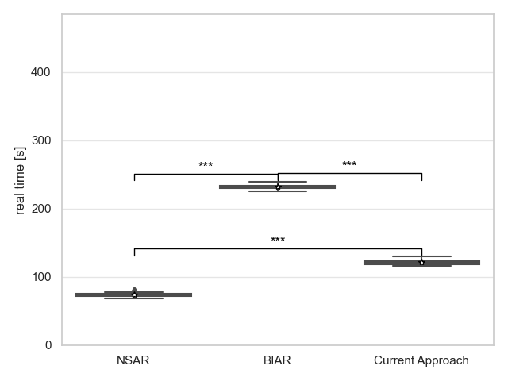
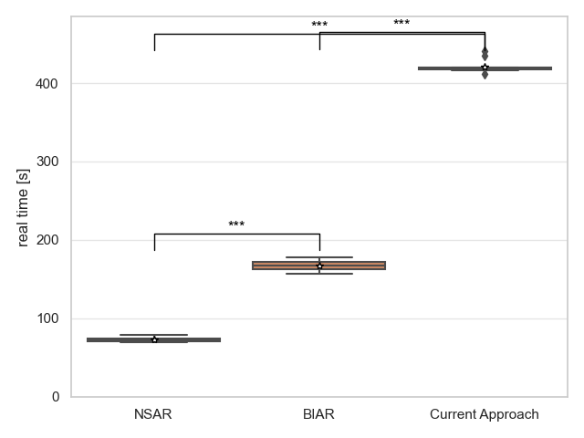
Results: Performance of first-time build
C++
Python
Notes:
We will start with the benchmark results of the first-time build of a configuration. Let's mention how measure the first time build. We measure the build time of our prototypes starting from a new configuration and empty caches until the environment is ready. Now, the exact execution steps for this are very different for each approach.
Let's take a look; For both environments C++ and Python, it looks like the NSAR prototype is the fastest, followed by BIAR or the current approach. The Python version of the current approach very slow because it has to build Python from source code, whereas all other benchmarks use pre-built binaries. Note the scales are the same for both graphs. So we can see that our prototypes NSAR and BIAR have roughly the same build time no matter which environment. Otherwise, the results make sense, for example, the NSAR is the fastest as it doesn't need to build or push any images.

Slide 12
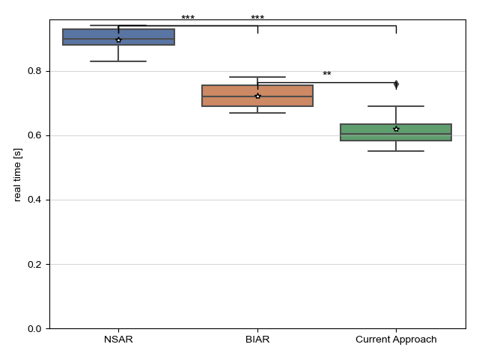
Performance of subsequent time build
Notes:
Let's move to the performance of subsequent time builds. Remember this is where its important to be fast, and I'm going to show you just the C++ environment as the results are analogous to the other one. Let's see, both of our prototypes are below 900ms on average, which is good, but both prototypes are significantly slower than the current approach, which does not entirely make sense. The cause for the slow NSAR startup is likely the time needed to check the cache. And for BIAR, we need to compute the hash over the configuration, which adds a small delay.

Slide 13
Security evaluation
BIAR: builder container are vulnerable to attacks from lecturers
NSAR: environments are vulnerable to attacks from all users
Attack vectors:
Shared cache
Network access
Notes:
The security of an environment is essential as we want to restrict users from breaking out of their isolated container to prevent attacks on the host system or other users' environments.
The BIAR prototype is only vulnerable to attacks from the lecturer, whereas the current prototype of the NSAR approach is vulnerable to attacks from any user.
There are two primary attack vectors: its the shared cache and the network access of the builder container in case of BIAR and the environments in case of NSAR.
Both prototypes have a shared Nix store which is vulnerable to cross cache attacks. For example a user can fill the shared cache with garbage packages until the system runs out of memory, resulting in a DoS attack. The Nix store is also potentially vulnerable to cache poisoning, where a malicious user ca put a bad package into the cache such that it is used later in another users build process. The NSAR prototype has a another shared cache for part of the nix-shell execution. This cache is is vulnerable to more attacks than the Nix store.
Let's discuss the network attack vector. To run build steps Nix needs network access to download packages or fetch code from remote sources. Network access makes it easy for users to source and execute malicious code in a container. Mitigating the network attack vector is not difficult, but protecting the shared cache is more involved.

Slide 14
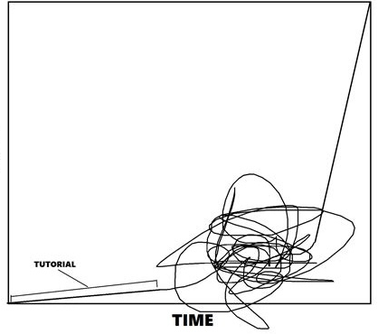
Developer experience
Nix learning curve
Change the configuration to the lecturers needs
Responsibility shift
Development and testing
Maintenance
Skill
Time
Adapted from: https://www.reddit.com/r/forhonor/comments/5ta1g9/after_much_research_and_analysis_i_have_made_a/?utm_source=share&utm_medium=web2x&context=3
Notes:
Now let's move on to results of the developer experience evaluation. First, we will look at how much the developer needs to be involved when the lecturer wants to change a configuration.
For basically all configuration changes, the developer has to do nothing for both of our approaches which is good.
In contrast, in the current approach the developer needs to be in direct contact with the lecturer and make the changes manually, then build the image, test it and then finally deploy it to production systems. This process results in a bad developer experience.
[next]
Another point is that our approaches shift the responsibility for setting up a correct and secure image from the developer to the lecturer.
[next]
Nix provides many powerful tools to help with development and testing but has a steep learning curve, even if you know some functional programming.
[next]
The maintenance of our prototypes is minimized as the developer only has to maintain one or base images. This stands in contrasts with the current approach, which has many predefined images to maintain. (One reason for the many images is that with the current Docker based build approach it's hard to install two different versions of the same software stack (i.e. two different versions of Python) or different programming languages in the same image.) Also, every newly added package to an image might break existing code, making maintaining these images a burden.

Slide 15
User experience
Ease of configuration
Flexibility
Configuration change wait time
Notes:
So, user experience. Configuring an environment with NSAR or BIAR is easy if the package is already in the Nix package collection. Otherwise, the lecturer needs to learn how to specify a custom package. With Nix, it also may be hard for the lecturer to figure out all the environment variables that need to be set such that the interpreter finds all libraries or the compiler finds shared libraries for linking.
In the current approach, the configuration process can be challenging as the lecturer needs to message the developer for minor changes and needs to write a custom configuration using a Dockerfile.
[next]
With NSAR or BIAR, lecturers gains much flexibility as they can use over 60'000 predefined packages of the Nix collection or specify a custom package or version themselves. In the current implementation, it can happen that specific packages or versions that the lecturer wants is not available for installation.
With our prototypes, lecturers can quickly iterate over configuration changes and test them in production systems. This is because the build time takes a few minutes compared to possibly many days for a configuration change with the current approach.

Slide 16
Conclusion and proposition
 | First-time performance | Subsequent-time performance | Security | Developer experience | User experience | Total
NSAR |  |  |  |  |  | 3.5
BIAR |  |  |  |  |  | 4
Current approach |  |  |  |  |  | 3
Great = 1
Mediocre = 0.5
Bad = 0
Notes:
So, coming back to the bigger picture, we conclude with a summary of our results.
The first-time build performance is great for NSAR, but the NSAR is lacking behind BIAR and the current approach in case of the subsequent-time performance. As we have seen, the security is terrible for NSAR and manageable for BIAR. For the developer and user experience criteria we can conclude that both of our approaches beat the current approach.
To conclude, I think NSAR is a very cool approach but unacceptable from a security standpoint. [next] So I'm proposing the BIAR approach, which also has the highest point total.

Slide 17
Further work
Improve security of shared cache
BIAR: Remove rebuild and push bottleneck
Test prototype with user feedback
Custom package collection
Notes:
Some future work that remains to be done:
We can improve the security of the shared cache in both prototypes by, for example, using an overlay filesystem, where you mount a read-only snapshot of the cache into the container and overlay this with a user-writable directory. Each of these containers has now a copy-on-write view of the cache, and the cache can be regularly prebuilt with the most popular packages.
[next]
For the BIAR approach, we can significantly improve the rebuild and push cycle by skipping already pushed layers to the image registry and thus avoiding expensive rebuilds.
We definitely need to test the prototype with user feedback, for example, to refine the configuration interface.
It would be nice to add a custom package collection that extends the official Nix collection so that the lecturers and developers can share custom packages and tools.

Slide 18
Boost flexibility in coding exercises by building containers at runtime
Romeo Stoll
23.06.22
Advisors: Dr. D. Sichau (co-head), Dr. M. Dahinden (co-head),
Prof. Dr. B. Gärtner
Department of Computer Science, ETH Zürich
Notes:
Alright, so that's my thesis presentation.
The takeaway is that the BIAR prototype offers the basis for the next environment version of CodeExpert as it has the potential to relieve the developer of headaches, make the lecturer independent and perform better or equally well.
With this, I like to thank my supervisors and the CodeExpert developer team for all their support; it has been great.
I will now take any questions from you.

Slide 19
Applications
Applications
Applications
Guest OS e.g. Windows
Guest OS e.g. Linux
Guest OS e.g. NixOS
VM management software
Virtual Hardware
Virtual Hardware
Virtual Hardware
Virtual Machine Manager (Type 2 Hypervisor)
Host OS
Hardware layer

Slide 20
Applications
Applications
Applications
Guest OS e.g. Windows
Guest OS e.g. Linux
Guest OS e.g. NixOS
Type 1 Hypervisor (Virtual Machine Manager)
Hardware layer

Slide 21
Privileged container
Container
Container
Remote admin, Core services
Applications
Applications
Host OS (1)
Host OS (2)
Host OS (2)
Virtualization layer (Container engine)
Shared host OS
Hardware layer

Slide 22
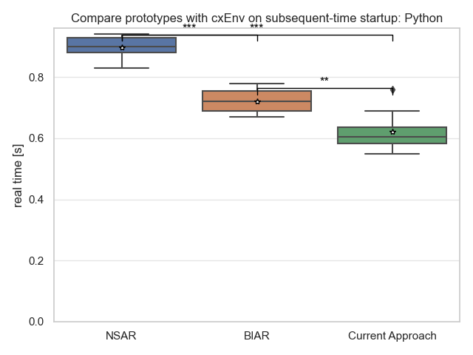

Slide 23
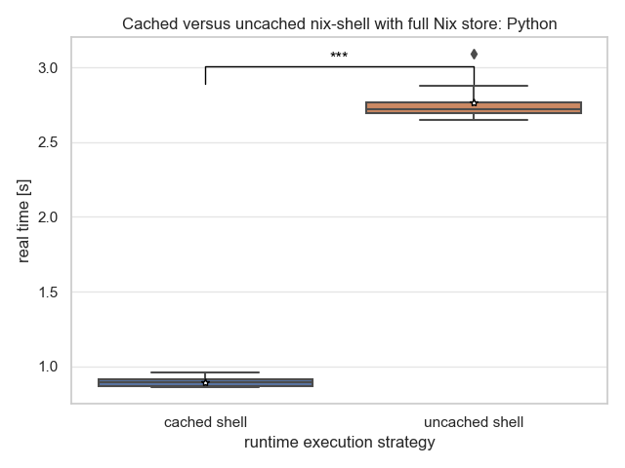
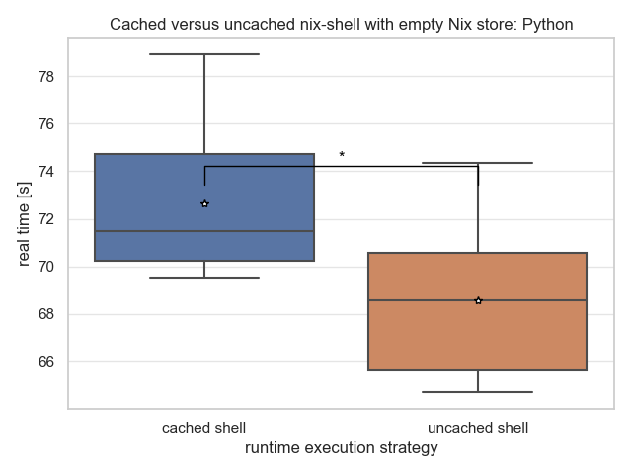

Slide 24
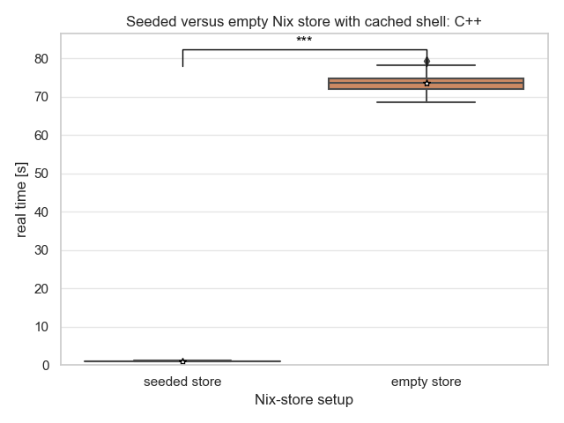
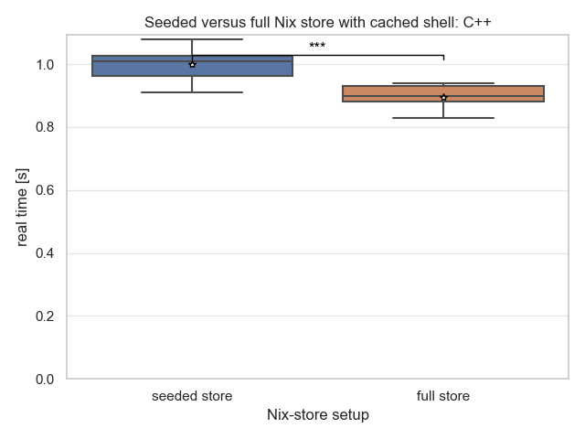

Slide 25
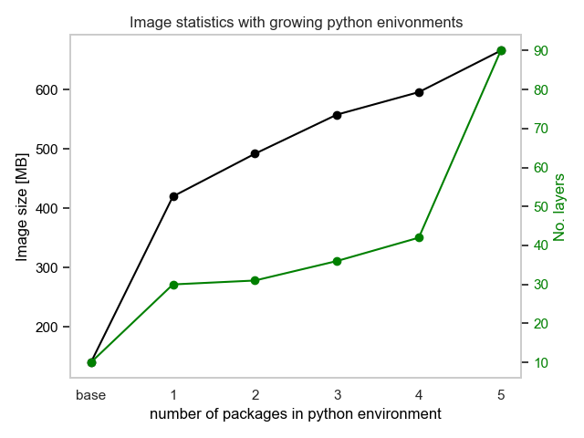
Approach | Image size (Python)
NSAR | 557MB
BIAR | 666MB
Current Solution | 1.27GB
Notes:
Packages: numpy, scypi, pandas, scikit-learn, matplotlib

Slide 26
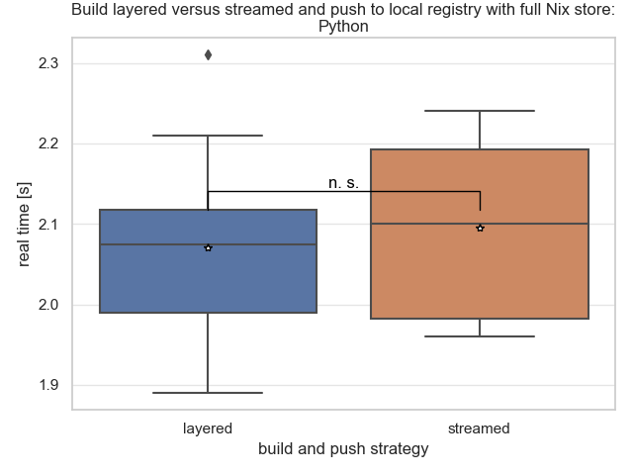
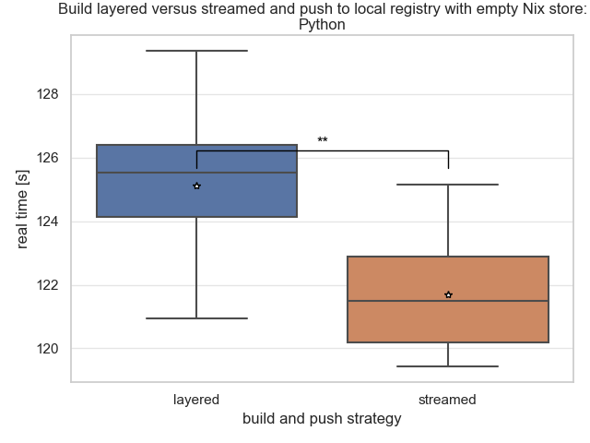

Slide 27
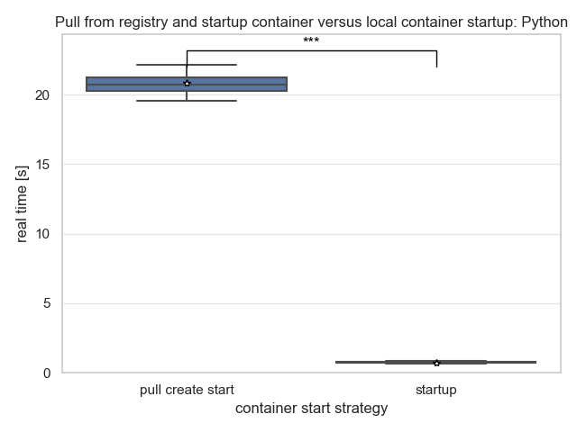

Slide 28
Conclusion and proposition
 | First-time Performance | Subsequent-time Performance | Security | Developer Experience | User Experience | Total
NSAR |  |  |  |  |  | 3.5
BIAR |  |  |  |  |  | 4
CodeExpert |  |  |  |  |  | 3
Notes:
So, coming back to the bigger picture, we conclude with a summary of our results.
The first-time build performance is very good for NSAR, but the same approach is lacking behind BIAR and CodeExpert in case of the subsequent-time performance. As we have seen, the security is terrible for NSAR and manageable for BIAR. For the developer and user experience criteria both of our approaches beat the current CodeExpert implementation.
To conclude, I think NSAR is a very cool approach but unacceptable from a security standpoint. [next] So I'm proposing the BIAR approach, which luckily also has the highest point total.

Slide 29
Build images at runtime (BIAR) execution flow
Builder container
Image registry
Push
Mapping F
Pull
Configurations
Container engine

