Slide 1


Boost flexibility in coding exercises by building containers at runtime
Romeo Stoll
23.06.22
Advisors: Dr. D. Sichau (co-head), Dr. M. Dahinden (co-head),
Prof. Dr. B. Gärtner
Department of Computer Science, ETH Zürich

Slide 2




What you need to know
Container engine
Environments:
Container image
Image registry
push pull
runnable
Container

Slide 3
Decide how to set up environments based on user configuration
Provide a fixed set of packages and languages as pre-built images
Set up a flexible environment at runtime to the user's needs

Slide 4
Objectives of my thesis
Find feasible approaches to build images at runtime based on the user configuration
Evaluate prototypes for each approach

Slide 5

Build images at runtime using properties of Nix
Content-addressable package store
Reproducibility
/nix/store
Source code
<…hash…>-<…name…>
bin/hello
Dependencies
72by2iw5wd8i…-glibc-2.3.5
Highly cacheable builds
Cheap images
Compose environments easily
https://devrant.com/rants/2341310/always-works-on-my-machine

Slide 6

Nix build process of a package or image
Construct an environment where all the tools and dependencies are available for building the image or package
Execute a build script to run all build steps
nix-shell

Slide 7
Objectives of my thesis
Find feasible approaches to build images at runtime based on the user configuration
Evaluate prototypes for each approach
Configure environment: lecturer
User
Run code in environment: student

Slide 8
Build images at runtime (BIAR) execution flow
BIAR computes the mapping F
Builder container
Image registry
Push
F
Config
Pull
Container engine
Configurations
Images
Environment

Slide 9
Nix-shell at runtime (NSAR) execution flow
NSAR computes the mapping G
Container engine
nix-shell builds environment
Config
Cache
G
Base image
Configurations
Environments

Slide 10
Objectives of my thesis
Find feasible approaches to build images at runtime based on the user configuration
Evaluate prototypes for each approach with 4 evaluation criteria: performance, security, user experience and developer experience.

Slide 11
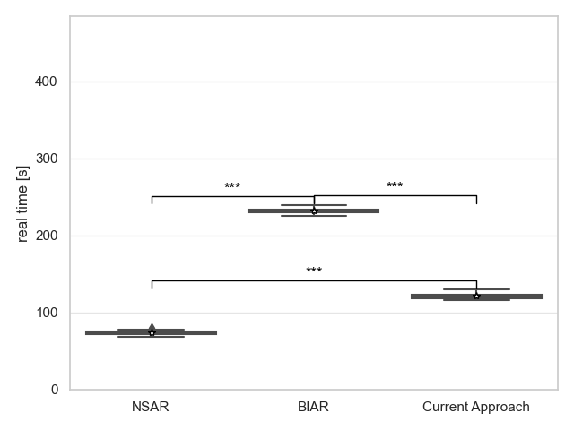
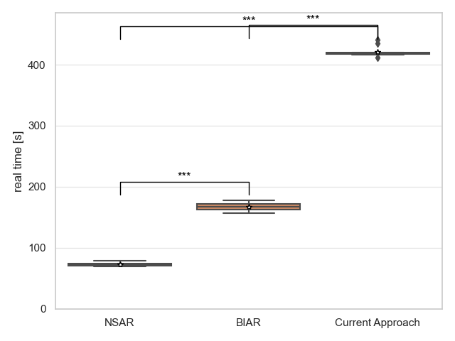
Results: Performance of first-time build
C++
Python

Slide 12
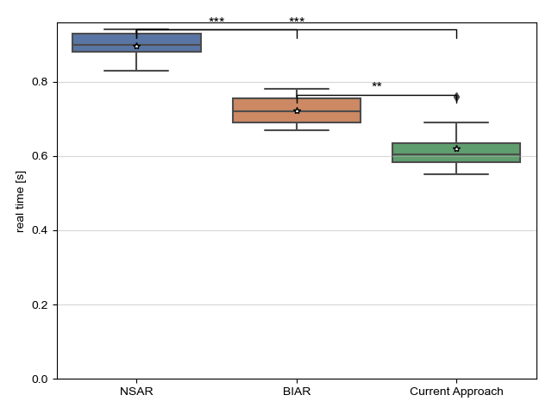
Performance of subsequent time build

Slide 13
Security evaluation
BIAR: builder container are vulnerable to attacks from lecturers
NSAR: environments are vulnerable to attacks from all users
Attack vectors:
Shared cache
Network access

Slide 14
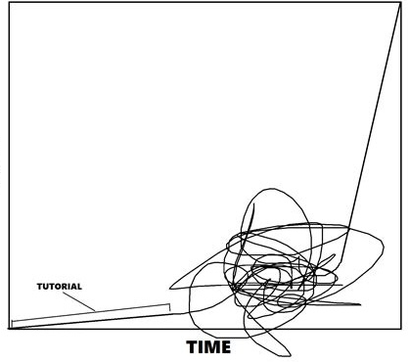
Developer experience
Nix learning curve
Change the configuration to the lecturers needs
Responsibility shift
Development and testing
Maintenance
Skill
Time
Adapted from: https://www.reddit.com/r/forhonor/comments/5ta1g9/after_much_research_and_analysis_i_have_made_a/?utm_source=share&utm_medium=web2x&context=3

Slide 15
User experience
Ease of configuration
Flexibility
Configuration change wait time

Slide 16
Conclusion and proposition
 | First-time performance | Subsequent-time performance | Security | Developer experience | User experience | Total
NSAR |  |  |  |  |  | 3.5
BIAR |  |  |  |  |  | 4
Current approach |  |  |  |  |  | 3
Great = 1
Mediocre = 0.5
Bad = 0

Slide 17
Further work
Improve security of shared cache
BIAR: Remove rebuild and push bottleneck
Test prototype with user feedback
Custom package collection

Slide 18
Boost flexibility in coding exercises by building containers at runtime
Romeo Stoll
23.06.22
Advisors: Dr. D. Sichau (co-head), Dr. M. Dahinden (co-head),
Prof. Dr. B. Gärtner
Department of Computer Science, ETH Zürich

Slide 19
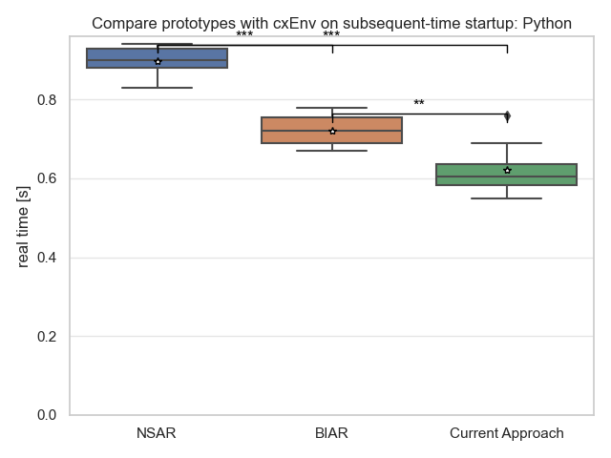

Slide 20
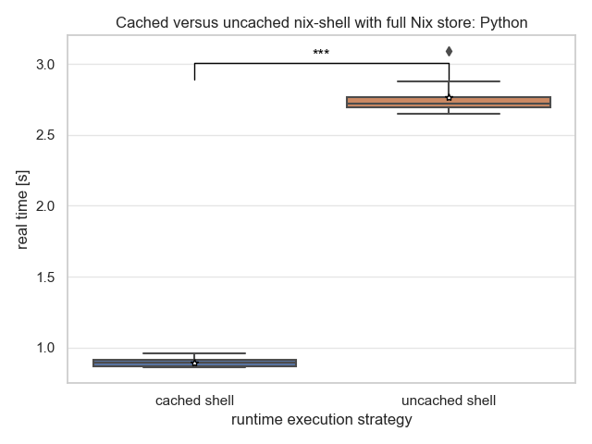
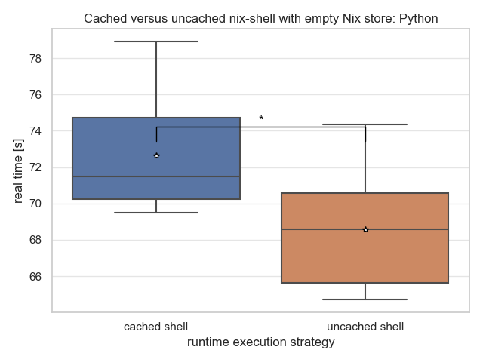

Slide 21
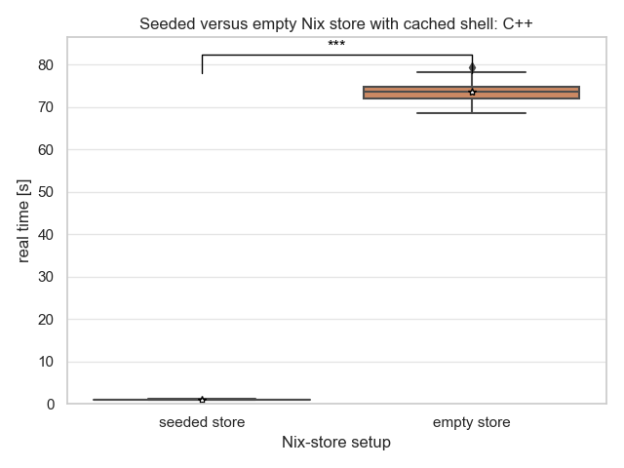
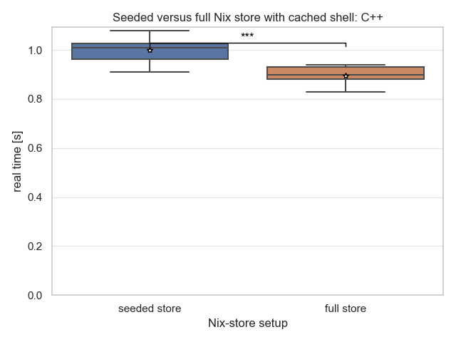

Slide 22
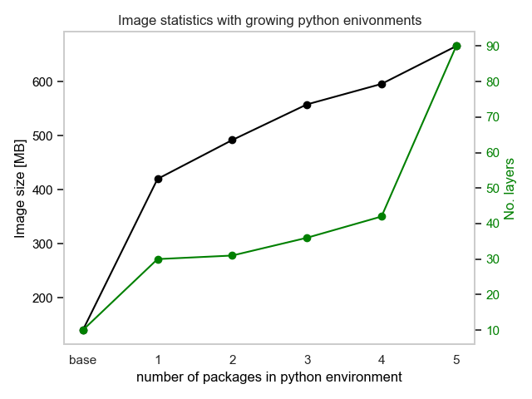
Approach | Image size (Python)
NSAR | 557MB
BIAR | 666MB
Current Solution | 1.27GB
Notes:
Packages: numpy, scypi, pandas, scikit-learn, matplotlib

Slide 23
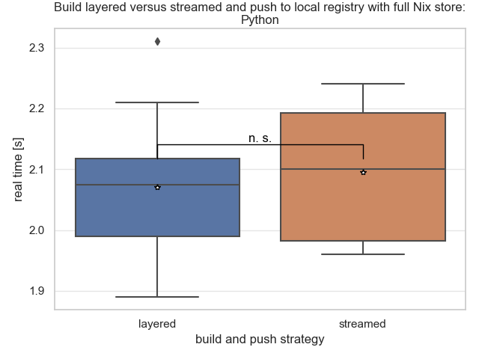
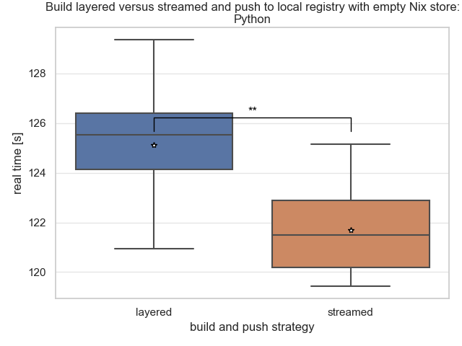

Slide 24
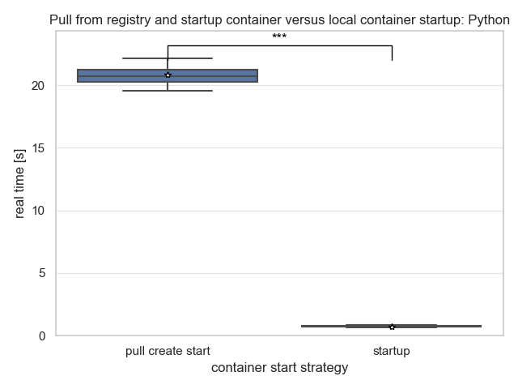

Slide 25
Conclusion and proposition
 | First-time Performance | Subsequent-time Performance | Security | Developer Experience | User Experience | Total
NSAR |  |  |  |  |  | 3.5
BIAR |  |  |  |  |  | 4
CodeExpert |  |  |  |  |  | 3

