Slide 1
RSE – Project

Slide 2
public final class Event {
// start and end time of this event
public final int start, end;
public Event(int start, int end) {
assert start <= end; // check START_END_ORDER
this.start = start;
this.end = end;
}
public void switchLights(int time) {
assert time >= this.start; // check AFTER_START
assert time <= this.end; // check BEFORE_END
}
}

Slide 3
// expected results:
// START_END_ORDER SAFE
// AFTER_START SAFE
// BEFORE_END SAFE
public class Basic_Test_Safe {
public static void m1() {
Event e = new Event(2, 4);
e.switchLights(3);
}
}

Slide 4
// expected results:
// START_END_ORDER UNSAFE
// AFTER_START UNSAFE
// BEFORE_END UNSAFE
public class Basic_Test_Unsafe {
public void m2(int j) {
Event e = new Event(2, j);
if (-1 <= j && j <= 3) {
e.switchLights(1);
}
}
}

Slide 5
Frameworks for analysis
APRON (for numerical analysis)
{0 <= x <= 3} Assign(y, x + 2) {0 <= x <= 3, 2 <= y <= 5}
Soot
  For parsing Java code: if => JifStmt.getCondition()
  For pointer analysis

Slide 6
Frameworks for software engineering
Docker
GitLab CI/CD
JaCoCo
Maven
SLF4J

Slide 7
Frameworks
That’s a lot BUT
Getting familiar with these is part of the assignment (spending time there is normal and expected)
We provide resources in the project description
And installation instructions in README

Slide 8
README
In your gitlab repository at
README.md

Slide 9
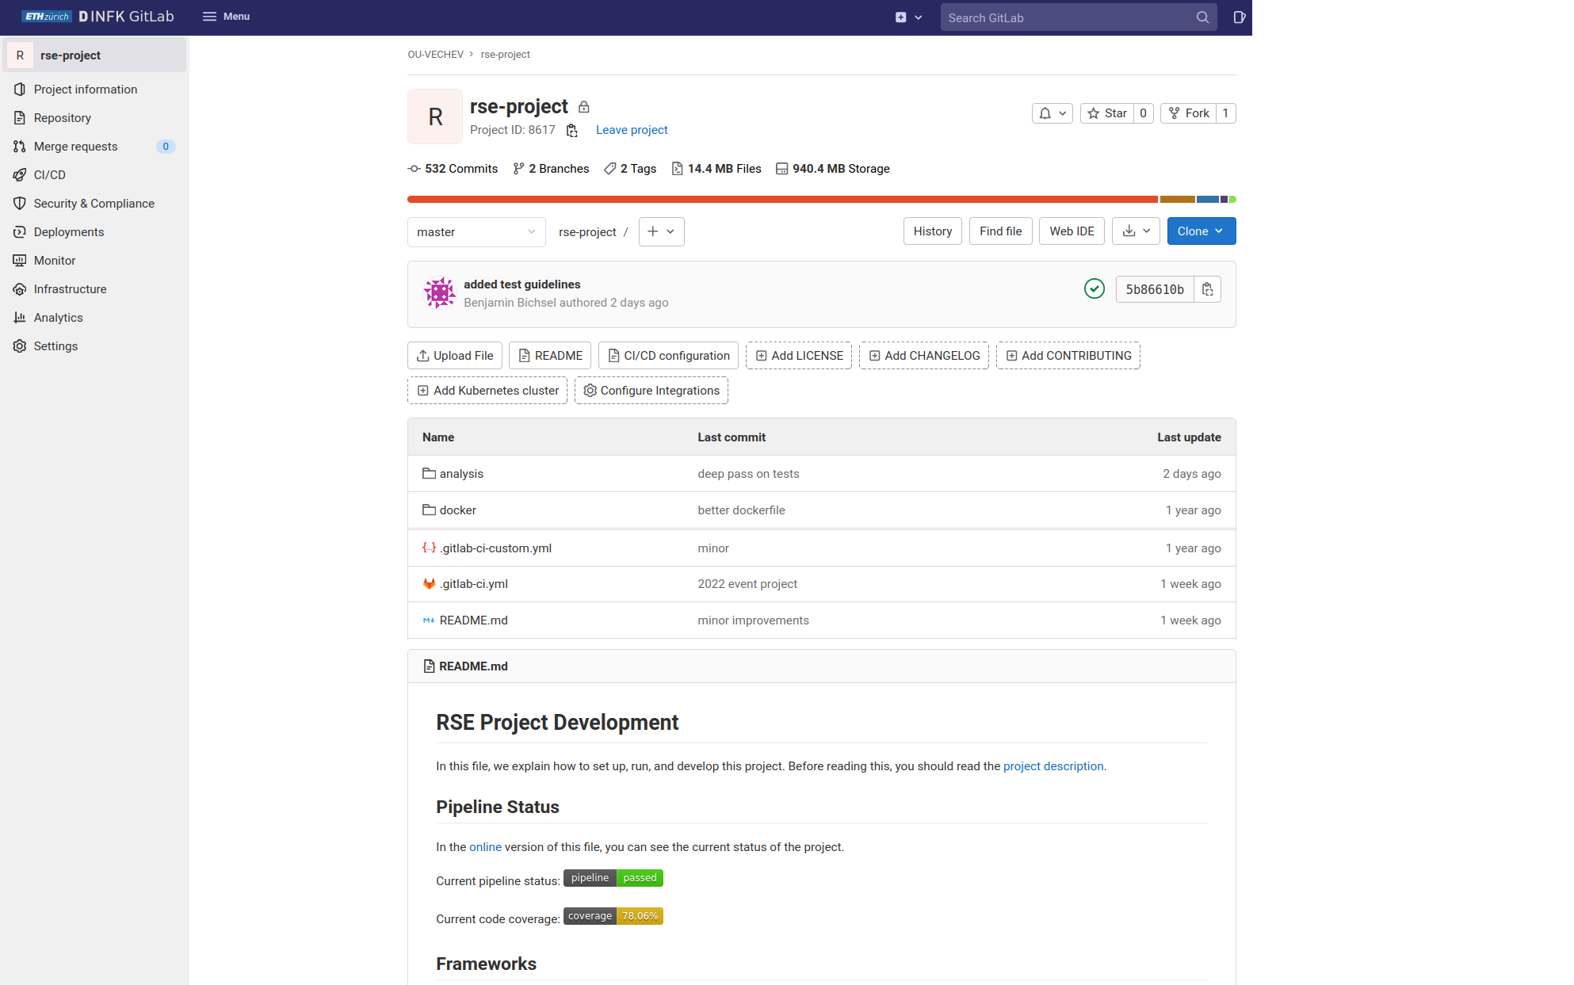
Pipeline status and test coverage

Slide 11
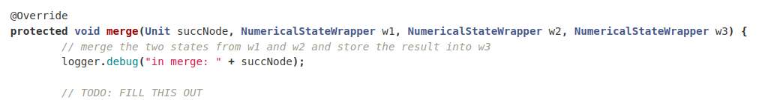

Slide 12
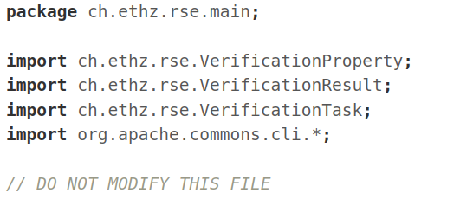

Slide 13
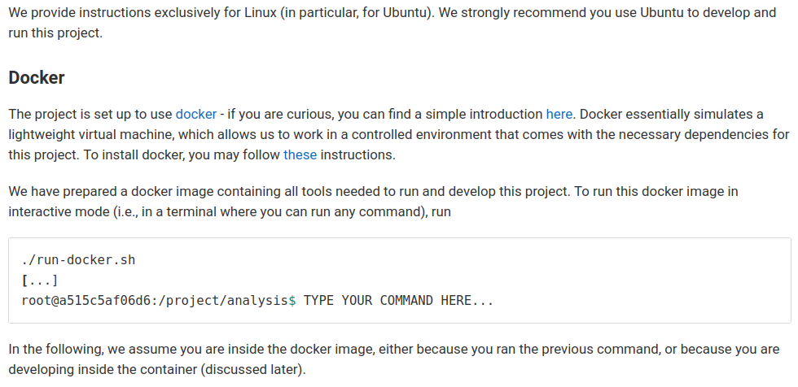

Slide 14
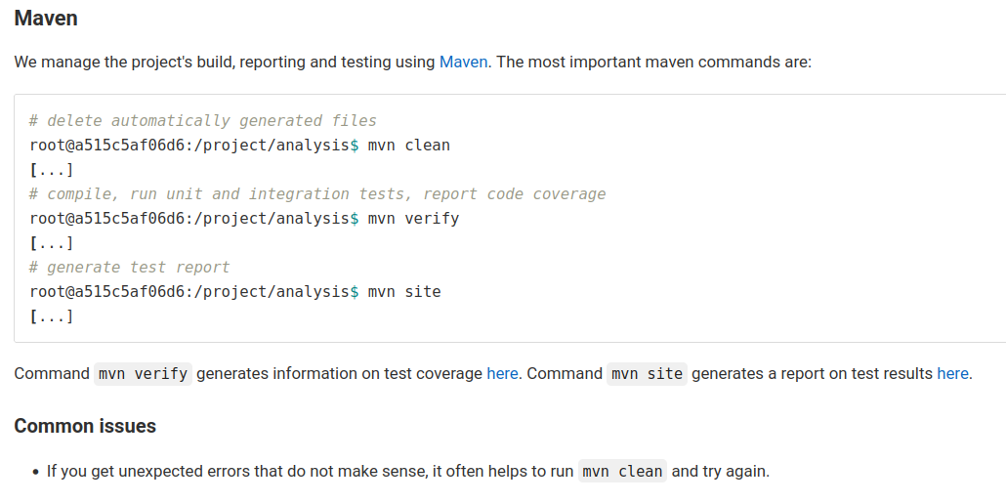

Slide 15
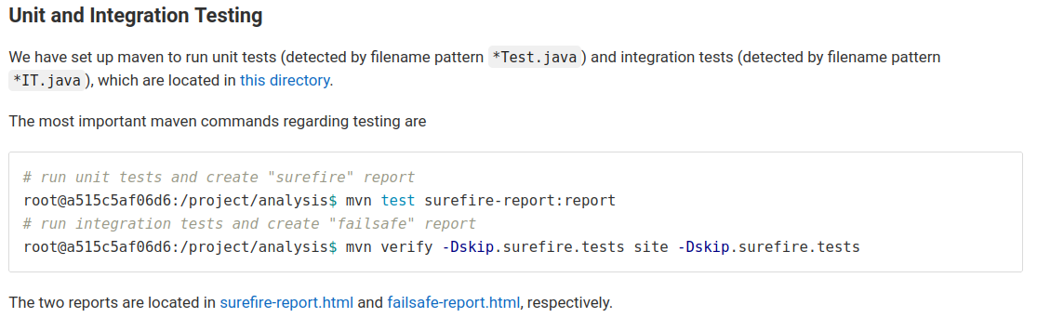

Slide 16
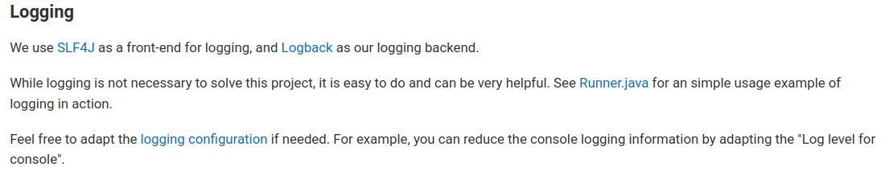
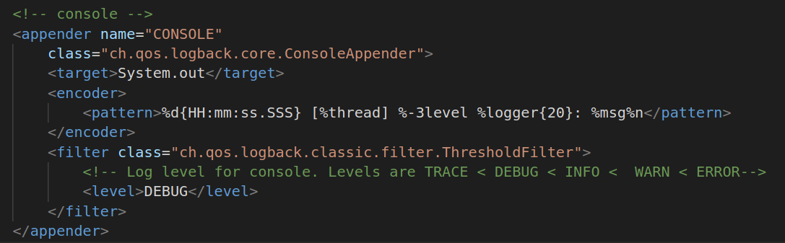

Slide 17
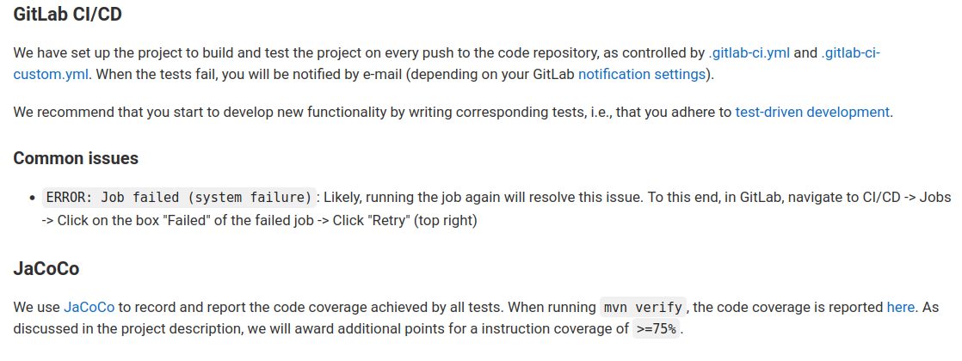

Slide 18
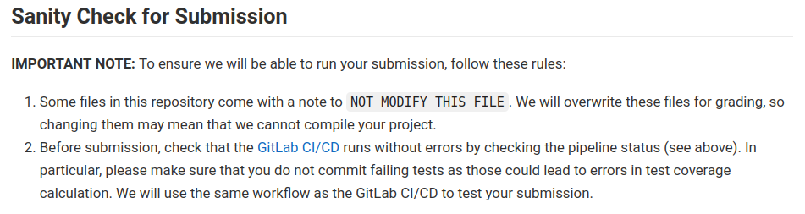

Slide 19
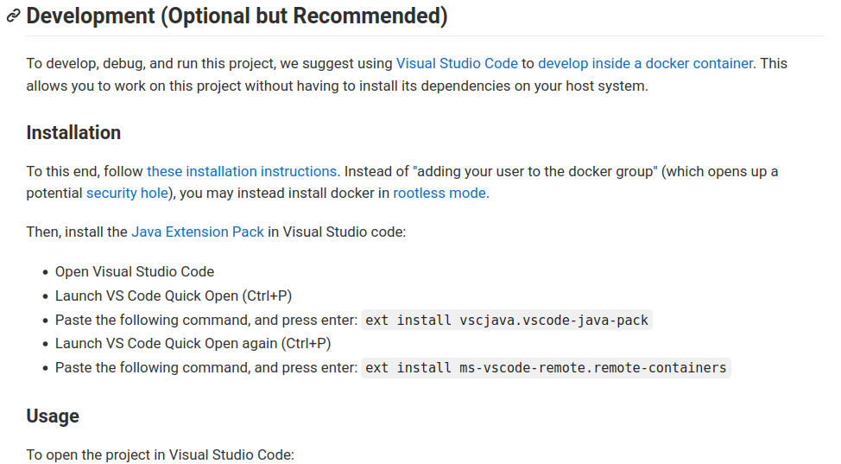

Slide 20
Detailed project description
In your gitlab repository at
resources/project-description/project.md
Changes communicated via Moodle
subscribe to it!
This presentation in your gitlab repository at
resources/introduction.odp

Slide 21
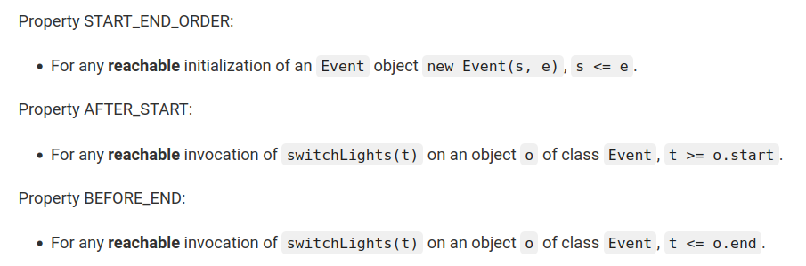
if (3 <= 1) {
Event e = new Event(2, 1);
}
Unreachable

Slide 22
Independant properties: checked one at a time, and other violations are ignored.
BEFORE_END may be SAFE even if START_END_ORDER is UNSAFE

Slide 23
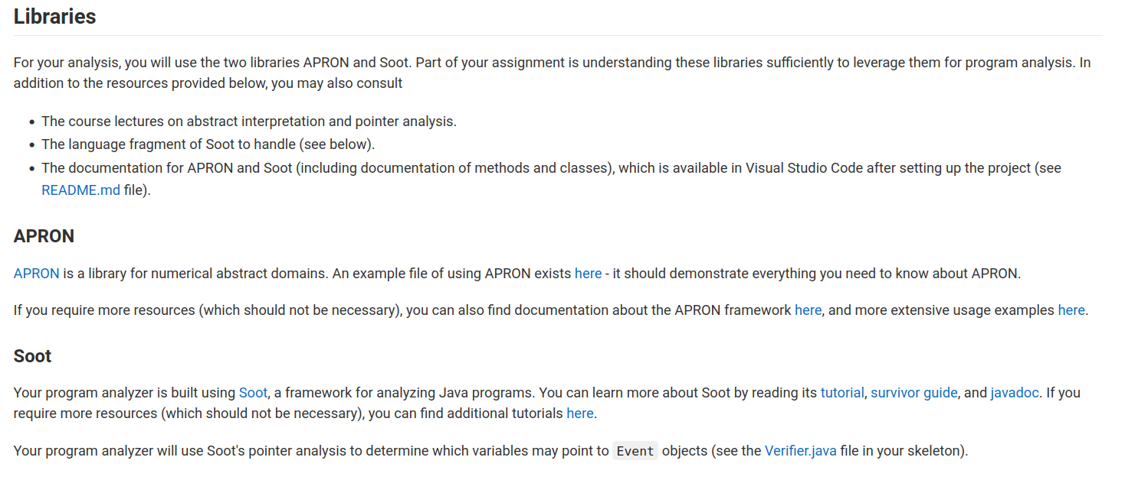

Slide 24
Apron examples
(extra resouces should not be necessary)

Slide 25
Soot documentation

Slide 26
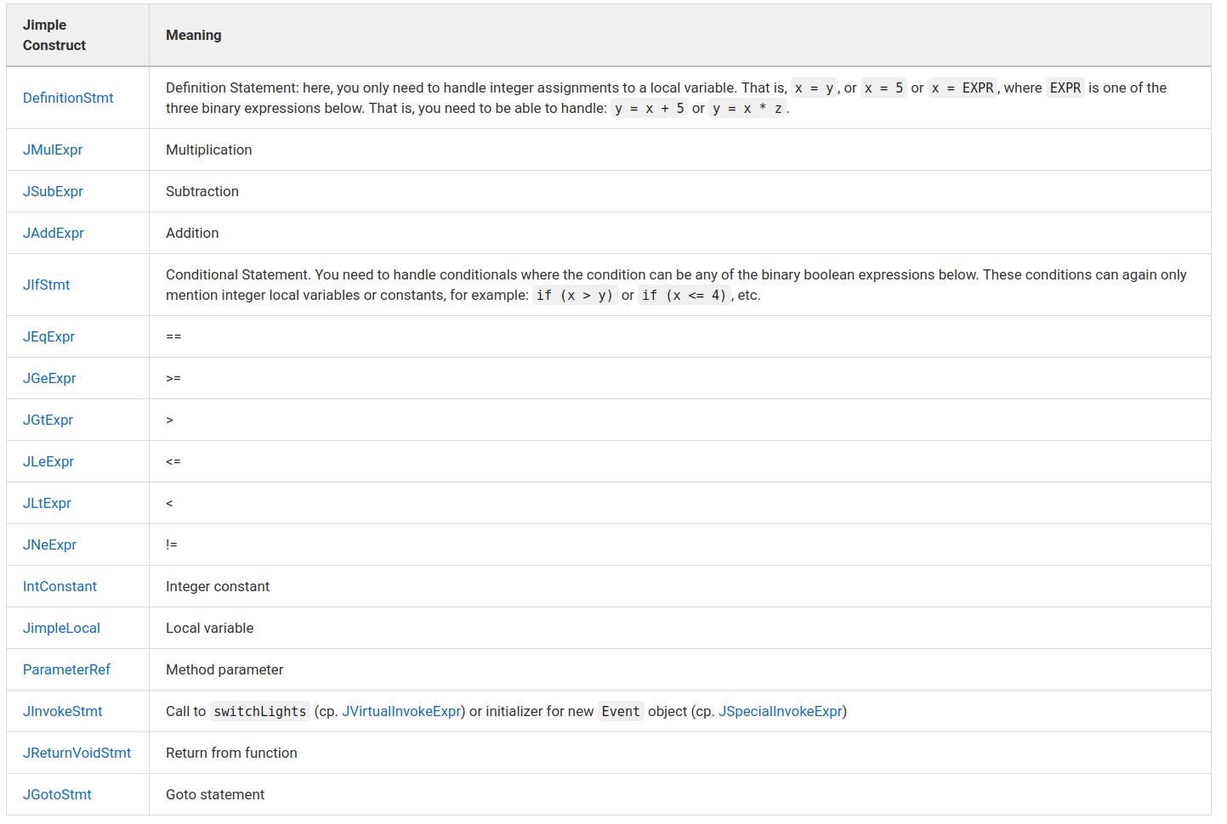

Slide 27
Additional constraints
public class Basic_Test_Unsafe {
public void m2(int j) {
Event e = new Event(2, j);
if (-1 <= j && j <= 3) {
e.switchLights(1);
}
}
}
Single method in test class, empty constructor

Slide 28
Additional constraints
public class Basic_Test_Unsafe {
public void m2(int j) {
Event e = new Event(2, j);
if (-1 <= j && j <= 3) {
e.switchLights(1);
}
}
}
Start is ALWAYS a constant (never a local variable)

Slide 29
Additional constraints
public class Basic_Test_Unsafe {
public void m2(int j) {
Event e = new Event(2, j);
if (-1 <= j && j <= 3) {
e.switchLights(1);
}
}
}
End can be a constant or a local variable

Slide 30
Additional constraints
public class Basic_Test_Unsafe {
public void m2(int j) {
Event e = new Event(2, j);
if (-1 <= j && j <= 3) {
e.switchLights(1);
}
}
}
Only int parameters (no Event parameters)

Slide 31
Additional constraints
You only need to track local variables (Event taken care of by the pointer analysis)
You can assume the analyzed code never throws exceptions
and ignore overflows (ie assume that Apron captures Java semantics correctly)
There may be loops: you will need to apply widening (but we ensure changing threshold doesn’t give extra points)

Slide 32
Additional hints
Properties are ordered by difficulty START_END_ORDER < AFTER_START < BEFORE_END
If you see an operation for which you are not precise, don’t crash, go to top (and be imprecise)
Come up with your own examples for testing

Slide 33
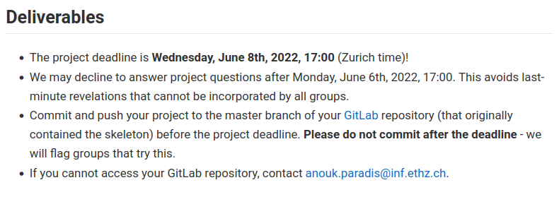

Slide 34
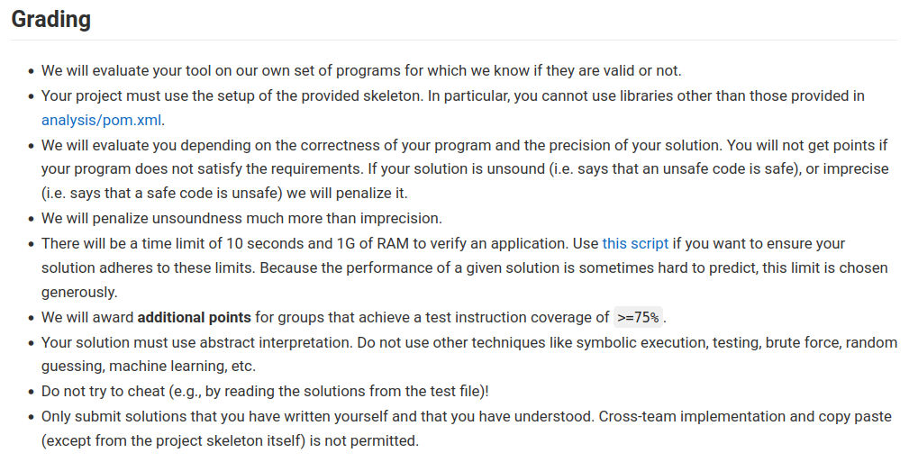

Slide 40
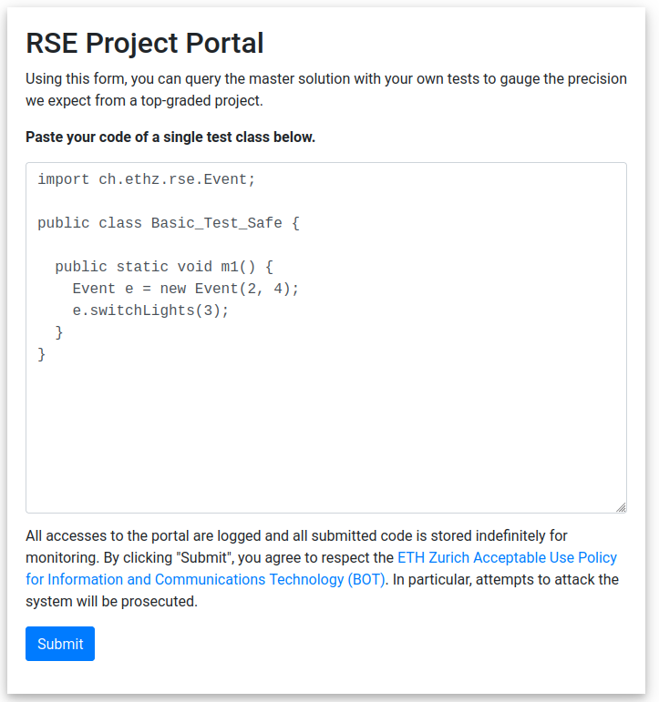
Web interface to master solution
https://rseproject.ethz.ch/rse-project

Slide 41
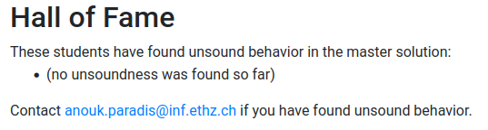
Web interface to master solution
https://rseproject.ethz.ch/rse-project

Slide 42
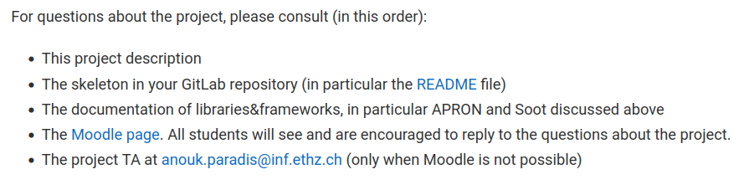
Where to get help

Slide 43
Don’t get overwhelmed and ignore the project
Start with SOUNDNESS
  then try for more PRECISION
  (points for partial sound solutions)
Don’t ignore the project: 20% of the grade means you need a 5 at the exam to pass without it

Slide 44
Getting started
Read project.md
Follow README.md
Look for FILL THIS OUT in files (avoid DO NOT MODIFY THIS FILE)
Aim at soundness before precision
Properties in order of difficulty
(All the slides content is in those files)

Slide 45
Soundness/precision
Sound analysis:
  if SAFE then for all executions assertions are verified.
  if UNSAFE, we don’t know
Precise analysis:
  reduce “false” UNSAFE

