Slide 1
Invoke
@RequestMapping,
@InitBinder, @ModelAttribute handler methods
RequestMappingHandlerMapping
Select
RequestMappingHandlerAdapter
Invoke
HandlerMethodArgumentResolver
HandlerMethod
HandlerMethodReturnValueHandler
Invoke
Find & invoke
@ExceptionHandler
handler method
ExceptionHandlerExceptionResolver

Slide 2
HandlerMethodArgumentResolver(s)
@RequestParam
@PathVariable
@ModelAttribute
@RequestPart *
@RequestHeader
@CookieValue
@Value
ServletRequest
ServletResponse
HttpEntity
RedirectAttributes *
Model
Map
Errors
SessionStatus
Custom argument...
HandlerMethodReturnValueHandler(s)
ModelAndView
Model
View
HttpEntity
@ModelAttribute
@ResponseBody
String
Custom return value...
* New in Spring 3.1

Slide 3
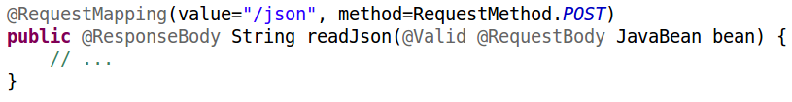
HandlerMethod
HandlerMethodArgumentResolver
Resolve argument
Handle return value
HandlerMethodReturnValueHandler

Slide 4
HandlerMethod
-------------
getBean()
getMethod()
getMethodParameters()
getReturnType()
getMethodAnnotation(Class<A> annotationType)
The selected handler method
+ argument resolution & method invocation:
e.g.
@ModelAttribute
@InitBinder
methods
InvocableHandlerMethod
----------------------
invokeForRequest(..)
ServletInvocableHandlerMethod
-----------------------------
invokeAndHandle(..)
+ return value handling:
e.g.
@RequestMapping
@ExceptionHandler
methods

