Slide 1
PowerAnalysis.m Guide
Roger Strong
Harvard University

Slide 2
General Notes
PowerAnalysis.m does most the work, and is called in the example scripts
Key Components:
prefs.data:
either a #subjects (rows) x #conditions (columns) array, or a string file name of an excel or .csv file with data listed as #subjects x #conditions.
Data can be listed as either decimal (.5) or percentage (50), although you will get a warning for the later (as data will be converted to decimal)
If using excel or csv file, there should NOT be a header row
prefs.within_between:
1 is using a within-subjects design (each participant has a score for each condition, 2 if using a between-subjects design (each subject only has a score for one condition)
prefs.N_range
Range of number of participants to simulate. E.g., 10:10:50 will simulate with 10, 20, 30, 40, and 50 participants. This is TOTAL number of participants (for both within and between-subjects designs)
prefs.trial_range
Range of number of trials per condition to simulate. E.g., 8:4:24 will simulate with 8, 12, 16, 20, and 24 trials per condition
prefs.alpha
p-value to use in power simulations
prefs.nSims
How many simulations to use for every participant/trial number combination. 10,000 is a decent estimate and runs pretty quickly, 100,000 is slower but a more stable estimate.
prefs.comps
Which comparisons to test for significance. Each row is a comparison, with the condition expected to be higher magnitude listed in the first column, and the condition expected to have lower magnitude in the second column. A study will be classified as “successful” only if all listed comparisons are significant (see examples).
prefs.condition_allocation
Used only for between-subjects designs (ignored when prefs.within_between == 1). Ratio of how total number of subjects should be divided between conditions during simulations. Should be a value for each condition in data, and values should sum to 1 (100%). For example, [.5, .5] would divide subjects evenly between two conditions. [.25, .5, .25] would use a 1:2:1 ratio for dividing subjects between 3 conditions.

Slide 3
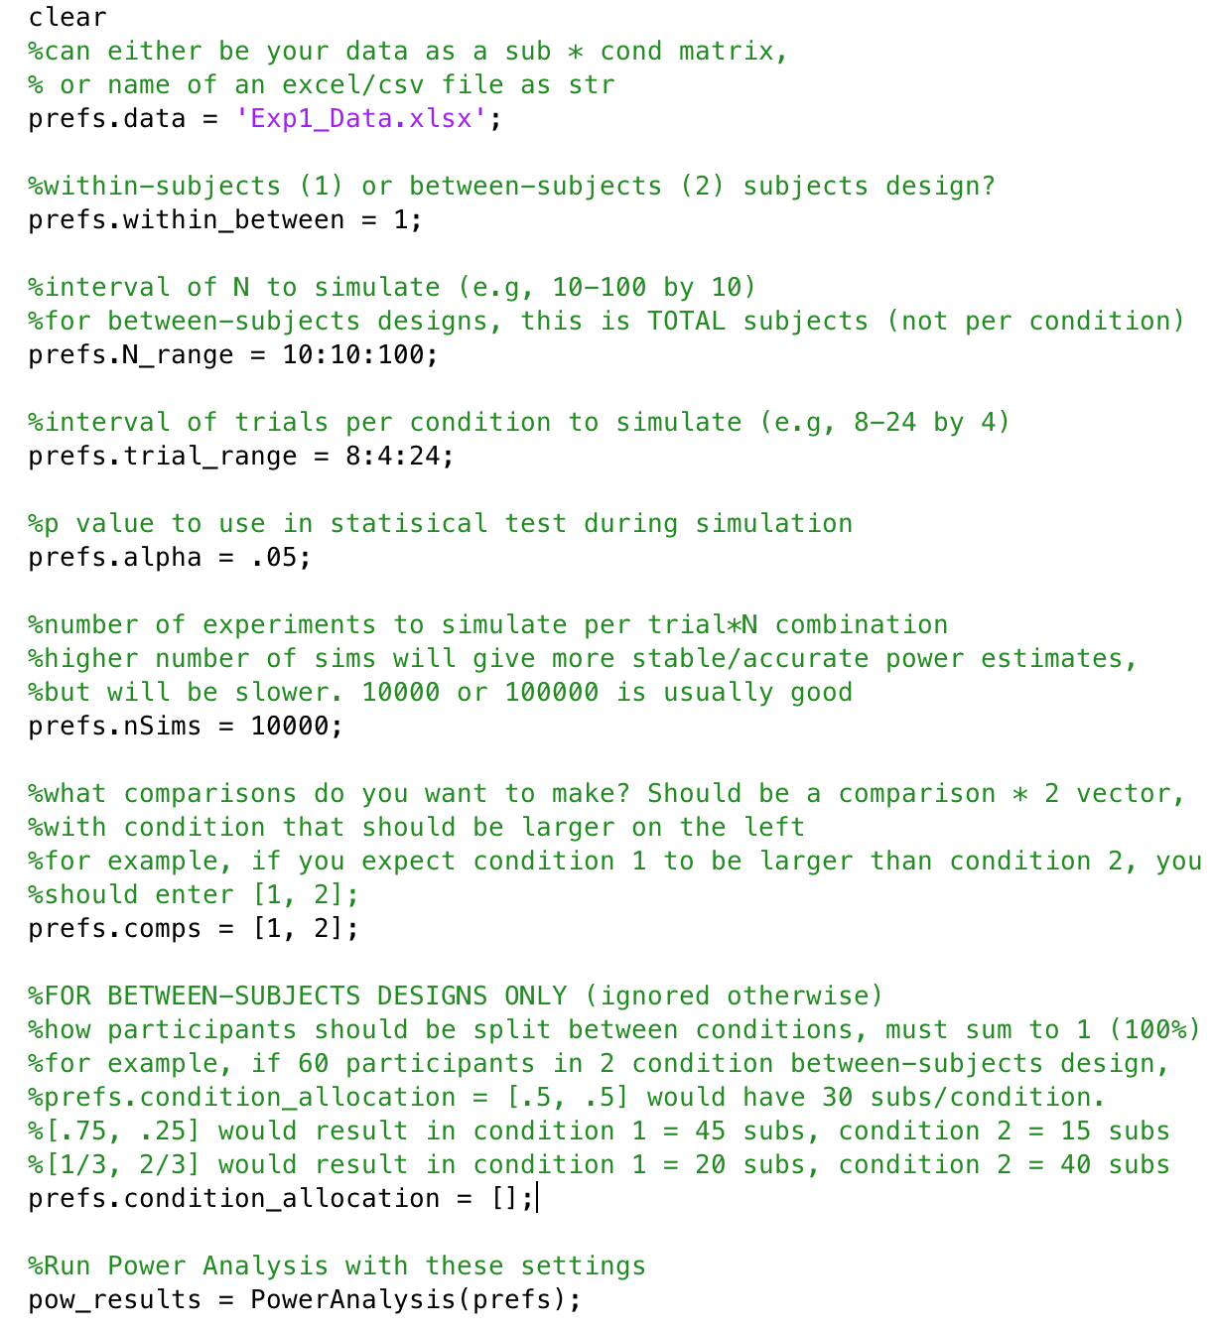
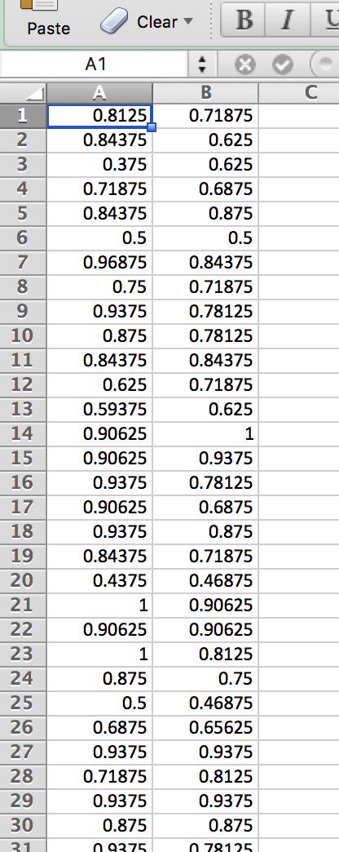
Example 1 – within-subjects 2 conditions
Power Analysis Settings
Pilot Data
File name as string (can also do data directly in matlab)
Within-subjects design (1): each subject has a score for each condition
97 subjects, 2 conditions
Excel file is 97 rows x 2 columns
I decided to simulate N from 10-100 by 10
I decided to simulate trial number per condition from 8-24 by 4
Critical p-value of .05 used in simulation
10,000 sims per N x num_trials combo (sims per cell in output graph)
Only comparison I was interested in was condition 1 being larger than condition 2
Only used for between-subjects design, so left this empty
Run power analysis using these settings
Power Analysis Output
Exp1_Data.xlsx
Simulated power for each N x number or trials per condition combo we specified in settings. Looking at this, I know I could achieve > 90% power by running 90 subjects with 12 trials per condition, for example

Slide 4
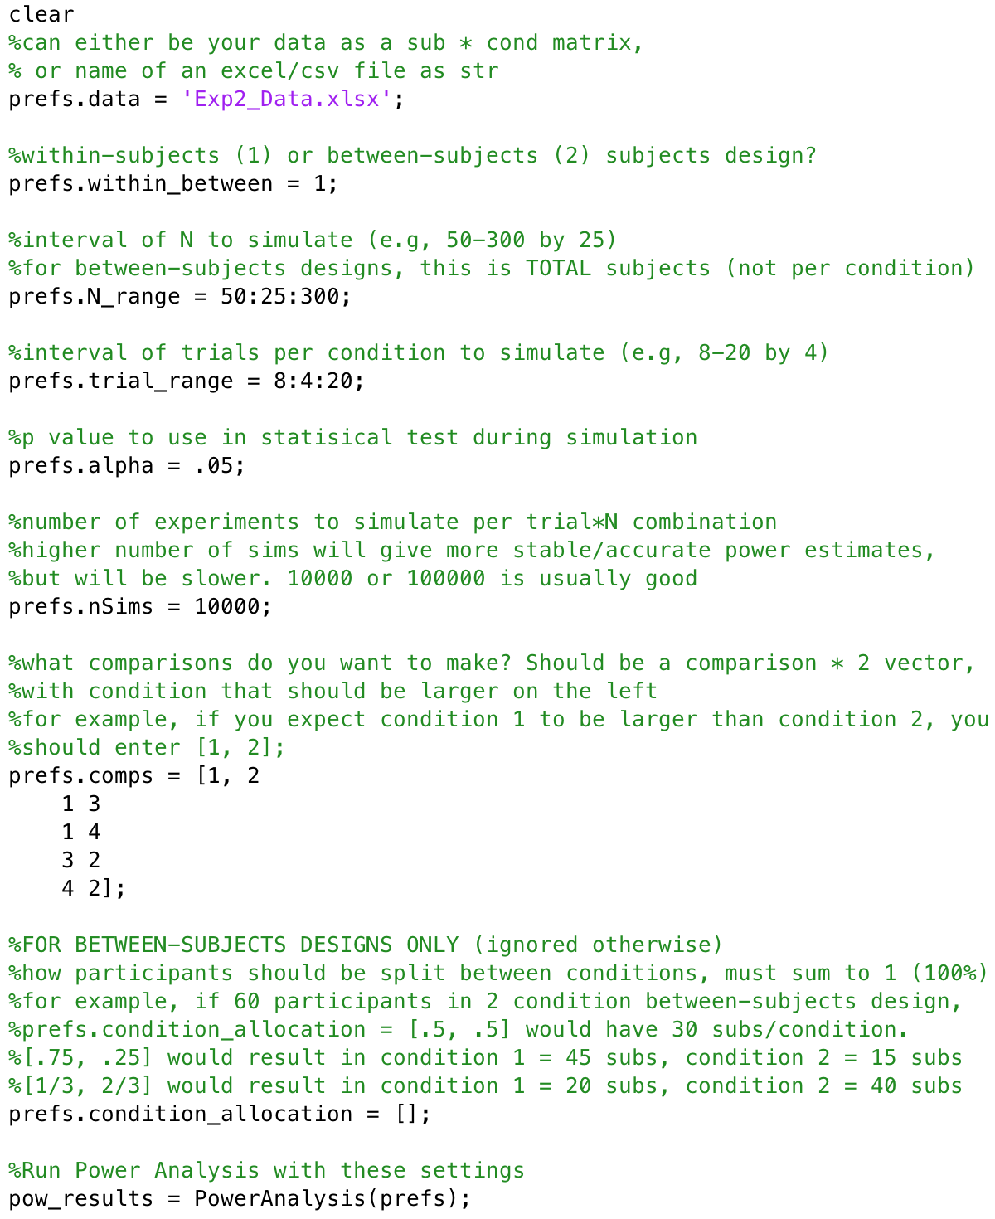
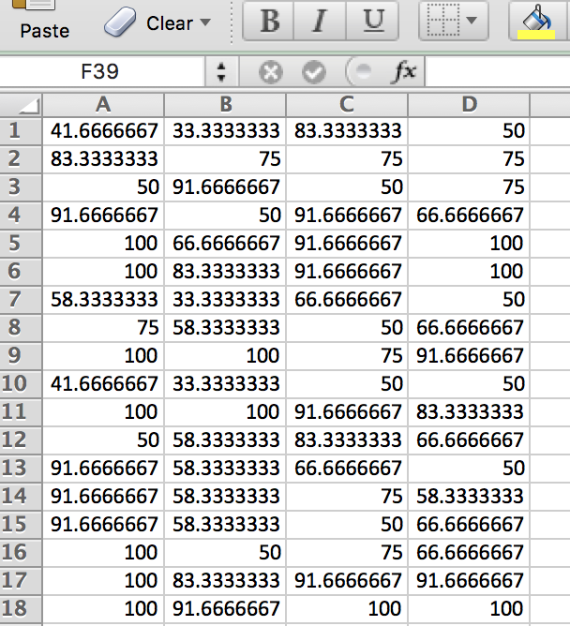
Example 2 – within-subjects 4 conditions
Power Analysis Settings
Pilot Data
File name as string (can also do data directly in matlab).
Within-subjects design (1): each subject has a score for each condition
41 subjects, 4 conditions
Excel file is 41 rows x 4 columns
I decided to simulate N from 50-300 by 25
I decided to simulate trial number per condition from 8-20 by 4
Critical p-value of .05 used in simulation
10,000 sims per N x num_trials combo (sims per cell in output graph)
This time, I had 5 comparisons I am interested in. Specifically, I only want to call the study a “success” if condition 1 >2, 1 >3, 1>4, 3>2, and 4>2. Each comparison specified as a separate row.
Only used for between-subjects design, so left this empty
Run power analysis using these settings
Power Analysis Output
Exp2_Data.xlsx
Data is in percent, so script will convert to decimal and give a warning that this has occurred.
Simulated power for each N x number or trials per condition combo we specified in settings. Looking at this, I know I could achieve > 90% power by running 300 subjects with 12 trials per condition, for example. Note that this is power for ALL 5 comparisons of interest being significant

Slide 5
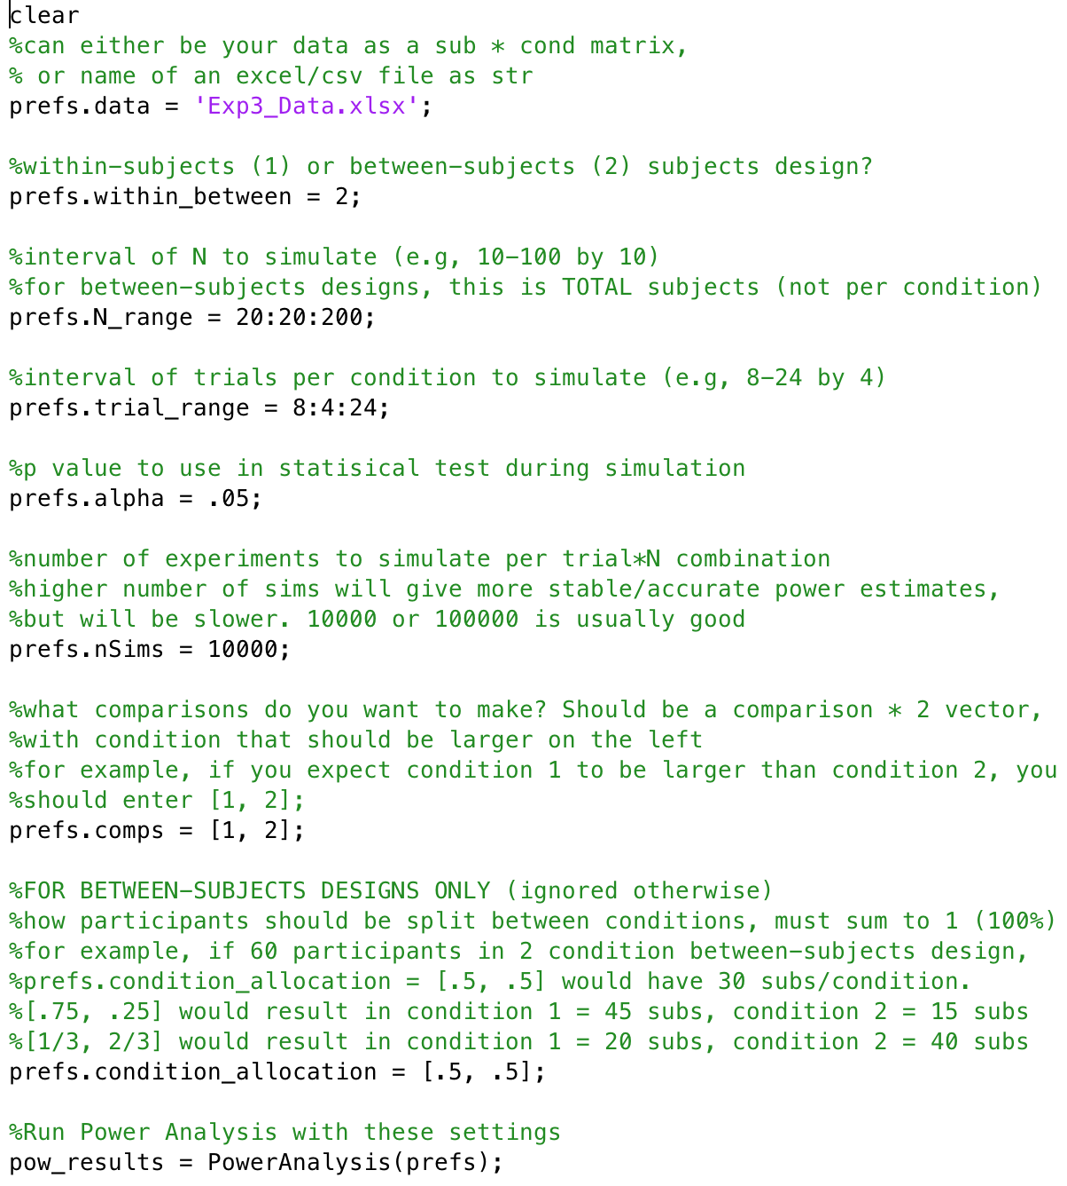
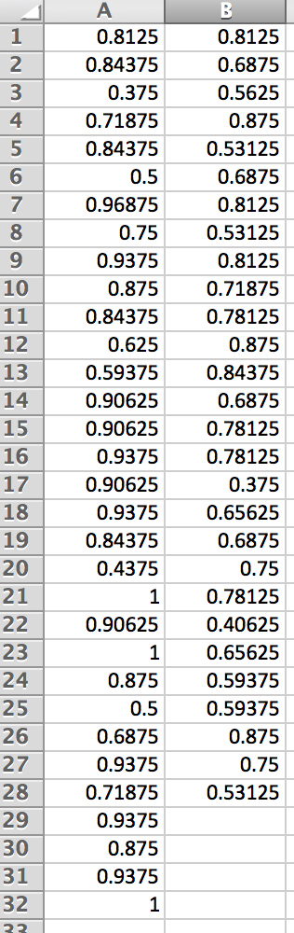
Example 3 – between-subjects 2 conditions
Power Analysis Settings
Pilot Data
File name as string (can also do data directly in matlab)
Between-subjects design (2): each subject only in one condition
2 conditions, between subjects
32 subjects for condition 1
28 subjects for condition 2
I decided to simulate N from 20-200 by 20. Note that this is the TOTAL number of subjects (not subjects per condition)
I decided to simulate trial number per condition from 8-24 by 4
Critical p-value of .05 used in simulation
10,000 sims per N x num_trials combo (sims per cell in output graph)
Only comparison I was interested in was condition 1 being larger than condition 2
Since we have a between-subjects design, we have to specify how to allocate subjects between conditions. I’ve chosen to evenly split subjects between the two conditions (see notes in code to left for other possibilities)
Run power analysis using these settings
Power Analysis Output
Simulated power for each N x number or trials per condition combo we specified in settings. Looking at this, I know I could achieve ~96% power by running 140 total subjects (70 per condition) with 16 trials per condition, for example
Exp3_Data.xlsx

