Slide 1
OpenShift
Associate Consultant Bootcamp
Ben Meiseles

Slide 2

Agenda
What is OpenShift?
Who uses OpenShift?
Why use OpenShift?
How does OpenShift work?
How do I use OpenShift?
Demo
Resources & Continued Learning

Slide 3
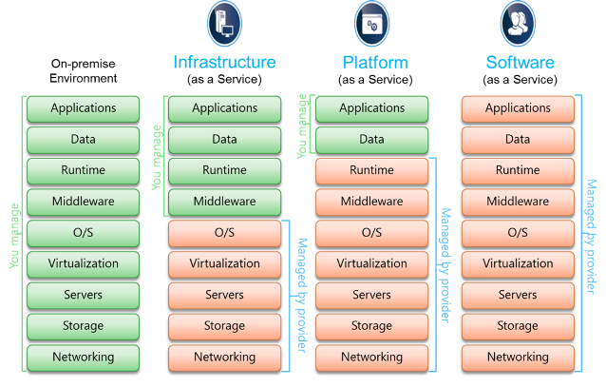
What is OpenShift?

Slide 4
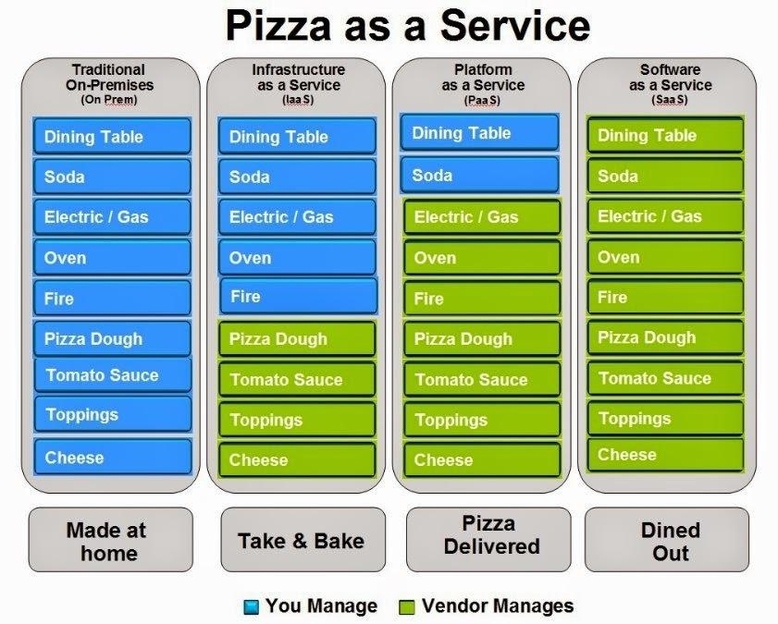
What is OpenShift?

Slide 5
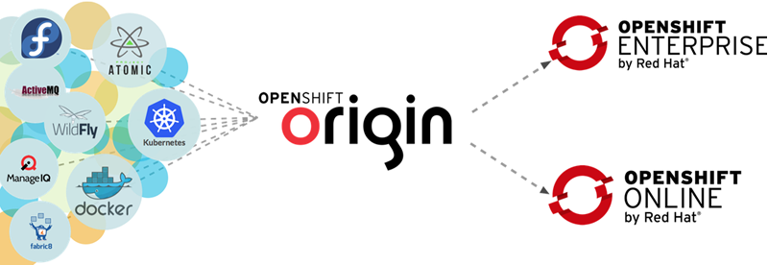
What is OpenShift?

Slide 6
Who uses OpenShift?
Developers want to focus on an idea, develop it, and then get it into production
Operations wants predictable, stable production deployments
So, Developers want rapid change, but Operations want stability and consistency? Can these coexist?
Yes, but only with the right tooling, and by enacting cultural changes within the organization
DevOps

Slide 7
Why use OpenShift? – DevOps
Culture
Development and Operations teams tightly coupled to avoid “throwing over the wall” and finger pointing
Tooling
Platform as a Service allows push-button environment creation in minutes for Developers, while enforcing consistency and scalability of environments for Operations

Slide 8
How does OpenShift work?
Broker: management engine, responsible for orchestration of nodes
Nodes: multi-tenant hosts where developer applications live inside gears
Gears: secure containers where applications run within nodes. Gears use cartridges to run application code.
Cartridges: languages, frameworks, middleware technologies that come pre-loaded in an OpenShift application’s gear
PHP, Java, Python, Ruby
MySQL, MongoDB, PostgreSQL
xPaaS: Red Hat middleware
Jenkins, WordPress
DIY

Slide 9
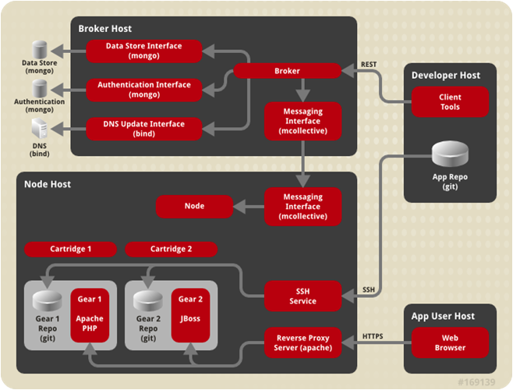
How does OpenShift work?

Slide 10
How do I use OpenShift? - Demo
Create application in OpenShift using web console
Select cartridge to load in gear
Deploy sample application to EAP running in OpenShift using CLI

Slide 11
Resources & Continued Learning
Red Hat PaaS Community of Practice
https://mojo.redhat.com/groups/paas-community-of-practice
OpenShift Online
https://www.openshift.com/products/online
Red Hat OpenShift Enterprise Product Documentation
https://access.redhat.com/documentation/en-US/OpenShift_Enterprise/
OpenShift Online Documentation
https://www.openshift.com/documentation
Contact Ben Meiseles:
b.meiseles@redhat.com
b.meiseles@gmail.com (gchat)
(774) 270-1100

Slide 12
Resources & Continued Learning
https://blog.openshift.com/devops-paas-and-modern-it/
https://www.openshift.com/walkthrough/how-it-works
https://www.openshift.com/walkthrough/developer-workflow

