Slide 1

Kubernetes
Workshop
Rainer Stropek
software architects gmbh
Web
Mail
Twitter
http://www.timecockpit.com
rainer@timecockpit.com
@rstropek
For Software Developers

Slide 2

Your Host
Rainer Stropek
Developer, Entrepreneur
Azure MVP, MS Regional Director
IT-Visions
Contact
software architects gmbh rainer@timecockpit.com Twitter: @rstropek

Slide 3
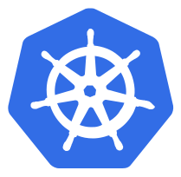
What‘s Kubernetes?

Slide 4
Feature View
Platform for containerized workloads and services
Open Source (open-sourced in 2014 by Google)
Portable cloud platform
Microservices
Tries to combine best of PaaS and IaaS
Current state → desired state
Container-centric
OS-level virtualization instead of HW-virtualization
Here: Focus on Docker
https://kubernetes.io/docs/concepts/overview/what-is-kubernetes/

Slide 5
Component View
Master (aka Control Plane)
API Server
etcd
Scheduler
Controller Manager (Node-, Replication-, Endpoints-, and Service Accounts-Controller)
Nodes
Kubelet (primary “node agent” ensuring that pods are running and healthy)
Network Proxy
Container Runtime (in our case Docker)
Addons
DNS
Dashboard (web UI)
Monitoring and Logging
https://kubernetes.io/docs/concepts/overview/components/

Slide 6
API
Web API
Documented with OpenAPI
Versioned
kubectl
CLI for interacting with API
Base for declarative configuration schema
https://kubernetes.io/docs/concepts/overview/kubernetes-api/

Slide 7
Demo: Tokens
# Get a list of secrets
kubectl get secret
# Get details of a secret (including JWT)
kubectl describe secret <name-of-secret>
# Access Kubernetes API directly to get a list of pods
# Note: Change IP, port, and namespace according to your environment
GET https://192.88.23.5:6443/api/v1/namespaces/student-r-stropek/pods
Authorization: <your-jwt>
Tip: Run kubectl proxy for authenticated access from localhost
https://kubernetes.io/docs/tasks/access-application-cluster/access-cluster/#without-kubectl-proxy

Slide 8
Demo: API
GET http://127.0.0.1:8001/api/v1/nodes
Accept: application/json
###
GET http://127.0.0.1:8001/api/v1/namespaces/default/pods
###
POST http://127.0.0.1:8001/api/v1/namespaces/default/pods
Content-Type: application/json
{
"apiVersion": "v1",
"kind": "Pod",
"metadata": {
"name": "api-demo-pod",
"labels": {
"app": "api-demo"
}
},
"spec": {
"containers": [
{
"name": "api-demo-pod",
"image": "nginx:alpine",
"ports": [
{ "containerPort": 80 }
]
}
]
}
}
API Docs
Read Nodes
Create Pod
Delete Pod
Label Selectors
https://www.json2yaml.com
https://github.com/rstropek/DockerVS2015Intro/blob/master/dockerDemos/13-kube-intro/api-demo.http

Slide 9
Demo: API
### DASHBOARD
# Find out name of services
kubectl get service
# Start authenticated proxy
kubectl proxy
# Note: Change your namespace accordingly
http://localhost:8001/api/v1/namespaces/student-r-stropek/services/https:kubernetes-dashboard:443/proxy/#/overview?namespace=student-r-stropek
### Access created port
# Create port forwarding for pod
kubectl port-forward api-demo-pod :80
# Note: Change port accordingly
GET http://127.0.0.1:42973
###
GET http://127.0.0.1:8001/api/v1/namespaces/default/pods? labelSelector=app%20in%20%28api-demo%29
###
DELETE http://127.0.0.1:8001/api/v1/namespaces/default/pods/api-demo-pod
Find pod in dashboard
K8s dashboard with Docker Desktop
Access created pod
Remove pod

Slide 10
Kubernetes 101
Pods
Typically one, sometimes multiple containers (tightly-coupled)
Common Pod environment (e.g. IP address, localhost)
Atomic unit (all-or-nothing)
Tip: Don’t create pods directly, use controllers (e.g. deployments)
Service
Each services gets its own stable IP address, DNS name, and port
Uses labels to dynamically associate with Pods
Load-balances requests across Pods
Service type LoadBalancer → make service available outside the cluster

Slide 11
Kubernetes 101
ReplicaSet (aka ReplicationController)
Number of replicas for a Pod
Desired State and Current State
Tip: Don’t create manually, use deployments
Deployments
Replication controller + rolling updates
Other Workload (not covered in detail here)
CronJob
DaemonSet (run copy of a pod on every node)
Jobs
StatefulSets (like deployments, but optimized for stateful applications)

Slide 12
Labels & Selectors
Key/value pairs for K8s objects
Organize and select objects
Used to define relationships of objects
E.g. service → pod
Label Selectors
https://kubernetes.io/docs/concepts/overview/working-with-objects/labels/

Slide 13
kubectl Fundamentals

Slide 14
Install Client Tools
Install kubectl and additional tools (if required)
For HTL Leonding, see here
Recommendation: Use WSL 2 to run kubectl on Linux
Tip: Configure auto-completion in shell
Tip: Consider enabling K8s aliases with kubectl-aliases
Consider K8s Extension for VSCode
https://marketplace.visualstudio.com/items?itemName=ms-kubernetes-tools.vscode-kubernetes-tools

Slide 15
Get a Kubernetes Cluster
Get access to an existing K8s cluster
For HTL Leonding, see https://cloud.htl-leonding.ac.at/
Install Docker Desktop
Enable Kubernetes
Get a managed K8s cluster in Azure (AKS)
https://docs.microsoft.com/en-us/azure/aks/kubernetes-walkthrough-portal
Don’t forget to undeploy demo cluster when no longer needed!

Slide 16
kubectl
kubectl [command] [TYPE] [NAME] [flags]
Kubectl get all
kubectl get pods
# kubectl configuration
kubectl config get-contexts
kubectl config use-context …
kubectl cluster-info
kubectl get nodes
kubectl describe nodes
kubectl get componentstatuses # or short “cs”
Command options
Resource name
Resource type (full name or abbreviation) List of resource types…
Different output formats
E.g. JSON, YAML, tables
Details…
Cheat sheet…
You know Docker?
kubectl for Docker users…
Operation; e.g. create, get, delete; List of operations…
https://kubernetes.io/docs/reference/kubectl/overview/

Slide 17
kubectl
kubectl get namespace
kubectl create namespace …
kubectl config set-context --current --namespace=…
Different output formats
E.g. JSON, YAML, tables
Details…
Cheat sheet…
You know Docker?
kubectl for Docker users…
https://kubernetes.io/docs/reference/kubectl/overview/

Slide 18
Object Management
Imperative commands
Manipulate live objects
No source control, no review process → development, not production
Imperative object configuration
Configuration files (YAML)
Individual files
Declarative object configuration
Directories with configuration files

Slide 19
Imperative Commands
# Create deployment
kubectl run nginx --image=nginx:alpine --port=80
kubectl get pods
# Interactive Pod
kubectl run my-shell --rm -it --image debian -- bash
# Work with deployment’s labels
kubectl describe pod nginx
kubectl label pod nginx env=testing
kubectl describe pod nginx
kubectl get pod -l env=testing -o yaml
# Create service
kubectl expose pod nginx --type=NodePort
kubectl get services
# Note: Change namespace and don’t forget to run kubectl proxy http://localhost:8001/api/v1/namespaces/student-r-stropek/services/nginx:80/proxy/
# Delete deployment and service
kubectl delete pod nginx
kubectl delete service nginx
Try this exercise in…
…Docker for Windows
…AKS
Try different service types
NodePort

Slide 20
Kubernetes Workloads

Slide 21
Pods
kind: Pod
apiVersion: v1
metadata:
name: nginx-pod
labels:
name: nginx-pod
app: workshop
spec:
containers:
- name: nginx-pod
image: nginx
ports:
- containerPort: 80
name: http
protocol: TCP
###
kubectl create -f nginx-pod.yaml
kubectl get pods
kubectl expose pod nginx-pod --type NodePort
kubectl get services
kubectl exec -it nginx-pod -- /bin/bash
curl http://localhost:8001/api/v1/namespaces/student-r-stropek/services/nginx-pod:80/proxy/
kubectl delete service nginx-pod
kubectl delete -f
https://kubernetes.io/docs/concepts/overview/object-management-kubectl/imperative-config/

Slide 22
Services
kind: Service
apiVersion: v1
metadata:
name: web-svc
spec:
selector:
app: workshop
ports:
- port: 8080
targetPort: 80
type: NodePort
###
kubectl create -f .\nginx-pod.yaml
kubectl create -f .\nginx-service.yaml
# or short: kubectl create -f .
curl http://localhost:8001/api/v1/namespaces/student-r-stropek/services/web-svc:8080/proxy/
kubectl get services
kubectl delete -f .\nginx-service.yaml
kubectl delete -f .\nginx-pod.yaml
# or short: kubectl delete -f .
Service Types
ClusterIP
NodePort
LoadBalancer (in AKS)

Slide 23
Deployment
apiVersion: apps/v1
kind: Deployment
metadata:
name: web
spec:
replicas: 5
selector:
matchLabels:
app: web
template:
metadata:
labels:
app: web
spec:
containers:
- name: web
image: nginx:alpine
ports:
- containerPort: 80
###
kubectl apply -f .
kubectl delete -f .
Scaling
Change number of replicas and run “apply” again
Scale cluster in AKS

Slide 24
Rolling Updates
apiVersion: apps/v1
kind: Deployment
metadata:
name: demo-web
spec:
selector:
matchLabels:
app: demo-web
replicas: 5
strategy:
rollingUpdate:
maxSurge: 1
maxUnavailable: 1
minReadySeconds: 30
template:
metadata:
labels:
app: demo-web
spec:
containers:
- name: demo-web
image: rstropek/docker-image-versioning:1.0
ports:
- containerPort: 80
env:
- name: PORT
value: "80"
###
kubectl apply –f .
kubectl get pods
Kubectl describe demo-web
kubectl set image deployment/demo-web demo-web=rstropek/docker-image-versioning:2.0
kubectl rollout status deployment/demo-web
kubectl get deployment demo-web
kubectl rollout history deployment demo-web
kubectl rollout history deployment demo-web --revision=2
kubectl rollout undo deployment demo-web

Slide 25
Ingress
Manages external access to the services in a cluster
Typically HTTP
You must have an Ingress controller to satisfy an Ingress
Example: Ingress for AKS
Already done at HTL Leonding
https://kubernetes.io/docs/concepts/services-networking/ingress/

Slide 26
Ingress
apiVersion: networking.k8s.io/v1
kind: Ingress
metadata:
name: minimal-ingress
annotations:
nginx.ingress.kubernetes.io/rewrite-target: /$2
spec:
rules:
- host: student.cloud.htl-leonding.ac.at
http:
paths:
- path: /r.stropek(/|$)(.*)$
pathType: Prefix
backend:
service:
name: web-svc
port:
number: 8080
###
kubectl apply –f .
kubectl get ingress
kubectl describe ingress minimal-ingress
kubectl delete –f .
(HTL Leonding)

Slide 27
Storage

Slide 28
Storage
Volumes
Volume‘s lifetime bound to Pod‘s lifetime
Different types of volumes including cloud (Azure, Google, etc.), path on host, GitHub, etc.
More…
PersistentVolume (PV)
Similar to a Node
Admin provides storage with certain properties (capacity, performance, etc.)
Different types of volumes including cloud (Azure, Google, etc.), path on host, etc.
PersistentVolumeClaim (PVC)
Similar to Pod
Request for storage (PV) by a user
https://kubernetes.io/docs/concepts/storage/

Slide 29
Volumes
apiVersion: v1
kind: Pod
metadata:
name: host-path
labels:
app: host-path
spec:
containers:
- image: nginx
name: host-path
volumeMounts:
- mountPath: /usr/share/nginx/html
name: test-volume
volumes:
- name: test-volume
hostPath:
path: /host_mnt/c/temp/kubernetes-data
type: Directory
---
apiVersion: v1
kind: Service
metadata:
name: host-path-svc
spec:
selector:
app: host-path
ports:
- port: 80
targetPort: 80
type: NodePort
Docker for Windows
Mount Windows folder

Slide 30
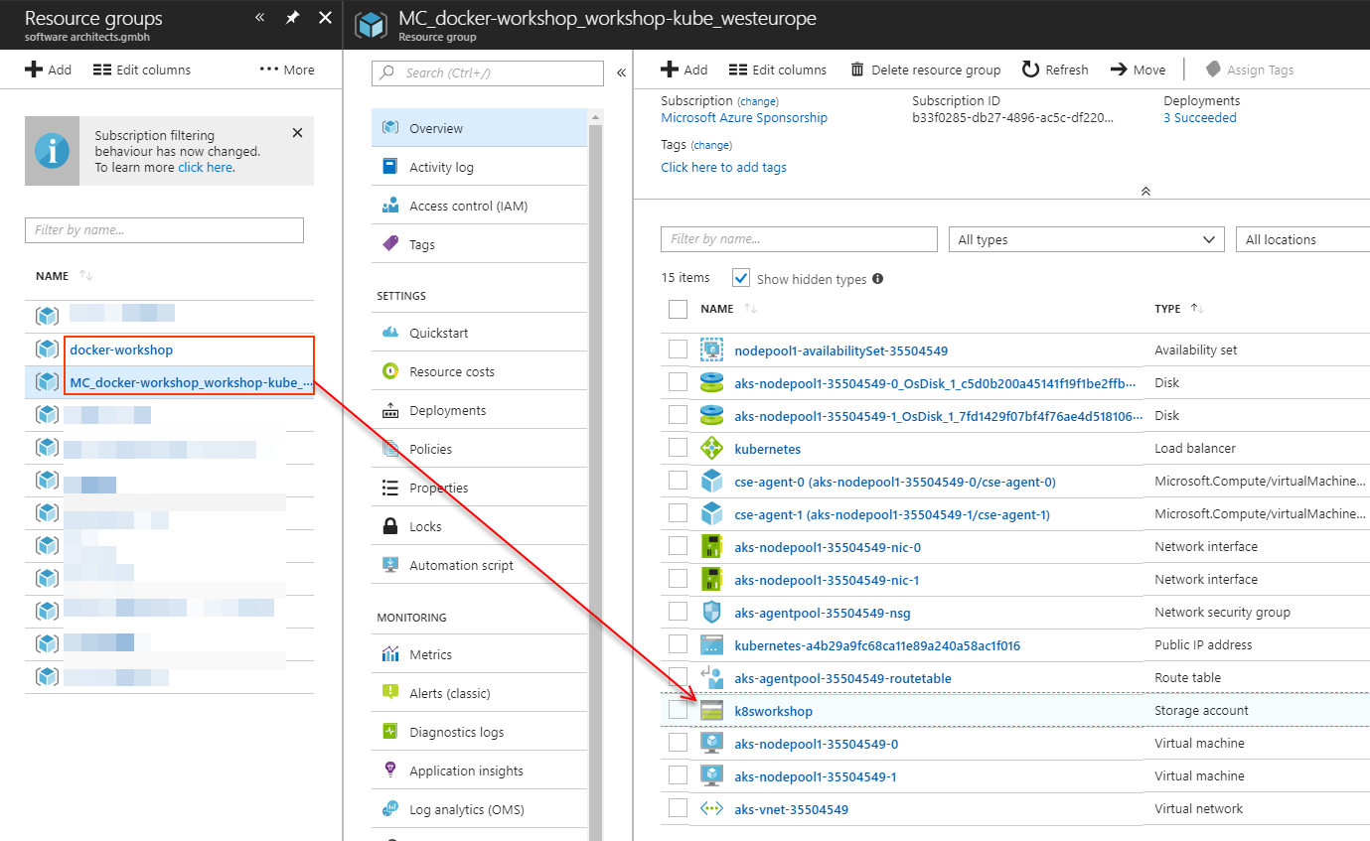
PV, PVC
kind: StorageClass
apiVersion: storage.k8s.io/v1
metadata:
name: k8sworkshop-files
provisioner: kubernetes.io/azure-file
parameters:
storageAccount: k8sworkshop
---
apiVersion: v1
kind: PersistentVolumeClaim
metadata:
name: k8sworkshop-pvc
spec:
accessModes:
- ReadWriteOnce
storageClassName: k8sworkshop-files
resources:
requests:
storage: 5Gi
With Azure

Slide 31
PV, PVC
apiVersion: v1
kind: PersistentVolumeClaim
metadata:
name: azure-managed-disk
spec:
accessModes:
- ReadWriteOnce
storageClassName: default
resources:
requests:
storage: 5Gi
---
kind: Pod
apiVersion: v1
metadata:
name: nginx
spec:
containers:
- name: mywebserver
image: nginx
volumeMounts:
- mountPath: "/usr/share/nginx/html"
name: volume
volumes:
- name: volume
persistentVolumeClaim:
claimName: azure-managed-disk
With Azure
Mount Windows folder

Slide 32
AKS
Azure Container Service – Kubernetes

Slide 33
AKS
Managed Kubernetes in Azure
No direct access (SSH) to the cluster
Note preview limitations
At the time of writing, no deployments possible in West Europe
Read more…
https://docs.microsoft.com/en-us/azure/aks/intro-kubernetes

Slide 34
Demo
# Note: Uses demo app from
# https://github.com/Azure-Samples/azure-voting-app-redis.git
cd ~/GitHub/azure-voting-app-redis
cat cat docker-compose.yaml
docker-compose up -d
# Try app at http://your-ip:8080
docker images
docker ps
docker-compose stop
docker-compose down
Prepare image
Create images locally
Test application locally
https://docs.microsoft.com/en-us/azure/aks/kubernetes-walkthrough

Slide 35
Demo
az provider register -n Microsoft.ContainerService
# Create service principal for AKS (or change password)
# This is necessary if you want to use ACR with AKS
az ad sp create-for-rbac --name azurecaas \
--password P@ssw0rd123
az ad sp credential reset --name azurecaas \
--password P@ssw0rd123
# Assign “reader” role for ACR to AKS service principal
az acr show --name azurecaas --resource-group azure-caas-demo \
--query "id"
az role assignment create \
--assignee ...(app id) --role Reader --scope ...(ACR id)
# Create AKS cluster
az aks create --resource-group azure-caas-demo \
--name azure-caas-kube --node-count 1 --generate-ssh-keys \
--location westeurope --client-secret P@ssw0rd123 \
--service-principal ...(app id)
Create AKS Cluster
Push demo image to ACR
Create service principal for AKS
Create AKS cluster
https://docs.microsoft.com/en-us/azure/aks/kubernetes-walkthrough
Note: Due to preview limitations, location has to be eastus, for details see https://github.com/Azure/AKS/blob/master/preview_regions.md

Slide 36
Demo
# Connect kubectl with AKS
az aks get-credentials --resource-group azure-caas-demo \
--name azure-caas-kube
# Check connection to AKS
kubectl config get-contexts
kubectl config use-context …
kubectl config current-context
kubectl get nodes
# Start Kubernetes dashboard (CMD, not bash!)
az aks browse --resource-group azure-caas-demo \
--name azure-caas-kube
# Scale Kubernetes server
az aks scale --resource-group azure-caas-demo \
--name azure-caas-kube --node-count 2
Create AKS Cluster
Deploy app to AKS

Slide 37
Workshop
Deploy a Web API to Kubernetes
Web API details
Web API implemented with Node.js (sources on GitHub, Dockerfile)
Automated build of image in Docker Hub (rstropek/node-mongo-sample)
Uses MongoDB (Docker Hub image mongo) to store data
Your Job
Deploy MongoDB to Kubernetes
For debugging purposes, add a service to access MongoDB using e.g. RoboMongo
Deploy rstropek/node-mongo-sample (cluster of two replicas) and connect it to MongoDB
Add a service that makes the Web API available on the network

Slide 38
Manifest
apiVersion: apps/v1
kind: Deployment
metadata:
name: event-db
spec:
selector:
matchLabels:
app: event-db
template:
metadata:
labels:
app: event-db
spec:
containers:
- name: event-db
image: mongo
ports:
- containerPort: 27017
---
apiVersion: v1
kind: Service
metadata:
name: event-db-svc
spec:
selector:
app: event-db
ports:
- port: 27017
targetPort: 27017
type: NodePort
Mongo
Tip: In real world, use stateful set
https://kubernetes.io/blog/2017/01/running-mongodb-on-kubernetes-with-statefulsets/

Slide 39
Manifest
apiVersion: apps/v1
kind: Deployment
metadata:
name: api
spec:
selector:
matchLabels:
app: api
replicas: 2
template:
metadata:
labels:
app: api
spec:
containers:
- name: api
image: rstropek/node-mongo-sample
ports:
- containerPort: 80
env:
- name: MONGO_URL
value: "mongodb://event-db-svc/member-management"
---
apiVersion: v1
kind: Service
metadata:
name: api-svc
spec:
selector:
app: api
ports:
- port: 80
targetPort: 80
type: NodePort
API

Slide 40
Q&A
Workshop
Rainer Stropek
software architects gmbh
Web
Mail
Twitter
http://www.timecockpit.com
rainer@timecockpit.com
@rstropek
Thank you for attending!

