Slide 1

Docker
Workshop
Rainer Stropek
software architects gmbh
Web
Mail
Twitter
http://www.timecockpit.com
rainer@timecockpit.com
@rstropek
Basics

Slide 2
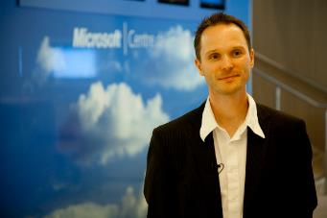
Your Host
Rainer Stropek
Developer, Entrepreneur
Azure MVP, MS Regional Director
Contact
software architects gmbh rainer@timecockpit.com Twitter: @rstropek

Slide 3
What is Docker?
Introduction
Notes:
Read docs offline: docker run -it -p 4000:4000 docs/docker.github.io:latest

Slide 4
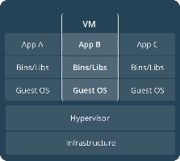
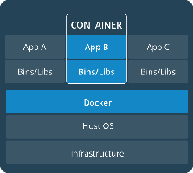
What is Docker?
Virtual Machines
Virtual machines vs. Docker
Each VM runs its own guest operating system
Container reuse the host operating system
Container run in user space
Not a total replacement of classical hypervisors or config management tools
Docker Container
Image Source: https://docs.docker.com/get-started/#containers-and-virtual-machines

Slide 5
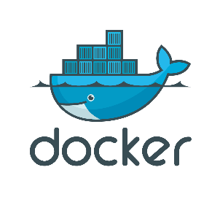
What’s Docker?
Container virtualization
Container run in user space and use kernel of host
Has been existing in Linux for quite a while
Docker builds on Linux Containers (LXC) and makes it easy to use and consume
Advantages?
Fast (boot time), small, and agile (e.g., Docker in Docker)
Portable
Immutable
Disadvantages?
Linux on Linux and Windows on Windows, no mix (consider WSL2)
Security (less isolated)

Slide 6
Strengths and Limits
Quotas, Limits
Added Isolation
Windows Server vs. Hyper-V Containers
Managed almost identically (Docker and PowerShell)
Difference: Isolation level
More details in Microsoft Docs
Process
Linux Container
Virtual Machines
Linux
Kernel
Process
Windows Server Container
Hyper-V Container
Hyper-V VMs
Windows
Kernel
Faster, more efficient
More isolated, more secure
Source: Mark Fussel (Microsoft), Azure Service Fabric - Build always-on, hyper-scalable, microservice-based cloud applications

Slide 7
Docker‘s Technical Components
Linux container format (libcontainer API)
Isolation layers
Filesystem – each container has its own filesystem (layered, copy-on-write)
Processes – each container has its own process environment
Network – separate virtual network interfaces
Resources – individually allocated CPUs, memory
Logging
STDOUT, STDERR, STDIN are logged for analysis purposes
Interactive shell
Pseudo-tty attached to STDIN

Slide 8
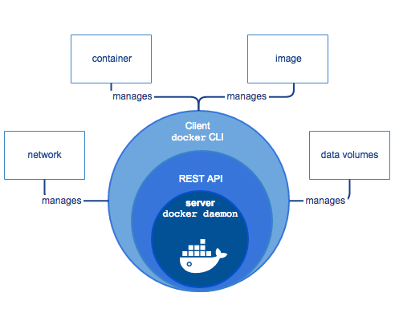
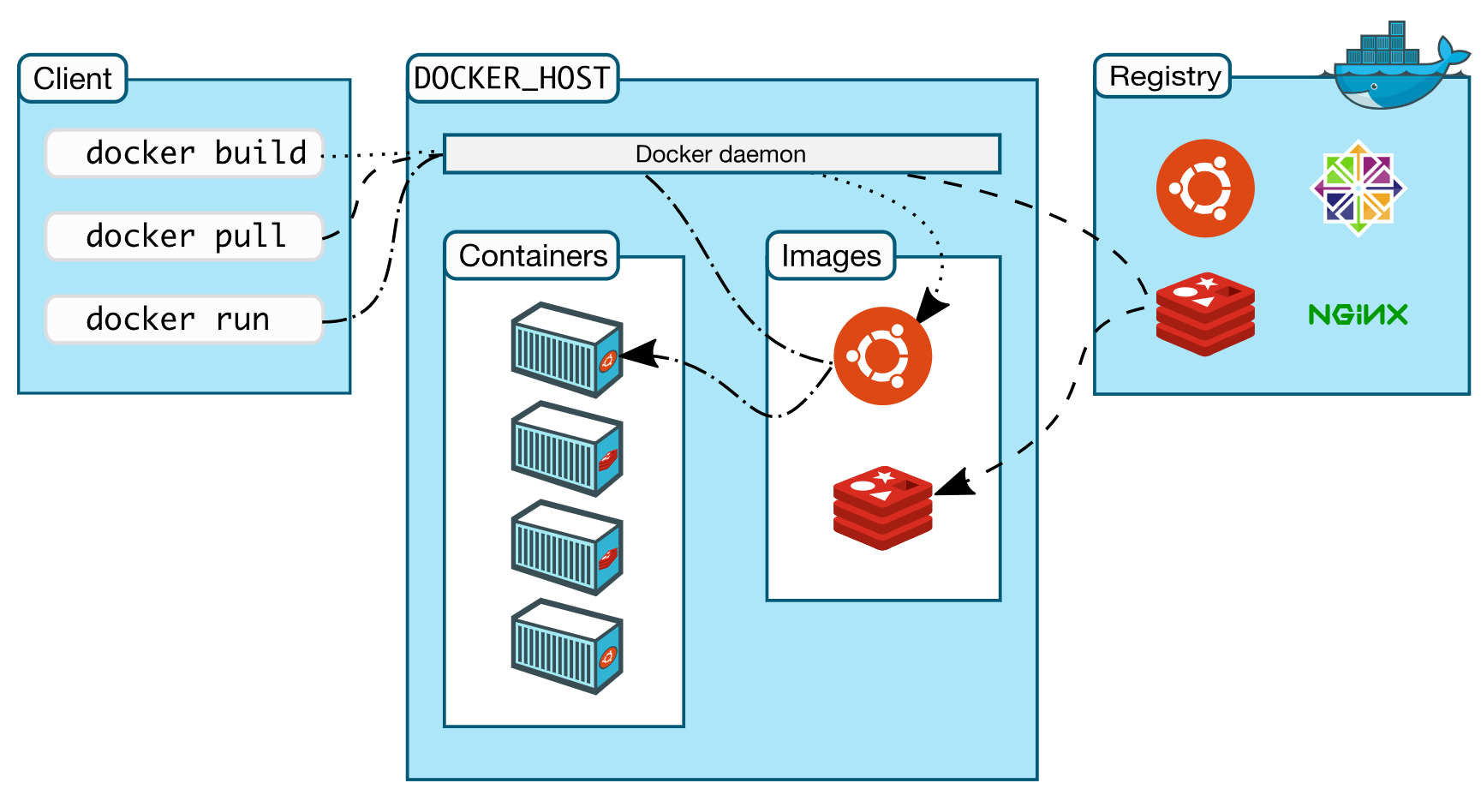
What‘s Docker?
Image Source: https://docs.docker.com/engine/docker-overview/#docker-architecture

Slide 9
What’s Docker?
Docker Daemon
“Server”
Note: Damonless alaternatives to Docker like podman
Command line tool, REST services
Docker client can manage remote Docker daemon
Container packaging format
Dockerfiles for image creation from source code
Version management for images
Images can be based on images
Docker Hub: Platform to exchange images and Dockerfiles
Publishing on Docker Hub is not in scope of this talk

Slide 10
What to Use Docker For?
Make dev/test/prod-cycle more productive
Developers build containers, not apps
Containerize build-, test- and CI-tools
Segregation of duties
Dev cares for app running in container, ops cares for managing containers
Microservices
Isolate services
Consistency across stages (dev/test/prod)
Test even complex environments locally
Containers are lightweight → run on rather small dev boxes

Slide 11
Docker Tools
Introduction

Slide 12
Docker and Microsoft
Docker Desktop
Docker environment for Windows and Mac
Container virtualization in Windows
Windows Containers Quick Start
Use Azure to play with Docker
Existing VM images in Azure marketplace
Use Docker container to run Azure tools (e.g., https://hub.docker.com/_/microsoft-azure-cli)
Azure App Service
Azure Container Instance
Azure Container Registry
Azure Kubernetes Service

Slide 13
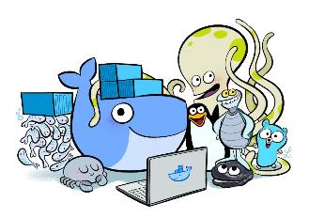
Docker Desktop
Docker Desktop (free for edu/small companies)
A secure, optimized Linux VM that runs Linux tools and containers
Seamless plumbing into the host OS giving containers access to the filesystem and networking
Bundled container tools including Kubernetes, Docker Compose, buildkit, scanning
Docker Dashboard for visually managing all your container content
A simple one click installer for Mac and Windows
Preconfigured sane and secure defaults
Automatic incremental updates to keep your system running securely
Source: https://www.docker.com/blog/the-magic-behind-the-scenes-of-docker-desktop/

Slide 14
Visual Studio DevOps Tooling
Docker Extension for Visual Studio Code
https://marketplace.visualstudio.com/items?itemName=ms-azuretools.vscode-docker
Remote Container Tools
https://marketplace.visualstudio.com/items?itemName=ms-vscode-remote.vscode-remote-extensionpack
Container Tools in Visual Studio
https://docs.microsoft.com/en-us/visualstudio/containers/overview?view=vs-2019

Slide 15
Docker Cluster Solutions
Docker Swarm Mode
https://docs.docker.com/engine/swarm/
Native clustering for Docker, turns a pool of Docker hosts into a single, virtual Docker host
Kubernetes
https://kubernetes.io/
Azure Kubernetes Service (AKS)
https://azure.microsoft.com/en-us/services/kubernetes-service/
Managed Kubernetes

Slide 16
Access Docker Remotely
Default: Docker runs on non-networked Unix socket
unix:///var/run/docker.sock
TCP socket can be enabled (see Docker docs) → Docker Remote Web API
Docker available on the network → enable TLS
Docker docs

Slide 17
Remote Docker
// Set environment variable (secure by default)
export DOCKER_HOST=tcp://40.68.81.114:2375
docker info
docker ps

Slide 18
Container
Working with containers

Slide 19
Containers
Launched from images
Layered, copy-on-write
Will be covered in detail later
Contain one or more processes
Can be short-lived
Sometimes even to run jus a single command
Shared via registries
Docker Hub (private and public repositories)
Run your own private registry (registry image on Docker Hub)

Slide 20
Docker CLI
Documentation
http://docs.docker.com/reference/commandline/cli
Important Commands for Containers
docker run – Run a command in a new container
docker ps – List containers
docker start/stop – Restarts/stops a container
docker rm – Removes container(s)
docker attach – Attach to running container
docker top – Display processes running in container
docker exec – Run a command in a container
docker [container | system] prune – Remove all stopped containers

Slide 21
Docker CLI
docker run
--name helloDocker -i -t ubuntu /bin/bash
Starting Containers
Command to execute
Interactive container
Daemonized container
Running in the background
--rm removes container when it exits
Image name
Allocate pseudo-tty
Keep STDIN open
Name of the container
docker run --name …
-d ubuntu /bin/bash -c "while true; do echo hi; done"
Command to execute (with arguments)
Detach the container to the background (daemonized)

Slide 22
Demo
# Check if docker is running
docker info
# Start interactive container
docker run -it ubuntu /bin/bash
echo Hello > hello.txt
exit
# List containers
docker ps
docker ps –a
docker ps --no-trunc -aq
# Restart container
docker start …
# Attach to container
docker attach …
# Remove container
docker rm …
# Remove all containers
docker rm `docker ps --no-trunc -aq`
docker container prune
Interactive Container

Slide 23
Demo
# Start demonized container and get logs
docker run -d ubuntu /bin/bash \
-c "while true; do echo hello world; sleep 1; done"
# Get the logs (-f for continuous monitoring)
docker logs …
# Check the processes in docker container
docker top …
# Open interactive shell in running container
docker exec -it … /bin/bash
# Inspect the details of a running container
docker inspect …
# WINDOWS
docker run –it mcr.microsoft.com/windows/servercore cmd
docker build –t myweb .
docker run
Daemonized Container

Slide 24
Docker Events
Docker reports real time events from the server
docker events
Usages
Admin and monitoring purposes
Triggering auto-configurations (e.g.nginx-proxy)

Slide 25
Networking
Docker Networking

Slide 26
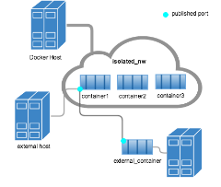
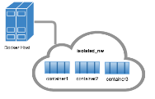
Networks
By default, three networks
none, host, bridge (default)
Additional networks can be created
Bridge network = single host
Overlay network (advanced topic, see Docker docs) can include multiple hosts
Network isolation
For details see https://docs.docker.com/engine/userguide/networking/dockernetworks/

Slide 27
Networks
# List all networks
docker network ls
# Inspect network details
docker network inspect bridge
# Disconnect a container from network
docker network disconnect bridge mycontainer
# Connect a container to a network
docker network connect mynetwork mycontainer
# Create own network
docker network create -d bridge mynetwork
# Start container in a specific network
docker run -it --net=mynetwork ubuntu
For details about network security, see Docker docs
Container name
Network name
Network name
Driver name

Slide 28
DNS
# Start nginx web server on a custom network
docker run -d --net mynetwork --name web nginx
# Start Ubuntu client in same network
docker run -it --net mynetwork --name client ubuntu
# Ping web server
ping web
# Install curl and access web server
apt-get install curl
curl web
# Start Ubuntu container and link it using alias
docker run -it --net mynetwork --link=server3:nginx ubuntu
Container name in DNS
Docker daemon contains embedded DNS server
Container-specific link
For details see https://docs.docker.com/engine/userguide/networking/configure-dns/

Slide 29
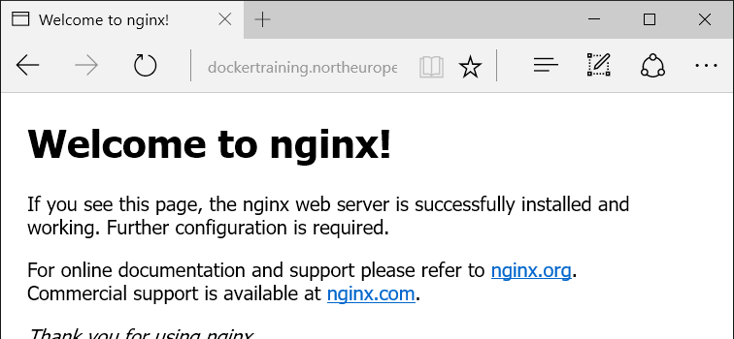
Binding container ports to host
docker run -d --net bridge -p 8080:80 nginx
# Start nginx web server on host network
docker run -d --net host nginx
# Nginx is now available on the public internet:
Host port
Container port
Port mapping
EXPOSE in Dockerfiles
See Docker docs
Use host network
Assign container to host network

Slide 30
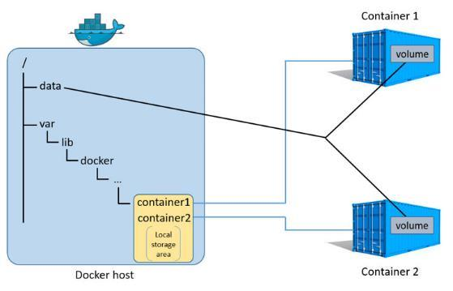
Data Volumes
Directory or file in the Docker host’s filesystem that is mounted directly into a container
Details see Docker docs
Source: https://docs.docker.com/engine/userguide/storagedriver/imagesandcontainers/

Slide 31
Mount Host
# Run postgres in a new container
docker run --name mydb -e POSTGRES_PASSWORD=P@ssw0rd \
-d postgres
docker inspect mydb
# Run client and execute some SQL
docker run -it --rm postgres /bin/bash
-c "psql -h 172.17.0.2 -p 5432 -U postgres"
# Execute some SQL (e.g. create and fill a table)
CREATE TABLE Test (ID INT PRIMARY KEY);
INSERT INTO Test VALUES (1);
SELECT * FROM Test;
\q
# Delete container --> data is gone
docker rm –f mydb

Slide 32
Mount Host
# Create data directory on host
mkdir dbdata
# Repeat the same example but this time with volume mapping
docker run --name mydb -e POSTGRES_PASSWORD=P@ssw0rd! \
--mount 'type=bind,src=/home/rainer/dbdata,dst=/var/lib/postgresql/data' -d postgres
Bind Mount

Slide 33
Data Volume Container
# Create volume
docker volume create dbstore
docker volume inspect dbstore
# Create postgres container and mount data volume container
docker run --name mydb -e POSTGRES_PASSWORD=P@ssw0rd \
-e PGDATA=/dbdata \
--mount 'type=volume,src=dbstore,dst=/dbdata' \
-d postgres
# Run client and execute some SQL (see previous example)
# Remove postgres container, recreate it --> data still there
# Start container to backup data
mkdir backup
docker run --rm \
--mount 'type=volume,src=dbstore,dst=/dbdata' \
--mount 'type=bind,src=/home/rainer/backup,dst=/backup' \
ubuntu tar cvf /backup/backup.tar /dbdata
ls –la backup/

Slide 34
Docker Volumes on Azure Files
Azure Files-Driver for Docker Volumes available
https://github.com/Azure/azurefile-dockervolumedriver
Store persistent data outside of Docker Containers
Docker containers/hosts can be moved, recreated, etc. without loosing data
High availability, replication for data
Multiple containers/hosts can access the same volume

Slide 35
Azure Files Volume
// Create volume
docker volume create
-d azurefile --name dbdatavol -o share=dbdatavol
// Create container accessing volume
docker run --rm --volumes-from dbstore
-v dbdatavol:/backup ubuntu
tar cvf /backup/backup.tar /dbdata
Volume name
Share name
Driver name
Volume container with DB data
Volume mapping to Azure Files

Slide 36
Images
Working with images

Slide 37
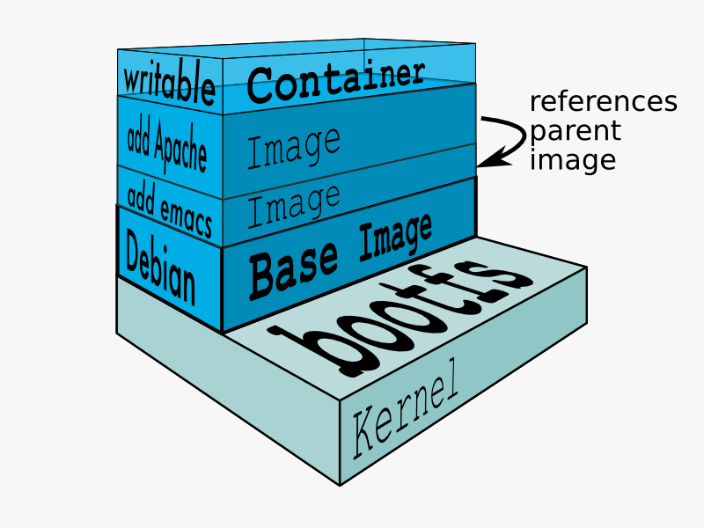
File System Layers
Rootfs stays read-only
Union-mount file system over the read-only file system
Multiple file systems stacked on top of each other
Only top-most file system is writable
Copy-on-write
Image Source: https://docs.docker.com/terms/layer

Slide 38
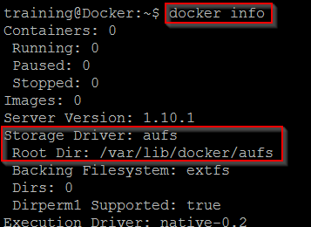
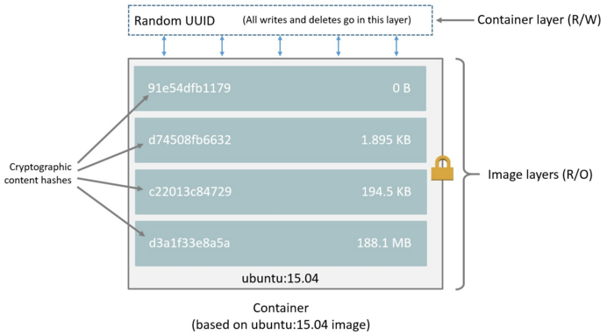
Images
# Pull image from docker hub
docker pull ubuntu
# Look for image directories on disk
ls /var/lib/docker/aufs/layers
Docker data directory
More about storage drivers see Docker docs
Source: https://docs.docker.com/engine/userguide/storagedriver/imagesandcontainers/

Slide 39
Docker CLI
Important Commands for Images
docker images – List all images
docker search – Search for image on Docker Hub
docker pull – Pulls an image from the registry (Docker Hub)
docker commit – Create image from container
docker inspect – Get low-level information on container or image

Slide 40
Docker CLI
docker commit
-m="Demo image" --author="Rainer Stropek"
Building Images from Containers
Message
Author of the image
templateContainer rstropek/ubuntu:withFile
Target repository:tag
Name of the container

Slide 41
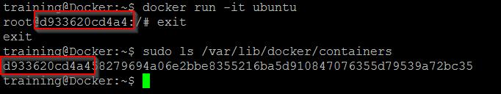
Demo
# Start interactive container
docker run -it ubuntu /bin/bash
echo "Hello Docker" > helloWorld.txt
exit
# Build image from container
docker commit … rainer:withFile
# Remove container
docker rm -f …
# Create new container from new image
docker run -it rainer:withFile /bin/bash
# View history of image
Docker history rainer:withFile
# Remove image
docker rmi rainer:withfile
Create Image

Slide 42
Checklist for Dockerfiles
Select approriate base image
Prefer existing (official) base images
Use multistage builds
Use image with SDK just for building
Use specialized runtime images for running containers
Consolidate RUN statements
RUN apt-get -y update && apt-get install -y python
Use tags to describe purpose of images
E.g. dev, prod, version, base (e.g. alpine)

Slide 43
Checklist for Dockerfiles
Never store data in container‘s writable layer
Use volumes instead
Use automated CI/CD
E.g. Azure DevOps, GitHub integration

Slide 44
Dockerfiles
Creating images from source

Slide 45
Dockerfiles
FROM nginx:alpine
LABEL maintainer=rainer@timecockpit.com
RUN apt-get -y update
COPY app/ /usr/share/nginx/html/
Execute command in new layer on top of the image and commit the result
Documentation
https://docs.docker.com/reference/builder/
https://registry.hub.docker.com/_/nginx/
Copy files to the filesystem of the container
docker build -t staticweb .
Build context
Tag for the image

Slide 46
Dockerfiles
FROM node as build
ENV approot /app
COPY ./app ${approot}
WORKDIR ${approot}
RUN rm -rf ./dist && rm -rf ./node_modules && npm install && npm run build
FROM nginx:alpine
COPY --from=build /app/dist/ /usr/share/nginx/html/
Multistep Build

Slide 47
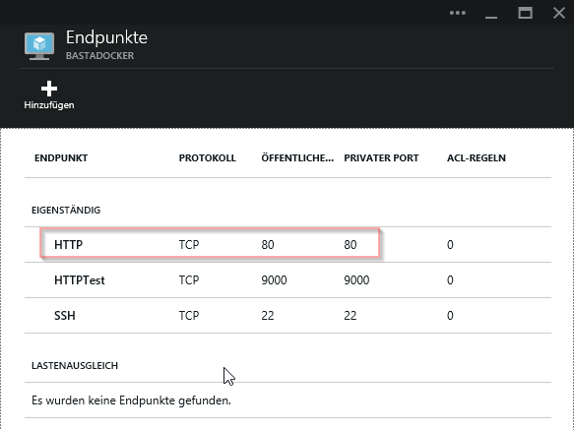
Docker CLI
docker run --name staticwebcontainer \
-d -p 80:80 staticweb
Exposing ports
Expose port 80
Run daemonized

Slide 48
Build Context
In Dockerfile: COPY and ADD to copy files from build context
Made available to build steps
Try to keep context small (note .dockerignore)
Recent enhancement (Dockerfile 1.4): Multiple build contexts
Define additional build contexts with --build-context [name]=[value]
Override source in Dockerfile
Supported sources: Local folders, Git repos, tarballs, Docker images
Blog with intro

Slide 49
Docker Buildx
CLI plugin, extends the docker build command
Features provided by Moby BuildKit builder toolkit
Enable with export DOCKER_BUILDKIT=1 or by using docker buildx
Docs, CLI reference
Build for multiple platforms
Not only for the architecture and OS where build has been invoked
Build multiple images concurrently
Defined in compose files
docker buildx bake
Docs

Slide 50
Docker Buildx
BuildKit frontends
Human-readable specification of image build
Mostly Dockerfiles, but other frontends available, too
Frontends are read from container images (repository)
Specify Dockerfile version to use external frontend
First line of your Dockerfile needs to be #syntax=docker/dockerfile:…
Lates version at time of writing: 1.4.1

Slide 51
Demo
# Get sample code from GitHub
git clone https://github.com/rstropek/DockerVS2015Intro.git
# Build website
cd dockerDemos/01-staticWeb/app
npm install
npm run build
cd ..
# Build image from Dockerfile
docker build -t staticweb .
docker run -d -p 80:80 staticweb
# Change website content and rebuild container
# Run a second container, run a third container (linked)
docker run -i -t --link <cont1>:sweb1 --link <cont2>:sweb2 ubuntu /bin/bash
apt-get install curl
curl http://sweb1
Dockerfile
Sample files see https://github.com/rstropek/DockerVS2015Intro/tree/master/dockerDemos/01-staticWeb

Slide 52
Demo
# Run webpack inside a docker container
docker run -t --rm -v C:\...\dockerDemos\01-staticWeb\app:/app -w /app node npm run build
# Run webpack inside a docker container (watch mode)
docker run -t --rm -v C:\...\dockerDemos\01-staticWeb\app:/app -w /app node bash -c "npm run watch -- --watch-poll 1000"
# Run nginx webserver inside container
docker run --rm -t -p 8081:80 -v C:\...\dockerDemos\01-staticWeb\app\dist:/usr/share/nginx/html/ nginx:alpine
Automated build

Slide 53
Demo
# Run grunt inside a docker container
docker run --rm
-v ~/dockerDemos/01-staticWeb/app/dist:/app
node
npm run build
Remove the container when it exists
Run Grunt (build) in Container
Mount host volume (host:container)
Use existing image
Run webpack

Slide 54
Docker Compose
Tool for running multi-container applications

Slide 55
Docker Compose
Docker Compose 2.0
Completely rewritten in Go (previously Python)
Part of Docker Desktop (since end 2021)
awesome-compose is a great way to get started
https://github.com/docker/awesome-compose
See also https://docs.docker.com/compose/cli-command/

Slide 56
Demo
printer:
build: .
links:
- dependent-service
dependent-service:
image: dependent-service
Build local Dockerfile
For more info visit https://docs.docker.com/compose/
Link to other containers (e.g. Redis, MongoDB)
Run service container depends on based on an existing image

Slide 57
Demo
# Build dependent service
# directory: ~/DockerVS2015Intro/dockerDemos/02-compose/dependentService
npm install
docker build –t dependent-service .
# Run container using dependent service
# directory: ~/DockerVS2015Intro/dockerDemos/02-compose
npm install
docker-compose run printer
Automated build
Sample files see https://github.com/rstropek/DockerVS2015Intro/tree/master/dockerDemos/02-compose

Slide 58
ASP.NET in Docker
Running ASP.NET in Docker (Docker-and-dot-net.pptx)

Slide 59
Application Scenarios
Running continuous integration in containers
Rebuild complex runtime environment on my laptop
Identical environment for dev, test, and prod
Cost reduction in the cloud
High density hosting (e.g. multiple versions)
Split software into multiple, independent services
Micro-services, see Manfred’s session tomorrow

Slide 60
Q&A
Workshop
Rainer Stropek
software architects gmbh
Web
Mail
Twitter
http://www.timecockpit.com
rainer@timecockpit.com
@rstropek
Thank you for attending!

