Slide 1


Azure ARC
Azure
Rainer Stropek
software architects gmbh
Web
Mail
Twitter
http://www.timecockpit.com
rainer@timecockpit.com
@rstropek
Azure Container Registry

Slide 2

Your Host
Rainer Stropek
Developer, Entrepreneur
MVP Microsoft Azure
MVP Development Technologies
MS Regional Director
Senior Consultant IT-Visions
Contact
software architects gmbh rainer@timecockpit.com Twitter: @rstropek

Slide 3
Agenda
Intro and Overview with a few Slides
Demos, Demos, Demos
Get slides on Speakerdeck
http://bit.ly/acr-doc-muc-slides
Get sample script from GitHub
http://bit.ly/doc-muc-acr

Slide 4
Basics
Store and manage Docker-compatible container images
Windows and Linux (5 TB storage limit)
Support for storing Helm charts (not covered here)
Encrypted-at-rest
Managed service
Based on OSS Docker Registry 2.0
Use standard docker commands to interact with ACR
Controlled access with Azure AD
Individual identity (MS Account, AAD) for access by developers
Azure AD-backed service principals
Admin account
Read more…
https://azure.microsoft.com/en-us/services/container-registry/

Slide 5
Azure Container Registry
Multilevel namespaces for repositories
E.g. myregistry.azurecr.io/hrdept/web:3.0.1
Content Trust in Preview
Signed images
Read more
Support for Webhooks
Push, delete
Process integration
Webhook integration
Integration in Azure EventGrid
https://azure.microsoft.com/en-us/services/container-registry/

Slide 6
Registries
Create one or more registries in Azure subscription
myregistry.azurecr.io
Registries network-close to deployments
Consider Premium SKU to geo-replicate
Three SKUs
Basic, Standard, Premium
Features
Pricing

Slide 7
Repositories
Registry contains one or more repositories
Hierarchical namespace
myregistry.azurecr.io/nginx:alpine
myregistry.azurecr.io/accounting/probooks:latest
myregistry.azurecr.io/marketing/launchcampaign/webui:3

Slide 8
ACR Tasks
Offload docker build to Azure
Pay per CPU-second
Registry Tasks
Build images on demand
Build image after checking in code (example)
Build image after base image refresh
Use Webhooks or events to update containers
Preview: Multi-Step Tasks
Step-based task definition
Build, push, test, execute containers
Example

Slide 9
Demo
Get sample script from GitHub
http://bit.ly/doc-muc-acr

Slide 10
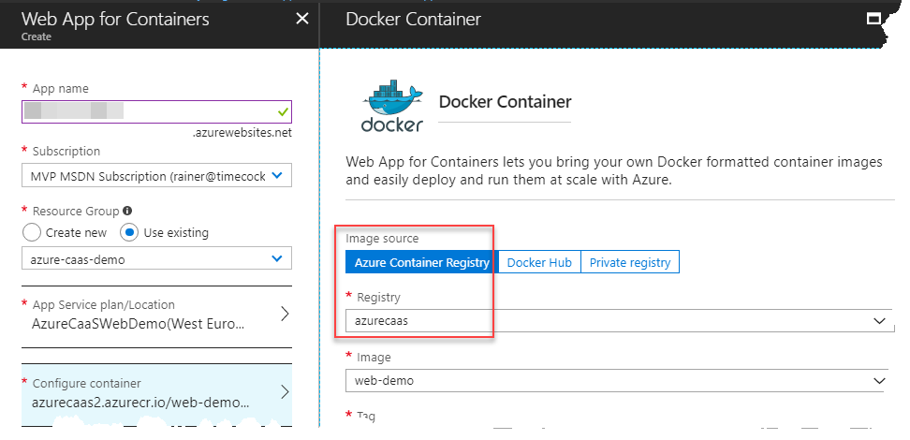
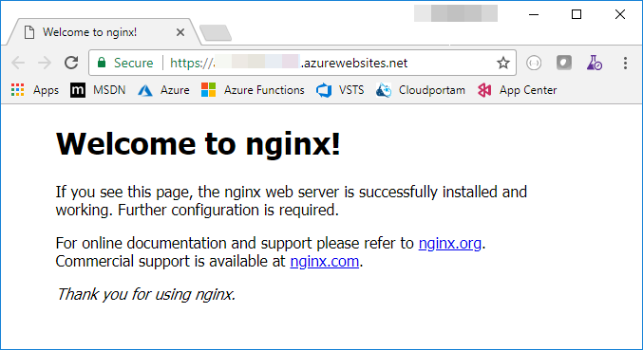
Demo
Create Registry
Create Azure Web App from ACR image
https://docs.microsoft.com/en-us/azure/container-registry/container-registry-get-started-azure-cli

Slide 11

Summary
Azure Docker
Use PaaS and Serverless…
…to get the most out of your cloud investments
Azure PaaS and Serverless offerings
Azure Container Registry (ACR) – store your images in Azure
Azure Container Instances (ACI) – Serverless Docker Containers
Azure Container Services (AKS) – Kubernetes as a Service
Azure App Service – Web devs will love it
Have fun with Docker on Azure

Slide 12
Q&A
Azure
Rainer Stropek
software architects gmbh
Mail Web Twitter
rainer@timecockpit.com http://www.timecockpit.com @rstropek
Thank your for coming!

