Slide 1

Azure CaaS
Azure
Rainer Stropek
software architects gmbh
Web
Mail
Twitter
http://www.timecockpit.com
rainer@timecockpit.com
@rstropek
Container-as-a-Service

Slide 2
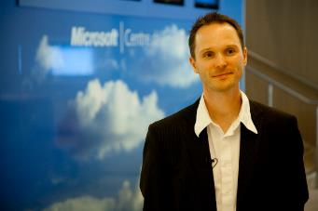
Your Host
Rainer Stropek
Developer, Entrepreneur
MVP Microsoft Azure
MVP Development Technologies
MS Regional Director
Senior Consultant IT-Visions
Contact
software architects gmbh rainer@timecockpit.com Twitter: @rstropek

Slide 3

Registry
Managed Docker Registry on Azure

Slide 4
Azure Container Registry
Store and manage Docker images
Windows and Linux
Managed service
Based on open-source Docker Registry
Controlled access with Azure AD
Azure AD-backed service principals
Admin account
Read more…
https://azure.microsoft.com/en-us/services/container-registry/

Slide 5
Azure Container Registry
Multilevel namespaces for repositories
E.g. myregistry.azurecr.io/hrdept/web:3.0.1
Support for Webhooks
Push, delete
https://azure.microsoft.com/en-us/services/container-registry/

Slide 6
Demo
# Login and select subscription
az login
az account set --subscription ...
# Create resource group
az group create --name azure-caas-demo --location westeurope
# Create Azure Container Registry (ACR)
az acr create --resource-group azure-caas-demo --name azurecaas --sku Premium --admin-enabled
# Login to ACR to enable “docker push”
az acr login --name azurecaas
# Create an image that you want to store in registry
# Here we take an nginx webserver
# Tag and push image to ACR
docker tag nginx:alpine azurecaas.azurecr.io/web-demo:1
docker push azurecaas.azurecr.io/web-demo:1
# Useful helpers...
az acr repository list --name azurecaas --output table
az acr repository show-tags --name azurecaas --repository web-demo --output table
az acr credential show --name azurecaas
Create Registry
Create a registry
Login to registry
Create and push image
https://docs.microsoft.com/en-us/azure/container-registry/container-registry-get-started-azure-cli

Slide 7
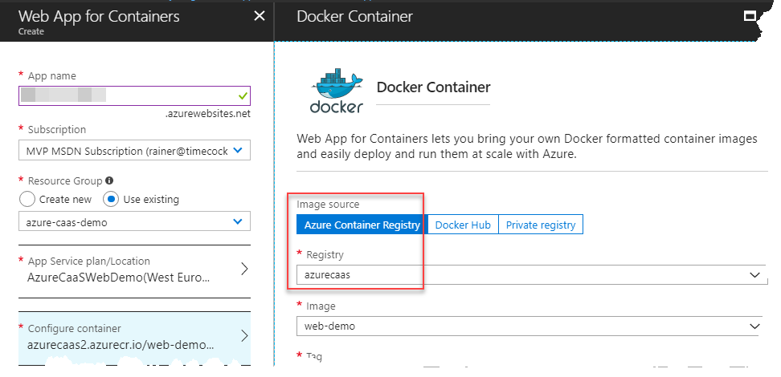
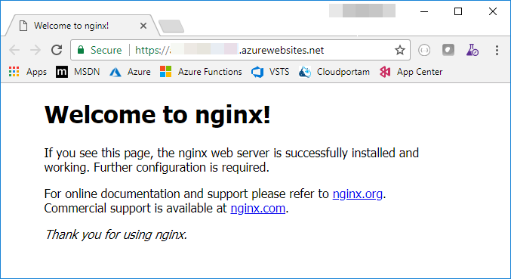
Demo
Create Registry
Create Azure Web App from ACR image
https://docs.microsoft.com/en-us/azure/container-registry/container-registry-get-started-azure-cli

Slide 8

Container Instances
Serverless Containers

Slide 9
Azure Container Instances
Preview!
Note limitations (e.g. no VNet support, quotas and regional limits)
Fastest and simplest way to run a container in Azure
Isolated containers with simple applications, task automations, build jobs, etc.
Use Container Groups to put containers on same host machine (e.g. shared network)
Not fully-featured container orchestrator
Serverless
Linux and Windows
Priced by container creations, Core-s, and GB-s
Read more…
https://docs.microsoft.com/en-us/azure/container-instances/container-instances-overview

Slide 10
Demo
# Get ACR password
az acr credential show --name azurecaas --query "passwords[0].value"
# Create container from
az container create --resource-group azure-caas-demo --name web-demo --image azurecaas.azurecr.io/web-demo:1 --cpu 1 --memory 1 --ip-address public --ports 80 --registry-password ...
az container show --resource-group azure-caas-demo \
--name web-demo --query ipAddress.ip
az container logs --resource-group azure-caas-demo \
--name web-demo
Create Container in ACI
Create container
From image in ACR
Access container
View logs
https://docs.microsoft.com/en-us/azure/container-instances/container-instances-quickstart

Slide 11
App Service
Containers for Web Frontends

Slide 12
Demo
# Create App Service Plan
az appservice plan create --name caas-plan --resource-group softday-caas-demo --is-linux --location westeurope
# Create Web App
az webapp create --name softday-web-demo --resource-group softday-caas-demo --plan caas-plan --deployment-container-image-name hello-world
# Enable logging
az webapp log config --name softday-web-demo --resource-group softday-caas-demo --web-server-logging filesystem
# Deploy image
az webapp config container set --docker-registry-server-url http://azurecaas.azurecr.io --docker-custom-image-name azurecaas.azurecr.io/nginx-demo:1 --docker-registry-server-user azurecaas --docker-registry-server-password ... --name softday-web-demo --resource-group softday-caas-demo
Create Container in ACI
Create container
From image in ACR
Access container
View logs
https://docs.microsoft.com/en-us/azure/container-instances/container-instances-quickstart

Slide 13
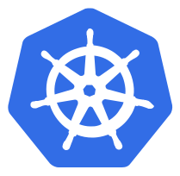
AKS
Azure Container Service – Kubernetes

Slide 14
Kubernetes 101
A data center OS
Orchestrator for microservice apps
Masters (aka control plane) and nodes
Created by Google, open source sind 2014
Go sources on GitHub at https://github.com/kubernetes/kubernetes
Pods
Typically one, sometimes multiple containers (tightly-coupled)
Common Pod environment (e.g. IP address, localhost)
Atomic unit (all-or-nothing)
https://kubernetes.io/docs/

Slide 15
Kubernetes 101
Service
Each services gets its own stable IP address, DNS name, and port
Uses labels to dynamically associate with Pods
Load-balances requests across Pods
Service type LoadBalancer → make service available outside the cluster
Replication controllers
Number of replicas for a Pod
Desired State
Deployments
Replication controller + rolling updates

Slide 16
AKS
Managed Kubernetes in Azure
No direct access (SSH) to the cluster
Note preview limitations
At the time of writing, no deployments possible in West Europe
Read more…
https://docs.microsoft.com/en-us/azure/aks/intro-kubernetes

Slide 17
Demo
# Note: Uses demo app from
# https://github.com/Azure-Samples/azure-voting-app-redis.git
cd ~/GitHub/azure-voting-app-redis
cat cat docker-compose.yaml
docker-compose up -d
# Try app at http://your-ip:8080
docker images
docker ps
docker-compose stop
docker-compose down
Prepare image
Create images locally
Test application locally
https://docs.microsoft.com/en-us/azure/aks/kubernetes-walkthrough

Slide 18
Demo
az provider register -n Microsoft.ContainerService
# Push demo docker image to ACR (web frontend)
docker tag azure-vote-front \
azurecaas.azurecr.io/azure-vote-front:v1
docker push azurecaas.azurecr.io/azure-vote-front:v1
# Create service principal for AKS (or change password)
az ad sp create-for-rbac --name azurecaas \
--password P@ssw0rd123
az ad sp credential reset --name azurecaas --password P@ssw0rd123
# Assign “reader” role for ACR to AKS service principal
az acr show --name azurecaas --resource-group azure-caas-demo --query "id"
az role assignment create --assignee ...(app id) --role Reader --scope ...(ACR id)
# Create AKS cluster
az aks create --resource-group softday-caas-demo --name azure-caas-kube --node-count 1 --generate-ssh-keys --location westeurope --client-secret P@ssw0rd123 --service-principal ...(app id)
Create AKS Cluster
Push demo image to ACR
Create service principal for AKS
Create AKS cluster
https://docs.microsoft.com/en-us/azure/aks/kubernetes-walkthrough
Note: Due to preview limitations, location has to be eastus, for details see https://github.com/Azure/AKS/blob/master/preview_regions.md

Slide 19
Demo
# Connect kubectl with AKS
az aks get-credentials --resource-group azure-caas-demo \
--name azure-caas-kube
# Check connection to AKS
kubectl get nodes
# Create Kubernetes deployments and services
kubectl create -f azure-vote-all-in-one-redis.yaml
# Watch front-end service to get public IP
kubectl get service azure-vote-front --watch
# Try to reach web app via public IP
# Start Kubernetes dashboard (CMD, not bash!)
az aks browse --resource-group azure-caas-demo \
--name azure-caas-kube
# Scale Kubernetes server
az aks scale --resource-group azure-caas-demo \
--name azure-caas-kube --node-count 2
Create AKS Cluster
Deploy app to AKS

Slide 20
Manifest
apiVersion: apps/v1beta1
kind: Deployment
metadata:
name: azure-vote-back
spec:
replicas: 1
template:
metadata:
labels:
app: azure-vote-back
spec:
containers:
- name: azure-vote-back
image: redis
ports:
- containerPort: 6379
name: redis
---
apiVersion: v1
kind: Service
metadata:
name: azure-vote-back
spec:
ports:
- port: 6379
selector:
app: azure-vote-back
---
Deploy Redis backend
Create service with internal IP and DNS name
https://hub.docker.com/_/redis/

Slide 21
Manifest
apiVersion: apps/v1beta1
kind: Deployment
metadata:
name: azure-vote-front
spec:
replicas: 1
strategy:
rollingUpdate:
maxSurge: 1
maxUnavailable: 1
minReadySeconds: 5
template:
metadata:
labels:
app: azure-vote-front
spec:
containers:
- name: azure-vote-front
image: azurecaas.azurecr.io/azure-vote-front:v1
ports:
- containerPort: 80
resources:
requests:
cpu: 250m
limits:
cpu: 500m
env:
- name: REDIS
value: "azure-vote-back"
---
Deploy front-end
Rolling update
Get image from ACR

Slide 22
Manifest
apiVersion: v1
kind: Service
metadata:
name: azure-vote-front
spec:
type: LoadBalancer
ports:
- port: 80
selector:
app: azure-vote-front
Enable external access using load balancer

Slide 23

Summary
Azure Docker
Use PaaS and Serverless…
…to get the most out of your cloud investments
Azure PaaS and Serverless offerings
Azure Container Registry (ACR) – store your images in Azure
Azure Container Instances (ACI) – Serverless Docker Containers
Azure Container Services (AKS) – Kubernetes as a Service
Have fun with Docker on Azure

Slide 24
Q&A
Azure
Rainer Stropek
software architects gmbh
Mail Web Twitter
rainer@timecockpit.com http://www.timecockpit.com @rstropek
Thank your for coming!

