Slide 1

Container
Workshop
Rainer Stropek
software architects gmbh
Web
Mail
Twitter
http://www.timecockpit.com
rainer@timecockpit.com
@rstropek
in the Microsoft Universe

Slide 2
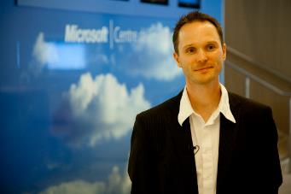
Your Host
Rainer Stropek
Developer, Entrepreneur
MVP Microsoft Azure
MVP Development Technologies
MS Regional Director
Senior Consultant IT-Visions
Contact
software architects gmbh rainer@timecockpit.com Twitter: @rstropek

Slide 3
Questions for this Session
Why?
Do Linux containers matter for Microsoft?
Docker is great on Linux, why do we need it on Windows?
Options, options, options
When to use what?
Demos, demos, demos
See things in action

Slide 4
Overview
Available Options and Tools

Slide 5
Microsoft  Containers
Docker client on Windows
In Windows shell
In Bash shell (Bash on Ubuntu on Windows)

Slide 6
Docker Client
Docker Client in Windows Shell
Ubuntu subsystem for Windows
Not Docker, not Hyper-V
Pico processes
Bash on Ubuntu on Windows
Advantage: Completion

Slide 7
Microsoft  Containers
Docker client on Windows
In Windows shell
In Bash shell (Bash on Ubuntu on Windows)
Linux containers on Windows
Docker for Windows
Windows containers on Windows
Windows Server containers
Hyper-V containers
Docker support on Windows Server 2016 and Windows 10

Slide 8
Microsoft  Containers
Ready-made containers
For Linux and Windows
See Docker Hub (e.g. Azure CLI, .NET Core, PowerShell, IIS, SQL Server on Linux, etc.)
Containers on Azure (Services)
ARM Templates (e.g. Docker on Unbuntu) and drivers from Microsoft (details later)
Docker Machine with Azure driver
Containers-as-a-Service with Container Instances and App Service
Managed/unmanaged Kubernetes DC/OS, Docker Swarm with Azure Container Service
Azure Container Registry
Containers in Service Fabric and Batch

Slide 9
SQL Server
Linux
Windows

Slide 10
SQL Server
# Linux
docker run -e ACCEPT_EULA=Y -e SA_PASSWORD=P@ssw0rd!123 -m 4096MB -p 1433:1433 microsoft/mssql-server-linux
# Windows
docker run -p 1433:1433 -e sa_password=P@ssw0rd!123 -e ACCEPT_EULA=Y microsoft/mssql-server-windows-developer

Slide 11
Microsoft  Containers
Visual Studio Support
Visual Studio Tools for Docker (VS2017)
VSTS Docker Extension
Docker Support for Visual Studio Code

Slide 12
Strengths and Limits
Quotas, Limits
Added Isolation
Windows Server vs. Hyper-V Containers
Managed almost identically (Docker and PowerShell)
Difference: Isolation level
More details in docs
Version Compatibility
Server Containers: Must match
Hyper-V Containers: Need not match
Process
Linux Container
Virtual Machines
Linux
Kernel
Process
Windows Server Container
Hyper-V Container
Hyper-V VMs
Windows
Kernel
Faster, more efficient
More isolated, more secure
Source: Mark Fussel (Microsoft), Azure Service Fabric - Build always-on, hyper-scalable, microservice-based cloud applications

Slide 13
Isoluation
Windows Hyper-V Containers

Slide 14
Isoluation
# Run Hyper-V container
docker run -it --rm --isolation=hyperv microsoft/nanoserver cmd /c ping localhost –t
# Show vmwp.exe process on host -> virtual machine
# Run Windows Server container
docker run -it --rm microsoft/nanoserver cmd /c ping localhost –t
# Show ping process on host -> kernel reuse
Windows Hyper-V Containers

Slide 15
Linux on Windows
Running Linux containers on Windows

Slide 16
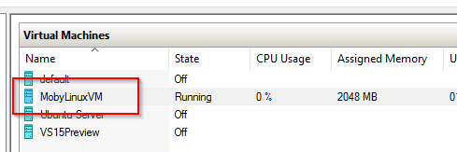
Linux on Windows
Use Docker for Windows
Uses Hyper-V to run Linux with Docker
Run Docker client on Windows or Linux

Slide 17
Docker for Windows
Docker for Windows UI
Settings
VM in Hyper-V
Container scenarios
Interactive container
Volume mapping
Port mapping
Microsoft-provide image
.NET on Linux

Slide 18
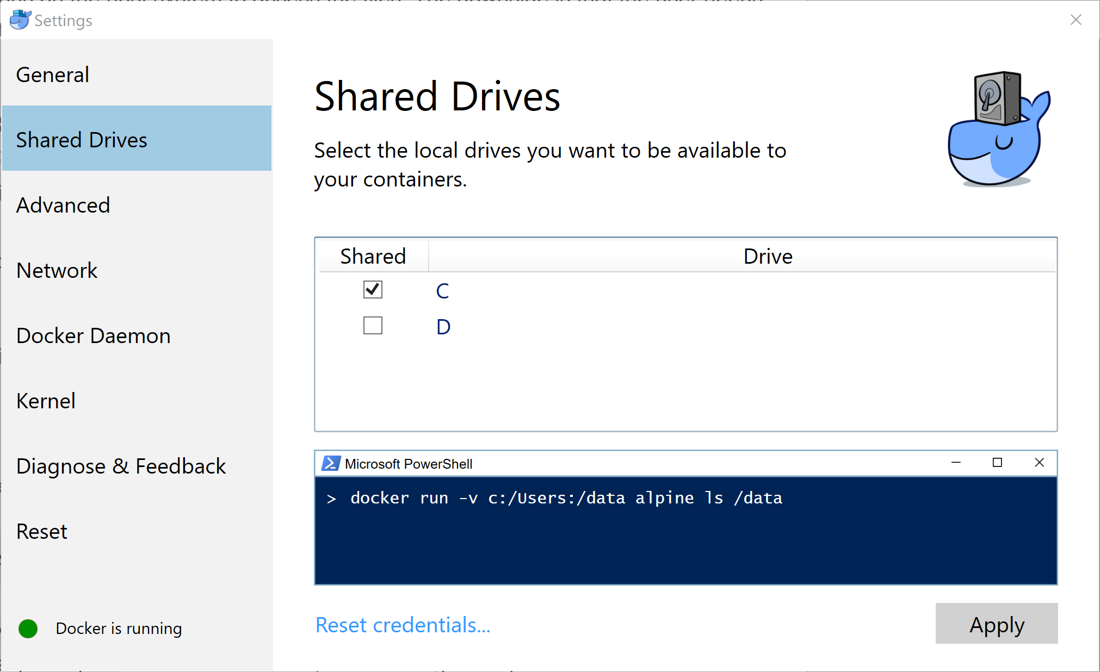
Demo
# Run interactive ubuntu container
docker run -it --rm ubuntu /bin/bash
# Run postgres with volume mapping
docker run –d --name postgres -v c:\temp\data:/dbdata -e POSTGRES_PASSWORD=P@ssw0rd! -e PGDATA=/dbdata postgres
# Show content of mapped volume on Windows
# Run mongo with port mapping
docker run -d --name mongo -p 27017:27017 mongo
# Use mongo client under Windows to access mongo in container
# Run .NET Core on Linux
docker run -it --rm microsoft/dotnet /bin/bash
mkdir /demo
cd /demo
dotnet new console --framework netcoreapp1.1
ls –la
dotnet restore
dotnet run
# Option: Show .NET Core with VSCode and
# Volume mapping
Prerequisites
Docker for Windows installed and configured
Don‘t forget to share drive in Docker for Windows settings!

Slide 19
Demo
# nginx.conf
events {
worker_connections 4096; ## Default: 1024
}
http {
server {
listen 80;
location /global-azure-bootcamp-2017/ {
root /usr/share/web;
}
location / {
return 301 /global-azure-bootcamp-2017/;
}
}
}
# Dockerfile
FROM nginx:alpine
COPY . /usr/share/web/global-azure-bootcamp-2017
COPY nginx.conf /etc/nginx/nginx.conf
Jekyll

Slide 20
Windows on Windows
Running Windows containers on Windows

Slide 21
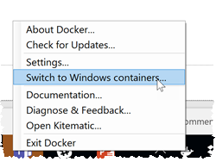
Windows on Windows
OS Support
Windows Server 2016
Windows 10 (Hyper-V Container)
Nice integration with Docker for Windows on Windows 10
Windows Server Container
Hyper-V Container
Additional isolation layer
Runs inside of Windows Nano Server VM
docker run -it --rm --isolation=hyperv microsoft/nanoserver

Slide 22
Windows Container
Docker on Windows 10
Nano Server
Docker on Windows Server 2016
Full Server
Nano Server
Remote Docker (Linux and Windows) client
Container scenarios
Interactive container
Dockerfiles on Windows
Volume mapping
Ready-made container (.NET)

Slide 23
Demo
# Ping Docker host on Windows Server
docker -H tcp://1.2.3.4:2375 info
set DOCKER_HOST=tcp://1.2.3.4:2375
docker info
docker ps -a
docker images
# Run ’dir’ inside a short-lived Nano Server container
docker run --rm microsoft/nanoserver cmd /C dir
# Run existing IIS image (source: Microsoft)
docker run -d -p 80:80 microsoft/iis
# Volume mapping
echo Hello > c:\temp\greeting.txt
docker run --rm -v c:\temp:c:\somedir microsoft/nanoserver cmd /C type \somedir\greeting.txt
Prerequisites
Windows Server with Container support
See also sample Dockerfile https://github.com/rstropek/DockerVS2015Intro/blob/master/dockerDemos/07-win-container-nano-server/Dockerfile

Slide 24
Dockerfile
FROM microsoft/windowsservercore
MAINTAINER rainer@timecockpit.com
RUN dism.exe /online /enable-feature /all /featurename:iis-webserver /NoRestart
RUN echo "Hello World - Dockerfile" > c:\inetpub\wwwroot\index.html
CMD [ "ping", "-t", "127.0.0.1" ]

Slide 25
Dockerfile
FROM microsoft/aspnet
COPY . /inetpub/wwwroot
ASP.NET 4.6

Slide 26
Windows on Windows
Configuration via daemon.json
Details see Microsoft docs
Support for Dockerfiles
Windows shell
Powershell support
Details see Microsoft docs
Swarm-support
Details see blog post

Slide 27
Docker on Azure
Running containers in Azure

Slide 28
Docker on Azure
Docker support in Azure Resource Manager (ARM)
Extension for Docker on Linux
Ready-made ARM-templates (e.g. Docker on Ubuntu)
Azure driver for Docker Machine
Azure Container Services (AKS)
Storage
Docker Volume Driver for Azure File Storage

Slide 29
Containers in Azure
Docker Machine
Azure Driver
ARM with Docker
Using Quickstart Template
Volume driver for Files

Slide 30
Demo
docker-machine create --driver azure --azure-subscription-id 00000000-0000-0000-0000-000000000000 doc16-demo
# Show result in Azure Portal
# Create volume on Azure files
docker volume ls
docker volume create -d azurefile --name myvol -o share=doc16
docker volume ls
docker run -it --rm -v myvol:/data ubuntu /bin/bash
cd /data
echo Hello > greeting.txt
# Show result in Azure Portal
Prerequisites
Docker Machine installed
Docker Driver for Azure Files installed and configured

Slide 31
Container Registry
Fully mananged
Linux and Windows images
Registry
Store images in Azure data centers near to your Azure Docker clusters
Feature-rich (e.g. Webhooks, AAD integration, geo-replication, multilevel namespaces, etc.)
Docker CLI
Standard Docker tools for push/pull

Slide 32
Container Registry
Azure Portal
Push/pull image using Docker CLI

Slide 33
App Service
Fully mananged PaaS
Currently, Linux only
For web tier
No multi-container solutions
Ideal for Web APIs and Web Sites

Slide 34
Container Instances (Preview)
Fully mananged
Linux and Windows (Hyper-V containers)
No replacement for AKS
Limited orchestration capabilities
Great for simple apps, task automation, CI/CD etc.
Can be integrated with Kubernetes (scale-out; experimental)
Pay what you really use
Tailor CPU cores and memory to your needs
Ideal for highly variable workloads

Slide 35
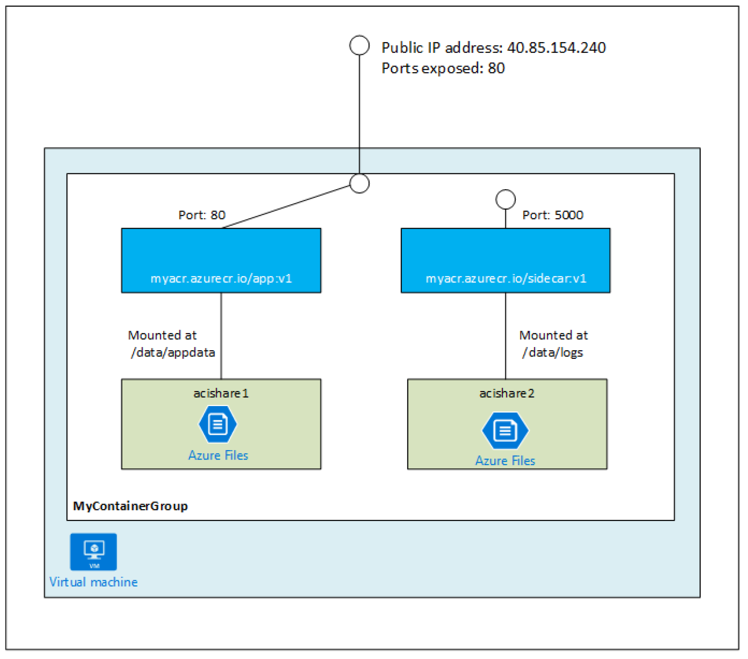
Container Groups
Group of containers
Share same host, lifecycle, network, shared volumes
Similar to a Pod in Kubernetes
Networking
Same external IP
No port mapping
Deployment and Management
ARM Templates
Azure CLI
PowerShell
Image Source: Microsoft Azure Documentation

Slide 36
Container Instances
.NET Core App
Deployment
Azure CLI
ARM Template

Slide 37
Developer Tools
Visual Studio support

Slide 38
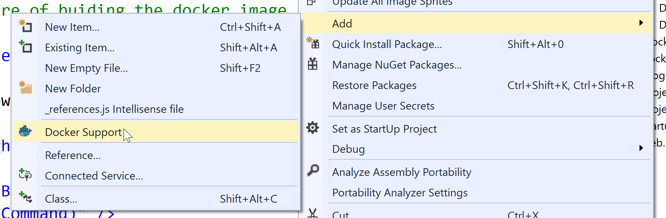
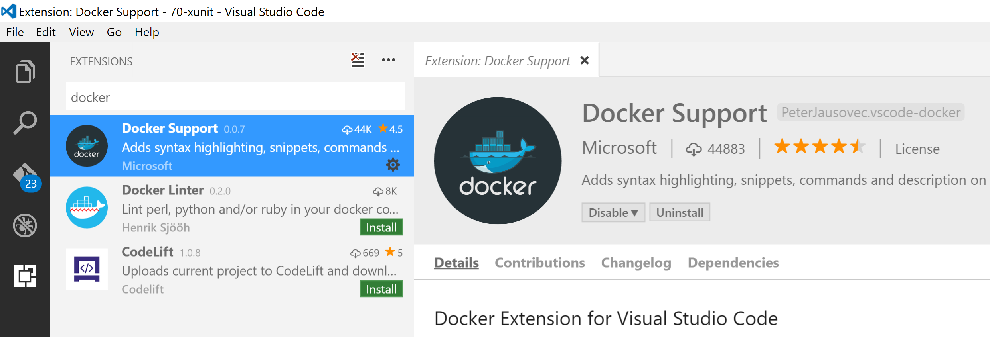
Visual Studio
Docker Tools for Visual Studio
Docker support for Visual Studio Code

Slide 39
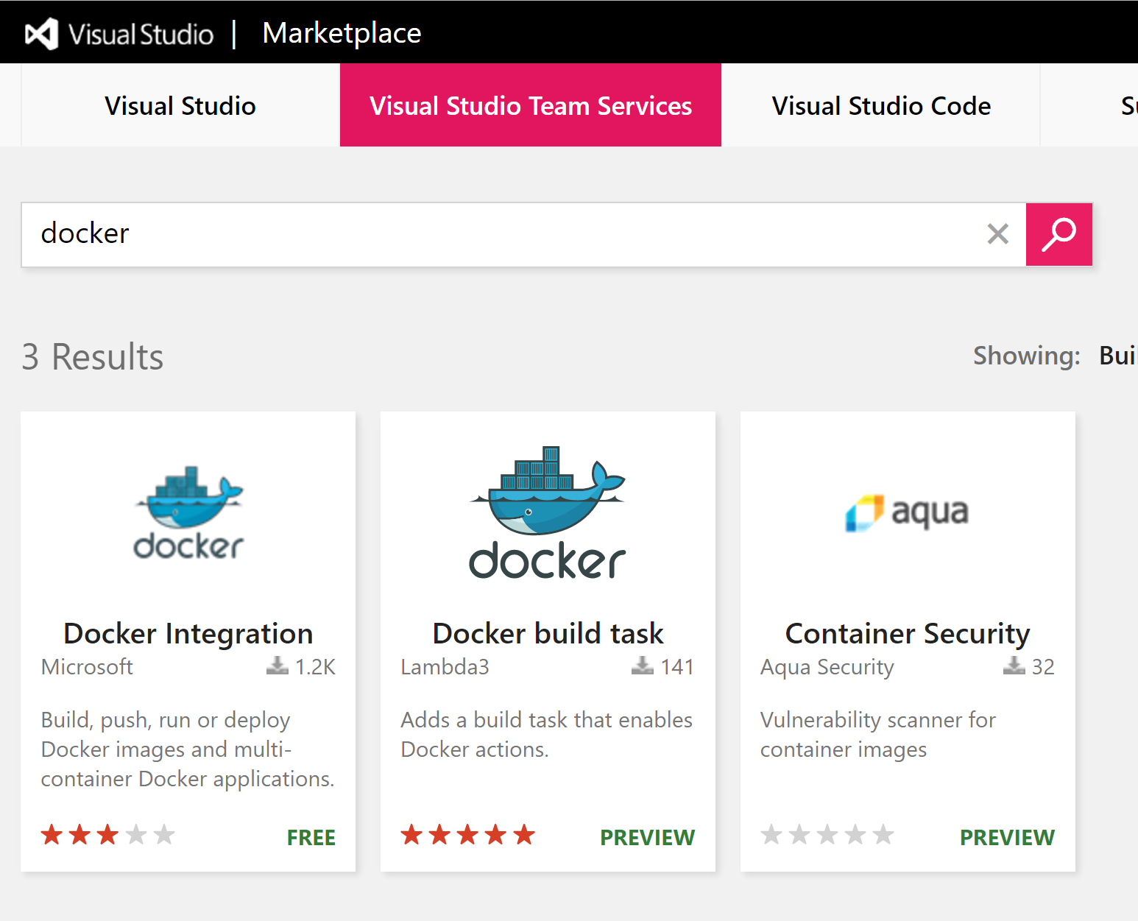
TFS/VSTS
Docker extensions for TFS/VSTS

Slide 40
Summary

Slide 41
Summary
Microsoft  Linux and containers
Linux on Windows Windows on Windows All kinds of containers on Azure
For dev/test and prod
Containers on Windows 10 for devs
Windows Server 2016 for on-premises Windows prod
Azure for Windows/Linux prod

Slide 42
Q&A
Workshop
Rainer Stropek
software architects gmbh
Web
Mail
Twitter
http://www.timecockpit.com
rainer@timecockpit.com
@rstropek
Thank you for attending!

