Slide 1
Structured Outputs with OpenAI
Technology, Practice, and Benefits
Melanie Bauer software architects gmbh
Notes:
Welcome everyone. Today we'll explore OpenAI's Structured Outputs — what they are, why they matter, and how to use them effectively in production systems.

Slide 2
Demo: Customer UX Improvement
▶ LIVE DEMO
Real-world example of how Structured Outputs transformed a customer-facing application
Before: unstructured chatbot responses with inconsistent UI rendering
After: structured response → UI components can be filled with structured data
Notes:
DEMO: Real customer case study showing how switching from unstructured to structured responses improved their chatbot UX. Before: plain text blobs. After: rich UI components with cards, tables, and charts.

Slide 3
Agenda
What is Structured Output?
Motivation: Why Structured Output?
Usages Overview
Context-Free Grammar (CFG)
Demos: Contract Extraction, Function Calling, Lark CFG, Real-World UX
Summary & Takeaways
Q&A
Notes:
Here's our roadmap for the next 60 minutes. We'll start with the concepts, explore the underlying technology, then jump into four live demos showing real-world applications.

Slide 4
What is Structured Output?
Definition
LLM responses constrained to a predefined JSON Schema
Guarantees type-safe, parseable output every time
Eliminates post-processing, regex, and retry logic
In this talk we focus on OpenAI
other providers offer similar functionality (e.g. Anthropic)
If you need XPlat, consider …
… libs like AI-SDK
… proxies like LiteLLM
Notes:
Structured Outputs constrain the LLM's response to match a predefined JSON Schema. Every response is guaranteed to be valid, parseable, and type-safe. No more regex parsing or retry loops.

Slide 5
Motivation: Why Structured Output?
The Problem
Free-text LLM responses are unpredictable and break downstream systems
Regex/string parsing is fragile, error-prone, and costly to maintain
Retry loops waste tokens, increase latency, and add complexity
The Solution
Structured Outputs = 100% schema-compliant responses
Production-ready from day one → no glue code required
Notes:
The core problem: free-text LLM responses are inherently unpredictable. This causes crashes, parsing errors, and fragile glue code. Structured Outputs solve this at the model level.

Slide 6
Overview of usages
Data extraction and parsing
e.g. from documents (like PDF, JPEG, Word, PPT) for RAG
Create semi-structured reports
e.g. summaries, incident reports, etc.
Form filling
e.g. pre-fill form in UI from user-request
Content classification
e.g. for content moderation, structured customer feedback
Function calling arguments
LLM provides function arguments
Train of thought
Show reasoning process step-by-step
Notes:
Full toolkit overview: JSON Mode for basic validity, Structured Outputs for full schema enforcement, Function Calling with validation, and Pydantic integration for Python developers. Available in Python, Node.js, and REST.

Slide 7
Demo: Contract Data Extraction (PDF)
▶ LIVE DEMO
Extract structured fields from unstructured PDF contracts using Structured Outputs
Upload a PDF contract → extract parties, dates, clauses, obligations
JS/TS: Zod model defines the extraction schema
Output: validated, type-safe JSON ready for database storage
Notes:
DEMO: Upload a real PDF contract and extract structured data including parties, dates, clauses, and obligations using a Pydantic model that defines the extraction schema. Show the before and after.

Slide 8
Context-Free Grammar (CFG)
JSON Schema is converted to a Context-Free Grammar
CFG constrains token sampling at inference time
Only valid grammar transitions are allowed for next token
Supported Grammar Syntax for DSL
Lark
Regex
Notes:
Under the hood, OpenAI converts your JSON Schema into a Context-Free Grammar. During token generation, the model can only sample tokens valid according to the grammar. Tools like Lark let you define custom grammars beyond JSON.

Slide 9
Demo: Lark CFG Setup & Code Example
▶ LIVE DEMO
Define custom grammars beyond JSON Schema for domain-specific output formats
Lark grammar definition for custom output formats (SQL, DSLs)
Integration with OpenAI API for grammar-constrained generation
Notes:
DEMO: Define a custom Lark grammar to constrain outputs beyond JSON. Think SQL queries, custom DSLs, or domain-specific formats. Show the grammar definition and API integration.

Slide 10
Demo: Function Calling & Structured Outputs
▶ LIVE DEMO
Type-safe tool arguments with automatic schema validation in code
Define function arguments with JSON Schema parameters
Model generates validated function arguments - no parsing needed
Notes:
DEMO: Define tools with strict JSON Schema parameters and show how the model generates validated function arguments. No JSON.parse needed, no try-catch blocks. Show the Python SDK code.

Slide 11
Summary & Takeaways
Key Takeaways
Reliability → 100% schema-compliant outputs, every time
Simplicity → Eliminates parsing, retries, and validation boilerplate
Versatility → JSON Schema, Function Calling, and custom CFG grammars
Production-Ready → Native SDK support in Python and Node.js
Impact → Better UX, lower costs, faster time-to-market
Notes:
Five key takeaways: 1) Reliability with 100% compliance, 2) Simplicity by removing boilerplate, 3) Versatility across formats, 4) Production-readiness with SDK support, 5) Real business impact on UX and costs.

Slide 12

Questions & Answers
Let's discuss your use cases and challenges!
Notes:
Open the floor for questions. Be ready to discuss specific use cases, implementation challenges, performance considerations, and architectural decisions around Structured Outputs.

Slide 13
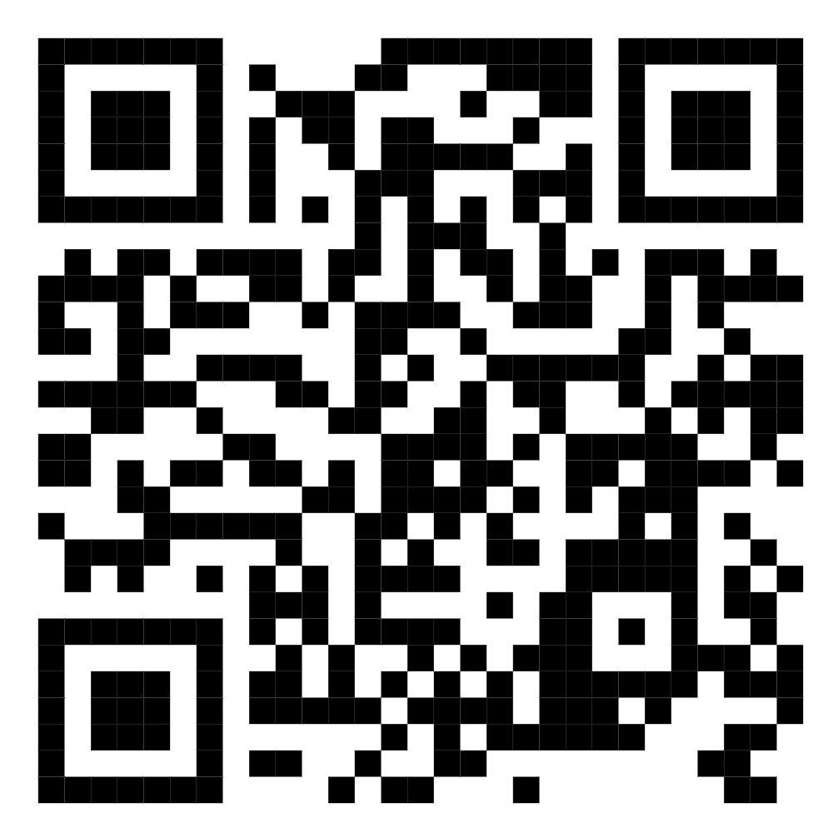
Thank You!
Structured Outputs - Build with Confidence
Notes:
Thank you for attending! Start experimenting with Structured Outputs today. The setup is minimal and the benefits are immediate. Share your contact info and offer to follow up on specific questions.

