Slide 1
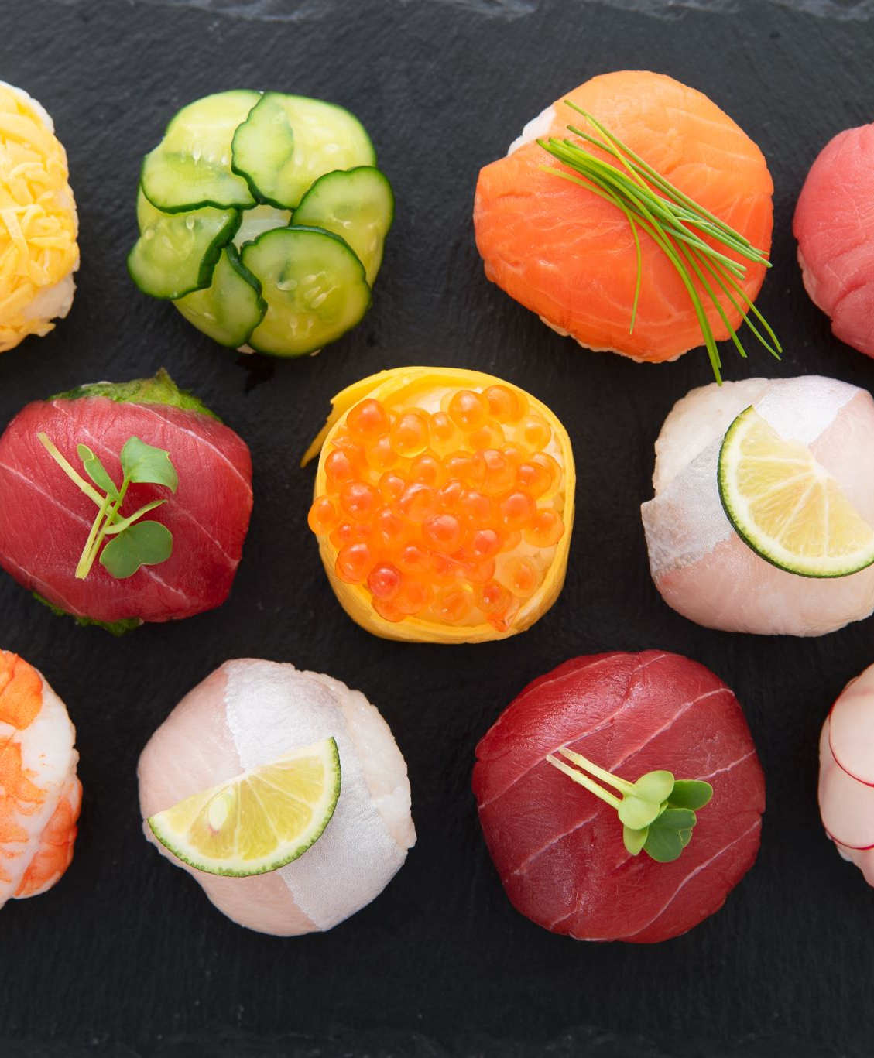
Sushi Restaurants
Jack Bressett, Rachel Studer, Ran Zhao

Slide 2
N-Gram + LDA Results
Most Representative Good Quotes Example -
Goleta Sushi House in Goleta, CA
General findings
To reply to the two people that left the "blegh" and "mediocre" reviews - Clearly, "Miss Blegh" you have no idea what true hospitality is, in any culture... thus perhaps you should stick to what you know best, and apparently expect, in your "dining experience" - the drive-thru at McD's. We fellow Yelpers........
BEST sushi in town!! I've been a regular at Goleta Sushi House for the past 6 years and my consistent conclusions are 1. Delicious, fantastic food 2. Absolutely delightful staff and 3. Great, fun times with friends. I see the negative comments on this page, and I seriously wonder if they're even referring to the same place: Goleta Sushi House on Hollister.........
Freshness + Service especially relevant
All-you-can-eat sushi is polarizing, must be done with care (price, quality)
Spicy-Tuna-Roll is most popular roll in both negative and positive reviews – freshness/spice important
Customers love additional menu items like green tea ice-cream and Miso soup

Slide 3
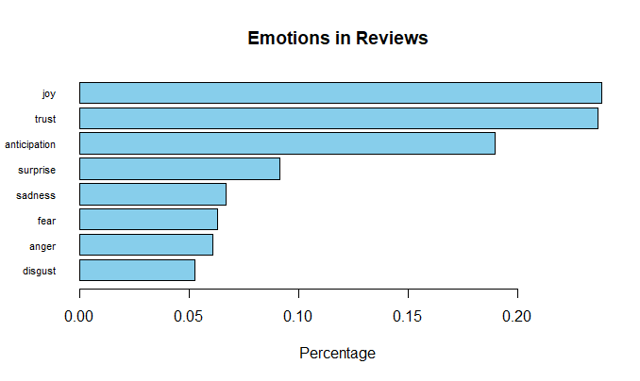
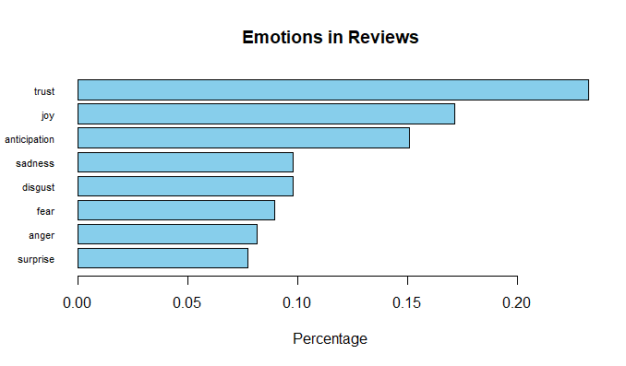
Sentiment & Emotion Analysis
Using National Research Council's emotion dictionary, we measure the following emotions in reviews:
Anger, Anticipation Disgust, Fear, Joy, Sadness, Surprise, Trust
Calculated sentiment score for each individual sushi restaurant
Emotions of all the sushi reviews
Emotions of a particular business

Slide 4
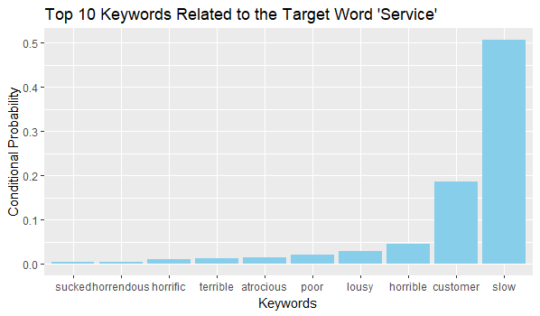
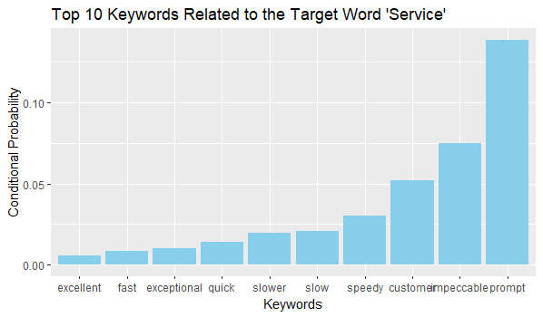
Word2Vec Results

Slide 5
Business Recommendations
Freshness
Key for inland states
Eliminate slow service times
Patrons note slowdowns more than promptness
Serve highly rated rolls
Rainbow Roll
Allocate time & money to non-fish ingredients
Spider & California rolls
Provide options
All-you-can eat sushi
Sides like miso soup & salad, green tea ice-cream

Slide 6
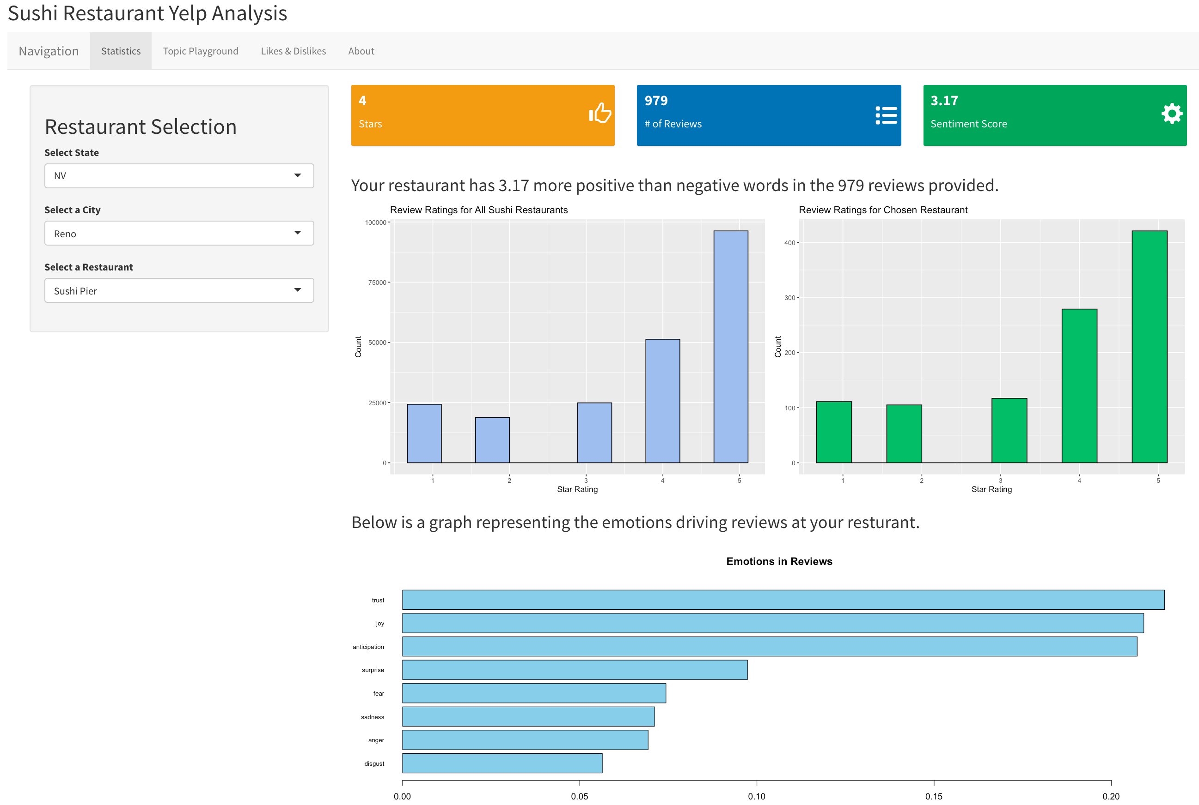
Statistics

Slide 7
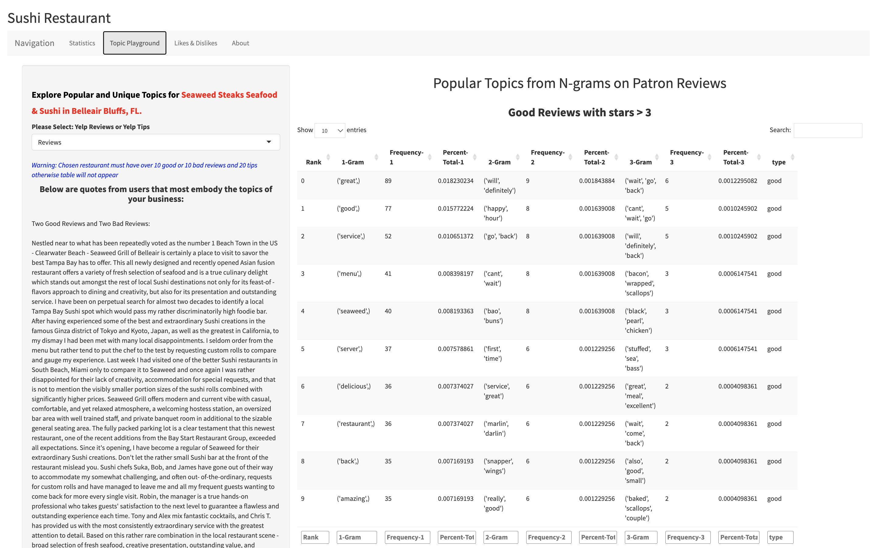
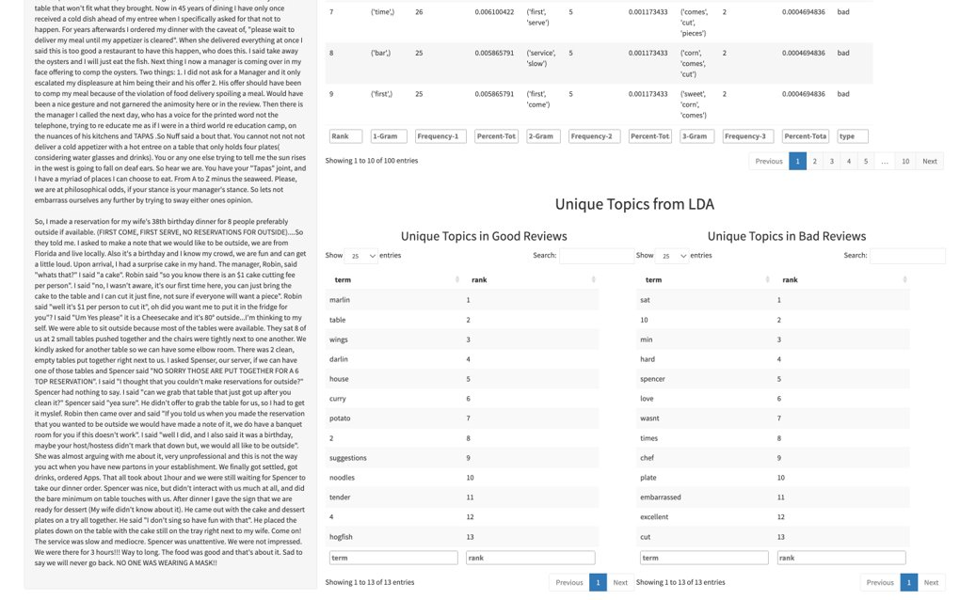
Topics Playground – Reviews/Tips

Slide 8
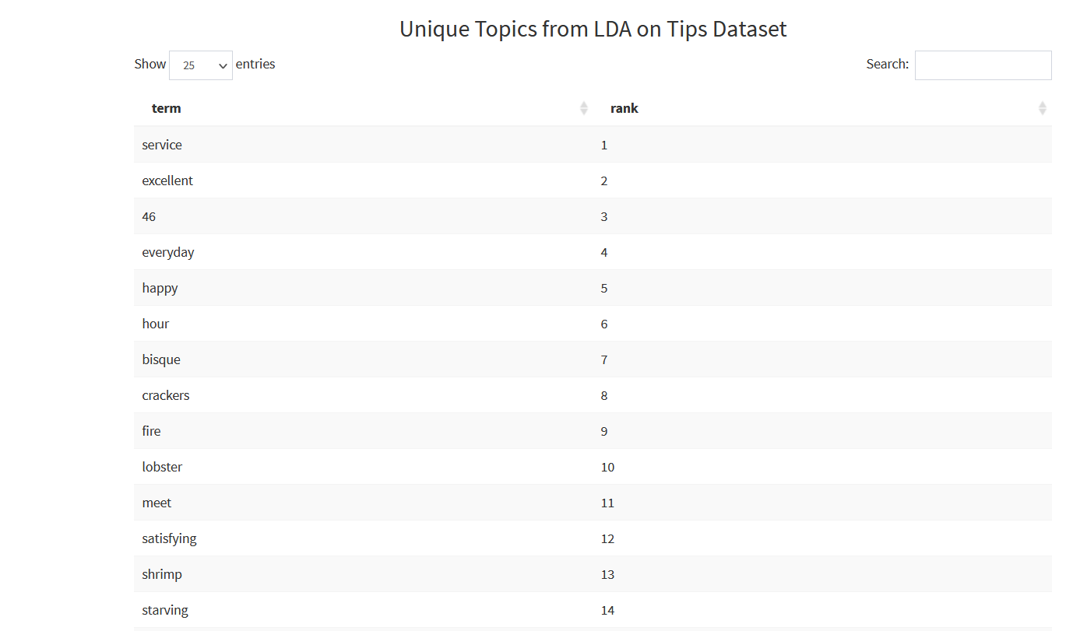
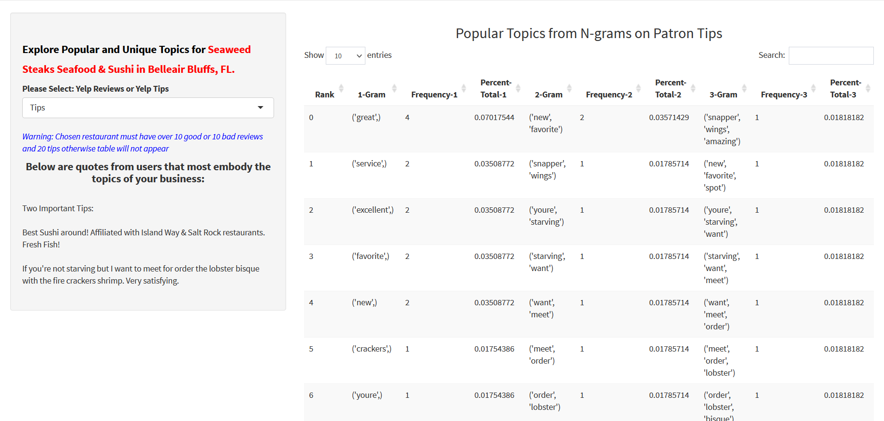
Topics Playground – Reviews/Tips

Slide 9
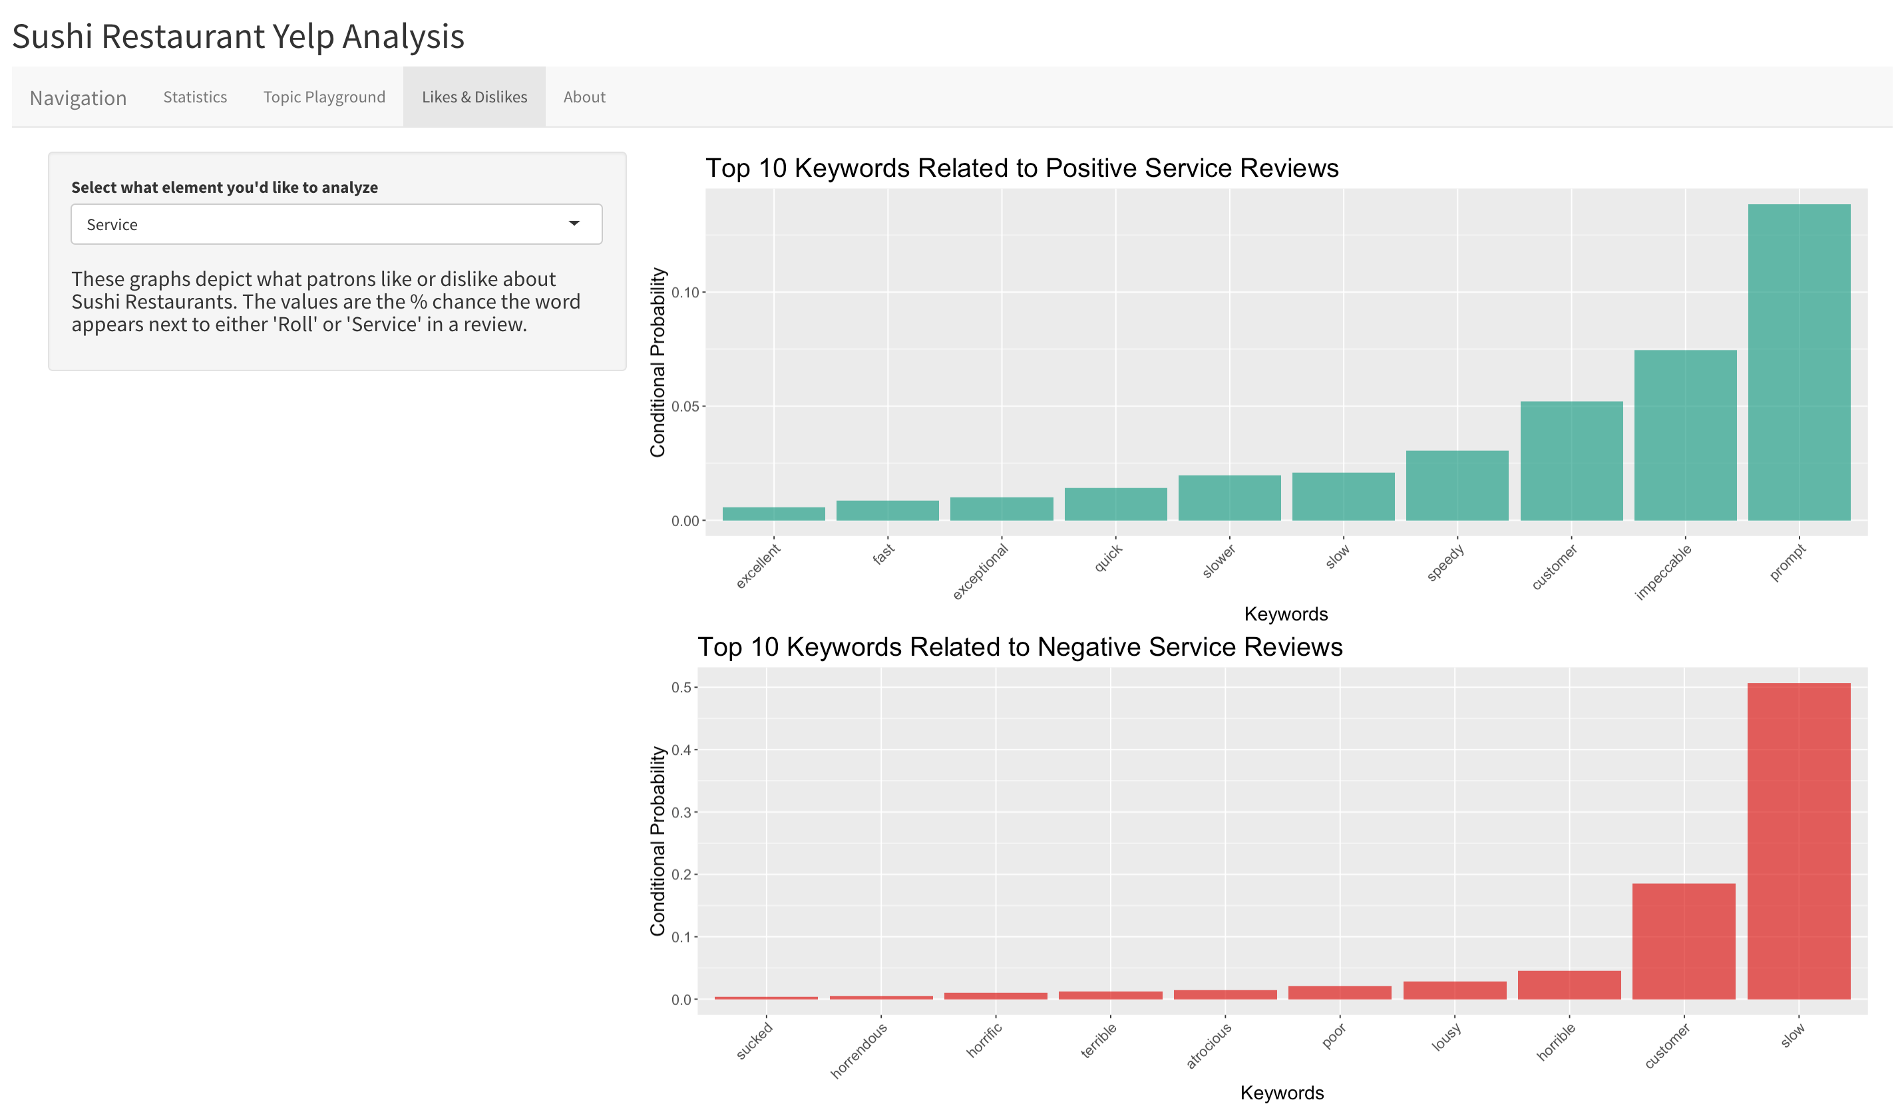
Likes & Dislikes

Slide 10
Thank you

