Slide 1
Yelp Reviews -Preliminary Analysis
Jack Bressett, Rachel Studer, Ran Zhao

Slide 2
Sushi Restaurants – Business & Reviews JSON
Main Questions
Sub Questions
What does it take to gain a 5-star rating?
How do you avoid an unsatisfactory rating?
What roles do region and proximity to the coast play?
What topics get brought up within each star reviews?
What elements of service quality to improve for higher stars?
Which type of food (sushi roll) should restaurants serve?

Slide 3
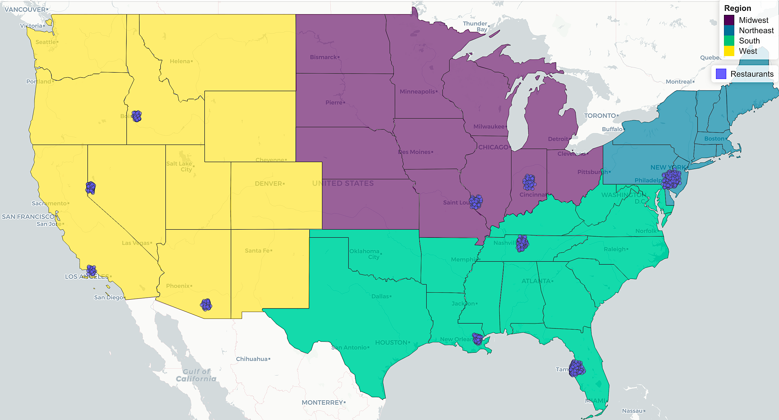
Business Data Processing
Total Sushi Restaurants: 1616
Select categories "Restaurant" & "Sushi Bar"
Only Main focus of Sushi
Eliminated: Music Venues, Buffets, Event Planning, Caterers, Dance Clubs
Create region variables
Inland, Coastal
Northeast, South, West, Midwest
Inland | Coastal
583 | 1033
Northeast | South | West | Midwest
540 | 624 | 241 | 211

Slide 4
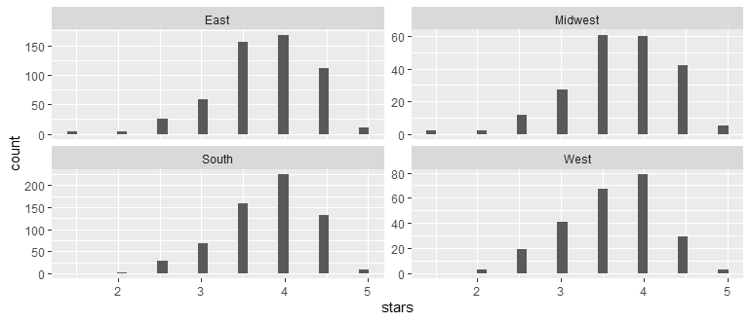
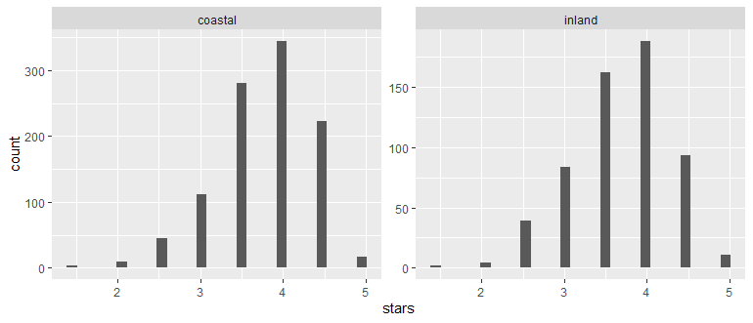
Business Data Questions – Regional/Coastal
Do Ratings Distributions change by region?
Do Ratings Distributions Change by coastal/inland
Regions appear fairly similar in rating distribution
Midwest has fewest ratings and appears flattest at peak
Midwest is the only region with more 3.5 than 4 star ratings
Distributions of ratings are much more similar
Larger drop between 4 and 4.5 stars for inland sushi restaurants
All graphs closely match the overall star distributions.

Slide 5
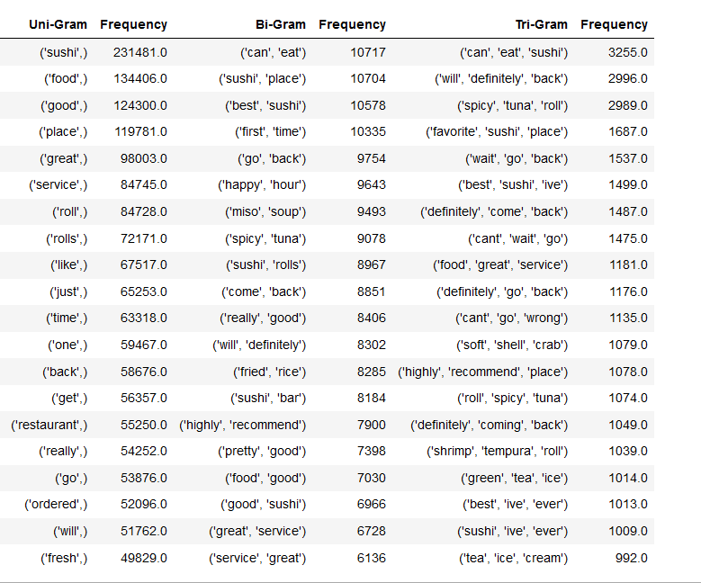
Initial Text Results: Generating N-grams
20 Top N-grams from All Sushi Restaurant Reviews
Clean reviews via textstem and tm R packages:
-Removing punctuation and non-letters
-Removing stop words
-Making lowercase
-Lemmatize text
Note: default stop words list used at this time

Slide 6
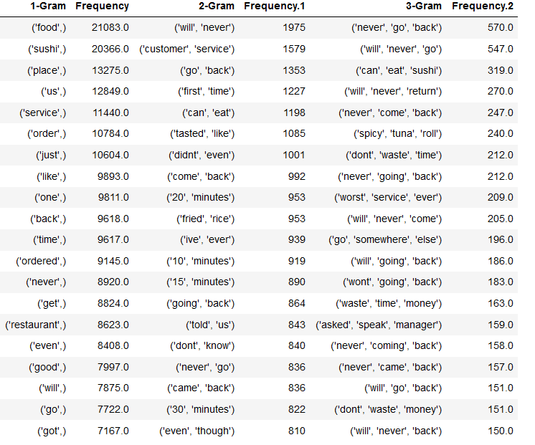
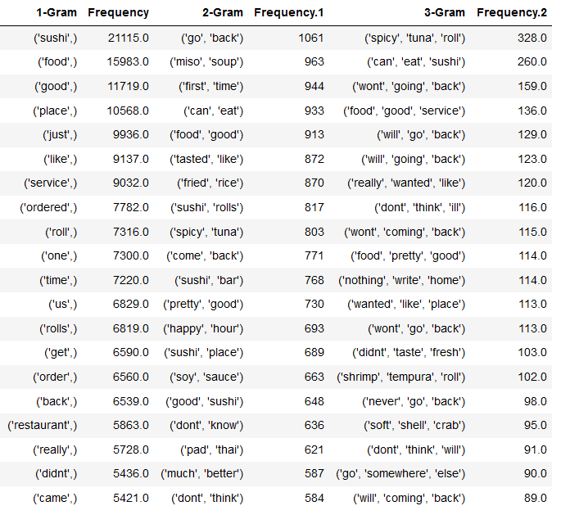
Top N-Grams by Review Star: Bad Reviews
1-Star Reviews
2-Star Reviews

Slide 7
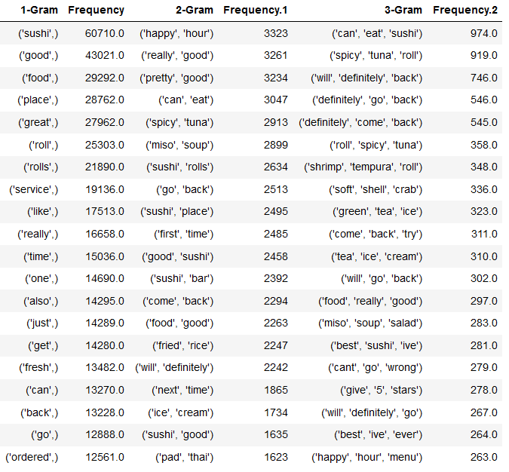
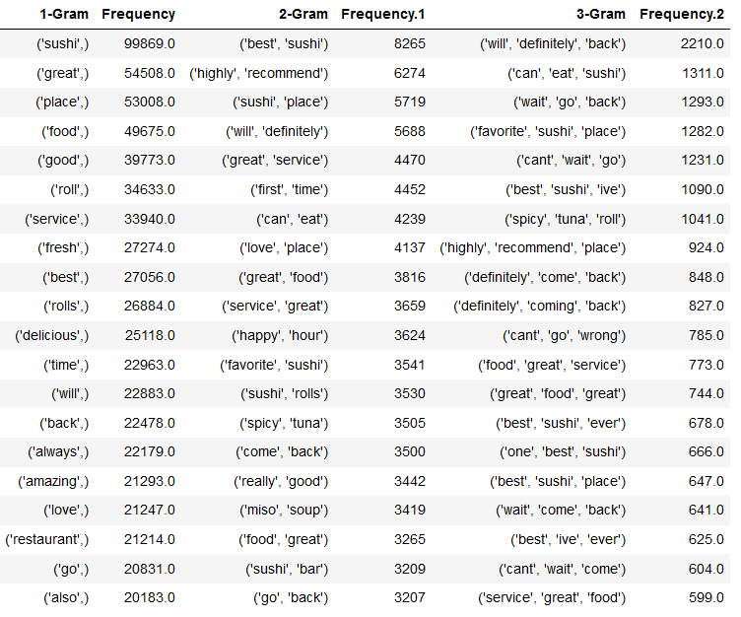
Top N-Grams by Review Star: Good Reviews
4-Star Reviews
5-Star Reviews

Slide 8
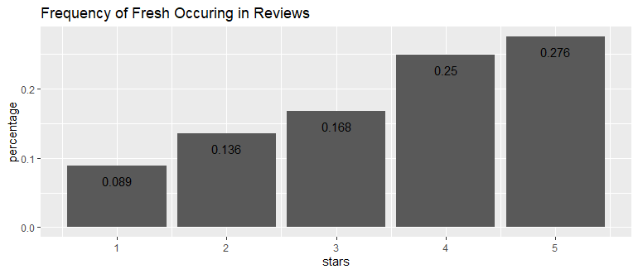
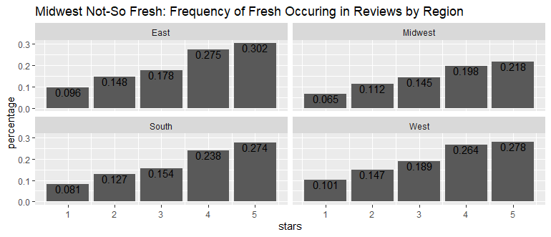
Freshness is Very Important and Generally Indicates a Good Review Rating
Over half of "good" reviews include the word fresh

Slide 9
Reviews Data Questions – Service/Rolls
Word2Vec for "service"
Keywords | scores
prompt | 0.13845329
impeccable | 0.07470306
speedy | 0.030404378
slow | 0.020772817
quick | 0.014292846
exceptional | 0.010011709
fast | 0.008757688
Keywords | scores
slow | 0.50651544
horrible | 0.044976983
lousy | 0.028771037
poor | 0.02106411
atrocious | 0.013965093
terrible | 0.012632573
horrific | 0.010301732
Word2Vec within positive reviews (4 or 5 stars)
Word2Vec within negative reviews (1 or 2 stars)

Slide 10
Word2Vec for "roll"
Do the same for another target word "roll" because it's a frequently occurring word in the reviews. These surrounding words can give the business owners some inspiration on what kind of rolls they should serve or what rolls are underperforming.
Keywords | Scores
rainbow | 0.09822248
dragon | 0.082700655
volcano | 0.06505596
spider | 0.05476412
godzilla | 0.03794156
tiger | 0.023949167
dynamite | 0.019389512
Keywords | Scores
spider | 0.30841097
california | 0.28429496
dragon | 0.16142091
rainbow | 0.06348156
godzilla | 0.030406343
caterpillar | 0.017445315
cali | 0.015267036
Word2Vec within positive reviews (4 or 5 stars)
Word2Vec within negative reviews (1 or 2 stars)

