Slide 1
Widget Forecast PowerPoint
Data Scientist Dave

Slide 2
Overview
Historical widget data through June 30, 2018
Holt Winters model
Forecast through March 31, 2019

Slide 3
Sales Table
Date | Sales
2017-10-31 | 56,439
2017-11-30 | 54,121
2017-12-31 | 55,550
2018-01-31 | 56,330
2018-02-28 | 54,183
2018-03-31 | 59,138
2018-04-30 | 58,810
2018-05-31 | 62,098
2018-06-29 | 60,214
Historical Widget Sales 2018 (All Products)

Slide 4
Forecast Table
Month | Forecast Sales
Jul 2018 | 62,023
Aug 2018 | 59,034
Sep 2018 | 56,663
Oct 2018 | 60,212
Nov 2018 | 60,148
Dec 2018 | 57,814
Jan 2019 | 59,878
Feb 2019 | 58,006
Mar 2019 | 66,339
Widget Sales Forecast Through Q1 2019 (All Products)

Slide 5
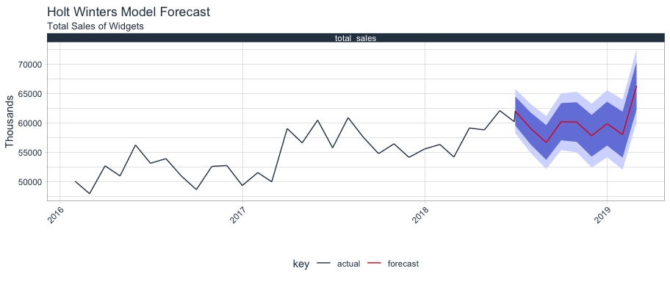
Forecast Graph

