Slide 1


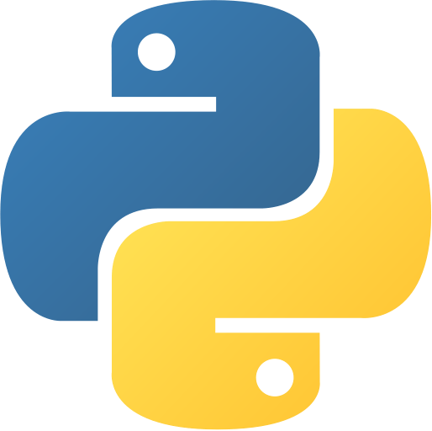


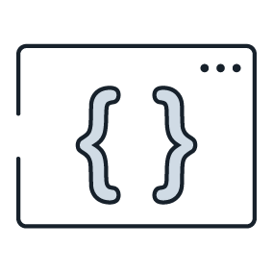



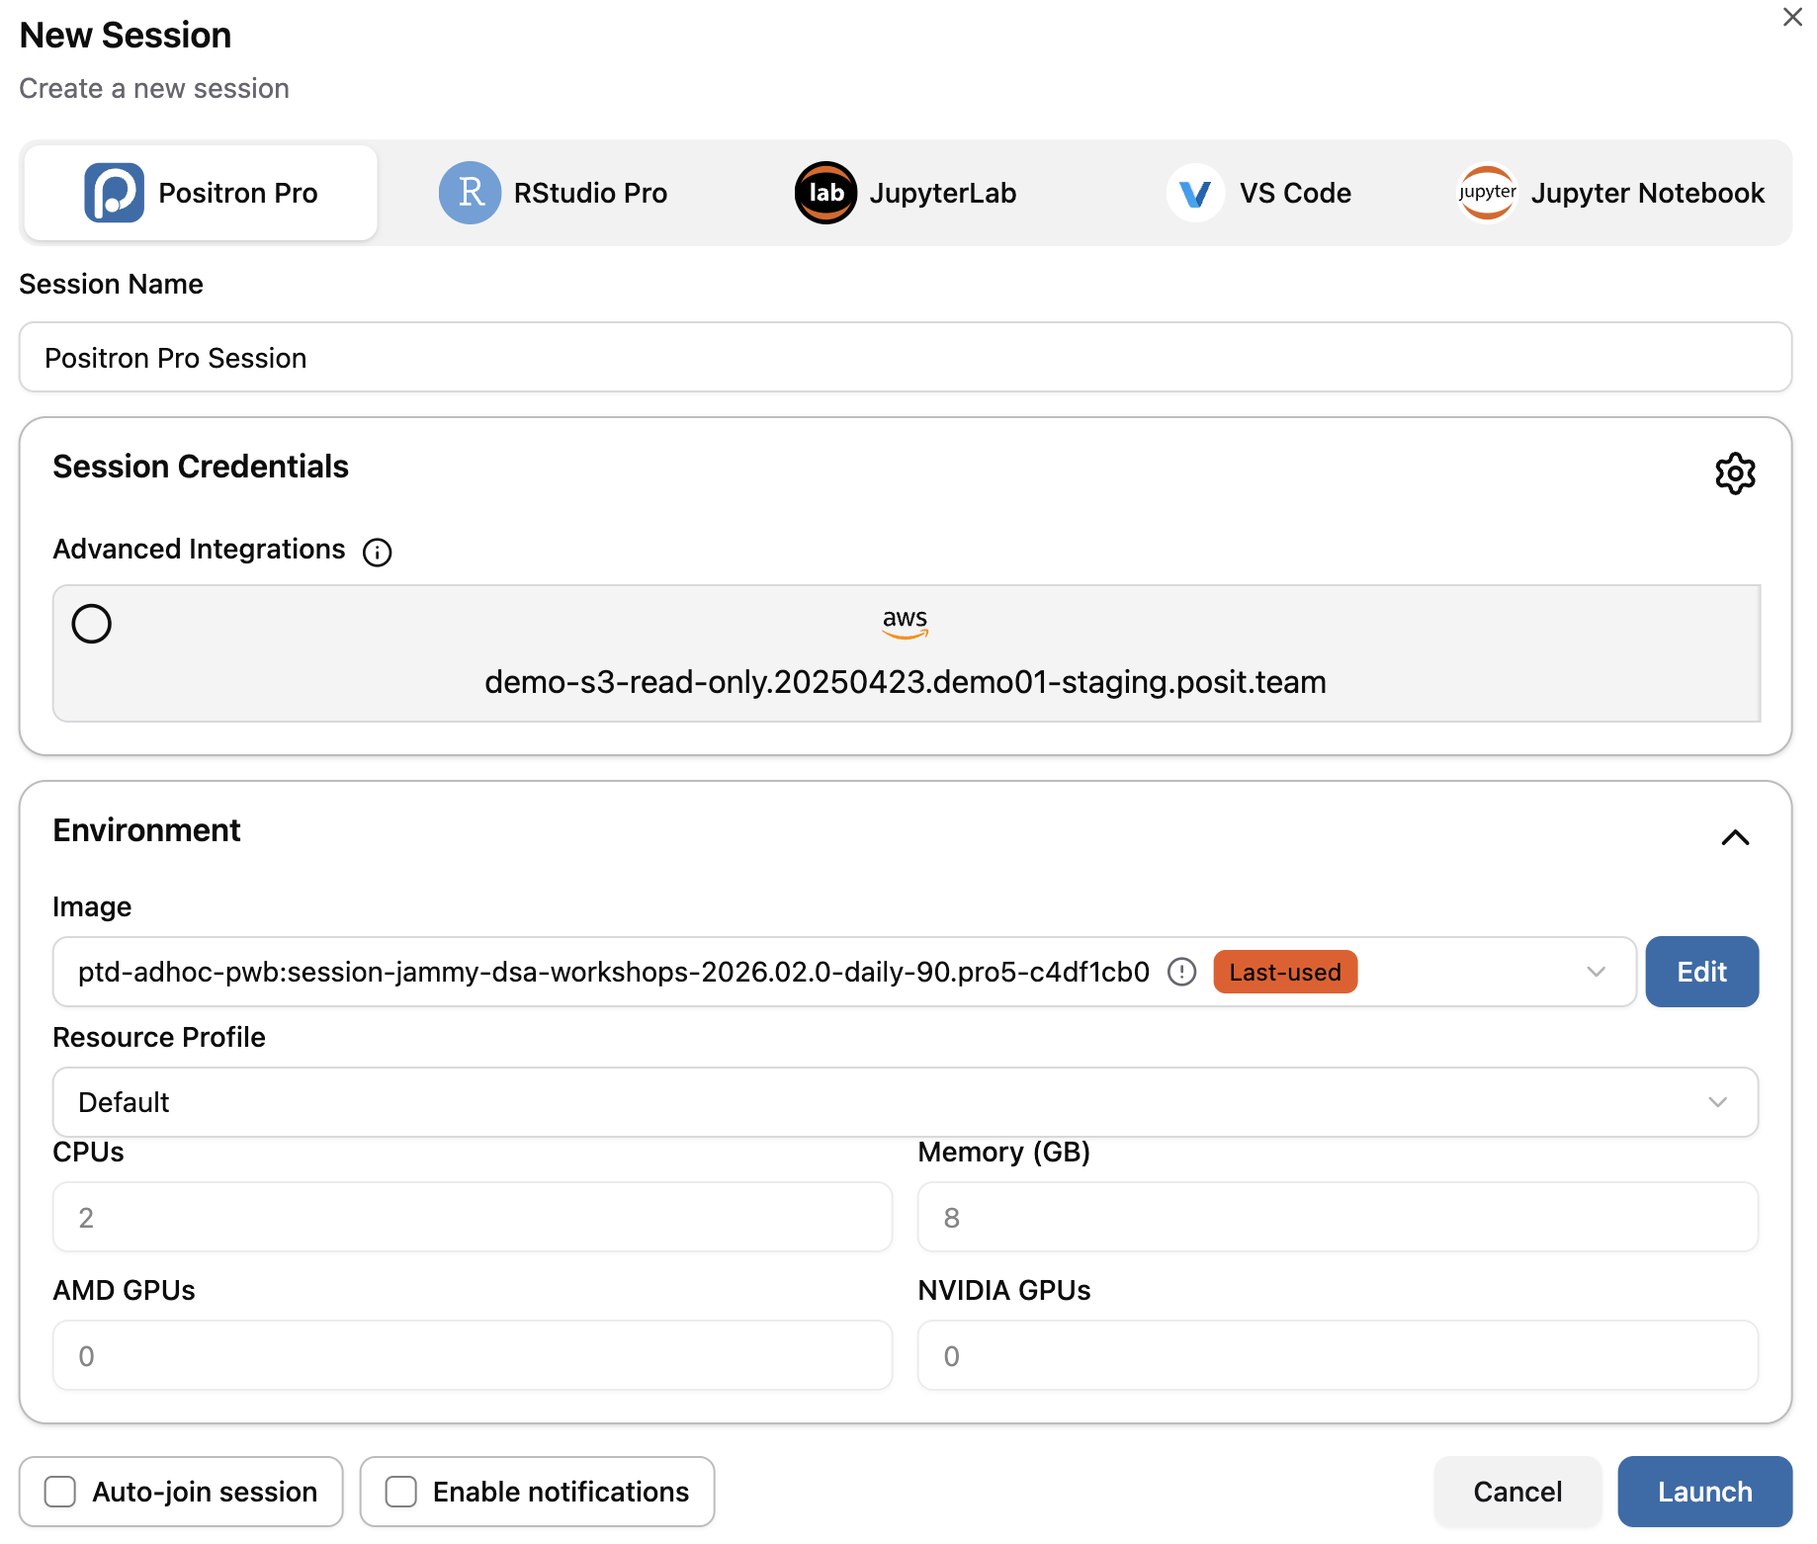
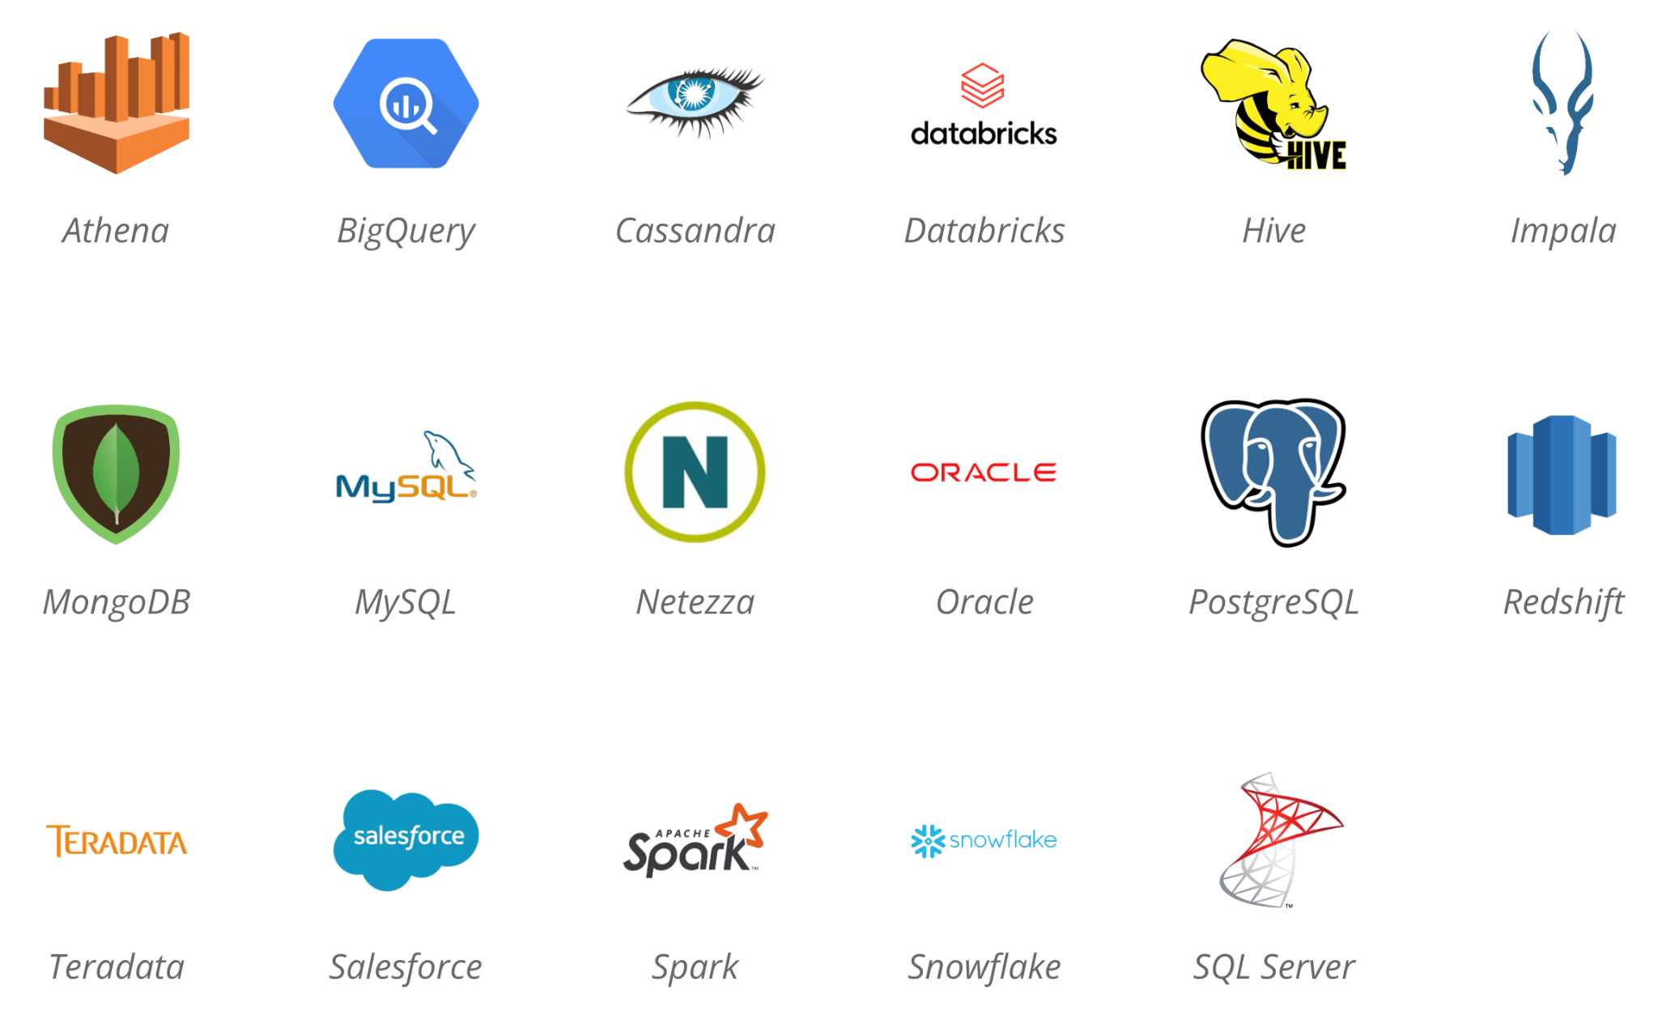
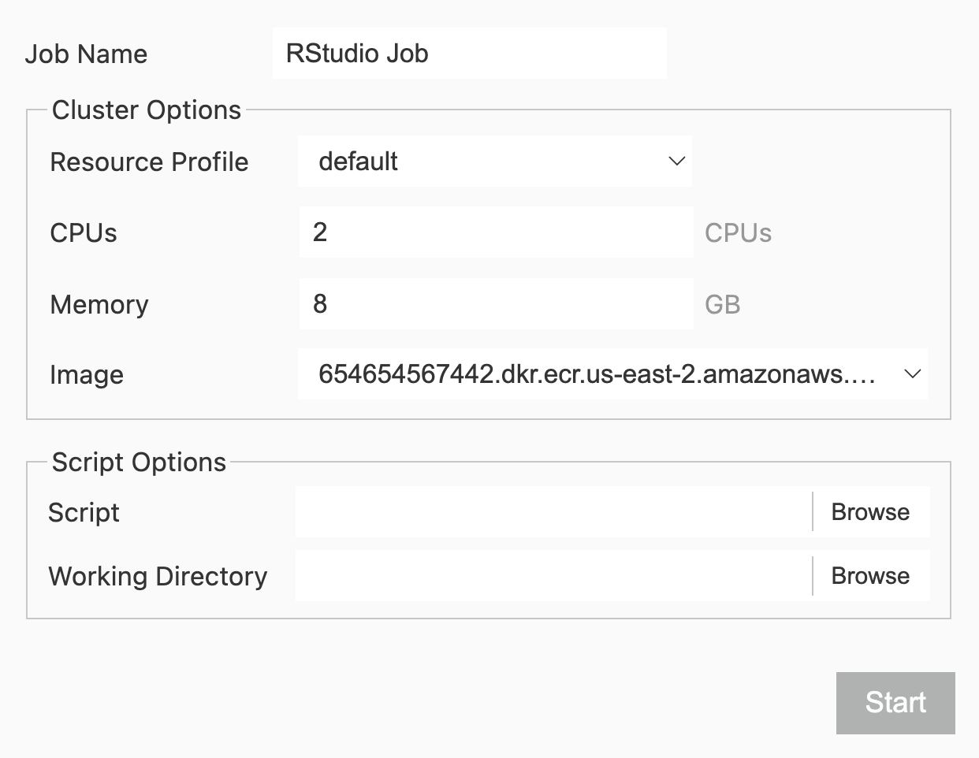


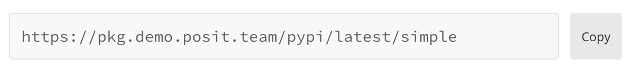

A cheat sheet for open-source developers creating and sharing data insights using Posit Team
Overview
3
Access Your Data
Posit Team bundles Posit’s premier data science tools, including:
Access your data within Posit Team no matter where it lives and what format it’s in:
DB-API
Python Database API
Development environment for creating insights
Local or Shared Directory
Examples: data.csv, data.txt, data.parquet
Example
con = sqlite3.connect('example.db')
Hosting environment for accessing and sharing insights
APIs
Interact with APIs using packages such as {requests} in Python or {httr2} and {jsonlite} in R
DBI
Database Interface
Example
con <- DBI::dbConnect(
RPostgres::Postgres(),
hostname = ”db.company.com",
port = 5432)
R and Python package repository management
Pins
Store and retrieve Python/R objects including data and models
1
Open New Session in Posit Workbench
Open a new development session by clicking + New Session
Databases
Connect to a variety of database types using DBI/DB-API/ODBC
ODBC
Open Database Connectivity
Available IDEs
Examples
Posit’s Professional ODBC Drivers
con = pyodbc.connect(
driver = 'PostgreSQL',
database = 'test_db',
server = 'localhost',
port = 5432,
uid = os.getenv('DB_USER'),
pwd = os.getenv('DB_PASSWORD'))
Cluster Options
May vary depending how Posit Workbench is configured in your environment
con <- DBI::dbConnect(odbc::odbc(),
driver = "PostgreSQL Driver",
database = "test_db",
UID = Sys.getenv("DB_USER"),
PWD = Sys.getenv("DB_PASSWORD"),
host = "localhost",
port = 5432)
2
Configure Package Repositories
Tip: Never hard code credentials! Use environment variables or talk to your administrator about setting up a DSN
Check Current Repositories
Configure Repositories with Posit Package Manager
options("repos")
options(repos = c(CRAN = "https://your-package-manager-url.com"))
4
Run your Code
pip config list
pip config set global.index-url https://your-package-manager-url.com
Support for multiple Python and R versions
Example Posit Package Manager Repository URL
VENV
Leverage virtual environments and project-oriented workflows
Obtain your repository URL by clicking
on Posit Package Manager
Tip: Talk to your administrator about configuring your repositories to ensure they persist across sessions
RStudio and Positron: Submit long-running Python/R jobs to Posit Workbench server to run in independent sessions
CC BY SA Posit Software, PBC · info@posit.co · Learn more at posit.co/products/enterprise/team · HTML cheatsheets at pos.it/cheatsheets · Updated 2026-08

Slide 2






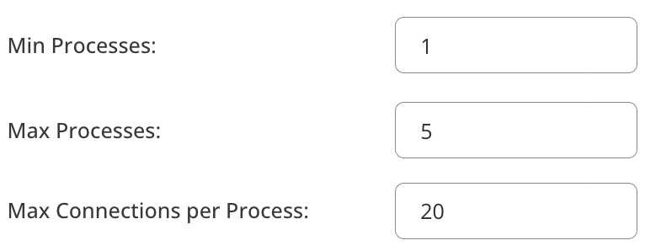
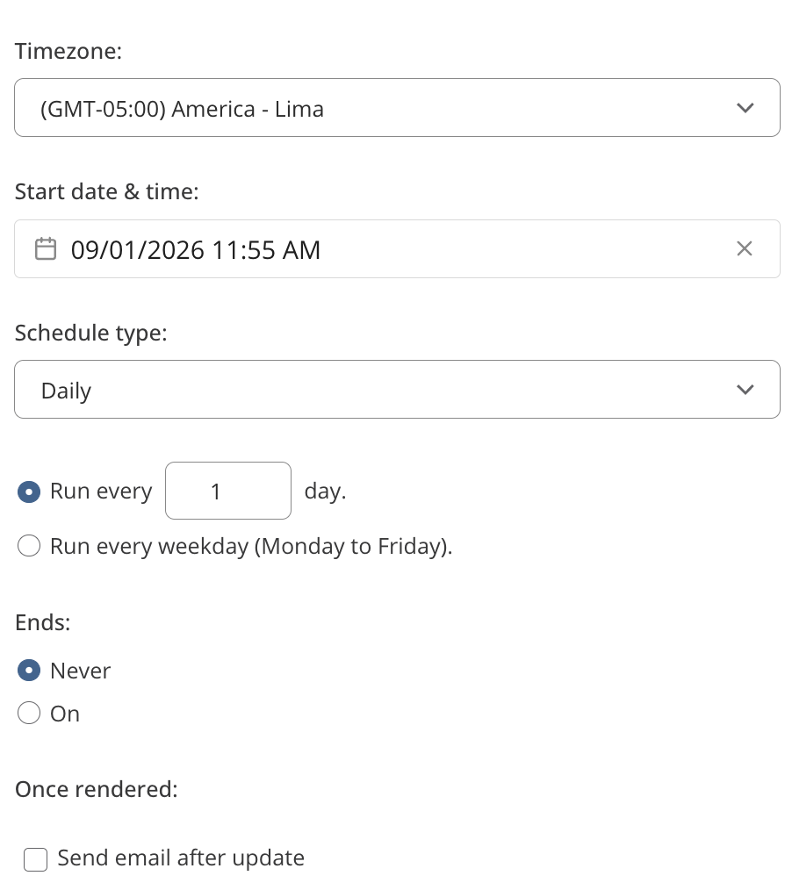



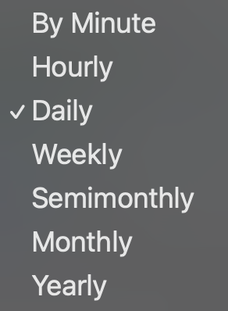

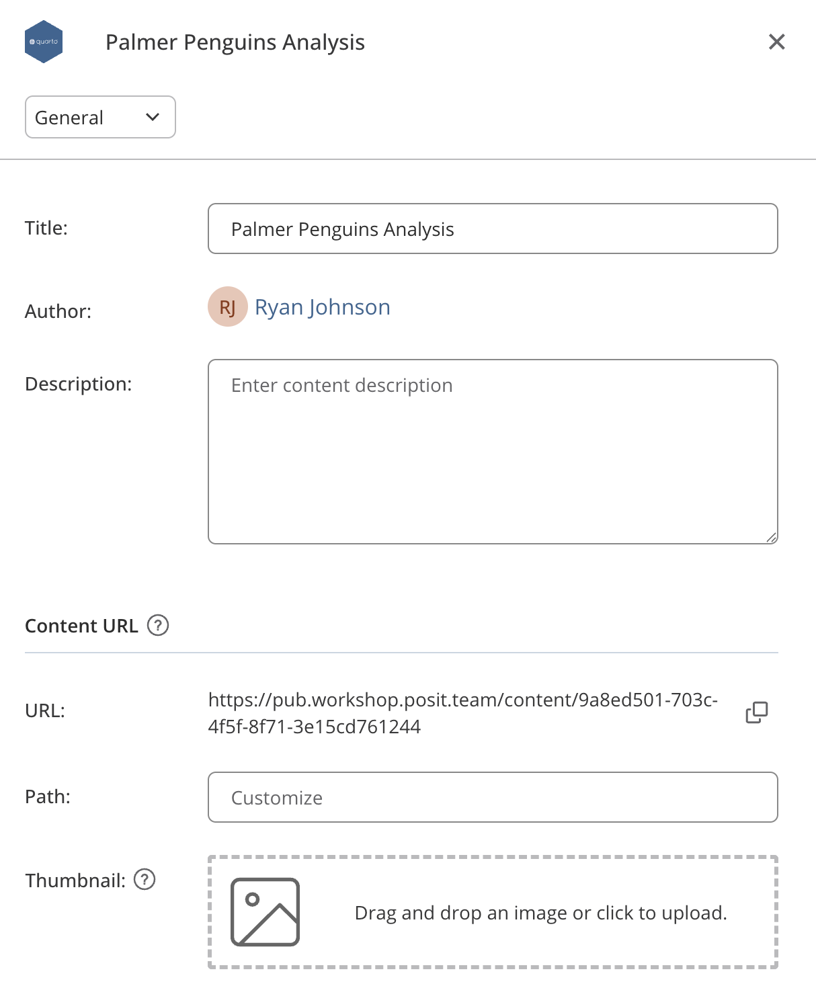






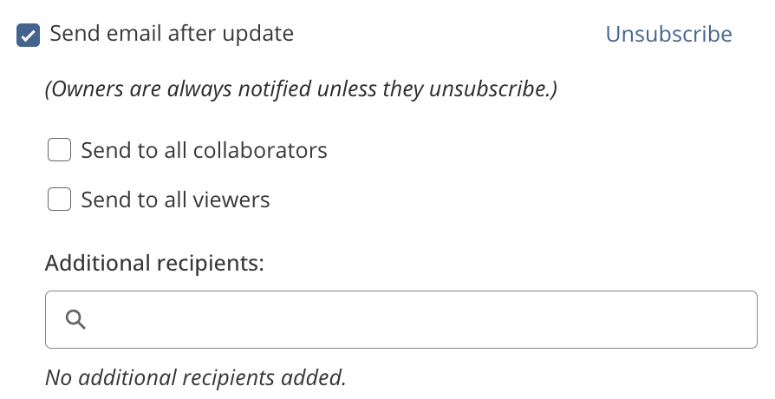
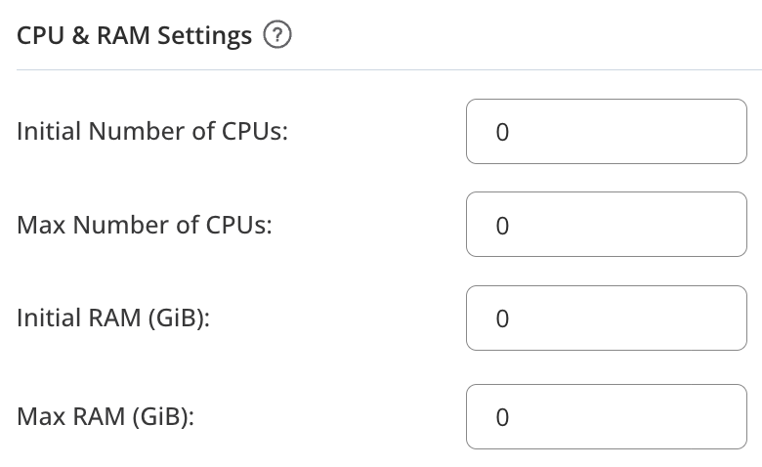
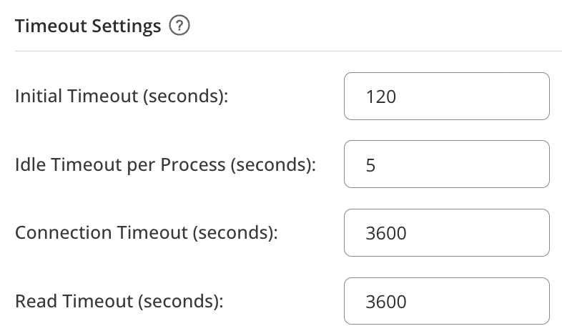
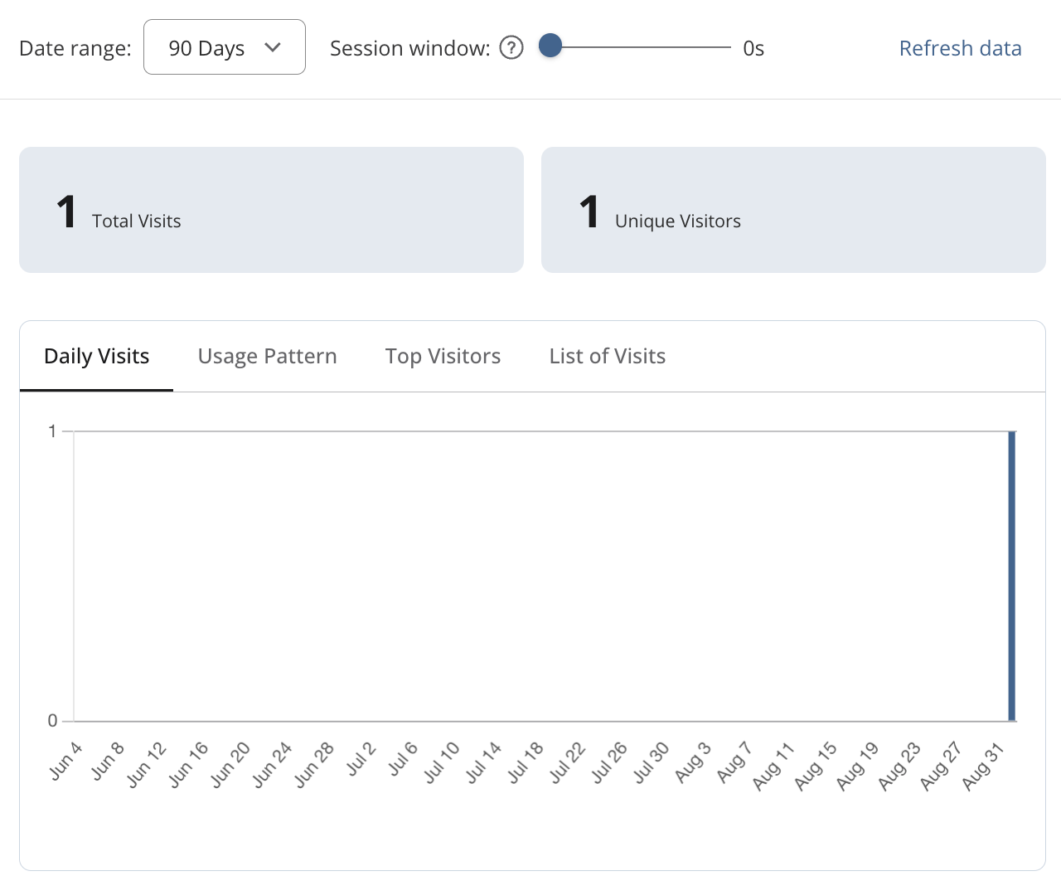
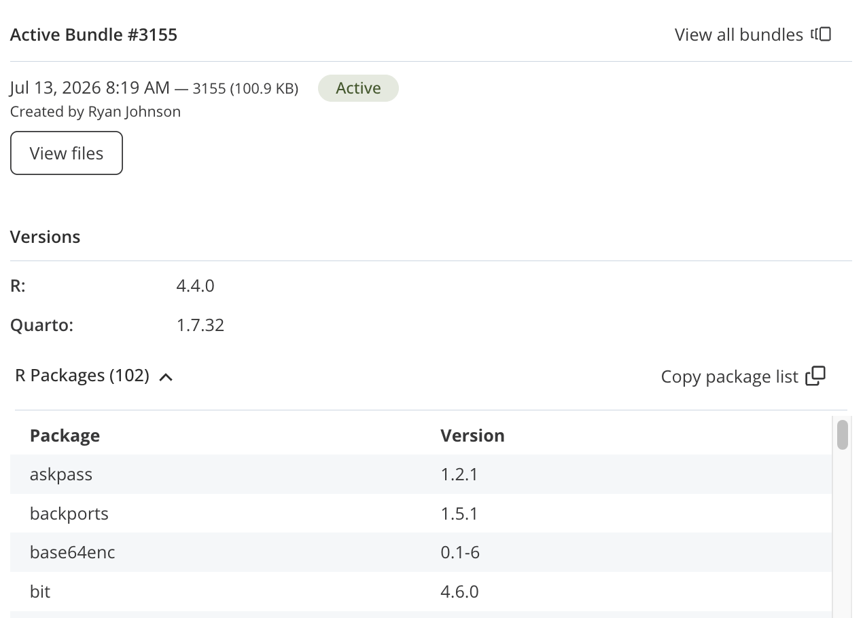
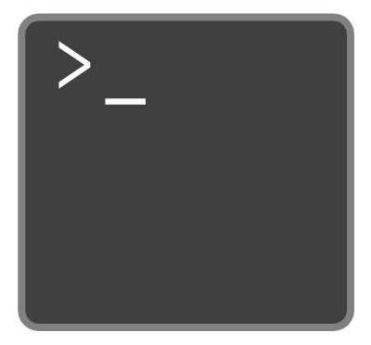
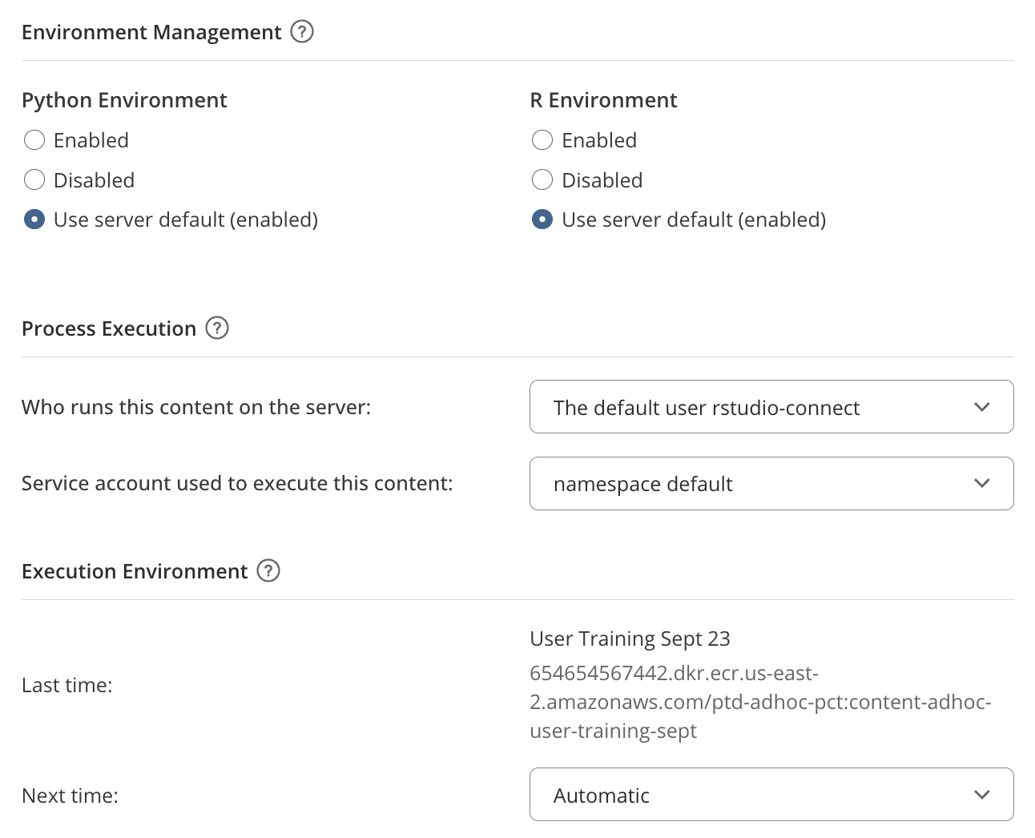



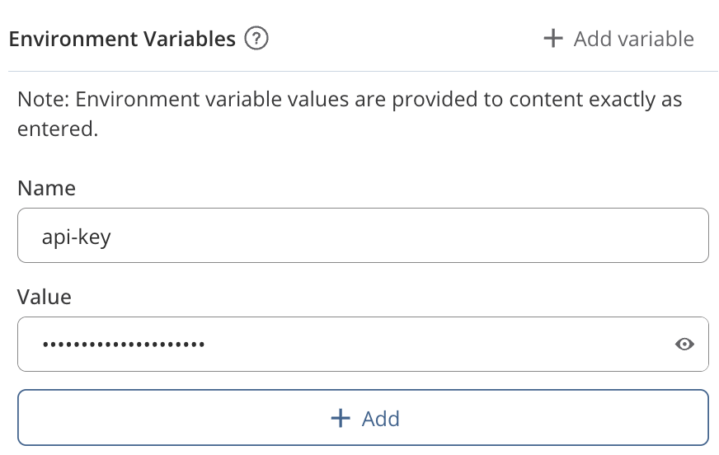

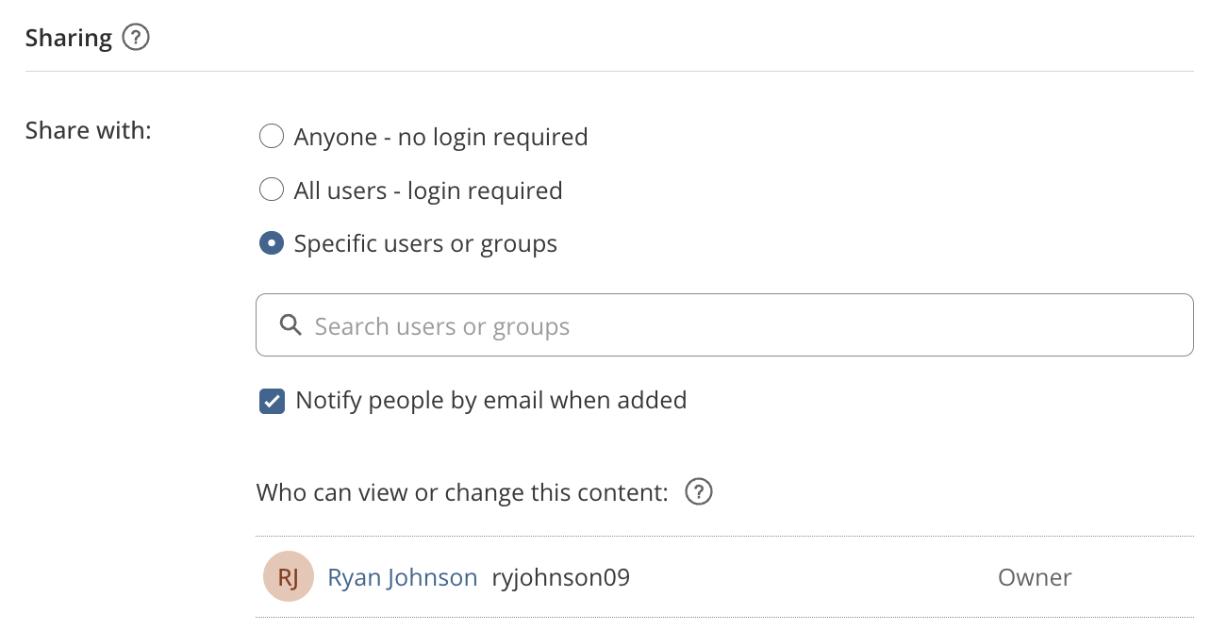




5
Publish your Content to Posit Connect
6
Share and Control your Content on Posit Connect
Supported Content Types on Posit Connect
Content controls are accessed by clicking the icon
Documents
Applications
General
Runtime Settings
Schedule
Content Title & Description
Content URL
Thumbnail
Tags
Lock/Delete Content
Tune and scale applications and APIs by modifying the number of processes (e.g., Python and R sessions) and connections per process
Documents can be configured to execute on a schedule
Schedule type options
APIs
Pins
In this above configuration, the content can accommodate up to 100 concurrent connections (20 x 5). There will also be at least one process always running, meaning the content never goes to sleep
Email configuration options
Other Runtime Settings
Tip: Learn how to send custom and conditional emails: pos.it/rmd_email & pos.it/qmd_email
Node.js
Share content by sharing the Content URL
Easily modify how your content runs by modifying any of the below settings. Note: some options may not be available depending on how Posit Connect is configured in your environment
Source
Monitor
Methods for Publishing to Posit Connect
Content Bundles
Language/Quarto Versions
Package Dependencies
Publish content directly from R using the rsconnect R package
View number of visitors to your content and logs
Publish content using the CLI within the rsconnect-python package
Environment Variables
Securely pass configuration options to your content as environment variables including API Keys and Passwords
Publish content with the click of a button using push button deployment
Access
Configure who can access your content
Publish directly from a git repository
Posit Publisher Extension
Need Help? Want to learn More?
Learn more about Posit Team through free on-demand courses and live workshops: https://academy.posit.co
Questions about sales and licensing → sales@posit.co
Technical Issues → support@posit.co
Other questions? → info@posit.co
Posit Team docs → https://docs.posit.co
Release notes → https://docs.posit.co/release-notes.html
Open forum for any open source or Posit Team question:
https://forum.posit.co
CC BY SA Posit Software, PBC · info@posit.co · Learn more at posit.co/products/enterprise/team · HTML cheatsheets at pos.it/cheatsheets · Updated 2026-08

