Slide 1
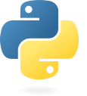
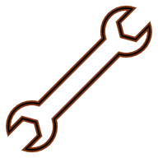



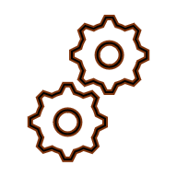


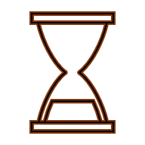
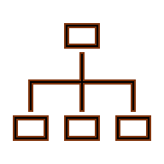

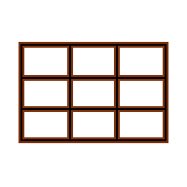




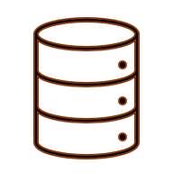




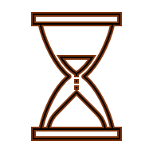

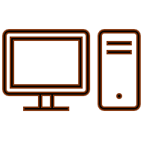
Profiling and Optimising in Python: CHEAT SHEET
Carpentries incubator lesson:
https://carpentries-incubator.github.io/pando-python/
Basics
Function-level profiling
Optimisation
Measures the time taken by individual functions in your code., to help identify which functions are taking the most time to execute.
The process of improving the performance of your code by making changes to it.
As code grows in complexity, it starts taking longer to execute. Improving code’s performance will makes the work easier and saves energy.
cProfile
Commonly used tool for function-level profiling. It is a part of the Python standard library.
Potential risks associated with optimising:
Performing optimisations in a way that make code harder to understand.
The Carpentries Incubator lesson can be found on the GitHub repository: https://github.com/carpentries-incubator/pando-python
Run
python -m cProfile my_script.py
Changing the code with a potential to introduce new bugs.
Profiling
Store output
Trying to optimise code that only takes up a minuscule fraction of the total runtime, you might end up spending more time on the optimisation than you actually gain from it.
The process of measuring the performance of the code to identify which parts of the code are taking the most time to run.
Not every script needs profiling: For example, for a one-off script that runs quickly, profiling will not be necessary. However, for a long-running script that is expected to be run multiple times, profiling can be very useful.
python -m cProfile –o output.prof my_script.py
Visualise output using snakeviz
snakeviz output.prof
Simple tips to optimise Python code
Line-level profiling
Use built-in functions and the standard library - don’t reinvent the wheel!
Records the time taken to execute individual lines of code.
Types of profiling
line_profiler
Commonly used tool for line-level profiling. It is not a part of the Python standard library and needs to be installed using:
Use list comprehension when creating lists
Manual profiling
Use the `time` module to measure the time taken by different sections of the code.
Prefer tuples, dictionaries, and sets over lists, when appropriate
pip install “line_profiler[all]”
Minimise Python written: Use scientific Python packages (NumPy, Pandas). NumPy arrays support broadcasting (mathematical operation is automatically parallelised over elements of the array - much faster than explicit for-loop)
Decorate functions to be profiled
Function-level profiling
Measures time taken by individual functions in the code.
from line_profiler import LineProfiler
@profile
def my_function(arg):
...
return
print(my_function(arg=arg_value))
Newer is often faster: When possible, use the latest versions of Python and packages
Line-level profiling
Measures the time taken by individual lines of code.
Run
One large file is better than many small files
python -m kernprof -lvr my_script.py
Avoid destroying and recreating objects
Timeline profiling
Gives an idea of the execution of the code over time.
Output
Outputs to a file (my_script.py.lprof). This file is not human-readable. To print it to console:
Link to the lesson
python -m line_profiler –rm my_script.py.lprof
Hardware metric profiling
Measures hardware related metrics.
CC-BY-SA Saranjeet Kaur Bhogal, Jost Migenda • Learn more at carpentries-incubator.github.io/pando-python • Updated: 2026-04

