Slide 1


Best Practices for Working with R & Databases
March 2018
.com/resources/webinars

Slide 2

Current challenges
Neither option use the SQL engine
Option 1 - Save small pieces, analyze later
Small conduit
Option 2 –
Load a lot of data into memory

Slide 3
Ideally, analyze in-place
select sum(amount) from sales group by month
“total sales by month”
Returns a data.frame with 12 records

Slide 4
Ideally, analyze in-place
select count() from sales where amount > 1000 group by month
“Number of sales over $1K by month”
Returns a data.frame with 12 records

Slide 5
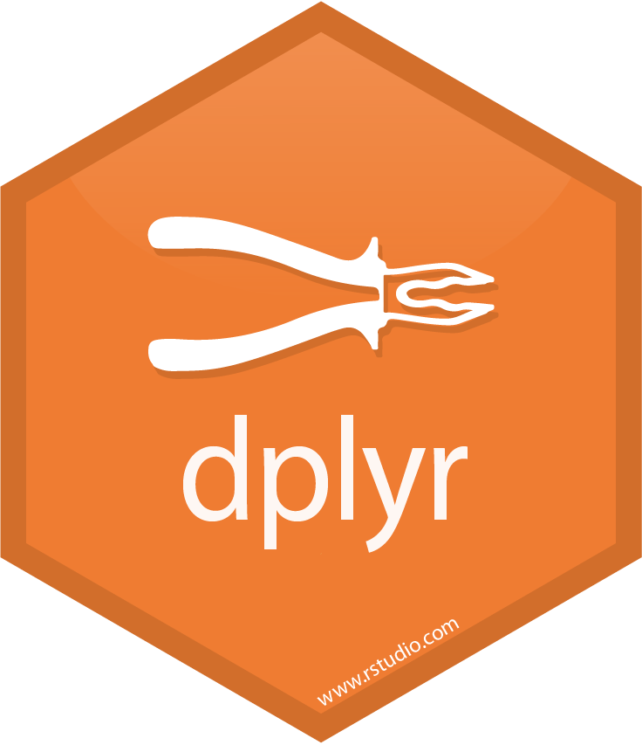
Ideally, analyze in-place
using dplyr
dplyr writes the SQL query
select count() from sales where amount > 1000 group by month
“Number of sales over $1K by month”
sales %>%
filter(amount > 1000) %>%
group_by(month) %>%
tally()
Returns a data.frame with 12 records

Slide 6
Ideally, analyze in-place
using dplyr
sales %>%
filter(amount > 1000) %>%
group_by(month) %>%
tally()
Use piped code (Modular & easy to read)
All your code is in R!
Push compute to the database

Slide 7

New point!
Use RStudio v1.1

Slide 8
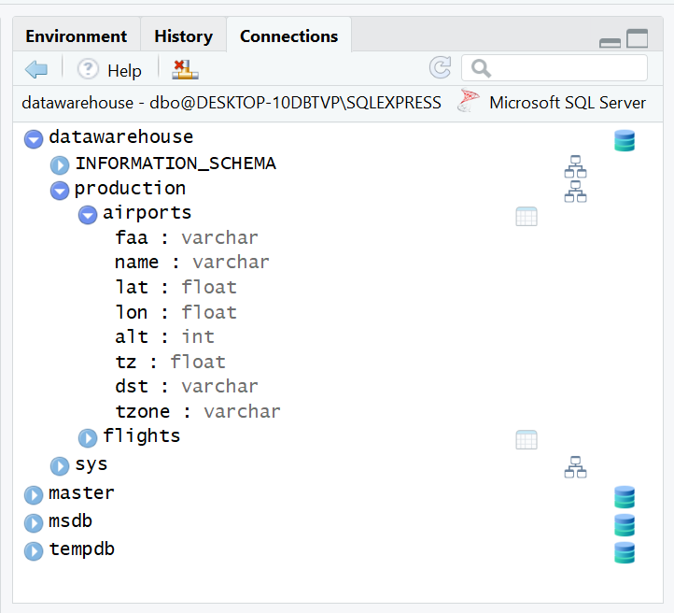
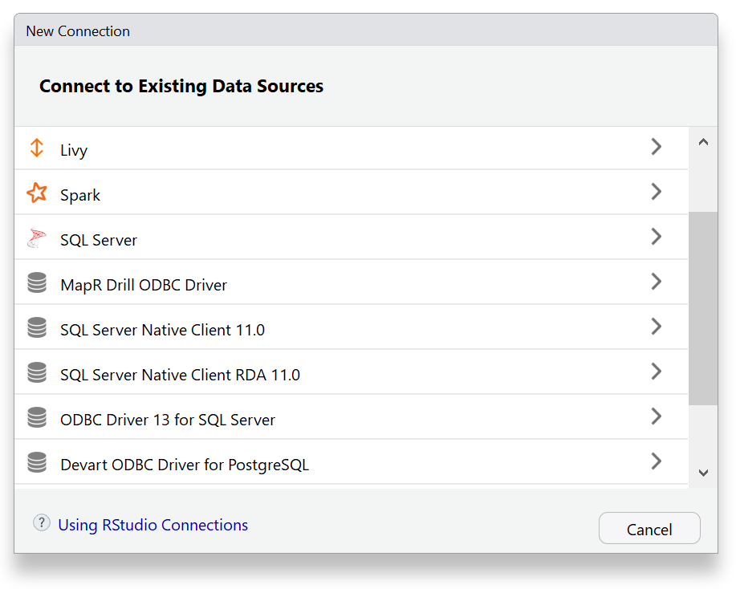
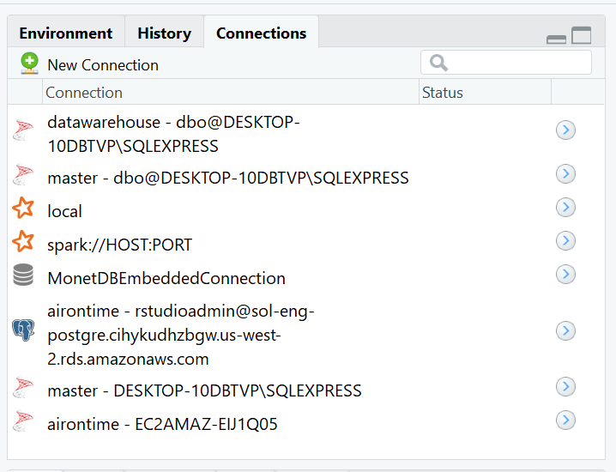
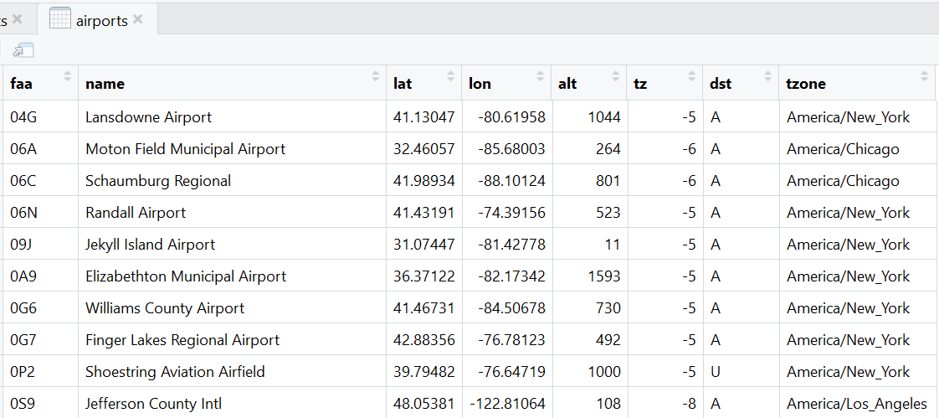
New point!
Use RStudio v1.1
New connections pane
Disconnect from database
Refresh connection
Manage connections
Preview records
Expand DBs, schemata & tables
Custom icons

Slide 9
Demo time!

Slide 10
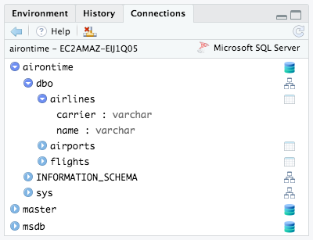
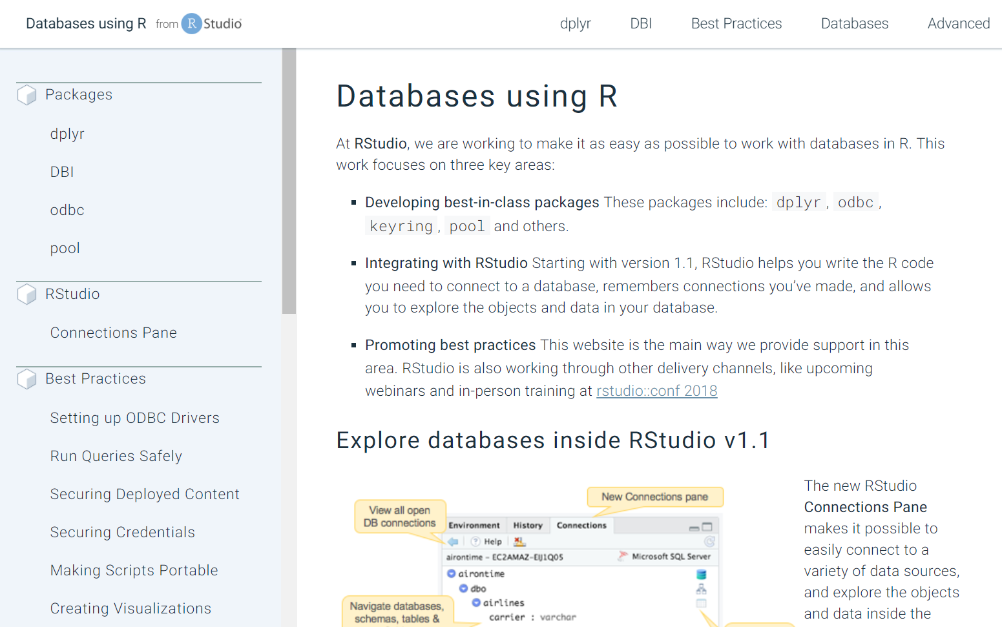
RStudio’s support of databases and R
RStudio v1.1 Integration
View databases, schemas, tables, and fields
Explore data in tables or views
Remembers connections you’ve made
Utilize best-in-class packages
dplyr
odbc
DBI
Promoting best practices
db.rstudio.com
Training & presentations
Blog posts (rviews.rstudio.com)

Slide 11
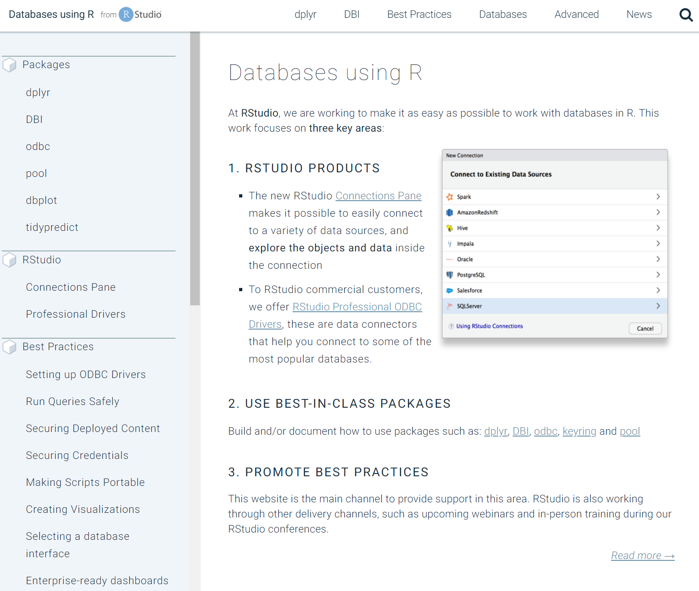
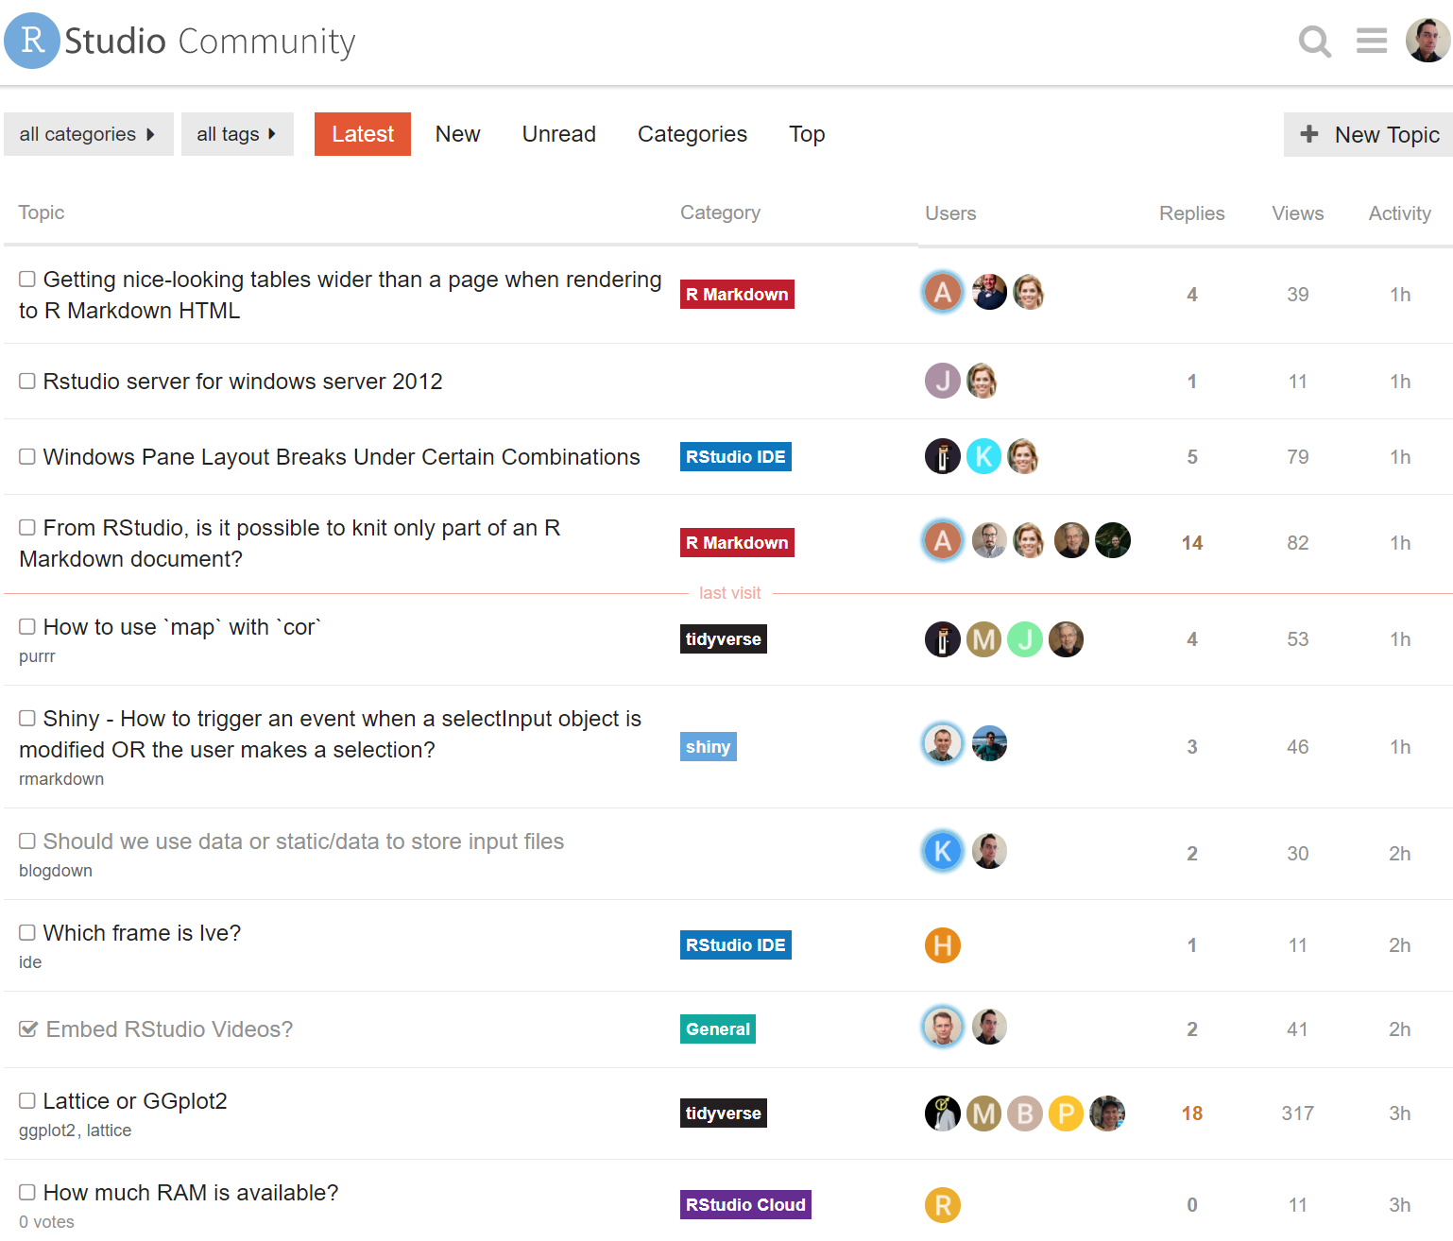
Recommended sites
db.rstudio.com
community.rstudio.com

Slide 12
Thank you !!

Slide 13
Working with R & Databases
Webinar
March 28th, 2018
11 EDT / 10 CDT
.com/resources/webinars
Edgar Ruiz
| @theotheredgar
| linkedin.com/in/edgararuiz

