Slide 1
Lost in Just the Translation
Translation-based Steganography without Cover Source Transmission
  Ryan Stutsman,
  Mikhail Atallah,
  Krista Grothoff
  Purdue University
  Christian Grothoff,
  UCLA

Slide 2
Outline
Background
  Translation-based Steganography
    Hide information in noise that occurs in natural language translation
  Lost in Translation (LiT) Implemented System
    A protocol that uses Translation-based Steganography to encode information
Lost in Just the Translation (LiJtT)
  A new, different protocol that overcomes limitations in the LiT protocol

Slide 3
Translation as a cover for hiding info
Automated Natural Language Translation
  Natural Language translation is a noisy process
  Far from perfect
  Availability of low-quality translations makes alterations plausible

Slide 4
An example from Babelfish
The following German text was taken from a Linux Camp website:
  “Keine Sorge, sie sind alle handzahm und beantworten auch bereitwillig Fragen rund um das Thema Linux und geben gerne einen kleinen Einblick in die Welt der Open-Source.”
A reasonable English translation would be the following:
  “Don’t worry, they are all tame and will also readily answer questions regarding the topic ‘Linux’ and gladly give a small glimpse into the world of Open Source.”
Babelfish gave the following translation:
  “A concern, it are not all handzahm and answer also readily questions approximately around the topic Linux and give gladly a small idea of the world of the open SOURCE.”

Slide 5
Lost in Translation (LiT)
The Protocol:
We assume Alice and Bob have a shared secret in advance – in this case, it is the translation-system configuration (training corpus, etc).
To send a message: First, Alice chooses a source text – possibly public. It does not have to be secret.

Slide 6
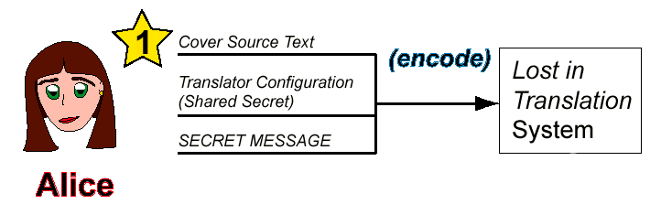
LiT Protocol: Step 1
Alice feeds the shared-secret configuration, her cover source text, and the secret message into the LiT system.

Slide 7
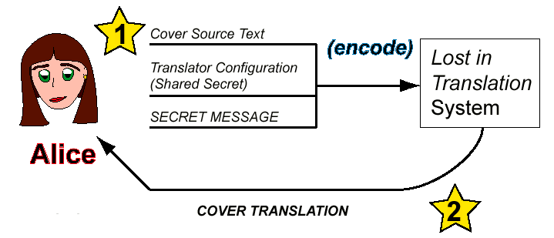
LiT Protocol, Step 2
System encodes the secret message within a cover translation.

Slide 8
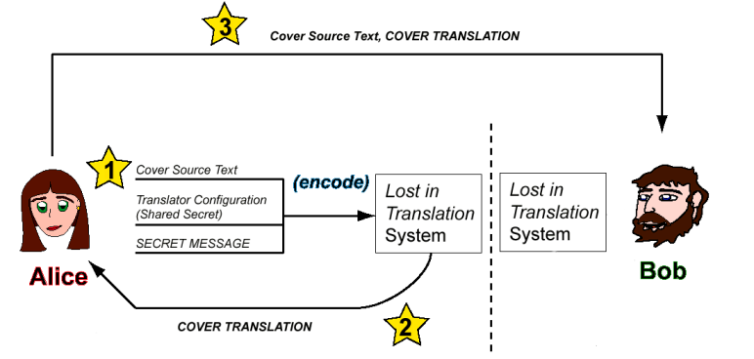
LiT Protocol: Step 3
Alice sends the cover source text (or a reference to it) and the cover translation to Bob

Slide 9
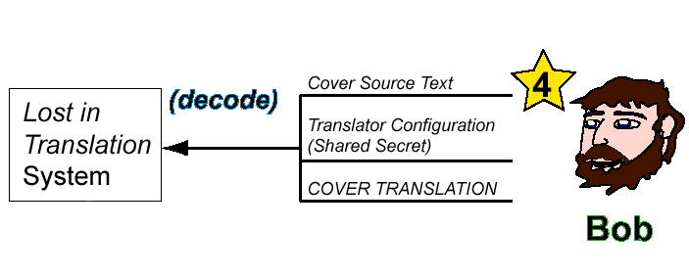
LiT Protocol: Step 4
Bob, who already has the system configuration, feeds this, the cover source text and cover translation into his LiT system.

Slide 10
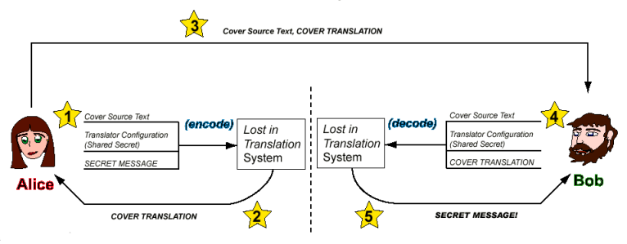
LiT Protocol: Step 5
The system matches the cover translation with the appropriate translation values and gives Bob the secret message.

Slide 11
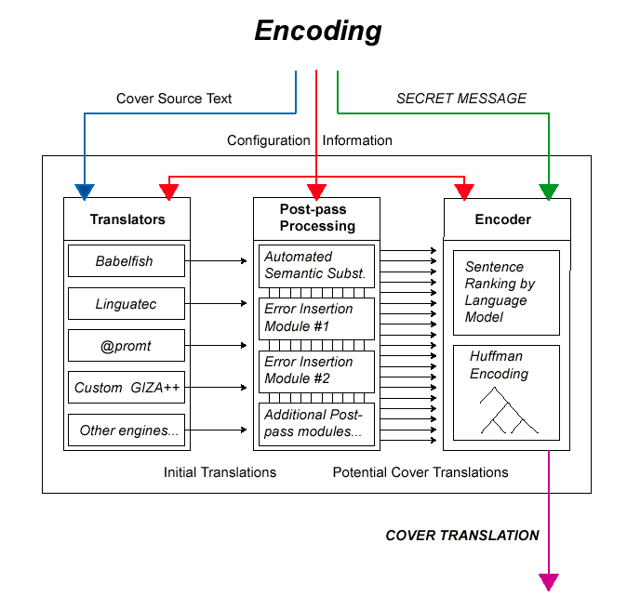
Encoding

Slide 12
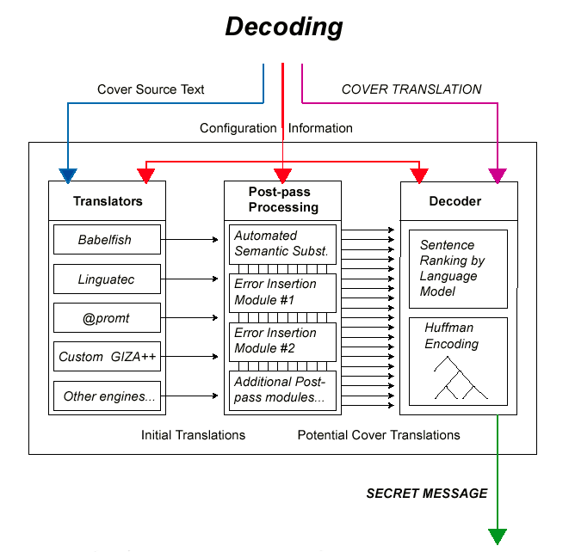
Decoding
Notes:
Virtually infinitely many different behaviors (training corpus, etc.).

Slide 13
Advantages
LiT hides within the limits of machine translation – as MT models change, so can our system
Avoids “generation” problem by trying to mimic the results of an imperfect transformation, not by mimicking correct, human-produced text
Secret key (implementation, training corpora and configuration) allows for many possible encoders
Cover text can be public and obtained from public sources
Notes:
Upon mentioning CFGs cite Wayner; Chapman and Davida (sem sub).
Secret key can be arbitrarily large. Don't go on about it.

Slide 14
Disadvantages
Attacker could spot obvious inconsistencies
  Same sentence translated in two ways
  Certain mistakes made inconsistently (“feet”/“foots”)
Need to transmit both source text (or a reference to it) and translation
  Steganographers are generally uncomfortable with transmitting the original source object
Both of these issues are addressed
  A new protocol – Lost in Just the Translation

Slide 15
Lost in Just the Translation (LiJtT)
Transmission without the source text
Encode data based on keyed hashes of translations
More complicated encoder
Straightforward decoder
  A good place to begin to get an overview of the protocol

Slide 16
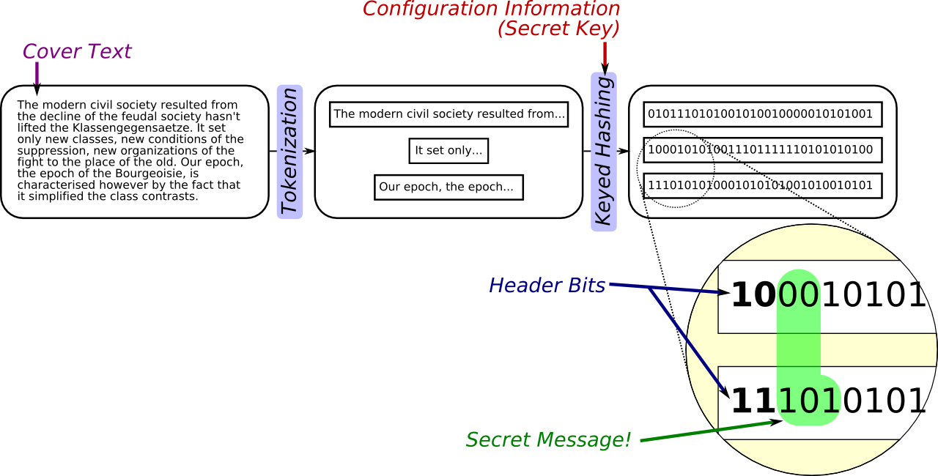
Decoding

Slide 17
Decoding embedded messages
Tokenize according to original LiT decoder
  LiJtT generally works best with sentences as tokens
Compute keyed hash using shared secret k
Split the bits of the hash into two pieces
  First h bits encode an integer b
  Bits [h + 1, h + b] contain the hidden information

Slide 18
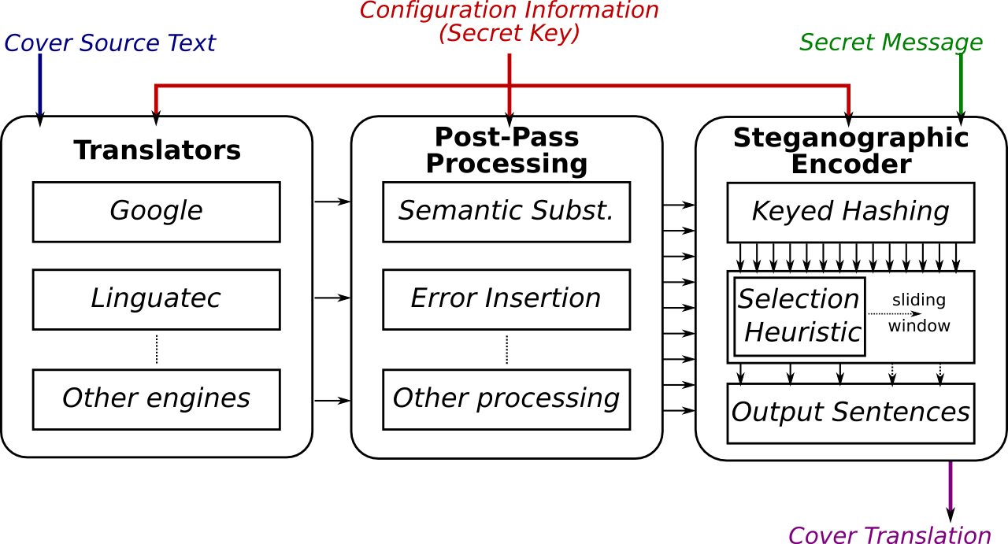
Encoding
Notes:
Mention need for ECC right here to head off any ideas audience may get about correctness.
Text is tokenized just as with LiT
A set of translations is generated for each token
Translations above quality threshold are considered
For all translations of a given source text token a keyed hash is computed
The bitstream of each hash is evaluated to see if the [h + 1, h + b] bits match based on the b stored in the first h bits

Slide 19
Which Translation to Select
Hashes of translations scored and ranked
  Metric of how well a hash matches what we are trying to encode
Select longest matching sequence
  Maximizes carrying capacity for that sentence
  Smarter selection: Adjust for errors
    Select largest b minus the cost of correcting errors
Error correction is used in case of inability to encode

Slide 20
Encoding Messages
Sender/Receiver share secret key
h, the number of header bits, must be agreed upon
  Can be shared or transmitted in first hash, for example
Sender selects a cover source text
  Can be public or secret (more secure)
    Multiple translations are plausible
    Source is not necessary after encoding; can be discarded

Slide 21
Choosing h
h has a strong impact on capacity
  Too small: little data can be stored per sentence
  Too large: lowers the probability of a hash matching the bits [h + 1, h + b]
1 ≤ h ≤ 4 have been most effective in our testing

Slide 22
Issues Processing a Sliding Window
Maximize encoding, but
Avoid damage to later windows
  Best storage for a sentence may hinder later storage
A heuristic approach
  Exhaustive search and dynamic programming are too expensive

Slide 23
Tracking/Scoring State of Computation
Tentative choices made; can backtrack
Track the overall storage of a set of selections up until the current sentence using a tuple containing
  Translations, total number of bits and errors encoded up to current point
Maintain a pool of t tentative choices at any point throughout process (t is configurable)
Notes:
SKIP depending on time

Slide 24
Tracking/Scoring (cont.)
For each tentative choice a new set of sub-choices is computed
The new set of tentatives (larger than t) is quality-sorted and the best t selected

Slide 25
Experimental Results
Initial implementation built on LiT infrastructure
Employs various publicly accessible MT systems
  Initial tests only include two public MT systems

Slide 26
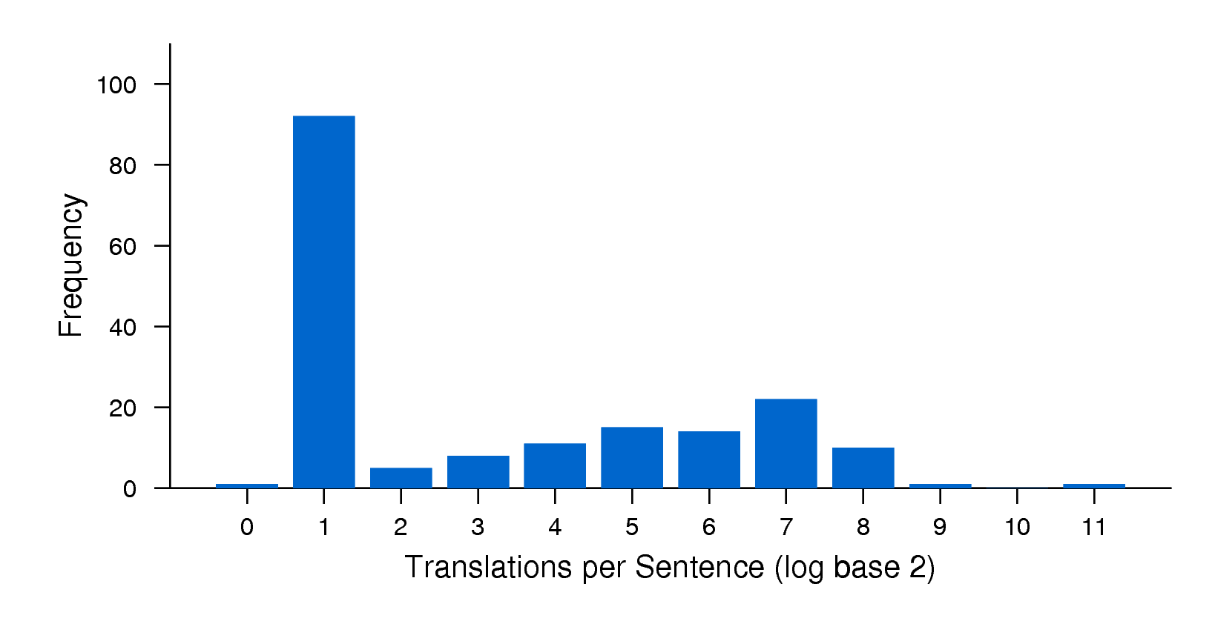
Translation Count Distribution
Notes:
Mention briefly:
2^1 occurs because of the translation sources available to us
Then move on quickly.
System works despite less than ideal distribution
Can be improved with more resources (MT systems, memory)
Ideal distribution would be a solid bar at 2^h, having a uniform number of translations available at each sentence which would eliminate the need for the traces mechanism. We would be able to encode an avg h bits in that case.

Slide 27
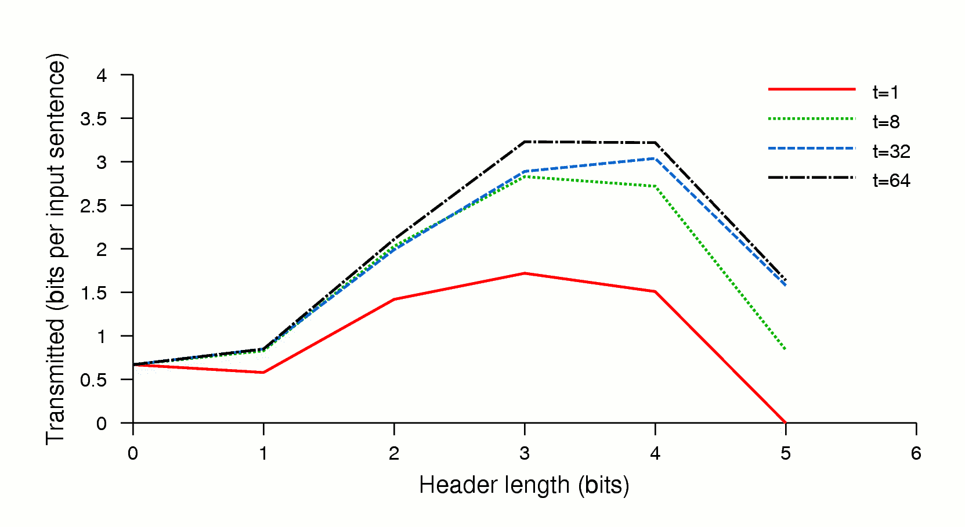
Effect of h and t
Notes:
Just note:
At any h as t increases total capacity does also
The trace mechanism has an clear positive impact
The impact decreases as t grows large, showing the impact of t is bounded to some degree
As expected, h has a limited range of effectiveness
For LiJtT encoders that are able to generate more translations, the curve from the previous figure would widen

Slide 28
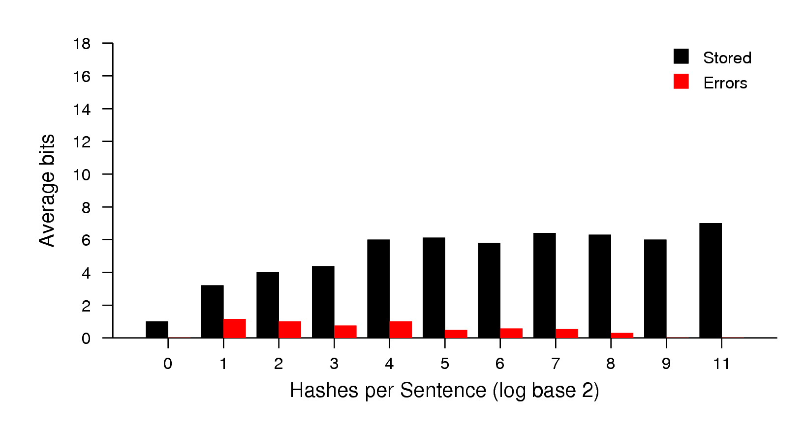
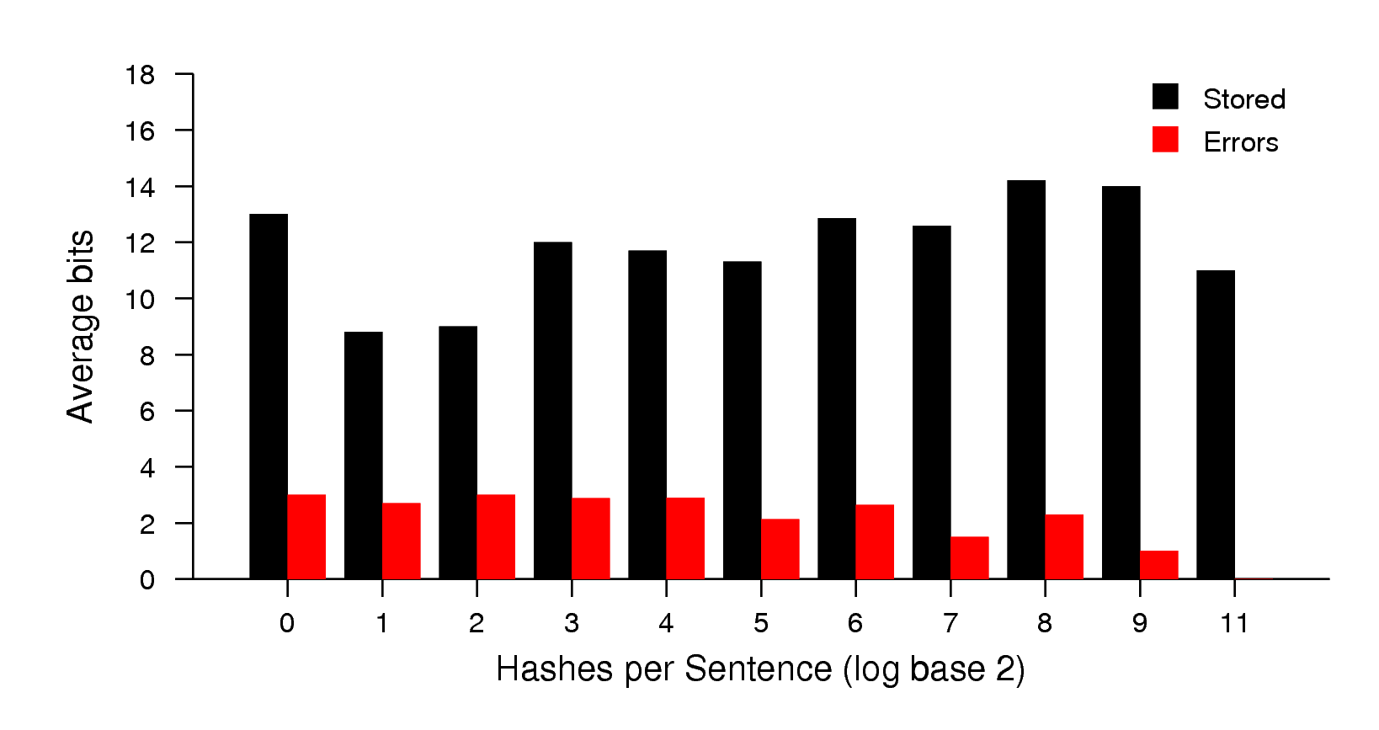
Data Rate Variance
Storage/Errors when
choices threshold is 1
Storage/Errors when
choices threshold is 32
Notes:
Increasing the number of traces used shows
More errors are being transmitted
Effect is more than balanced by higher data rate overall
It is important to note
The impact of t allows increased storage in situations when the number of translations is less than ideal
Large values of t remove the correlation between number of translations and number of errors transmitted

Slide 29
Information Density
Original LiT Implementation
  0.37%
LiJtT Implementation
  0.28% ~581 bits for 25.6 KB of transmitted text
The initial implementation transmits about 25-50% less data in the same transmission as the original protocol
LiJtT with 1 additional Human Translation
  0.33%

Slide 30
Conclusions
Transmission of the hidden message can be done without requiring the original source text
Protocols can be adapted to thwart adversarial analysis by modifying the language model in the encoder

Slide 31
The Implementation!
LiJtT uses PHP and MySQL and is available under the GNU General Public License
Prototype is available at http://www.cs.purdue.edu/homes/rstutsma/stego/
The software itself is available for download via subversion at https://gnunet.org/projects/stego/

Slide 33
Example Decoding from a Single Hash
3. Interpret header (h) bits (assume h = 3) as an integer b
0101110100101010100011
2
4. Extract the hidden message in bits [h + 1, h + b]
0101110100101010100011
11
5. Concatenate extracted bits to message extracted from previous tokens and repeat for next token.

Slide 34
Example Decoding from a Single Hash
1. Get next token from the transmitted text
(usually by sentence or phrase depending on configuration).
The history of all past society is the history of class warfares.
2. Hash using shared secret
key and agreed hash
function.
'secret'
Hash Function
Resulting Bitstream
0101110100101010100011

Slide 35
Hash Selection Example
A walkthrough
  Hash ranking/selection to find the set of sentences that best encodes the secret message bit sequence
Parameters we need to know
  Error correction cost can be estimated to be 3 bits for every error (we treat all errors as substitution errors)
  Let the number of header bits (h) per hash be 2
Notes:
Move very quickly though the walkthrough.

Slide 36
Hash Selection Example
h = 2 (# of header bits per hash)
Estimated cost of making a substitution error is 3 bits
Bitstream to hide:
011001011
Hashes for translations of the current input sentence:
1001...
Score: 2 bits stored – (3 * 0 errors) = 2 points
11111..
Score: 3 bits stored – (3 * 1 errors) = 0 points
If this were the entire picture the first translation would
be selected.

Slide 37
Hash Selection Example
We move on to the next sentence with “01” already hidden.
Bitstream to hide:
011001011
Hashes for translations of the current input sentence:
11011..
Score: 3 bits stored – (3 * 3 errors) = -6 points
11001..
Score: 3 bits stored – (3 * 2 errors) = -3 points
Both are bad choices so choose the one that causes
the least damage.
Total score is -1 adding the score from the previous sentence.
Could we have done better? Let's start over and try again.

Slide 38
Smarter Hash Selection Example
Bitstream to hide:
011001011
Hashes for translations of the current input sentence:
1001...
Score: 2 bits stored – (3 * 0 errors) = 2 points
11111..
Score: 3 bits stored – (3 * 1 errors) = 0 points
We consider the error to be a substitution error; even though
we encoded an error we still consider the bit hidden and
move on.
Where does this leave us for the next sentence?

Slide 39
Smarter Hash Selection Example
We move on to the next sentence with “011” already hidden.
Bitstream to hide:
011001011
Hashes for translations of the current input sentence:
11011..
Score: 3 bits stored – (3 * 1 errors) = 0 points
11001..
Score: 3 bits stored – (3 * 0 errors) = 3 points
Despite substitution error on the first selection we ended
up better off.
Total storage using this route: 3 points

