Slide 1
E.3 Git development pipeline
Architecture prototype
Working Copy → reviewed Git source
Automated version and changelog
Manual deployment by version tag
3 November 2026 · one lab target · real GitHub and Oracle execution
01
Notes:
E.3 handover. Sources: progress/E.3/sprint_E.3_handover.md

Slide 2
Walkthrough agenda
1. Author and capture one heading change
2. Review the PR and prepare version 1.0.1
3. Deploy the selected tag and inspect history
4. Review failure evidence and remaining risks
02
Notes:
E.3 handover. Sources: progress/E.3/sprint_E.3_increment_demo.md

Slide 3
Architecture and responsibilities
Developer / APEX Working Copy
Edit metadata; compare and merge into DEV Main
Git + SQLcl PROJECT
Review source and stage native Liquibase distribution
GitHub-hosted checks + Release Please
Validate label/title; generate release PR, version and changelogs
Deployer / local runner
Select tag; verify, package and deploy to E3_TARGET
PR merge, tag creation and GitHub Release publication do not deploy.
03
Notes:
E.3 handover. Sources: progress/E.3/sprint_E.3_design.md

Slide 4
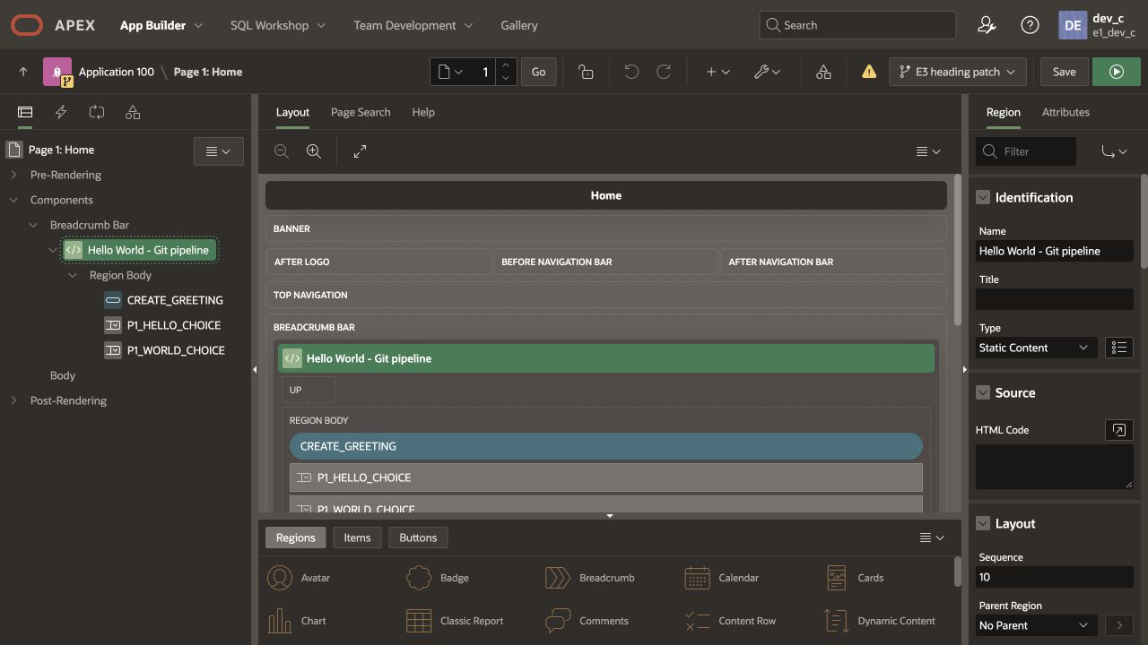
Working Copy: change one Home heading
Later inspection of retained Working Copy 100 · Main 810003 · shared schema
04
Notes:
E.3 handover. Sources: progress/E.3/tests/working-copy-inspection.png

Slide 5
Native comparison and Main checkpoint
Observed native comparison: 1 changed · 0 added · 0 missing
Selected component: Page 1, Home
Original heading: Hello World - Working Copy
Accepted heading: Hello World - Git pipeline
Target backup enabled; Working Copy retained
Main merge completed successfully
05
Notes:
E.3 handover. Sources: progress/E.3/tests/working-copy-diff.png Raw original comparison capture is retained; no later screenshot is represented as the historical merge.

Slide 6
Native source capture and staging
bash scripts/capture.sh
git diff -- src pipeline.json
python3 scripts/lab.py stage
python3 scripts/lab.py verify
git diff -- dist
Source adapter replaces the inherited E1 controller hook before stage.
Native verification must report zero errors.
06
Notes:
E.3 handover. Sources: progress/E.3/sprint_E.3_implementation.md

Slide 7
PR labels and Conventional Commits
patch → fix: update Home heading
minor → feat: add a compatible capability
major → feat!: change the contract
Hosted checks reject missing/conflicting labels or title mismatch
Squash merge retains the classification in Git history
Performed: PR 1 heading fix and PR 3 runtime correction; both patch.
07
Notes:
E.3 handover. Sources: https://github.com/rstyczynski/APEX_CICD_E3/pull/1

Slide 8
Release Please: version and both changelogs
Two accepted fixes accumulated into release PR 2
Generated version.txt: 1.0.0 → 1.0.1
Generated CHANGELOG.md and matching GitHub Release notes
Hosted checks were manually dispatched on the bot PR head
Release-PR merge created tag v1.0.1; target stayed unchanged
08
Notes:
E.3 handover. Sources: https://github.com/rstyczynski/APEX_CICD_E3/pull/2

Slide 9
Manual deployment of the selected tag
gh workflow run release.yml \
--repo rstyczynski/APEX_CICD_E3 \
--ref main -f version_tag=v1.0.1
gh run view 41664798289 \
--repo rstyczynski/APEX_CICD_E3
Succeeded: native verify → one archive → target deployment → preservation
Exact tag source uses a named local build branch; no live DEV export.
09
Notes:
E.3 handover. Sources: progress/E.3/tests/release-receipt.json

Slide 10
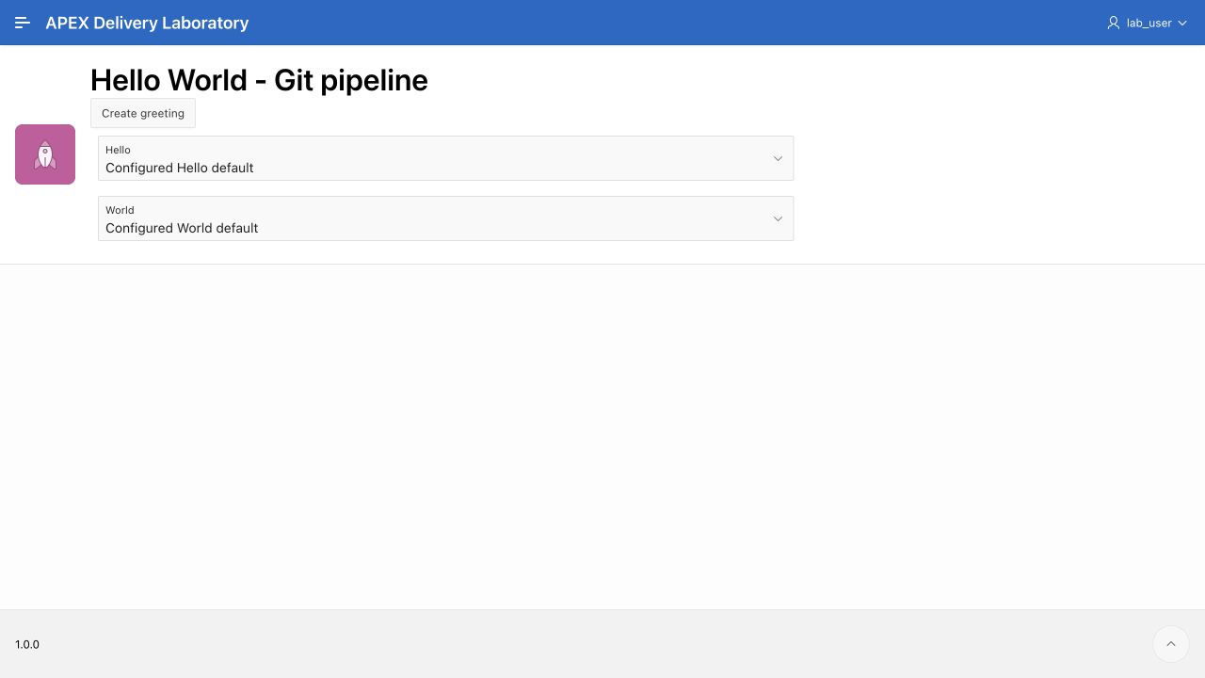
Deployed application and retained history
Observed in browser: Hello World - Git pipeline
Retained Hello World history row and all prior fields verified.
Repository release: v1.0.1. APEX display metadata remains 1.0.0.
10
Notes:
E.3 handover. Sources: progress/E.3/tests/deployed-home.png; progress/E.3/tests/deployed-history.png

Slide 11
Observed failures and corrections
Slash-containing branch: native source/dist verification failed; use explicit slashless demo branches
Mapping file lookup: resolve committed properties from the selected checkout
Inherited E1 runtime hook: correct reviewed source before native staging
Detached HEAD: first remote run stopped; corrected workflow uses a named build branch
Missing changeset: real native verification rejected it; target unchanged
11
Notes:
E.3 handover. Sources: progress/E.3/sprint_E.3_tests.md

Slide 12
Results and handover boundary
1. PBI-053.1: Working Copy, Git capture and native verification
2. PBI-053.2: classified PRs, release PR, version and changelogs
3. PBI-053.3: selected-tag deployment, preservation and failure gate
New smoke and integration gates passed; existing smoke regression passed.
Parallelism, full identity coverage, drift/fencing and general recovery remain later work.
Technical handover delivered. Product Owner acceptance and sprint closure remain separate.
12
Notes:
E.3 handover. Sources: progress/E.3/sprint_E.3_handover.md; progress/E.3/sprint_E.3_tests.md

