Slide 1
E.4
Selective native release
Independent A/B/C work • A/C delivered • B retained
Prepared-host Elaboration experiment | 9 November 2026
1
Notes:
Source: progress/E.4/sprint_E.4_increment_demo.md; current E.4 evidence. Single Codex operator role simulation. Live Product Owner acceptance pending.

Slide 2
Agenda
1 Scope and prepared environment
2 Independent author capture and staging
3 Release announcement and manager admission
4 Native conflict resolution, freeze and artifact
5 Trusted baseline, refusals and synchronization
6 Results, limits and Product Owner decision
2
Notes:
Source: progress/E.4/sprint_E.4_increment_demo.md; current E.4 evidence. Single Codex operator role simulation. Live Product Owner acceptance pending.

Slide 3
Scope and environment
PBI-060: independent contributions and selective release
PBI-042: deliberate central DEV synchronization
3
Notes:
Source: progress/E.4/sprint_E.4_increment_demo.md; current E.4 evidence. Single Codex operator role simulation. Live Product Owner acceptance pending.

Slide 4
Native delivery architecture
E4A / E4B / E4C: separate author databases, private connections and feature checkouts.
GitHub: announcement, developer opt-in PRs, manager admission and promotion.
E4I: separate native integration fixture after independent staging.
SQLcl PROJECT: export → stage → verify → release → package → deploy.
Central DEV: E3_TARGET / 810203; operator admission and preservation checks.
4
Notes:
APEX 24.2, Oracle Free 23.26.3.0.0, ORDS 25.3. A/B/C have canonical E1_DEV_C and app 810003. No shared author checkpoint; no automatic merge-to-deploy trigger.
Source: progress/E.4/sprint_E.4_increment_demo.md; current E.4 evidence. Single Codex operator role simulation. Live Product Owner acceptance pending.

Slide 5
Preflight the selected Git state
Use the prepared host, Java 21 and the pinned SQLcl build. Stop on any mismatch.
Discover the repository root; credentials and saved connections remain outside checkout scratch.
ROOT=$(git rev-parse --show-toplevel)
cd "$ROOT"
"$SQLCL" -version
jq -r .sqlcl.version "$LAB/.dbtools/project.config.json"
git -C "$LAB" status --short
Expected: 25.4.1.0 / build 25.4.1.022.0618; clean source. Walkthrough §1.
5
Notes:
Source: progress/E.4/sprint_E.4_increment_demo.md; current E.4 evidence. Single Codex operator role simulation. Live Product Owner acceptance pending.

Slide 6
What exists at handover
Release 1.0.7 is already installed and repeated on central DEV.
A/C are present; B remains unmerged on e4-b.
Temporary central Builder/proxy access has been removed.
The default walkthrough inspects this completed journey. New live writes require approved access and a new reservation.
No clean-host provisioning, production fencing or three-human concurrency claim.
6
Notes:
Source: progress/E.4/sprint_E.4_increment_demo.md; current E.4 evidence. Single Codex operator role simulation. Live Product Owner acceptance pending.

Slide 7
Independent author work
A, B and C start from accepted main before a release exists
One operator; three independent services and native processes
7
Notes:
Source: progress/E.4/sprint_E.4_increment_demo.md; current E.4 evidence. Single Codex operator role simulation. Live Product Owner acceptance pending.

Slide 8
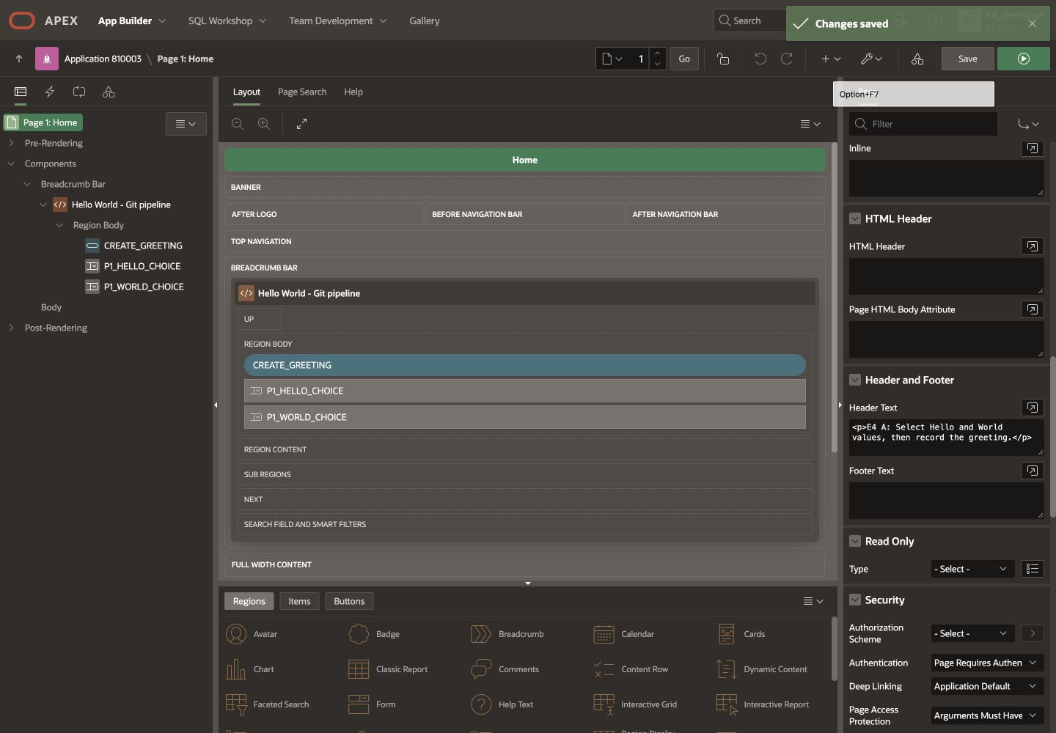
A: Home explanatory text
E4A / page 1 / Header Text. Save, then confirm Changes saved. Walkthrough §2.
8
Notes:
Selected contribution A. Exact value: <p>E4 A: Select Hello and World values, then record the greeting.</p>. Retained saved author screenshot; not a second human.
Source: progress/E.4/sprint_E.4_increment_demo.md; current E.4 evidence. Single Codex operator role simulation. Live Product Owner acceptance pending.

Slide 9
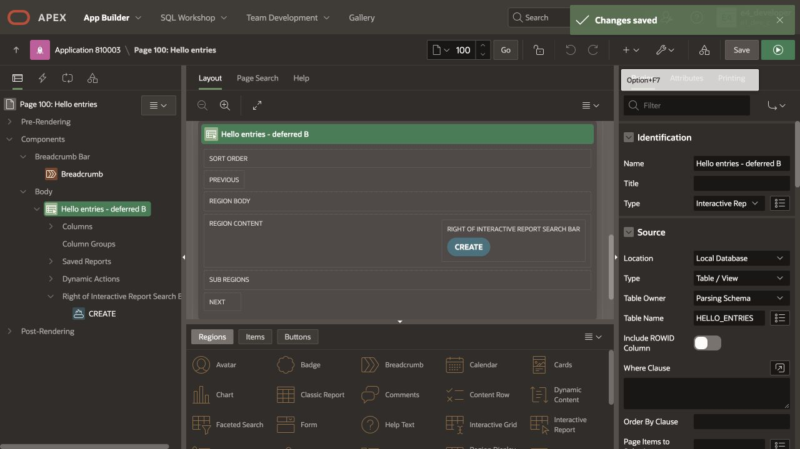
B: Hello label, deferred
E4B / page 100 / report Name. Preserve this source and stage for later delivery.
9
Notes:
Exact region name: Hello entries - deferred B. B original staged commit ed9fe37bbebe30306ce91e981da9b5565b44c5c5. No release PR submitted.
Source: progress/E.4/sprint_E.4_increment_demo.md; current E.4 evidence. Single Codex operator role simulation. Live Product Owner acceptance pending.

Slide 10
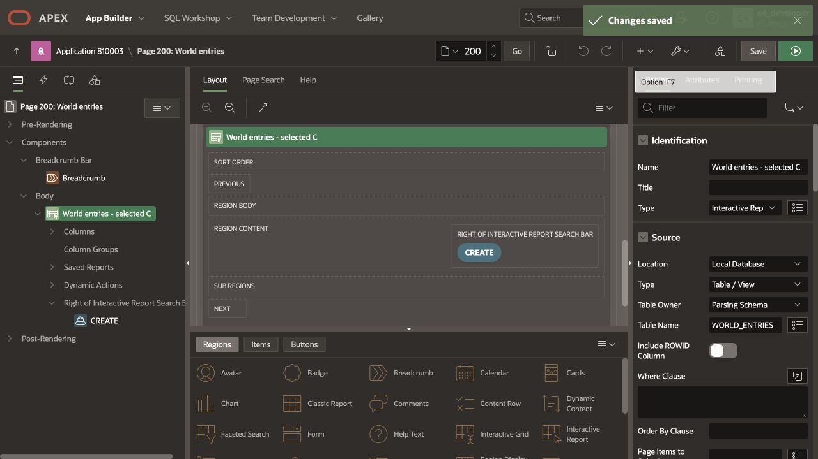
C: World label, selected
E4C / page 200 / report Name. C is independently implementable without A or B.
10
Notes:
Exact region name: World entries - selected C. Original staged head 2c966891b0bfd06fbfeff3f0500501eeb7b69f22.
Source: progress/E.4/sprint_E.4_increment_demo.md; current E.4 evidence. Single Codex operator role simulation. Live Product Owner acceptance pending.

Slide 11
Native capture and staging
Source commit precedes native stage
Original independent results remain preserved
11
Notes:
Source: progress/E.4/sprint_E.4_increment_demo.md; current E.4 evidence. Single Codex operator role simulation. Live Product Owner acceptance pending.

Slide 12
Capture source from each author
Connect to the correct independent service and confirm USER = E1_DEV_C.
Review the exported src diff and commit it before staging.
connect -name lab-dev-c
select user, sys_context('USERENV','SERVICE_NAME')
from dual;
project export -list
project export
Run in each private SQLcl home and feature checkout. Complete helper: walkthrough §3.
12
Notes:
Source: progress/E.4/sprint_E.4_increment_demo.md; current E.4 evidence. Single Codex operator role simulation. Live Product Owner acceptance pending.

Slide 13
Stage and verify independently
Each author compares against immutable e4-base at its recorded start.
All three native process intervals overlapped by about 25 seconds. Zero errors; one explained APEX-only warning each.
project stage -branch-name e4-base
project verify -cbn e4-base -verbose
Review and commit generated dist. SQLcl exit zero alone does not prove verification passed.
13
Notes:
Source: progress/E.4/sprint_E.4_increment_demo.md; current E.4 evidence. Single Codex operator role simulation. Live Product Owner acceptance pending.

Slide 14
Release participation and admission
The manager creates a release later, from then-current main
Developers choose whether to submit
14
Notes:
Source: progress/E.4/sprint_E.4_increment_demo.md; current E.4 evidence. Single Codex operator role simulation. Live Product Owner acceptance pending.

Slide 15
Announce the later release branch
PR #7 advanced accepted main after the authors began.
release-e4-candidate starts at that later main; issue #8 announces the invitation.
gh issue view 8 --repo "$REPO"
jq . "$E4/tests/release-branch.json"
Developer start 5a7655f…; release start a018a67…. Walkthrough §4.
15
Notes:
Source: progress/E.4/sprint_E.4_increment_demo.md; current E.4 evidence. Single Codex operator role simulation. Live Product Owner acceptance pending.

Slide 16
A/C opt in; the manager admits
A submits PR #9 and C submits PR #10 to the announced release branch.
The manager reviews source, checks and dependencies before each admission.
B postpones and keeps its branch, captured source and native stage.
gh pr view 9 --repo "$REPO"
gh pr view 10 --repo "$REPO"
gh api "repos/$REPO/git/ref/heads/e4-b"
Opt-in is not automatic admission. B has no release PR.
16
Notes:
Source: progress/E.4/sprint_E.4_increment_demo.md; current E.4 evidence. Single Codex operator role simulation. Live Product Owner acceptance pending.

Slide 17
Reconcile the combined source
Separate pages still conflict in the generated full app
Fresh native validation applies to the resolved bytes
17
Notes:
Source: progress/E.4/sprint_E.4_increment_demo.md; current E.4 evidence. Single Codex operator role simulation. Live Product Owner acceptance pending.

Slide 18
The actual conflict
Full application SQL, snapshot XML and application YAML conflicted.
Selecting one whole side could lose A or C.
The separate E4I fixture combines A’s full app with C page 200, then PROJECT recaptures the result.
code "$E4/tests/candidate-conflict.log"
code "$E4/tests/integration-qualified-capture.log"
No original author waited for this integration step before its first stage.
18
Notes:
Source: progress/E.4/sprint_E.4_increment_demo.md; current E.4 evidence. Single Codex operator role simulation. Live Product Owner acceptance pending.

Slide 19
Qualified native resolution
Mixed current/original IDs first failed a foreign-key check in E4I.
Consistent original-ID exports plus the canonical offset preserved all component IDs.
Against admitted A, the resolved source adds only C’s label and native hash. B stays absent.
project stage -branch-name e4-admitted-a
project verify -cbn e4-admitted-a -verbose
Fresh C PR check passed before merge. Shared INSTALL_810003 is runOnChange; no invented schema dependency.
19
Notes:
Source: progress/E.4/sprint_E.4_increment_demo.md; current E.4 evidence. Single Codex operator role simulation. Live Product Owner acceptance pending.

Slide 20
Promote, freeze and package
PR #11 promotes the accepted candidate
Native release output is committed before tagging or packaging
20
Notes:
Source: progress/E.4/sprint_E.4_increment_demo.md; current E.4 evidence. Single Codex operator role simulation. Live Product Owner acceptance pending.

Slide 21
Native numbered release
Checked version PR #6 selected 1.0.7.
Native release freezes next and updates lastReleaseVersion; inspect and commit those changes.
project release -version 1.0.7
# Review native distribution and metadata; commit.
project verify -cbn e4-release-base -verbose
project gen-artifact -name e3 -version 1.0.7 -format zip
Recorded sequence. Do not rerun freeze over the existing version. Walkthrough §6.
21
Notes:
Source: progress/E.4/sprint_E.4_increment_demo.md; current E.4 evidence. Single Codex operator role simulation. Live Product Owner acceptance pending.

Slide 22
Inspect the published artifact
Tag v1.0.7 binds the committed native freeze e0f60ff….
The archive contains inherited baseline plus A/C; B is absent from src, dist and ZIP.
gh release view v1.0.7 --repo "$REPO"
shasum -a 256 "$E4/tests/e3-1.0.7.zip"
unzip -Z1 "$E4/tests/e3-1.0.7.zip"
SHA-256 27541bed…ad9a1535. Full binding in release-artifact.json.
22
Notes:
Source: progress/E.4/sprint_E.4_increment_demo.md; current E.4 evidence. Single Codex operator role simulation. Live Product Owner acceptance pending.

Slide 23
Trust the initial target baseline
A previous release label does not attest to today’s live source
Full reconciliation precedes checksum authority
23
Notes:
Source: progress/E.4/sprint_E.4_increment_demo.md; current E.4 evidence. Single Codex operator role simulation. Live Product Owner acceptance pending.

Slide 24
Compare with the accepted archive
Verify the installed 1.0.5 archive hash from retained evidence.
Create a native mapped reference in isolated E4I; never reinstall it on central DEV.
Privately compare complete original-ID exports. Explain only exact exporter, instance and version-counter differences.
code "$E4/tests/initial-reconciliation.diff"
code "$E4/tests/trusted-initial-baseline.json"
Only then obtain two matching Available-state checksum readings. Walkthrough §7.
24
Notes:
Source: progress/E.4/sprint_E.4_increment_demo.md; current E.4 evidence. Single Codex operator role simulation. Live Product Owner acceptance pending.

Slide 25
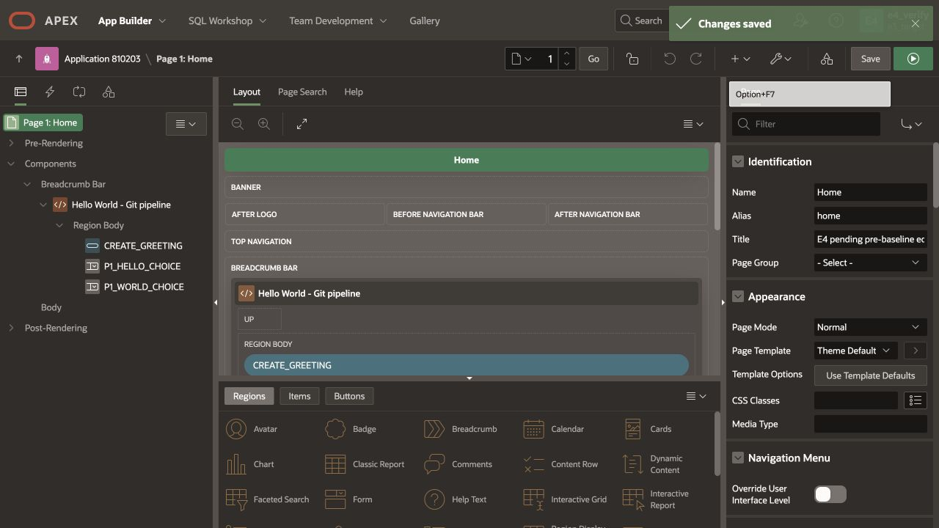
Pre-baseline pending edit is refused
Saved test title remains intact. No baseline created, no deployment, all business fields unchanged.
25
Notes:
IT-3a. Full-source comparison found unexpected p_step_title before any trusted checksum existed. Only the controlled title was later restored.
Source: progress/E.4/sprint_E.4_increment_demo.md; current E.4 evidence. Single Codex operator role simulation. Live Product Owner acceptance pending.

Slide 26
Admission refusals and recovery
Stale source and pending live work stop deployment
Preserve the prior receipt and every business field
26
Notes:
Source: progress/E.4/sprint_E.4_increment_demo.md; current E.4 evidence. Single Codex operator role simulation. Live Product Owner acceptance pending.

Slide 27
Refuse the stale candidate
After selecting 1.0.7, the operator requests the older accepted 1.0.5 candidate.
Source mismatch causes refusal; no PROJECT deploy is invoked.
Live checksum, all business fields and the prior receipt hash remain unchanged.
code "$E4/tests/it2-refusal.json"
Manual operator admission under reservation, not an autonomous stale-worker guard.
27
Notes:
Source: progress/E.4/sprint_E.4_increment_demo.md; current E.4 evidence. Single Codex operator role simulation. Live Product Owner acceptance pending.

Slide 28
Restored text did not restore checksum
The post-baseline edit was refused and remained saved.
Restoring the exact title advanced p_version_scn; the complete raw diff contains only that counter.
The Product Owner approved reviewed counter-only recovery, followed by two matching readings.
code "$E4/tests/postbaseline-restoration.diff"
code "$E4/tests/trusted-recovered-baseline.json"
Unknown differences still block. The original equality hypothesis failed; it was not silently marked passed.
28
Notes:
Source: progress/E.4/sprint_E.4_increment_demo.md; current E.4 evidence. Single Codex operator role simulation. Live Product Owner acceptance pending.

Slide 29
Deliberate central synchronization
Reserve users and authors for the complete interval
Availability is observed at each transition
29
Notes:
Source: progress/E.4/sprint_E.4_increment_demo.md; current E.4 evidence. Single Codex operator role simulation. Live Product Owner acceptance pending.

Slide 30
Admit and restrict the target
Re-read selected source/archive and compare live metadata to the trusted final receipt.
Privately snapshot every history/configuration field.
Restrict with the native APEX status API; observe status and checksum again.
APEX_APPLICATION_ADMIN.SET_APPLICATION_STATUS
(p_application_id => 810203,
p_application_status =>
APEX_APPLICATION_ADMIN.C_APP_RESTRICTED_ACCESS,
p_allowed_users_list => APEX_T_VARCHAR2('VERIFIER'));
Complete executable PL/SQL and private mapping: walkthrough §9. Participant exclusion is operational.
30
Notes:
Source: progress/E.4/sprint_E.4_increment_demo.md; current E.4 evidence. Single Codex operator role simulation. Live Product Owner acceptance pending.

Slide 31
Observe import, then restrict again
First deployment ran one changeset; 22 were already applied.
Immediately after import, actual status was Available. Reapply restriction before verifier checks.
The repeat ran zero changesets and stayed Restricted after deploy.
project deploy -file artifact/e3-1.0.7.zip
# Observe actual status/checksum after native deploy.
# Reapply the known native restriction.
No continuous technical-denial or rollback claim. Observe actual state on failure.
31
Notes:
Source: progress/E.4/sprint_E.4_increment_demo.md; current E.4 evidence. Single Codex operator role simulation. Live Product Owner acceptance pending.

Slide 32
Verify, publish and repeat
Acceptance and preservation precede publication
The successful receipt is finalized only in Available state
32
Notes:
Source: progress/E.4/sprint_E.4_increment_demo.md; current E.4 evidence. Single Codex operator role simulation. Live Product Owner acceptance pending.

Slide 33
Read-only acceptance before publication
Run lab_runtime.assert_ready and a native verifier APEX session.
Require A’s Home header and C’s World region; require baseline Hello and absence of B.
Compare complete ordered rows from all seven retained business/configuration tables.
cmp "$PRIVATE/before.txt" "$PRIVATE/after.txt"
check.sql has no publication action. Full SQL precedes invocation in walkthrough §10.
33
Notes:
Source: progress/E.4/sprint_E.4_increment_demo.md; current E.4 evidence. Single Codex operator role simulation. Live Product Owner acceptance pending.

Slide 34
Finalize the Available-state receipt
Publish only after native acceptance and data comparison pass.
Obtain two identical checksums in actual Available state, then record source/hash/options/target.
Repeat admission uses that finalized receipt. Both installs preserved every business field.
code "$E4/tests/sync-lifecycle.json"
code "$E4/tests/repeat-lifecycle.json"
code "$E4/tests/repeat-receipt.json"
Status API calls advance counters too; fingerprints are not stable across status toggles.
34
Notes:
Source: progress/E.4/sprint_E.4_increment_demo.md; current E.4 evidence. Single Codex operator role simulation. Live Product Owner acceptance pending.

Slide 35
Final browser result and cleanup
Inspect the selected behavior without writing business data
Remove only the temporary central access
35
Notes:
Source: progress/E.4/sprint_E.4_increment_demo.md; current E.4 evidence. Single Codex operator role simulation. Live Product Owner acceptance pending.

Slide 36
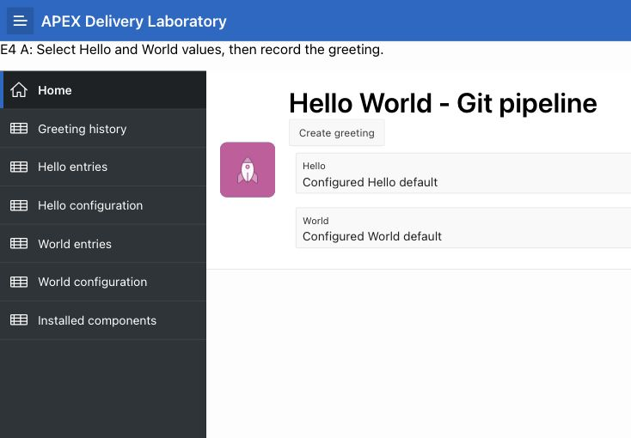
A’s Home text is installed
Central DEV after sync and repeat. No Create greeting action was invoked.
36
Notes:
Actual desktop runtime capture; viewport crop removes unused blank browser area. Static footer 1.0.0 is not release identity.
Source: progress/E.4/sprint_E.4_increment_demo.md; current E.4 evidence. Single Codex operator role simulation. Live Product Owner acceptance pending.

Slide 37
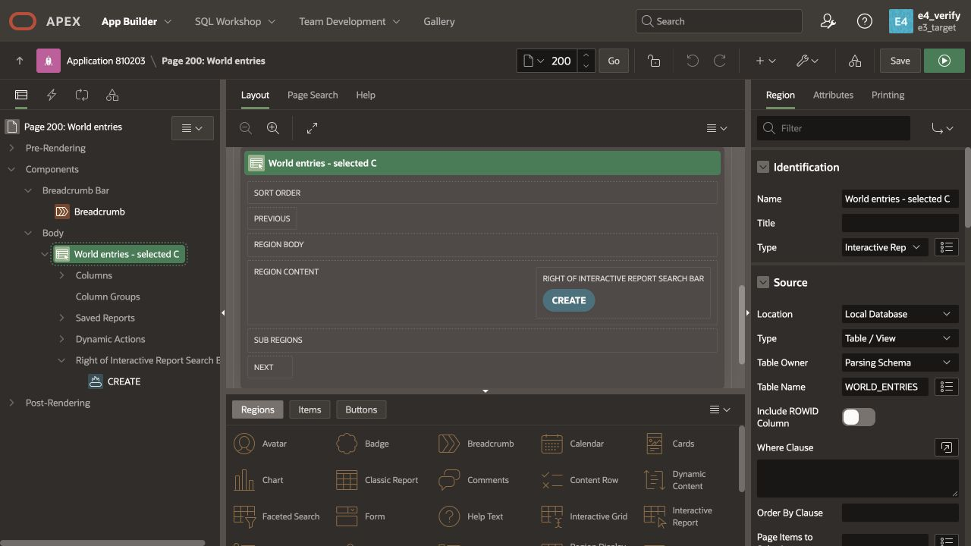
C is installed; B remains deferred
Central Builder shows C’s exact Name. Hello remains “Hello entries”; B’s label is absent.
37
Notes:
Runtime accessibility confirms C and baseline Hello; central-final-b-absent.png retains Hello Builder proof. E4_VERIFY and E4_SYNC subsequently removed; target Available.
Source: progress/E.4/sprint_E.4_increment_demo.md; current E.4 evidence. Single Codex operator role simulation. Live Product Owner acceptance pending.

Slide 38
Results and decisions
The prototype is qualified on the prepared host
Live Product Owner acceptance remains pending
38
Notes:
Source: progress/E.4/sprint_E.4_increment_demo.md; current E.4 evidence. Single Codex operator role simulation. Live Product Owner acceptance pending.

Slide 39
Gate outcomes and evidence boundaries
SM-1, IT-1, IT-2 and IT-4 demonstrated with current native/browser evidence.
IT-3 demonstrated with explicitly approved counter-only recovery after the original equality assumption failed.
A1: 1/1 smoke. A3: 3/3 grouped evidence checks. B1: 2/2 pipeline regression smoke.
Evidence readers do not constitute a new Oracle replay.
Temporary central users removed; final status Available. Full tests and receipts are linked in the walkthrough.
39
Notes:
Source: progress/E.4/sprint_E.4_increment_demo.md; current E.4 evidence. Single Codex operator role simulation. Live Product Owner acceptance pending.

Slide 40
What remains outside E.4
Clean-host provisioning and arbitrary fresh PROJECT installation.
Production race protection, atomic fencing and automatic admission.
General schema drift fingerprinting and three-human concurrency.
A later release for B, using fresh integration/stage/verification.
Live Product Owner walkthrough, acceptance and sprint closure.
PBI-056 and broader delivery-product completion are not claimed.
40
Notes:
Source: progress/E.4/sprint_E.4_increment_demo.md; current E.4 evidence. Single Codex operator role simulation. Live Product Owner acceptance pending.

Slide 41
Questions and Product Owner decision
Inspect the journey and its limits
Accept handover, request corrections, or direct the next scope
Sprint E.4 remains Progress until your decision
41
Notes:
Source: progress/E.4/sprint_E.4_increment_demo.md; current E.4 evidence. Single Codex operator role simulation. Live Product Owner acceptance pending.

