Slide 1
E.2 · Oracle lifecycle assessment
Give developers flexibility through stable,
industry-standard tools and techniques.
1
Notes:
Evidence and reproduction: progress/E.2/sprint_E.2_increment_demo.md. Primary Oracle sources and evidence limits: progress/E.2/oracle-gap-analysis.md.
Sources:
Project requirements/design and actual exercise ledger linked in the walkthrough.
Walkthrough: progress/E.2/sprint_E.2_increment_demo.md; actual outcomes: progress/E.2/sprint_E.2_tests.md

Slide 2
What we will inspect
1. Scope and owned laboratory
2. SQLcl PROJECT capture and delivery
3. Working Copies and team checkpoints
4. Contract admission and failure evidence
5. Recommendations, dependencies and decisions
2
Notes:
Evidence and reproduction: progress/E.2/sprint_E.2_increment_demo.md. Primary Oracle sources and evidence limits: progress/E.2/oracle-gap-analysis.md.
Sources:
Project requirements/design and actual exercise ledger linked in the walkthrough.
Walkthrough: progress/E.2/sprint_E.2_increment_demo.md; actual outcomes: progress/E.2/sprint_E.2_tests.md

Slide 3
One checkpoint, complementary capabilities
APEX Main owns the agreed authoring state.
Working Copies support selected metadata changes.
SQLcl PROJECT captures Main and stages native migrations.
Git retains reviewed source and distribution.
E.1 controls remain where requirements need them.
3
Notes:
Evidence and reproduction: progress/E.2/sprint_E.2_increment_demo.md. Primary Oracle sources and evidence limits: progress/E.2/oracle-gap-analysis.md.
Sources:
https://docs.oracle.com/en/database/oracle/sql-developer-command-line/25.3/sqcug/project-command.html
Repository source: refs/apex-lifecycle-management-v3.pdf (pages 18–30)
https://docs.oracle.com/en/database/oracle/apex/24.2/htmdb/about-working-copies.html
Repository source: refs/apex-lifecycle-management-v3.pdf (pages 12–14, 32)
Walkthrough: progress/E.2/sprint_E.2_increment_demo.md; actual outcomes: progress/E.2/sprint_E.2_tests.md

Slide 4
Scope and evidence
Disposable Elaboration fixture; preserved E.1 history.
APEX 24.2.0 · SQLcl 25.3.0.274.1210
Oracle AI Database 26ai Free, 23.26.3.0.0
Owned authoring, fresh and populated targets.
No production adoption or complex Foundation upgrade.
4
Notes:
Evidence and reproduction: progress/E.2/sprint_E.2_increment_demo.md. Primary Oracle sources and evidence limits: progress/E.2/oracle-gap-analysis.md.
Sources:
Project requirements/design and actual exercise ledger linked in the walkthrough.
Walkthrough: progress/E.2/sprint_E.2_increment_demo.md; actual outcomes: progress/E.2/sprint_E.2_tests.md

Slide 5
A · Inspect before mutation
Identify the retained run, exact versions and owned resources.
Missing infrastructure requires an explicit lab decision.
E2_RUN=e2-20261019-01
bash scripts/cicd-oracle-lifecycle-A_prepare.sh \
--preflight --run "$E2_RUN"
5
Notes:
Evidence and reproduction: progress/E.2/sprint_E.2_increment_demo.md. Primary Oracle sources and evidence limits: progress/E.2/oracle-gap-analysis.md.
Sources:
Project requirements/design and actual exercise ledger linked in the walkthrough.
Walkthrough: progress/E.2/sprint_E.2_increment_demo.md; actual outcomes: progress/E.2/sprint_E.2_tests.md

Slide 6
B · Native SQLcl PROJECT journey
Initialize one Git repository. Capture Main plus schema.
Review native staging and intentional seed/patch SQL.
Generate a prerelease candidate; bind exact bytes.
Qualify fresh install before populated-target upgrade.
Inspect repeat behavior and retained user data.
6
Notes:
Evidence and reproduction: progress/E.2/sprint_E.2_increment_demo.md. Primary Oracle sources and evidence limits: progress/E.2/oracle-gap-analysis.md.
Sources:
https://docs.oracle.com/en/database/oracle/sql-developer-command-line/25.3/sqcug/project-command.html
Repository source: refs/apex-lifecycle-management-v3.pdf (pages 18–30)
Walkthrough: progress/E.2/sprint_E.2_increment_demo.md; actual outcomes: progress/E.2/sprint_E.2_tests.md

Slide 7
SQLcl PROJECT repository layout
repo/
|-- .dbtools/
|-- src/database/e2_0254c95f_a/
| |-- apex_apps/f821788/
| | |-- f821788.sql
| | `-- readable/application/
| |-- package_specs/
| |-- package_bodies/
| `-- tables/
|-- dist/
| |-- install.sql
| |-- component-contract.json
| |-- releases/
| `-- utils/
`-- artifact/ [Git-ignored]
.dbtools: native project settings and filters.
src: Main APEX SQL, readable YAML and schema definitions.
dist: staged migrations, custom SQL and the added contract.
artifact: generated candidate ZIPs, outside tracked source.
Application source and Git history retained; laboratory resources are disposable.
7
Notes:
Source: progress/E.2/repository-layout.md; actual git ls-files at d5c3334486cac6300a0939a4d84bfcfe70627df9 in .local-apex/e2/e2-20261019-01/repo. Abbreviated actual paths. artifact/ exists locally and is Git-ignored. Dist contains exercise additions/adaptations including component-contract.json and separate APEX changelog, not solely untouched PROJECT output. Live: open the repo and inspect .dbtools, src, dist, artifact. Explain source versus migrations and custom SQL.

Slide 8
Supported mapping, deliberate data changes
Oracle defaults-file hook maps workspace, schema and app ID.
Initial native install: 7 changesets. Patch fresh: 9.
Populated patch: 3 run / 6 previous; repeat: 0 run.
Retained user setting and exact history fields survived.
Candidate success does not authorize formal release.
8
Notes:
Evidence and reproduction: progress/E.2/sprint_E.2_increment_demo.md. Primary Oracle sources and evidence limits: progress/E.2/oracle-gap-analysis.md.
Sources:
https://docs.oracle.com/en/database/oracle/sql-developer-command-line/25.3/sqcug/project-command.html
Repository source: refs/apex-lifecycle-management-v3.pdf (pages 18–30)
Walkthrough: progress/E.2/sprint_E.2_increment_demo.md; actual outcomes: progress/E.2/sprint_E.2_tests.md

Slide 9
Observed blocker · full native verification
Slash-containing stage branches expose a path mismatch.
Slashless branches remove that error; full verify still fails.
Initial: APEX SQL missing. Combined comparison: all six SQL files.
Other checks report matching source/distribution changes.
No formal release; inspect the retained Errors summary.
9
Notes:
Evidence and reproduction: progress/E.2/sprint_E.2_increment_demo.md. Primary Oracle sources and evidence limits: progress/E.2/oracle-gap-analysis.md.
Sources:
https://docs.oracle.com/en/database/oracle/sql-developer-command-line/25.3/sqcug/project-command.html
Repository source: refs/apex-lifecycle-management-v3.pdf (pages 18–30)
Walkthrough: progress/E.2/sprint_E.2_increment_demo.md; actual outcomes: progress/E.2/sprint_E.2_tests.md

Slide 10
Existing repository · bounded coexistence
SQLcl PROJECT init preserved 117 of 118 frozen input files.
It overwrote README.md; Git restored the original bytes.
Generated README was retained separately.
Physical coexistence needs a reviewed adoption procedure.
Existing E.1 migration history is not adopted automatically.
10
Notes:
Evidence and reproduction: progress/E.2/sprint_E.2_increment_demo.md. Primary Oracle sources and evidence limits: progress/E.2/oracle-gap-analysis.md.
Sources:
https://docs.oracle.com/en/database/oracle/sql-developer-command-line/25.3/sqcug/project-command.html
Repository source: refs/apex-lifecycle-management-v3.pdf (pages 18–30)
Walkthrough: progress/E.2/sprint_E.2_increment_demo.md; actual outcomes: progress/E.2/sprint_E.2_tests.md

Slide 11
C · Working Copies feed the same repository
Copy page 1 and Main page 2 changed independently.
Selective Refresh then Merge retained both agreed edits.
Main and copy used the same parsing schema.
A team checkpoint is exported from agreed Main.
Two no-edit SQLcl PROJECT captures produced zero source differences.
11
Notes:
Evidence and reproduction: progress/E.2/sprint_E.2_increment_demo.md. Primary Oracle sources and evidence limits: progress/E.2/oracle-gap-analysis.md.
Sources:
https://docs.oracle.com/en/database/oracle/apex/24.2/htmdb/about-working-copies.html
Repository source: refs/apex-lifecycle-management-v3.pdf (pages 12–14, 32)
Walkthrough: progress/E.2/sprint_E.2_increment_demo.md; actual outcomes: progress/E.2/sprint_E.2_tests.md

Slide 12
Working Copy checkpoint in Git
Integrate selected Working Copy changes into agreed Main.
Capture Main into the same src/database/ application path.
Review page YAML and SQL; stage the native distribution.
Retain the E.1 admission validator and added contract binding.
The demonstrated path needs no separate Working Copy source tree.
git diff --stat e2-before-working-copy d5c3334
git show d5c3334:dist/component-contract.json
Live inspection: run inside the retained application repository.
12
Notes:
Source: progress/E.2/repository-layout.md and sprint_E.2_increment_demo.md section 4. Source checkpoint d49bc94; distribution checkpoint d5c3334. Execute these read-only Git commands with git -C .local-apex/e2/e2-20261019-01/repo from the delivery root, or cd into that repo. Inspect both page document-title diffs, generated distribution and exact declaration. E.1 scripts remain in delivery repo. Does not resolve the recorded native verification blocker or establish arbitrary Working Copy strategy compatibility.

Slide 13
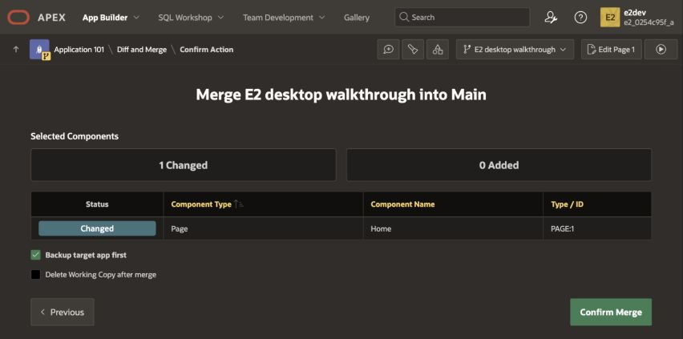
Selected changes · inspect before confirming
Only Home / PAGE:1 is selected; target backup is checked.
Desktop walkthrough repeat — confirmation captured, merge not applied.
13
Notes:
Evidence and reproduction: progress/E.2/sprint_E.2_increment_demo.md. Primary Oracle sources and evidence limits: progress/E.2/oracle-gap-analysis.md.
Sources:
https://docs.oracle.com/en/database/oracle/apex/24.2/htmdb/about-working-copies.html
Repository source: refs/apex-lifecycle-management-v3.pdf (pages 12–14, 32)
Walkthrough: progress/E.2/sprint_E.2_increment_demo.md; actual outcomes: progress/E.2/sprint_E.2_tests.md
Desktop repeat screenshot: progress/E.2/tests/e2_desktop_repeat_merge_full.jpg; captured after the original exercise in a separate disposable Working Copy. The repeat did not apply the merge. Earlier results remain in original evidence.

Slide 14
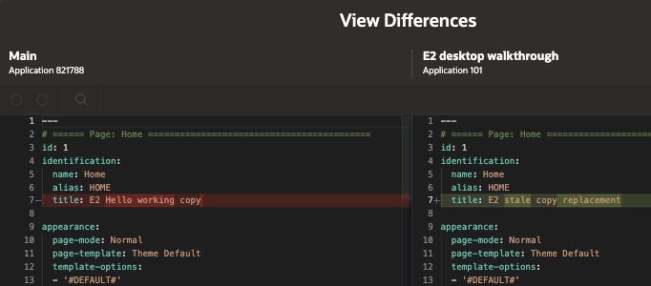
Failure · stale page replacement
Main and Working Copy titles are readable side by side.
Desktop view repeat; the earlier overwrite/recovery remains in the evidence ledger.
14
Notes:
Evidence and reproduction: progress/E.2/sprint_E.2_increment_demo.md. Primary Oracle sources and evidence limits: progress/E.2/oracle-gap-analysis.md.
Sources:
https://docs.oracle.com/en/database/oracle/apex/24.2/htmdb/about-working-copies.html
Repository source: refs/apex-lifecycle-management-v3.pdf (pages 12–14, 32)
Walkthrough: progress/E.2/sprint_E.2_increment_demo.md; actual outcomes: progress/E.2/sprint_E.2_tests.md
Desktop repeat screenshot: progress/E.2/tests/e2_desktop_repeat_diff.jpg; captured after the original exercise in a separate disposable Working Copy. The repeat did not apply the merge. Earlier results remain in original evidence.

Slide 15
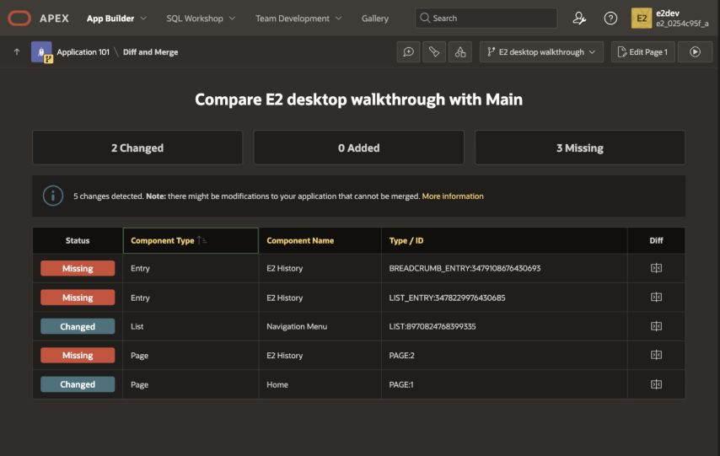
Deletion · explicit Main decision
Missing includes the deleted page and related shared components.
Desktop walkthrough repeat in a disposable copy; Main is retained.
15
Notes:
Evidence and reproduction: progress/E.2/sprint_E.2_increment_demo.md. Primary Oracle sources and evidence limits: progress/E.2/oracle-gap-analysis.md.
Sources:
https://docs.oracle.com/en/database/oracle/apex/24.2/htmdb/about-working-copies.html
Repository source: refs/apex-lifecycle-management-v3.pdf (pages 12–14, 32)
Walkthrough: progress/E.2/sprint_E.2_increment_demo.md; actual outcomes: progress/E.2/sprint_E.2_tests.md
Desktop repeat screenshot: progress/E.2/tests/e2_desktop_repeat_missing_full.jpg; captured after the original exercise in a separate disposable Working Copy. The repeat did not apply the merge. Earlier results remain in original evidence.

Slide 16
Usability · asynchronous comparison
Wait for comparison completion; initial zero counts were transient.
One comparison failed ORA-08177; read-only retry succeeded.
Scheduler limits were raised from 1 to 10 with approval.
Earlier completion preceded the change: no speedup claim.
No multi-user page-lock contention is claimed.
16
Notes:
Evidence and reproduction: progress/E.2/sprint_E.2_increment_demo.md. Primary Oracle sources and evidence limits: progress/E.2/oracle-gap-analysis.md.
Sources:
https://docs.oracle.com/en/database/oracle/apex/24.2/htmdb/about-working-copies.html
Repository source: refs/apex-lifecycle-management-v3.pdf (pages 12–14, 32)
https://docs.oracle.com/en/error-help/db/ora-08177/
https://docs.oracle.com/en/database/oracle/oracle-database/26/admin/oracle-scheduler-concepts.html
Walkthrough: progress/E.2/sprint_E.2_increment_demo.md; actual outcomes: progress/E.2/sprint_E.2_tests.md

Slide 17
Reconstruct the combined checkpoint
Both page titles survived native fresh/populated delivery.
The same Main state also reconstructed by split export/import.
Actual LOV values and Hello World passed database checks.
Browser inspection showed the retained populated history row.
The paths retain distinct migration responsibilities.
17
Notes:
Evidence and reproduction: progress/E.2/sprint_E.2_increment_demo.md. Primary Oracle sources and evidence limits: progress/E.2/oracle-gap-analysis.md.
Sources:
https://docs.oracle.com/en/database/oracle/sql-developer-command-line/25.3/sqcug/project-command.html
Repository source: refs/apex-lifecycle-management-v3.pdf (pages 18–30)
Walkthrough: progress/E.2/sprint_E.2_increment_demo.md; actual outcomes: progress/E.2/sprint_E.2_tests.md

Slide 18
Identity gap · changed mapped import
All observed region IDs changed on populated replacement.
Data, LOV values, greeting and document titles survived.
Stable runtime component identity remains unqualified.
No private saved-report loss was measured.
Qualify a supported fixed-offset/native configuration path next.
18
Notes:
Actual before/after: identities-upgrade-before.json and identities-upgrade-after.json in the retained run/evidence bundle. E.1 fixed-offset evidence belongs to its own importer.
Sources:
https://docs.oracle.com/en/database/oracle/apex/24.2/aeapi/SET_OFFSET-Procedure.html
Local actual evidence: identities-upgrade-before.json / identities-upgrade-after.json; no private-report-loss claim.
Walkthrough: progress/E.2/sprint_E.2_increment_demo.md; actual outcomes: progress/E.2/sprint_E.2_tests.md

Slide 19
D · Retain requirement-specific admission
Reuse the E.1 validator; native ZIP carries the declaration.
Bind source, declaration, exact bytes and observed target state.
Reject incompatible/missing/unknown declarations, altered bytes and missing receipts before invoking native deployment.
The bridge does not establish full drift/failure fencing.
19
Notes:
Evidence and reproduction: progress/E.2/sprint_E.2_increment_demo.md. Primary Oracle sources and evidence limits: progress/E.2/oracle-gap-analysis.md.
Sources:
https://docs.oracle.com/en/database/oracle/sql-developer-command-line/25.3/sqcug/project-command.html
Repository source: refs/apex-lifecycle-management-v3.pdf (pages 18–30)
Walkthrough: progress/E.2/sprint_E.2_increment_demo.md; actual outcomes: progress/E.2/sprint_E.2_tests.md

Slide 20
Component contracts and validation
A subscription is one APEX dependency mechanism.
LOV return codes and behavior belong to the component contract.
Version labels do not infer compatibility. PBI-052 owns the mapping.
Compose utPLSQL, coverage, audits, browser checks and admission around the same candidate identity; each addresses different risks.
20
Notes:
Evidence and reproduction: progress/E.2/sprint_E.2_increment_demo.md. Primary Oracle sources and evidence limits: progress/E.2/oracle-gap-analysis.md.
Sources:
https://docs.oracle.com/en/database/oracle/apex/24.2/htmdb/using-shared-component-subscriptions.html
https://semver.org/spec/v2.0.0.html
Walkthrough: progress/E.2/sprint_E.2_increment_demo.md; actual outcomes: progress/E.2/sprint_E.2_tests.md

Slide 21
Dependency-ordered follow-up
1. Stabilize policies, identity and toolchain: 028/029/037.
2. Capture, migration authority and artifacts: 020/037/038.
3. Coordination and synchronization: 019/039/042.
4. Admission, drift, recovery, provenance: 021–024/031/045; 052.
5. Validation, pipelines and reproduction: 034/040/041/030/043/017/046/047.
6. Complex Foundation upgrades: 048–050 in E.5.
21
Notes:
Evidence and reproduction: progress/E.2/sprint_E.2_increment_demo.md. Primary Oracle sources and evidence limits: progress/E.2/oracle-gap-analysis.md.
Sources:
Project requirements/design and actual exercise ledger linked in the walkthrough.
Walkthrough: progress/E.2/sprint_E.2_increment_demo.md; actual outcomes: progress/E.2/sprint_E.2_tests.md

Slide 22
Review and decide together
Inspect sources and receipts; repeat selected exercises.
Assess SQLcl PROJECT as an optional qualified path.
Assess Working Copies with explicit coordination policy.
Keep useful E.1 controls; avoid duplicate source/migration authority.
Record feedback and the Product Owner handover decision.
22
Notes:
Evidence and reproduction: progress/E.2/sprint_E.2_increment_demo.md. Primary Oracle sources and evidence limits: progress/E.2/oracle-gap-analysis.md.
Sources:
Project requirements/design and actual exercise ledger linked in the walkthrough.
Walkthrough: progress/E.2/sprint_E.2_increment_demo.md; actual outcomes: progress/E.2/sprint_E.2_tests.md

