Slide 1
E.2
Product Owner handover
SQLcl PROJECT and Working Copies
fit the delivery approach
Continue qualification before production adoption
Give developers flexibility through stable,
industry-standard tools and techniques.
22 October 2026
01
Notes:
E.2 Product Owner handover, 22 October 2026. Decisions pending.
Sources:
progress/E.2/sprint_E.2_handover.md
progress/E.2/oracle-gap-analysis.md
Recommendation only. No Product Owner decision, sprint closure or production certification is implied. E.1 historical evidence remains unchanged.

Slide 2
Demonstrated delivery outcomes
Capability | E.2 result
PROJECT lifecycle | Capture, stage, package and mapped deployment worked
Initial delivery | Integration and UAT used the same initial archive
Hello 1.0.1 patch | Fresh installation, populated upgrade and repeat passed
Runtime access | Restricted verifier access and native publication worked
Reference patch runs: 26 fresh, 4 applied on upgrade, 0 on repeat
Integration receipts record preparation. The Product Owner reported F, including UAT, completed.
02
Notes:
E.2 Product Owner handover, 22 October 2026. Decisions pending.
Sources:
progress/E.2/tests/project-integration-mapped-validation.json
progress/E.2/tests/project-uat-promotion-validation.json
progress/E.2/tests/project-f2-upgrade-validation.json
progress/E.2/sprint_E.2_handover.md
Counts concern the reference assessment patch, not a new acceptance claim for every artifact. Retained F verification still fails. Operator-reported F completion is separate from preparation receipts.

Slide 3
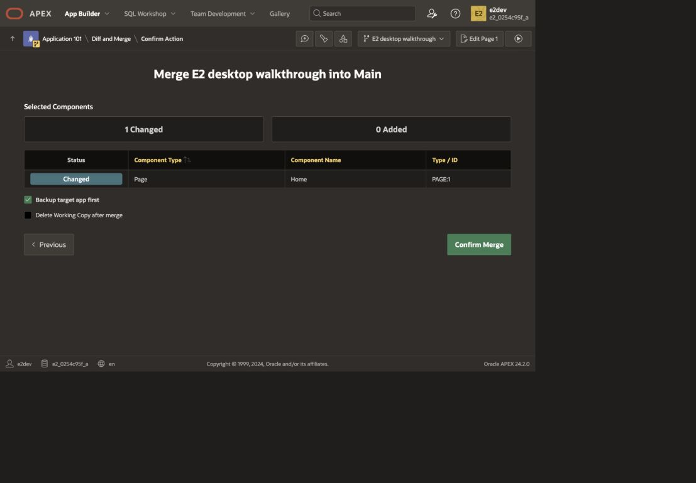
Working Copy integration and the team checkpoint
Reviewed Main state reaches Git through PROJECT export
Retained desktop repeat on the earlier fixture
03
Notes:
E.2 Product Owner handover, 22 October 2026. Decisions pending.
Sources:
progress/E.2/tests/e2_desktop_repeat_merge_full.jpg
progress/E.2/tests/desktop_repeat_main_preservation.json
progress/E.2/tests/project-f1-working-copy-validation.json
https://docs.oracle.com/en/database/oracle/apex/24.2/htmdb/about-working-copies.html
Image is a later desktop repeat on the earlier reduced fixture, not a screenshot of the Product Owner F execution. Native comparison, selective refresh and merge are observed. Working Copies share the parsing schema. Direct private-copy export is possible through selection filters but is not the demonstrated release path. A team checkpoint remains part of the Working Copy/Main journey.

Slide 4
Native tools replace specific custom responsibilities
Native capabilities
Controls still requiring qualification
APEX restricted access and publication
PROJECT source, distribution and artifacts
Liquibase migration execution history
Component compatibility and artifact admission
Deployment ownership and provenance
Live-drift rejection and reviewed recovery
E1_CTRL covers more than runtime access. Installed component versions are separate.
04
Notes:
E.2 Product Owner handover, 22 October 2026. Decisions pending.
Sources:
progress/E.2/oracle-gap-analysis.md
deploy/control.sql
deploy/release_control.sql
deploy/recovery/control.sql
Avoid a wholesale replacement claim. Native availability covers the exercised access gate, not request draining, stale-attempt fencing or promotion trust. Prefer native functions where qualified. Do not duplicate capture or packaging in a new controller.

Slide 5
G, H and I: native support gaps
Specified automatic protections in the evaluated APEX / SQLcl PROJECT workflow
Scenario | Native support | Required response
G Dependencies | Not supported | Explicit component contracts and admission
H Live drift | Not supported in evaluated path | Compare target definitions and reject before writes
I Automatic repair | Not supported | Inspect partial state and design a reviewed repair
Reviewed forward repair is supported by SQLcl/Liquibase. E.2 has not exercised it.
05
Notes:
E.2 Product Owner handover, 22 October 2026. Decisions pending.
Sources:
progress/E.2/tests/project-verify-fix-validation.json
progress/E.2/h-live-drift-evidence.md
progress/E.2/cicd-walkthrough.md
https://docs.oracle.com/en/database/oracle/sql-developer-command-line/25.2/sqcug/update.html
G: 25.4.1 clean native verification accepted both allowed and conflicting project declarations. H: limited export comparison detected the edit; zero-change replay proves neither rejection nor overwrite behavior for a pending import. Do not infer absence of every Oracle drift capability. I: automatic repair and reviewed forward repair are different capabilities. E.1-equivalent repair remains missing E.2 validation. Business-data equality is not application/schema drift detection.

Slide 6
Release qualification remains open
Retained F artifacts
Separate clean comparison
SQLcl 25.3
SQLcl 25.4.1
One native verification error remains
Post-stage APEX edits create source/distribution inconsistency
Verification passed on consistent source
Does not recertify retained F artifacts
Next: pin the client, qualify a consistent release and verify mapped identity preservation.
06
Notes:
E.2 Product Owner handover, 22 October 2026. Decisions pending.
Sources:
progress/E.2/tests/project-verify-fix-validation.json
progress/E.2/tests/project-f2-upgrade-validation.json
progress/E.2/oracle-gap-analysis-detail.md
25.4.1 comparison: Errors 0 / Warnings 0 / Info 15. Negative controls failed on a missing stage include and post-stage APEX alteration. Earlier mapped import changed observed region IDs, so required identity/saved-report preservation remains to qualify. This is a release-qualification blocker rather than general PROJECT/Working Copy incompatibility.

Slide 7
Follow-up order in the existing backlog
1. Toolchain and release identity
Pinned client, consistent source/distribution and target mappings
PBI-028/029/037/038
2. Collaboration and component contracts
Working Copy checkpoints, one migration owner and SemVer rules
PBI-020/039/042/052
3. Delivery protections and reviewed repair
Compatibility, drift rejection, ownership fencing and partial-state repair
PBI-021/022/023/024/045
4. Quality checks and pipeline operation
utPLSQL, audits and browser checks against the same candidate
PBI-040/041/043/046
Complex Foundation upgrades stay in E.5 after stabilization (PBI-048/049/050).
07
Notes:
E.2 Product Owner handover, 22 October 2026. Decisions pending.
Sources:
BACKLOG.md
progress/E.2/oracle-gap-analysis.md
Dependency order, not new sprint scheduling. Contract definition can begin during stabilization. Existing backlog owns priority and assignment. No duplicate root items. Combine checks without claiming any single audit, coverage measure or import proves overall correctness.

Slide 8
Product Owner decisions
1. Accept the assessment with its limits
Recommended: accept findings, retain protection gaps and missing repair validation
2. Keep PROJECT and Working Copies as options
Recommended: compatible repository conventions and one migration authority
3. Prioritize stabilization and protection
Recommended: qualify those outcomes before pipeline adoption
4. Reevaluate E.1 authoring restrictions
Recommended: allow native collaboration where required controls remain satisfied
5. Retain the E.5 boundary
Recommended: complex Foundation upgrades follow toolchain stabilization
All decisions pending. Acceptance does not certify production readiness.
08
Notes:
E.2 Product Owner handover, 22 October 2026. Decisions pending.
Sources:
progress/E.2/sprint_E.2_handover.md
progress/E.2/oracle-gap-analysis.md

Slide 9
PROJECT repository: retained application source
Abbreviated from component-repo-f2; omitted descendants are not shown
repo/
|-- .dbtools/
| |-- project.config.json
| `-- filters/project.filters
|-- src/database/e1_dev_c/
| |-- apex_apps/f810003/
| | |-- f810003.sql
| | `-- readable/application/
| |-- tables/
| `-- package_bodies/
repo/
|-- dist/
| |-- install.sql
| |-- component-contract.json
| |-- releases/
| | |-- 1.0.0/
| | |-- next/
| | `-- apex/
| `-- utils/properties/
`-- artifact/
The application Git repository is retained evidence. Only laboratory runtime resources are disposable.
09
Notes:
E.2 Product Owner handover, 22 October 2026. Decisions pending.
Sources:
progress/E.2/cicd-walkthrough.md
progress/E.2/repository-layout.md
.local-apex/e2/project-walkthrough/component-repo-f2
Actual local app repo .local-apex/e2/project-walkthrough/component-repo-f2 inspected during authoring. Tree abbreviated. artifact holds generated archives; tracked source/distribution and private archives are different retention responsibilities. .dbtools filters select Main 810003 for demonstrated release capture. Do not confuse this application repository with the parent APEX_CICD delivery repository.

Slide 10
Native commands and evidence boundaries
SQLcl PROJECT performs capture, staging and artifact deployment
project export -list
project export
project stage -branch-name e2-world -verbose
project gen-artifact -name e2 -version 1.0.1 -format zip
project deploy -file artifact/e2-1.0.1.zip
Illustrative command sequence. Prepared mappings, baseline branches and release inputs are required.
10
Notes:
E.2 Product Owner handover, 22 October 2026. Decisions pending.
Sources:
progress/E.2/cicd-walkthrough.md
https://docs.oracle.com/en/database/oracle/sql-developer-command-line/25.3/sqcug/project.html
This appendix is an explanation, not a new runnable walkthrough or a request to generate/overwrite archives. Actual artifact names and mappings are in cicd-walkthrough.md. PROJECT export does not commit to Git. Git reviews/commits are separate operations. Native commands do not infer component compatibility or implement a target drift admission policy.

Slide 11
Evidence and next review
Decision brief and gap analysis
sprint_E.2_handover.md
oracle-gap-analysis.md
Receipts identify actual clients, targets and reference runs
The Product Owner reported F completed on 20 October
G/H/I retain the stated native limits and unfinished validation
Next review: decide the direction and follow-up priority. E.1 evidence remains intact.
11
Notes:
E.2 Product Owner handover, 22 October 2026. Decisions pending.
Sources:
progress/E.2/sprint_E.2_handover.md
progress/E.2/oracle-gap-analysis.md
progress/E.2/tests/project-integration-mapped-validation.json
progress/E.2/tests/project-f2-upgrade-validation.json
progress/E.2/tests/project-verify-fix-validation.json
refs/apex-lifecycle-management-v3.pdf
All source file paths relative to repository root. Primary Oracle sources: refs/apex-lifecycle-management-v3.pdf; https://docs.oracle.com/en/database/oracle/sql-developer-command-line/25.3/sqcug/project.html; https://docs.oracle.com/en/database/oracle/sql-developer-command-line/25.4/sqcug/project.html; https://docs.oracle.com/en/database/oracle/apex/24.2/htmdb/about-working-copies.html; https://docs.oracle.com/en/database/oracle/apex/24.2/htmdb/using-shared-component-subscriptions.html; https://docs.oracle.com/en/database/oracle/sql-developer-command-line/25.2/sqcug/update.html. The historical increment deck remains separate. Product Owner decisions and sprint status have not been changed.

