Slide 1
Movie Recommendation system

Slide 2
Introduction
A recommendation system is a system that provides suggestions to users for certain resources like books, movies, songs, etc., based on some data-set.
Movie recommendation systems usually predict what movies a user will like based on the attributes present in previously liked movies.
We built a recommendation engine based on a lot of factors which can be considered while designing a movie recommendation system like the genre of the movie, actors present in it or even the director of the movie.
The engine recommends a movie based on all content-based attributes.

Slide 3
Project Scope
The data-set contains approximately 5000 movie data.
The recommendation engine recommends movie after selecting a movie from our data-set.
The application arrange the similar movies best choice to worst choice from all movies of data-set
The application has a search facility from the data-set.
There is a reset button to reset recommendation.

Slide 4
Recommendation
A recommendation engine filters the data using different algorithms and recommends the most relevant items to users. It first captures the past behavior of a customer and based on that, recommends products which the users might be likely to buy.
Often termed as Recommender Systems, they are simple algorithms which aim to provide the most relevant and accurate items to the user by filtering useful stuff from of a huge pool of information base. Recommendation engines discovers data patterns in the data set by learning consumers choices and produces the outcomes that co-relates to their needs and interests.

Slide 5
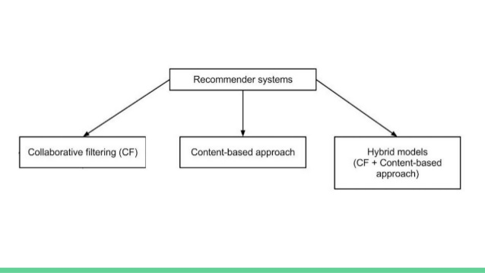
Types of Recommendation

Slide 6
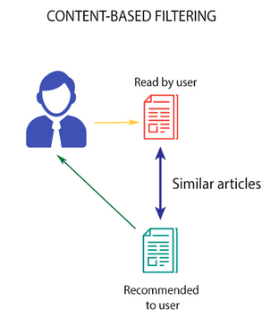
Content base filtering
Content-based filtering methods are based on a description of the item and a profile of the user's preferences. These methods are best suited to situations where there is known data on an item (name, location, description, etc.), but not on the user. Content-based recommendations treat recommendation as a user-specific classification problem and learn a classifier for the user's likes and dislikes based on an item's features.

Slide 7
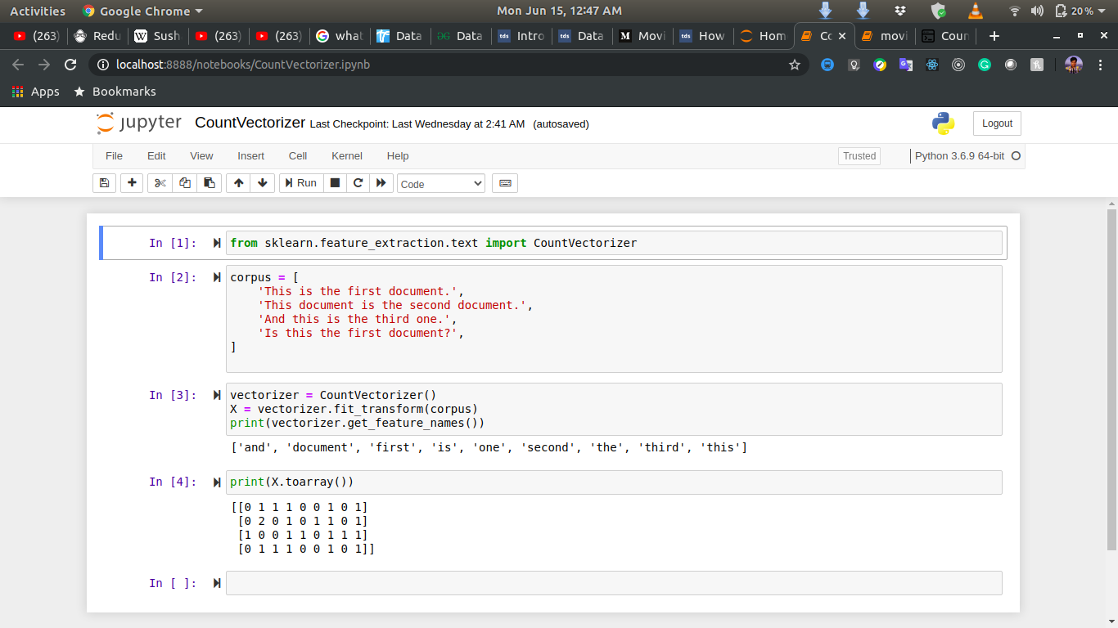
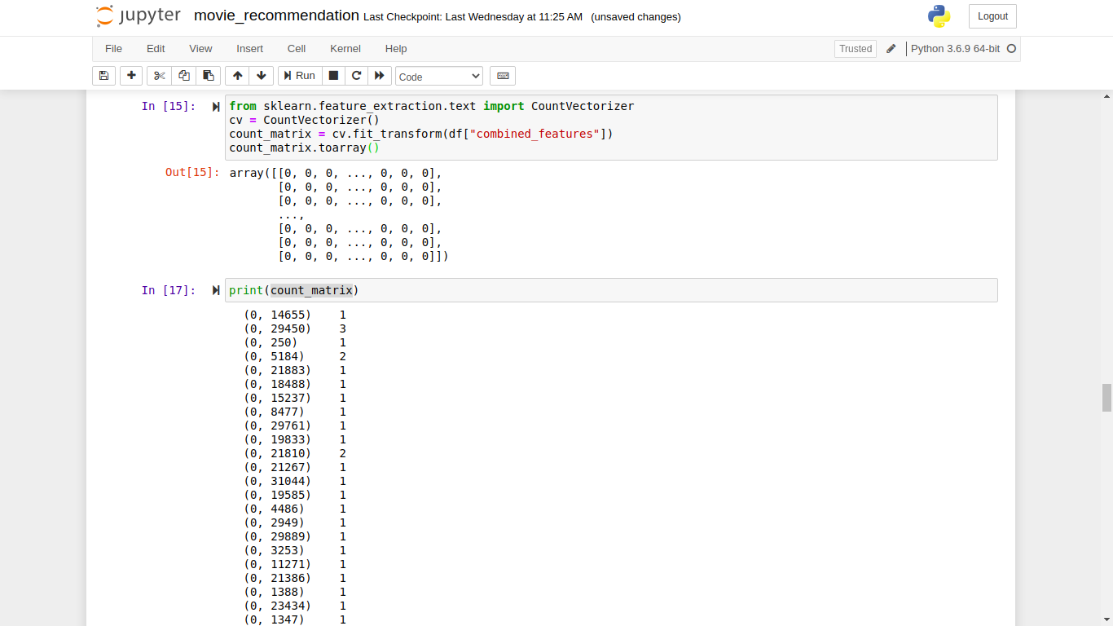
Count vector
Scikit-learn’s CountVectorizer is used to convert a collection of text documents to a vector of term/token counts. It also enables the ​pre-processing of text data prior to generating the vector representation. This functionality makes it a highly flexible feature representation module for text.

Slide 8
Cosine similarity matrix
Cosine similarity is a metric used to measure how similar the documents are irrespective of their size.
Mathematically, it measures the cosine of the angle between two vectors projected in a multi-dimensional space.
The cosine similarity is advantageous because even if the two similar documents are far apart by the Euclidean distance (due to the size of the document), chances are they may still be oriented closer together. The smaller the angle, higher the cosine similarity.

Slide 9
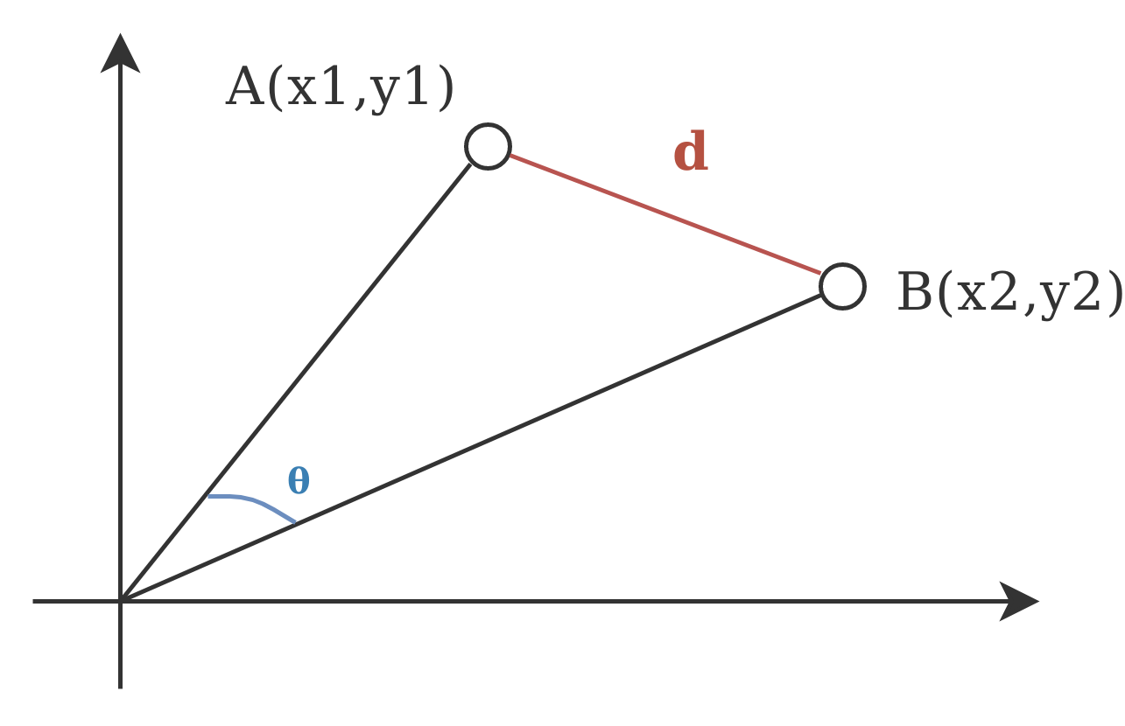
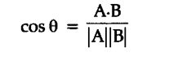
Let’s understand the similarity score and similarity matrix. Example: Text A: London Paris London Text B: Paris Paris London (London, Paris) A: (2, 1) B: (1, 2) X-Axis = London, Y-Axis = Paris A: (x1, y1) = (2, 1) B: (x2, y2) = (1, 2) D = Euclidean Distance and theta is Angular Distance The value of cos(theta) lies between 0 and 1 for positive direction of A vector and B vector. Now how much document is similar it depends on their distance of their count vector.

Slide 10
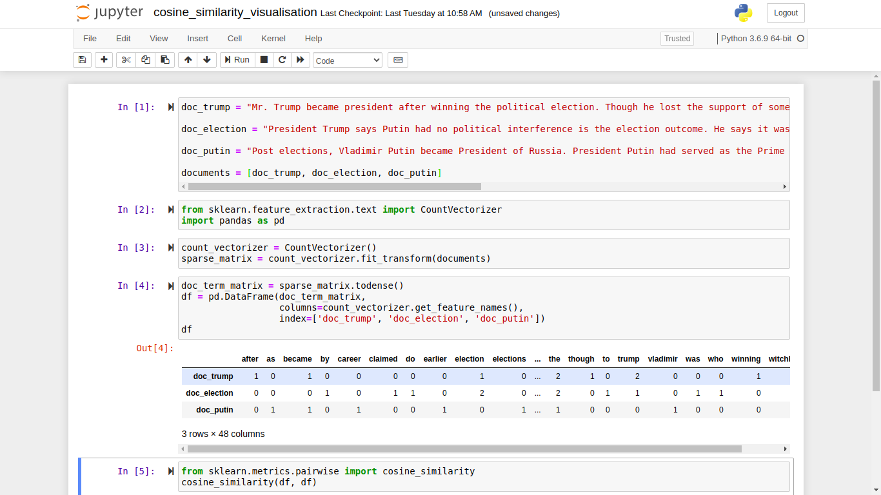
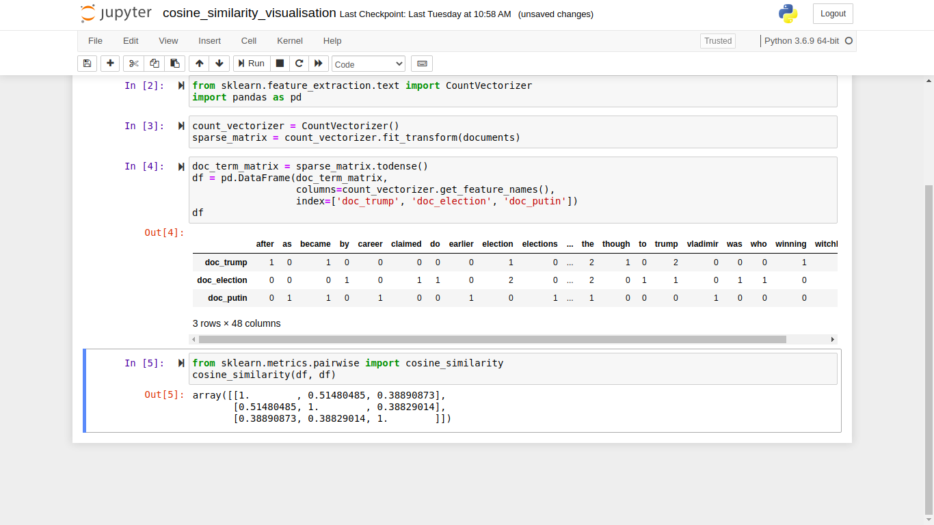
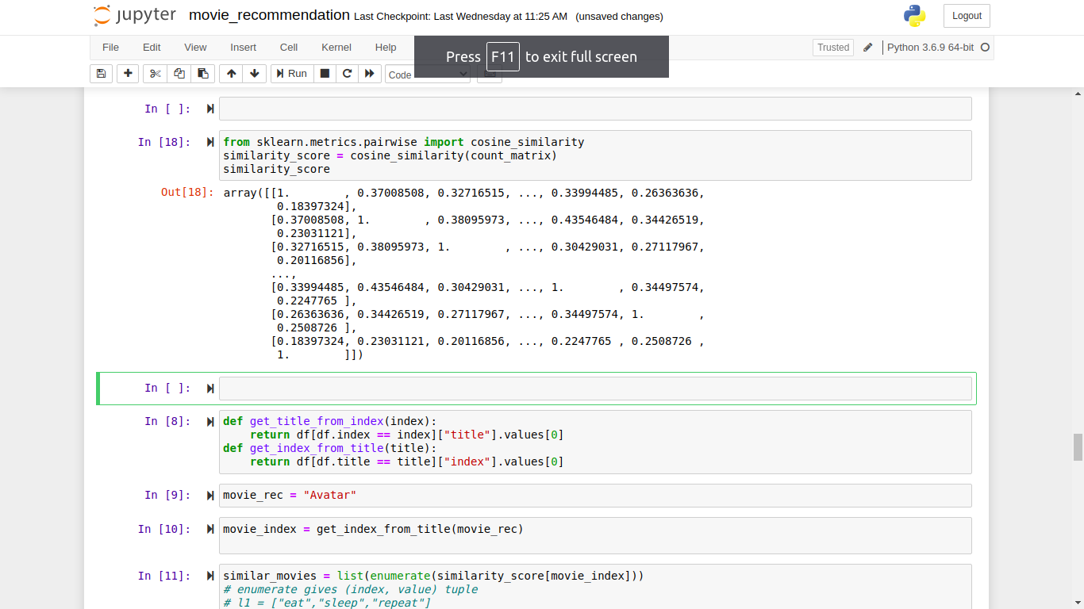
Cosine similarity matrix

Slide 11
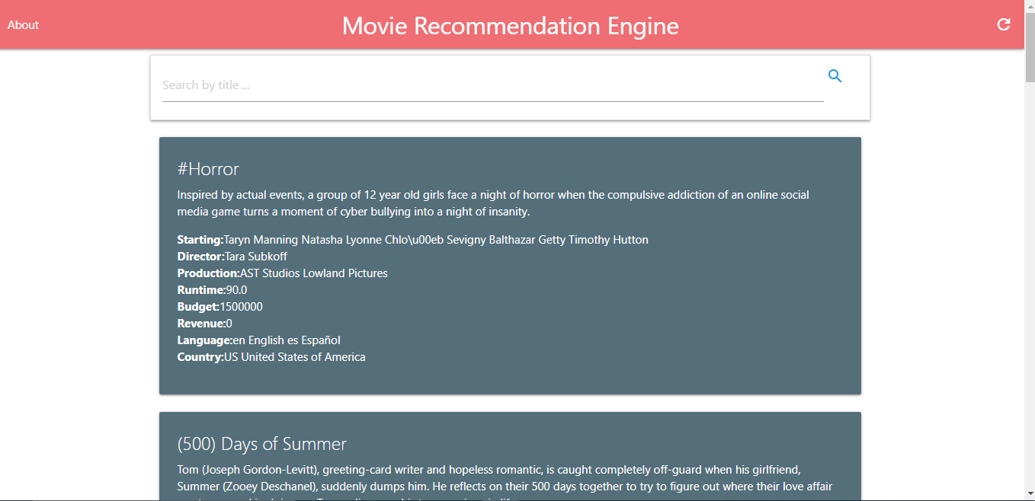
Application Demonstration

Slide 12
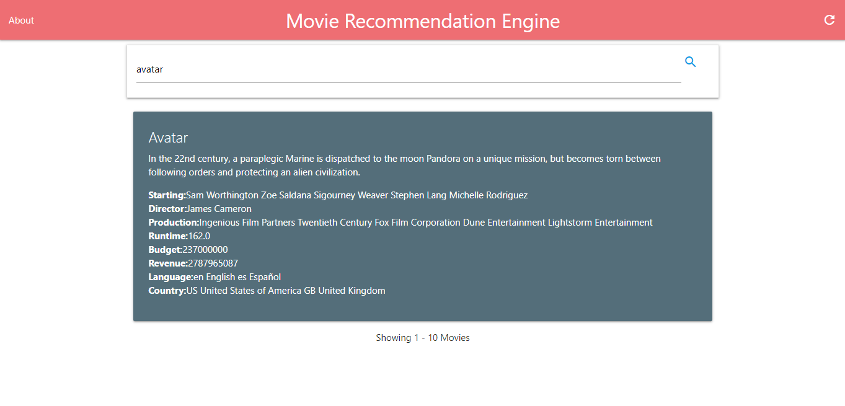
Application Demonstration

Slide 13
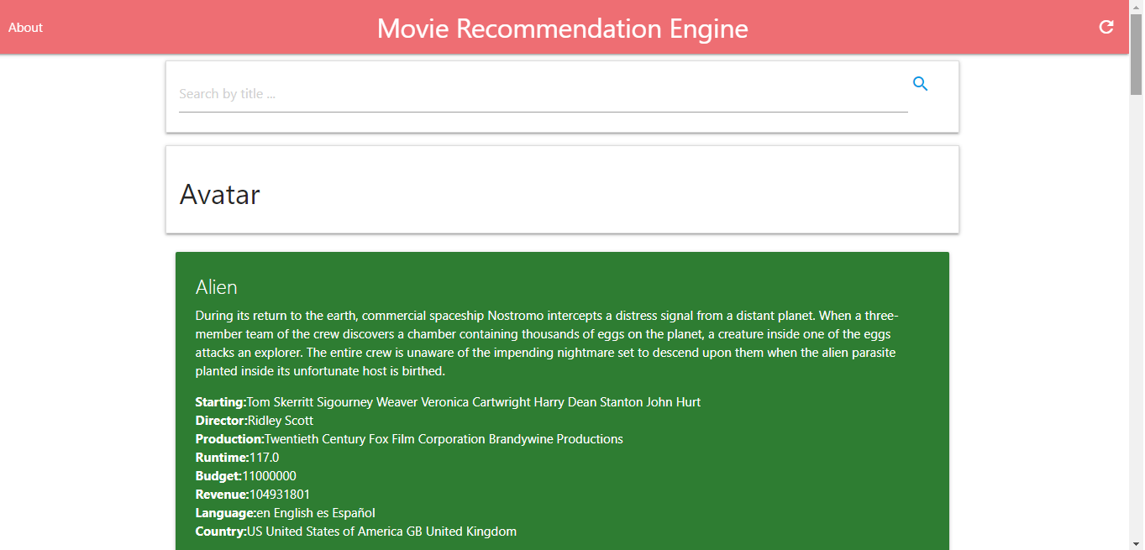
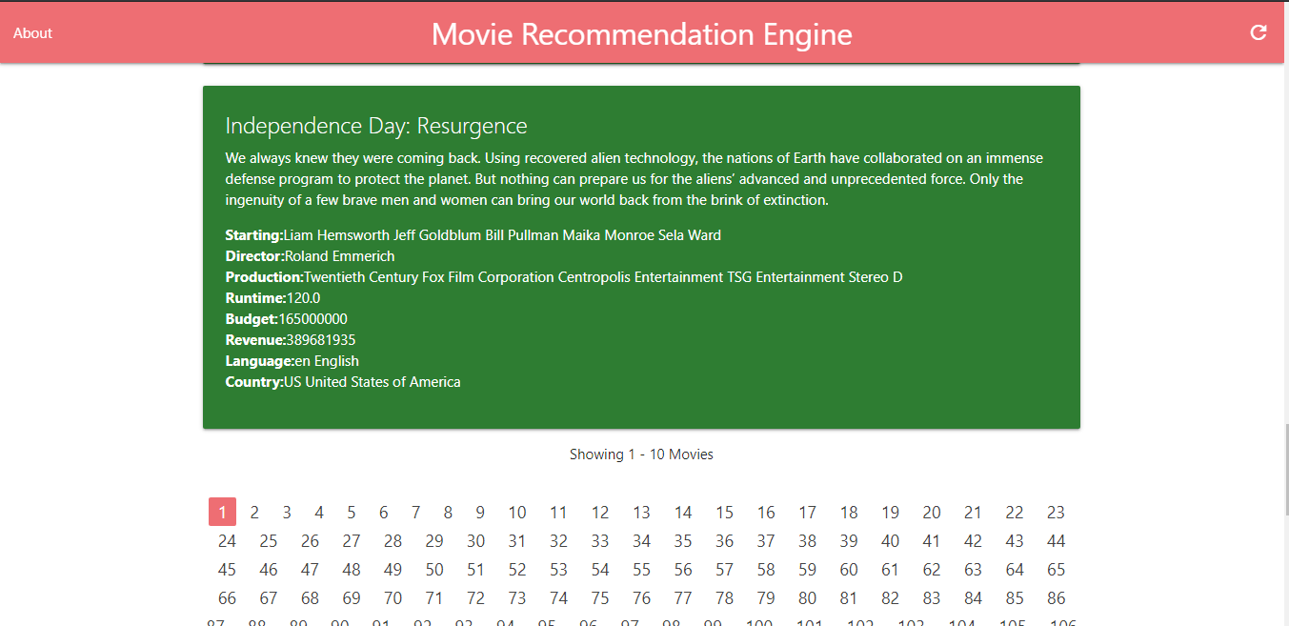
Application Demonstration

Slide 14
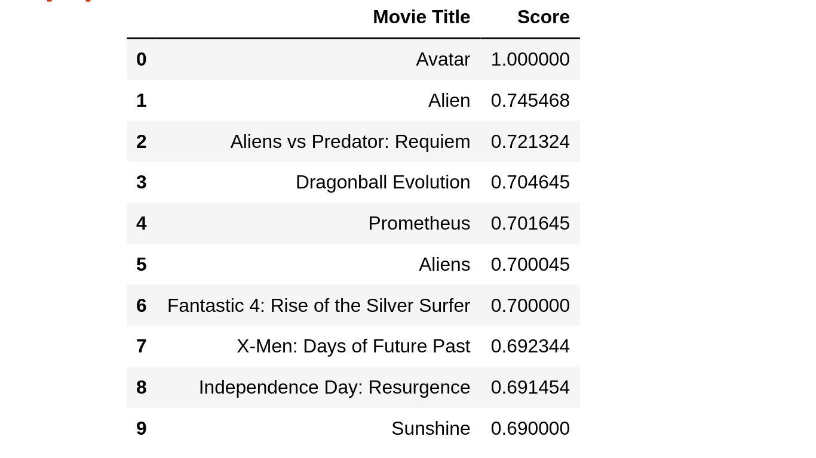
Evaluation
Based on ground truth dataset we get f1 score when we choose the movie “Avatar”.

Slide 15
Project Limitations
Limited content analysis: If the content doesn’t contain enough information to discriminate the items precisely, the recommendation itself risks being imprecise.
Over-specialization: Content-based filtering provides a limited degree of novelty since it has to match up the features of a user’s profile with available items. In the case of item-based filtering, only item profiles are created and users are suggested items similar to what they rate or search for, instead of their past history. A perfect content-based filtering system may suggest nothing unexpected or surprising.
Since the feature representation of the items are hand-engineered to some extent, this technique requires a lot of domain knowledge. Therefore, the model can only be as good as the hand-engineered features.
The model can only make recommendations based on existing interests of the user. In other words, the model has limited ability to expand on the users' existing interests.
Cold start is a potential problem in computer-based information systems which involve a degree of automated data modelling . Specifically, it concerns the issue that the system cannot draw any inferences for users or items about which it has not yet gathered sufficient information. The cold start problem is a well known and well researched problem for recommender systems . Recommender systems form a specific type of information filtering (IF) technique that attempts to present information items (ecommerce, films, music, books, news, images, web pages) that are likely of interest to the user. Typically, a recommender system compares the user's profile to some reference characteristics. These characteristics may be related to item characteristics (content-based filtering) or the user's social environment and past behavior (collaborative filtering). Depending on the system, the user can be associated to various kinds of interactions: ratings, bookmarks, purchases, likes, number of page visits etc.
If a new item is added in the data-set the model needs retraining which takes to much time.

Slide 16
Future Scope
We can implement a scope to add new movie in our data-set.
The engine only using content-based filtering. Collaborative filtering can be added for hybrid recommendation.
The different algorithm can be used to get better and faster recommendation model.
Also we can improve the user experience of the application.
A movie watching platform can be added.

Slide 17
Conclusion
The recommendation engine implemented in this project aims at providing movie recommendation based on the many features of the movies. It recommends similar movie of selected movie to a user. Recommendation systems are widely used in today’s era of internet searching for reliable and relevant information. While simple recommendation systems recommend users based on a few parameters, complex ones take many parameters into consideration. By implementing machine learning in recommendation systems, Several multinational companies have been exploiting the potential of recommendation system to lure customers into using their products. Such as Google, Netflix, Amazon etc.

Slide 18
Bibliography
https://www.google.co.in/
https://docs.djangoproject.com/en/2.2/
www.stackoverflow.com
https://www.youtube.com/
https://materializecss.com/
https://www.wikipedia.org/
https://medium.com/
https://www.coursera.org/
https://www.edureka.co/
https://scikit-learn.org/
https://pandas.pydata.org/
https://numpy.org/
https://docs.aws.amazon.com/ec2/index.html
https://developers.google.com/
https://towardsdatascience.com/

Slide 19
Thank you
Sudhanya roy
Binamrata Prasad
Arpan kumar charan
Subhadeep palai

