Slide 1
Blue/Green Deployment
Ram Sugasi
DevOps Engineer

Slide 2
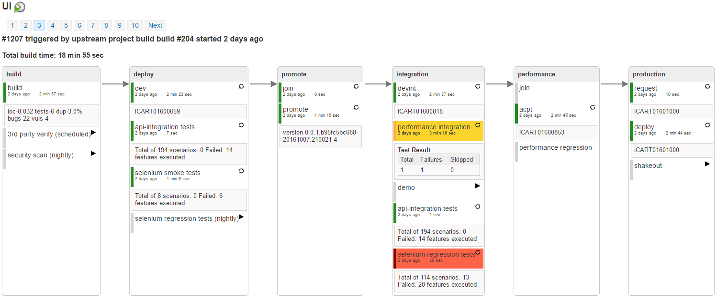
Continuous Integration
Continuous Integration (CI) is a development practice that requires developers to integrate code into a shared repository several times a day. Each check-in is then verified by an automated build, allowing teams to detect problems early.

Slide 3
Continuous Delivery
Continuous Delivery (CD) is the natural extension of Continuous Integration: an approach in which teams ensure that every change to the system is releasable, and that we can release any version at the push of a button. Continuous Delivery aims to make releases boring, so we can deliver frequently and get fast feedback on what users care about.
Continuous Deployment is the next step of continuous delivery: Every change that passes the automated tests is deployed to production automatically. Continuous deployment should be the goal of most companies that are not constrained by regulatory or other requirements.
At Fannie Mae, we have been doing Continuous Delivery but not Continuous Deployment

Slide 4

Types of Continuous Deployment Strategy
Blue/Green
Alpha/Beta (or) A/B
Canary Releases
Dark Launching
Production Immune Systems

Slide 5
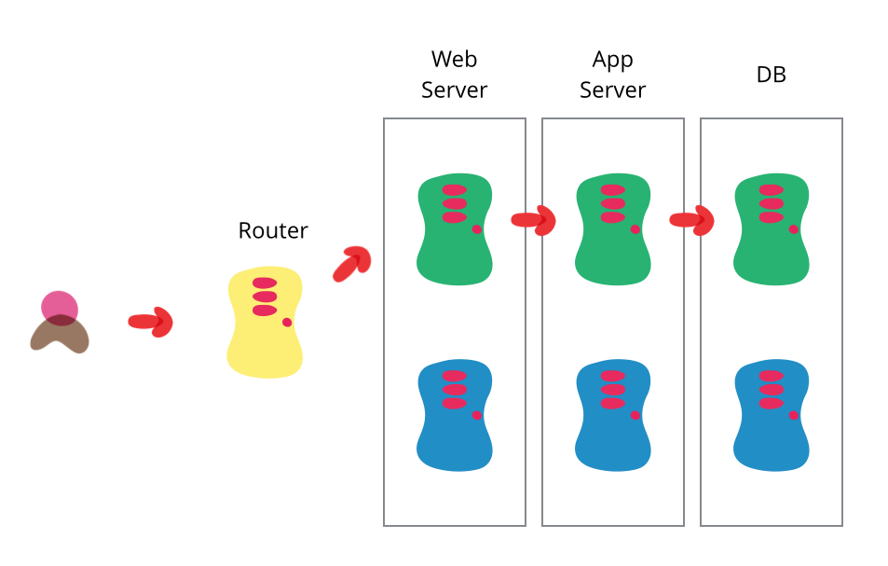
What is a Blue/Green deployment
Ensure you have two production environments, as identical as possible.
At any time one of them, let's say blue for the example, is live. As you prepare a new release of your software you do your final stage of testing in the green environment.
Once the software is working in the green environment, you switch the router so that all incoming requests go to the green environment - the blue one is now idle.

Slide 6
What next
Set up acceptance environment for ILE with Blue/Green Servers
Improve the process of restarting web server by automating it.

Slide 7
Thank You

