Slide 1
Zel'dovich Approximation (ZA)
IUCAA – NCRA
Graduate School Project
Sujatha Ramakrishnan
Guided by
Prof. Aseem Paranjape

Slide 2
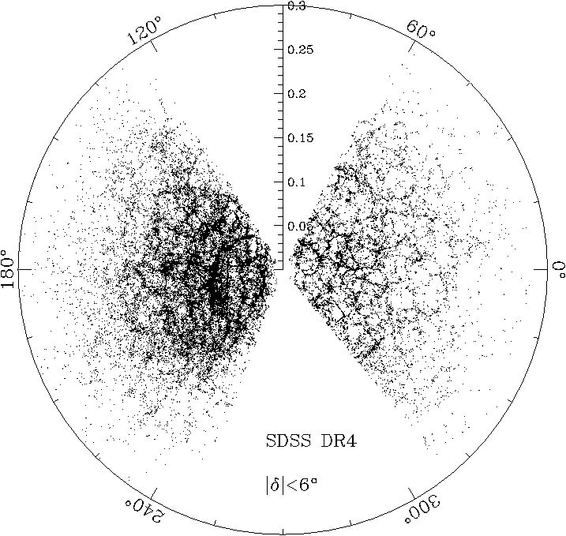
Motivation
Large Scale Structures in the Universe
N body Simulations
Analytical Approximations
Notes:
LSS ----> tiny fluctuations
Galaxies --> initial fluctuation large
Voids ----> initial fluctuation smal
Full fledged n body simulations
Anayltical approximations
One such approximation is the ZA
Initial condition in sim
Good match to sim at large scales
Ill begin by showing a movie where small initial matter density fluctuations are evoled in time using ZA.

Slide 3
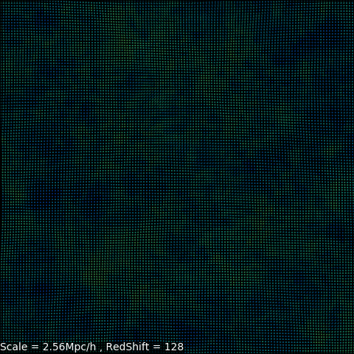
Zel'dovich Approximation (ZA)
2 D Collapse
1D Collapse
3D Collapse
Expansion
Notes:
Boxsize of 2.56Mpm
Evolution in time marked by a redshift countdown
The ZA is stopped at redshift 8
We now begin to see how za Helps to study non linear collapses.
Various kinds of collapses are color coded here.
3d-node-red
2d-sheet-yellow
1d-filament-blue
Black-voids

Slide 4
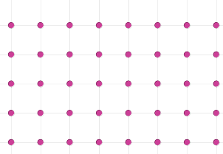
Zel'dovich Approximation takes Lagrangian view point
In Eulerian viewpoint property of fluid such as density is specified at a particular spacepoint.
In Lagrangian viewpoint - Observer follows the individual fluid element and track its position,velocity.
(Comoving Coordinates)
q---> Lagrangian
x---->Eulerian
Equation of Motion in Lagrangian Coordinates :

Slide 5
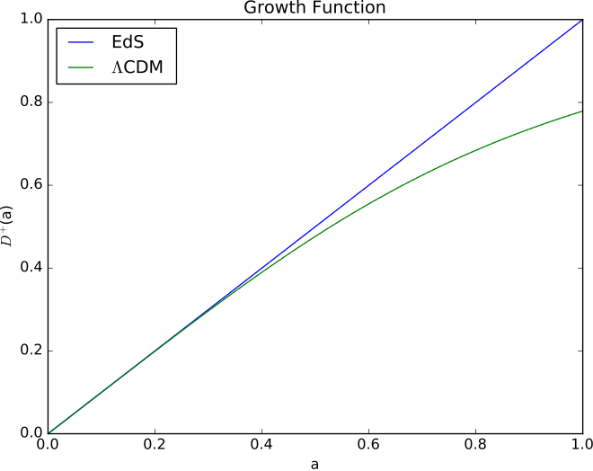
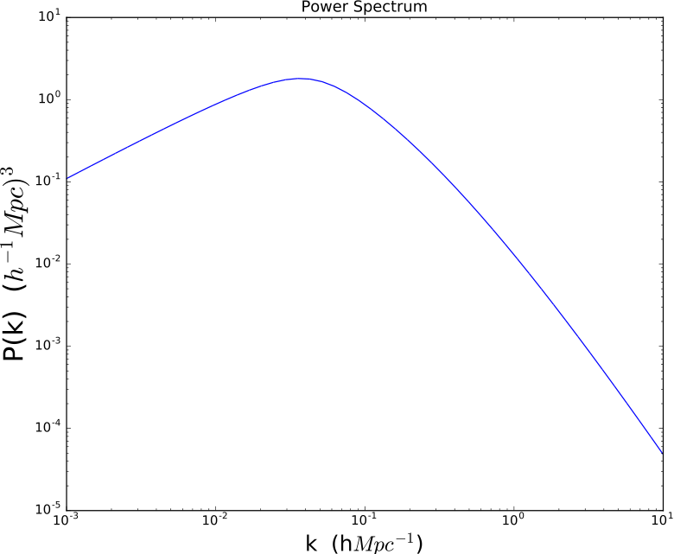
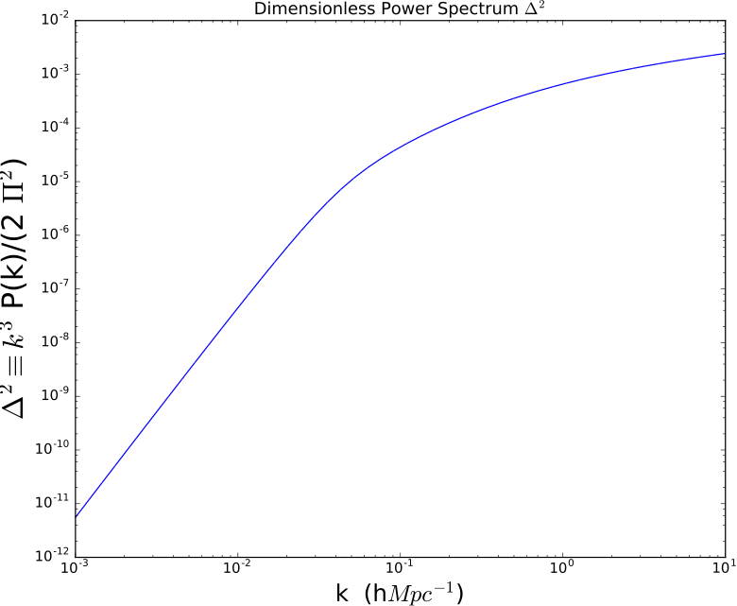
Ist Order
Solution----->
(Poisson Equation)
To do ZA, all we need to know is the initial density
fluctuations and the linear theory growth function
Cosmological Density Fluctuation Information
is encoded in the Linear Power Spectrum

Slide 6
Zel'dovich Approximation
One Dimension
Two Dimension
Three Dimension
Notes:
We are going to build intution step by step

Slide 7
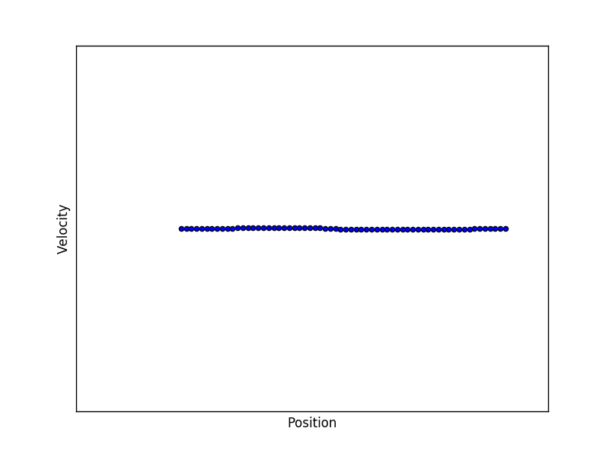
ZA in One Dimension

Slide 8
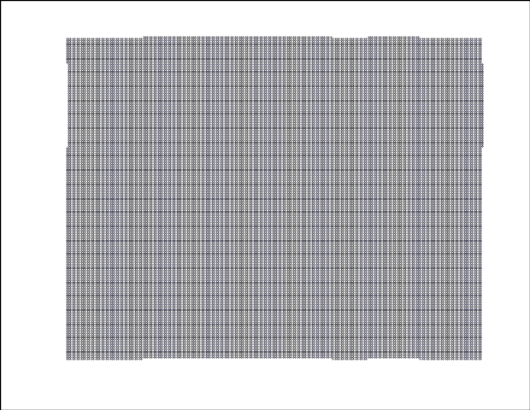
ZA in Two Dimension

Slide 9
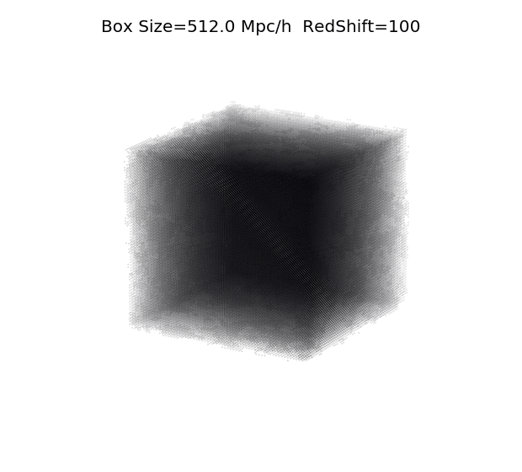
ZA in 3D (Cosmological P(k) using BBKS Transfer function}

Slide 10
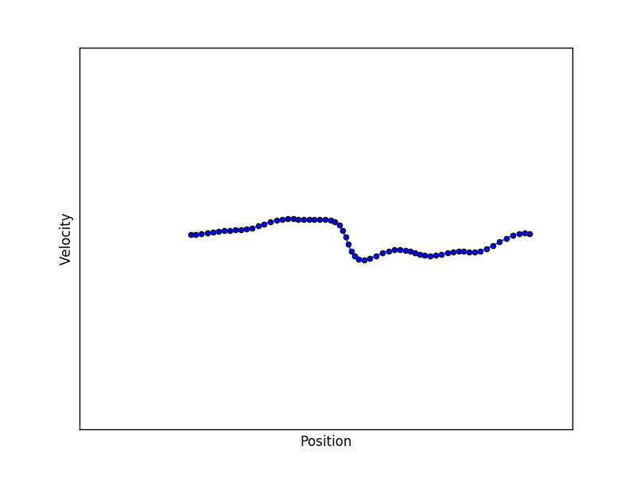
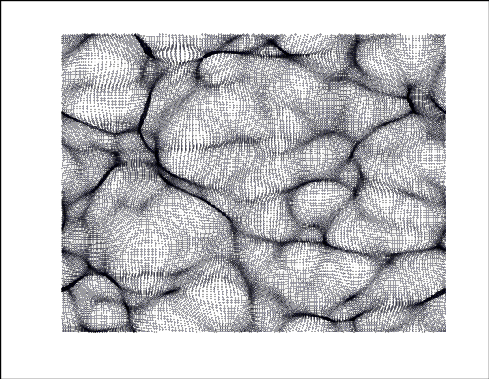
Multistreaming Regions and Formation of Caustics
1D
3D
2D

Slide 11
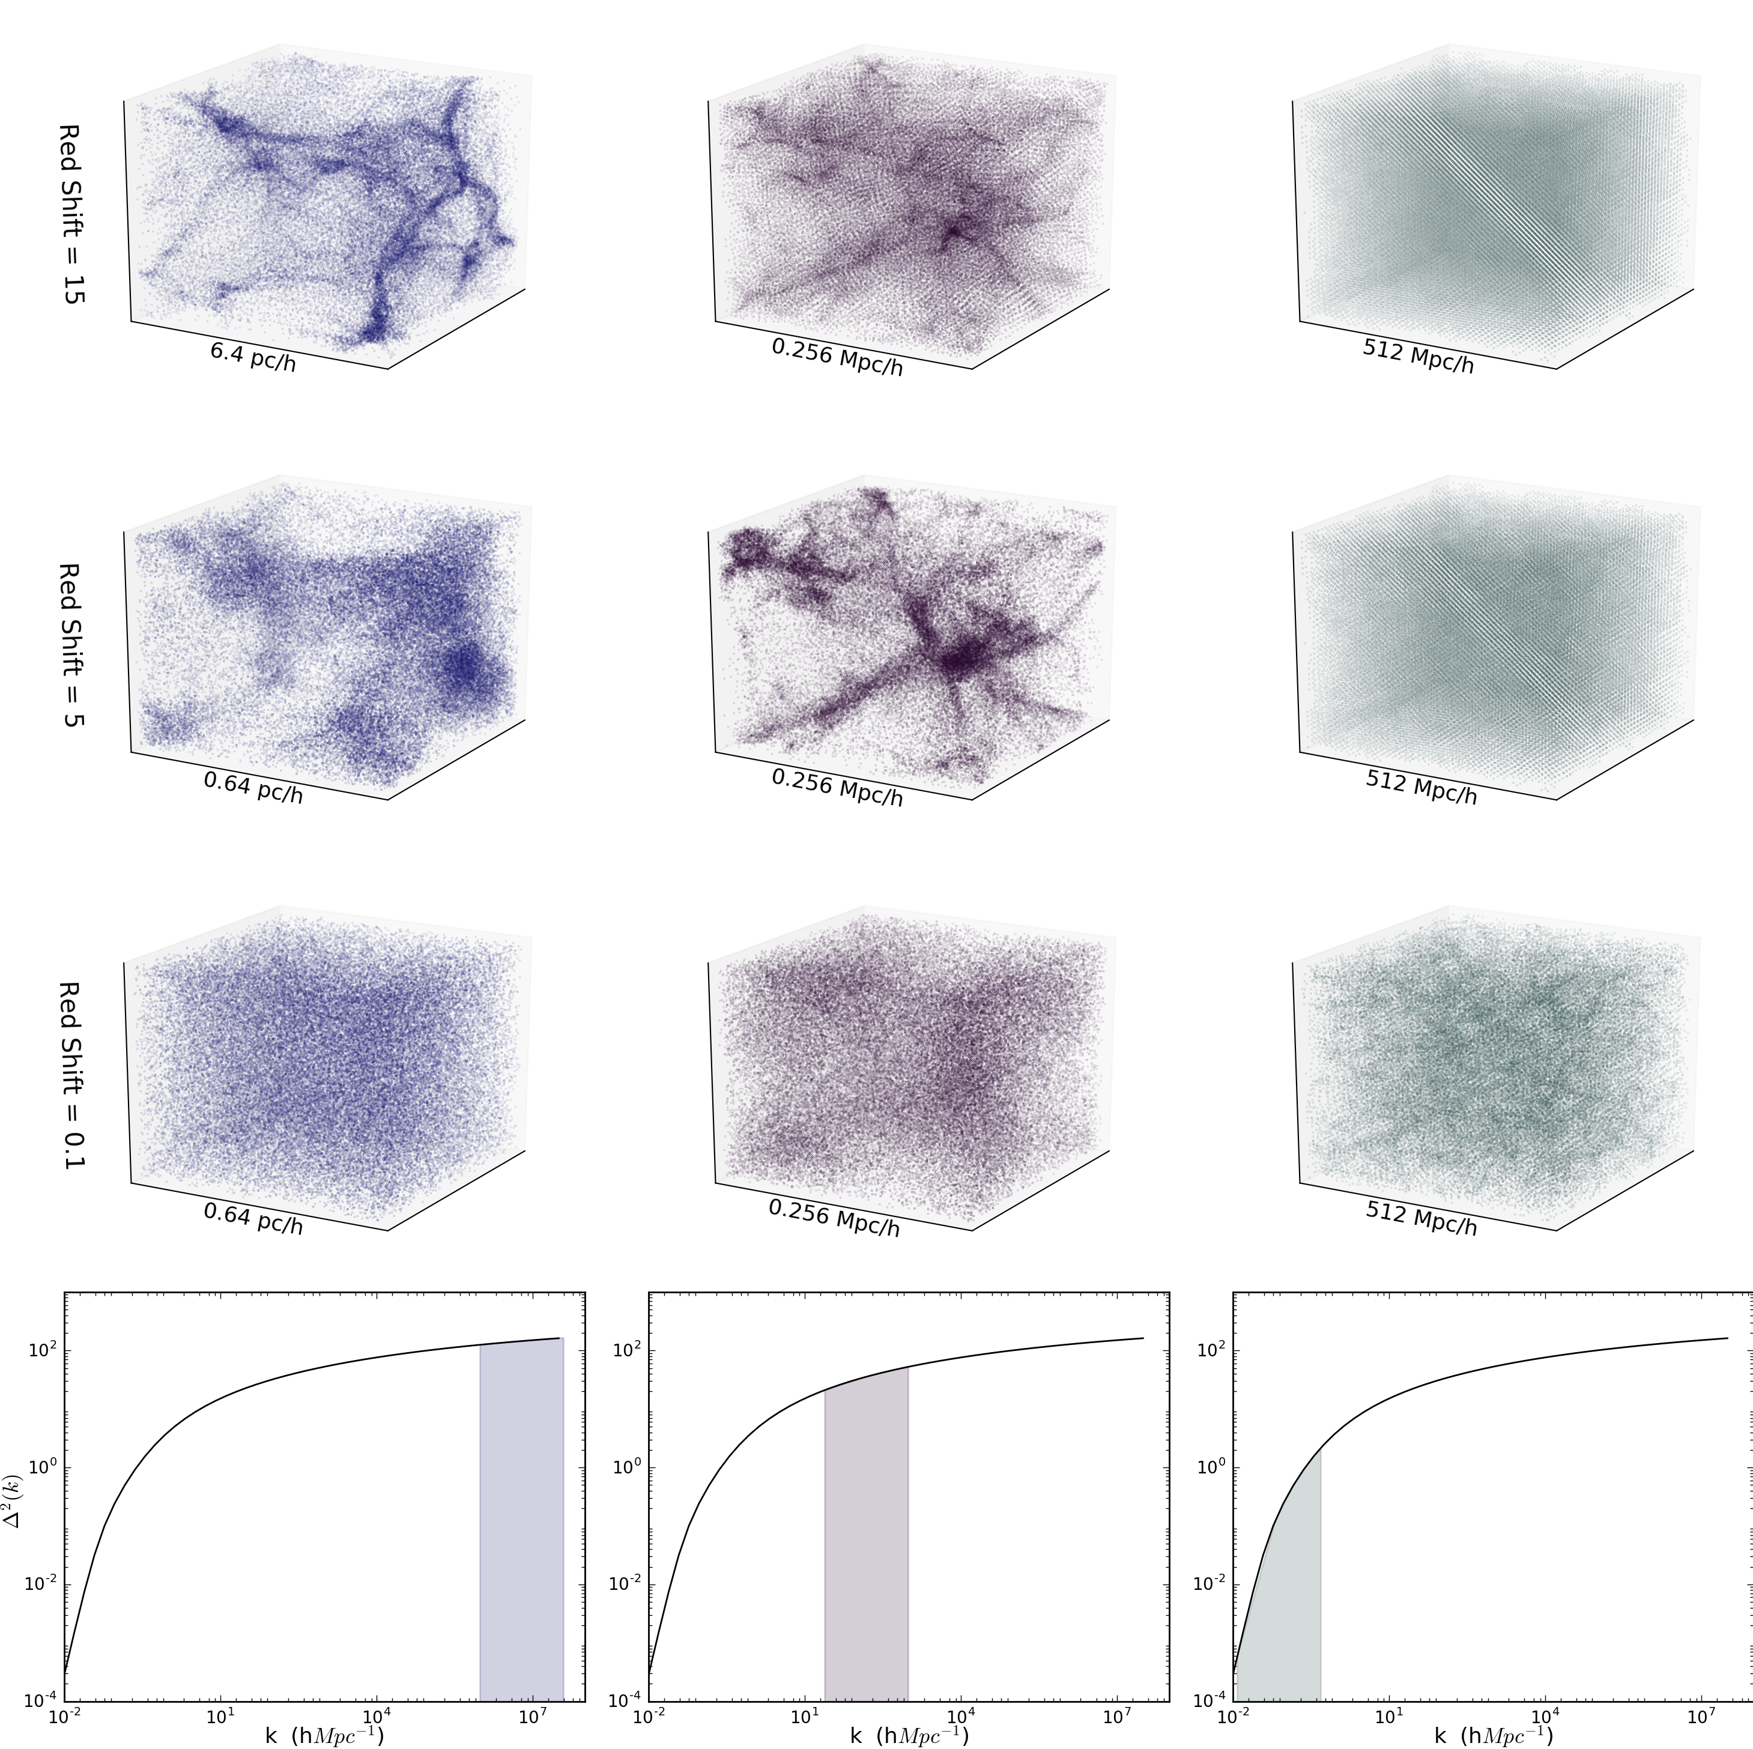
Structures form earlier at smaller scales
L is box size
dx is the size
of fluid element
Notes:
From fig we can see smaller boxes forming structures earlier
Explanation: the dimensionless power spectrum is directly related to variance of deltax. So more power impies more density fluctuations
Largest k mode 1/dx determined be smallest dx,can be made smaller by increasing gridsize.
Similarl

Slide 12
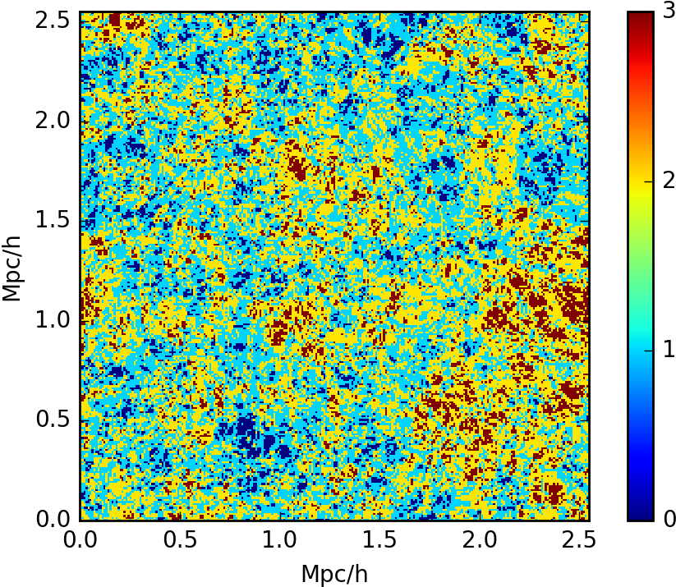
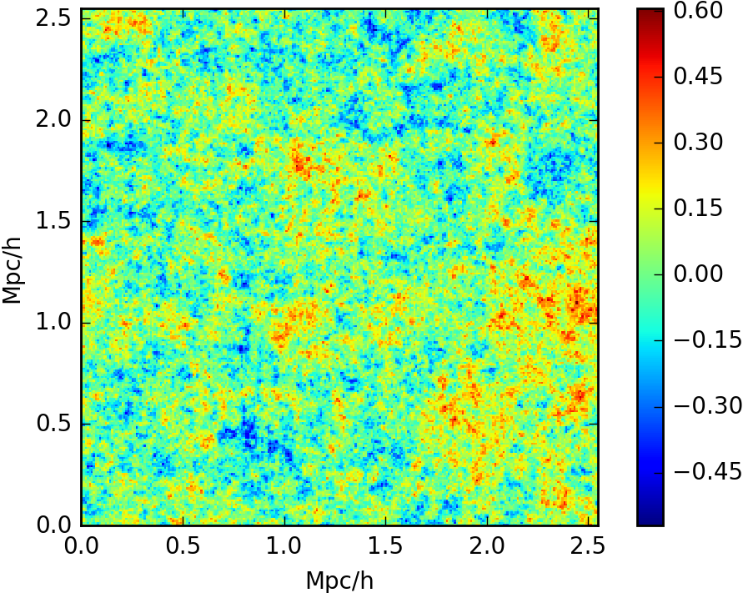
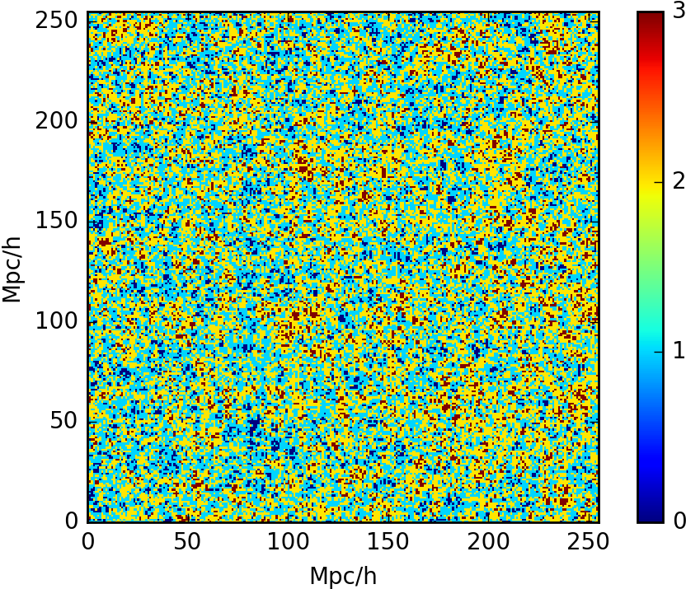
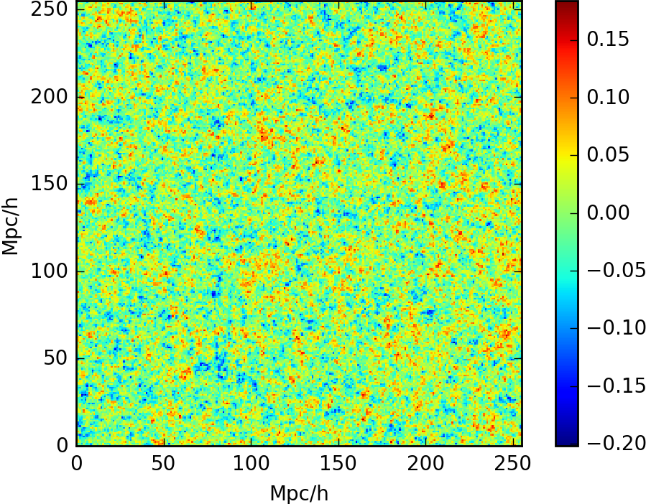
Web Classification
Eigen Value of Tidal Tensor
3 negative -- node
2 negative – filament
1 negative – sheet
0 negative -- void
BoxSize = 2.56 Mpc/h
Initial Redshift = 100
Final Redshift = 11
No of Particles = 256^3
BoxSize = 256 Mpc/h
Initial Redshift = 100
Final Redshift = 1
No of Particles = 256^3

Slide 13
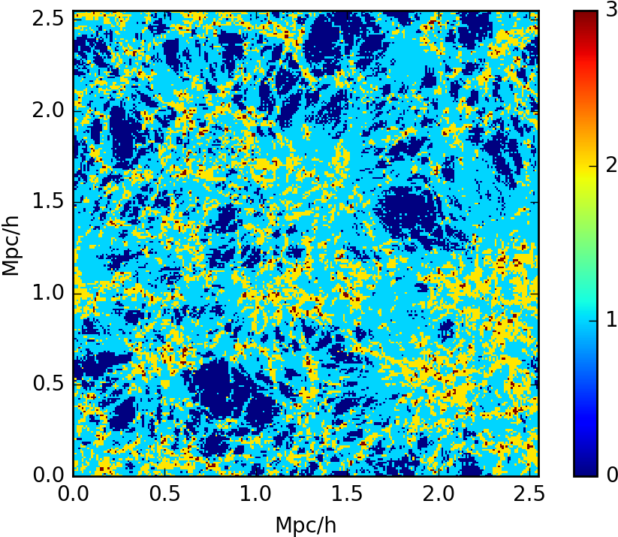
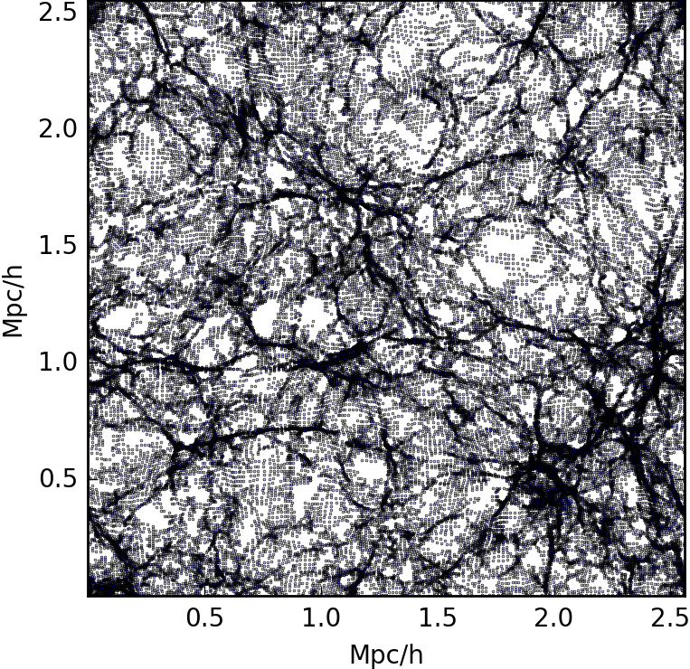
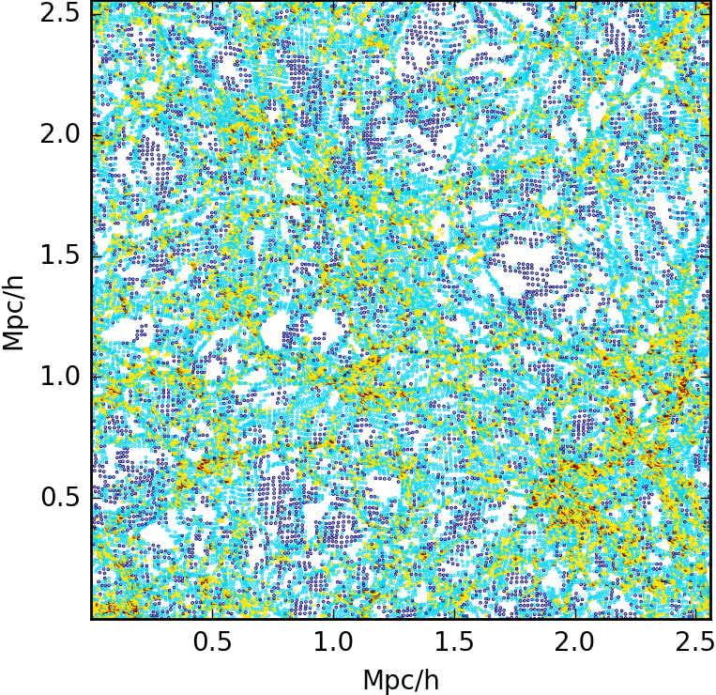
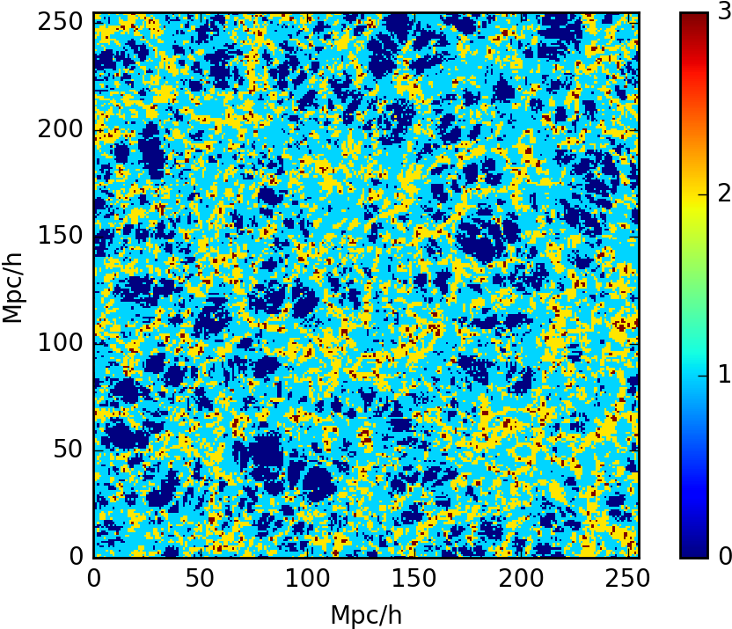
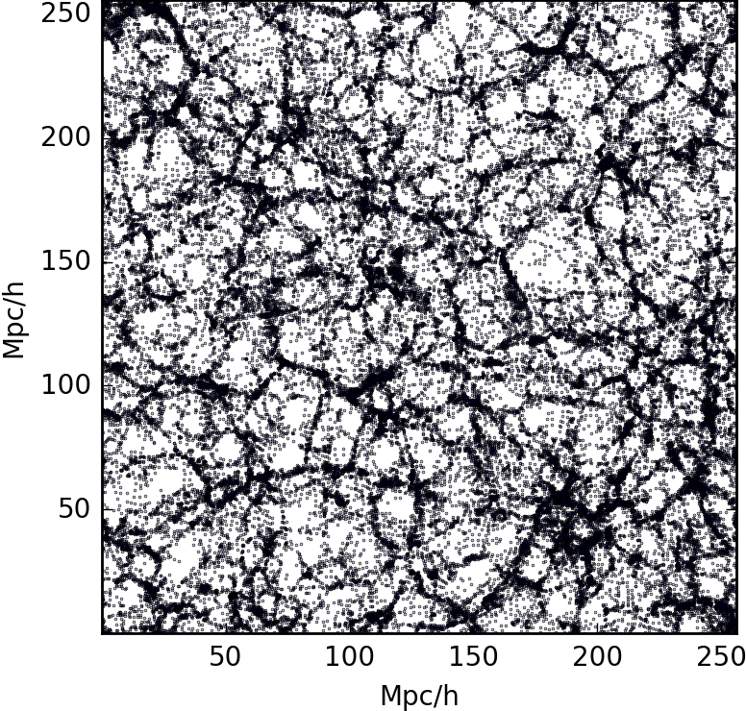
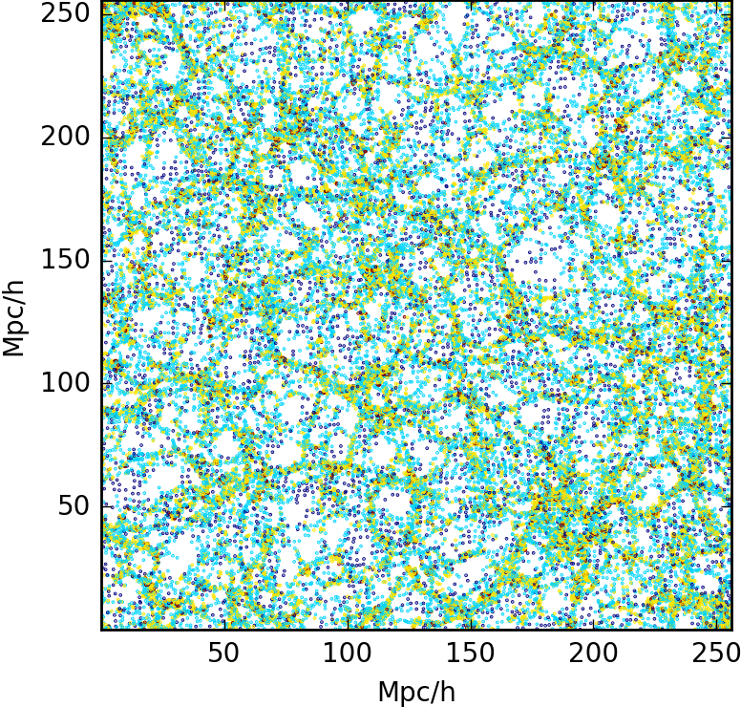
Web Classification of Final Density Field
.
BoxSize = 2.56 Mpc/h Initial Redshift = 100 Final Redshift= 11 No of Particles = 256^3
BoxSize = 256 Mpc/h Initial Redshift = 100 Final Redshift= 1 No of Particles = 256^3
Notes:
Interpolation schemes such as NGP, NGP Smooth, CIC allow us to get
density fluctuations after ZA.
We use this to classify final density field to identify void, filament, sheet, node regions

Slide 14
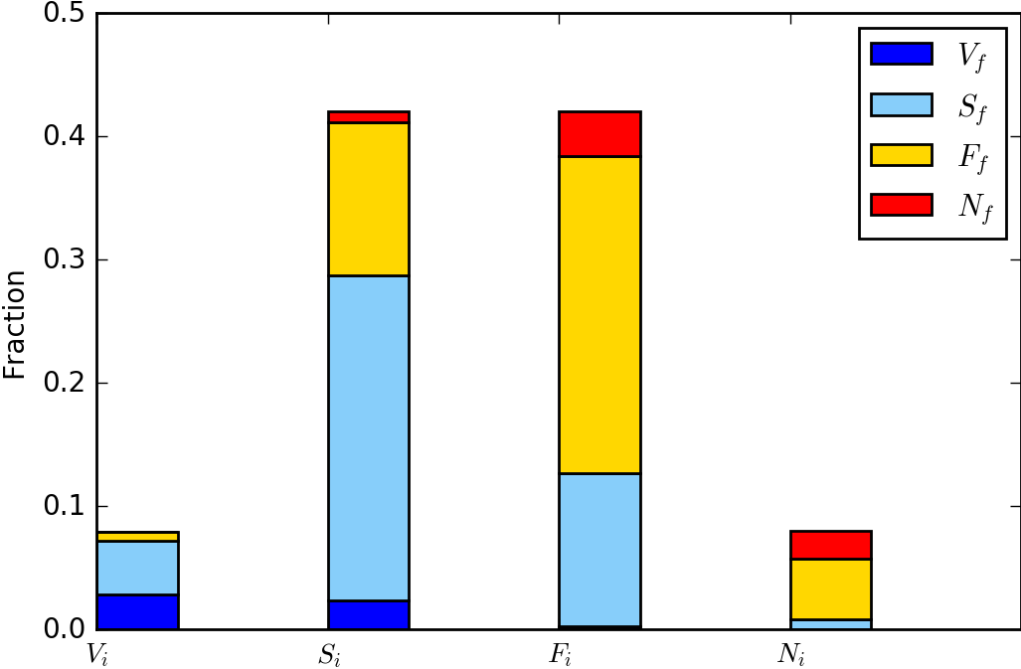
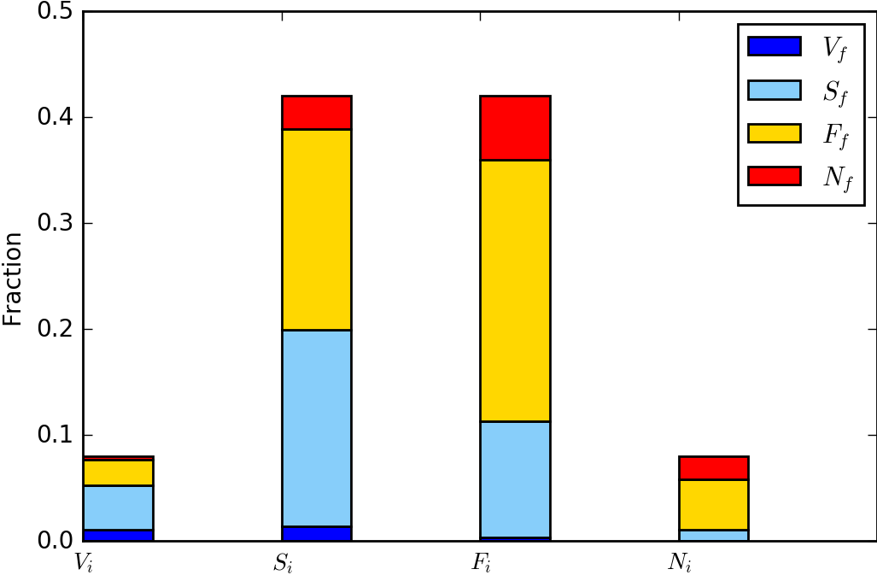
Web Classification of Final Density Field
BoxSize = 2.56 Mpc/h
Initial Redshift = 100 Final Redshift = 11
No of Particles = 256^3
BoxSize = 256 Mpc/h
Initial Redshift = 100 Final Redshift = 1
No of Particles = 256^3

Slide 15
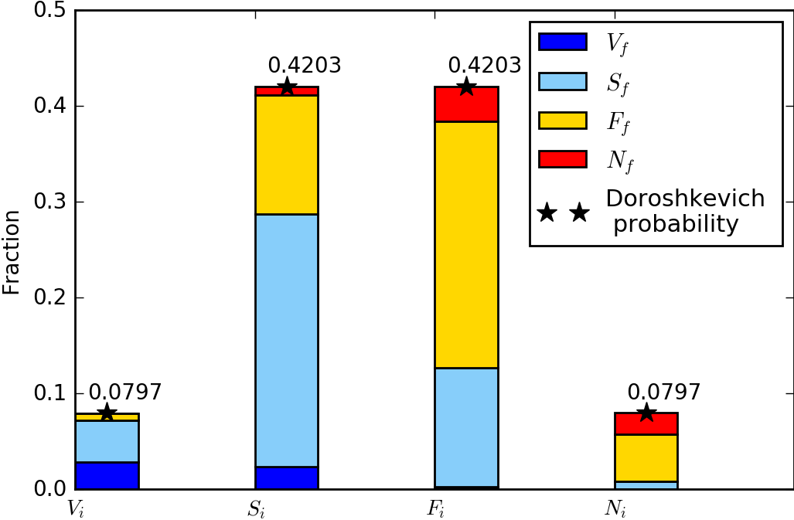
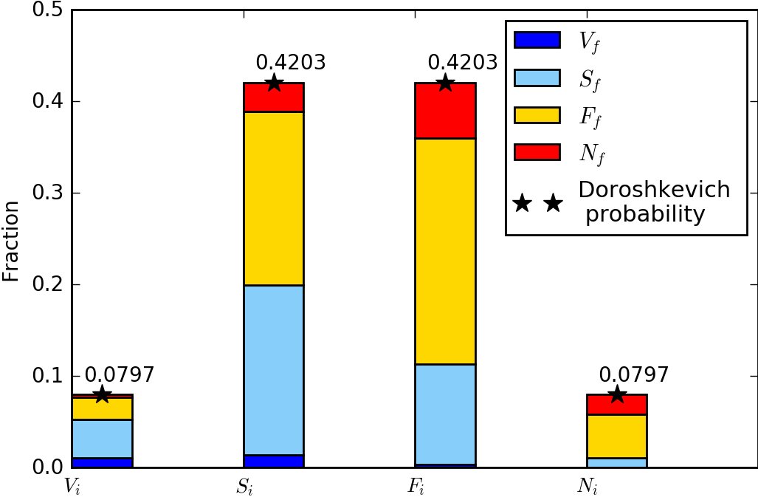
Web Classification of Final Density Field
Doroshkevich (1970)
BoxSize = 2.56 Mpc/h
Initial Redshift = 100 Final Redshift = 11
No of Particles = 256^3
BoxSize = 256 Mpc/h
Initial Redshift = 100 Final Redshift = 1
No of Particles = 256^3

Slide 16
Summary
ZA is used in 1, 2, 3D spaces to move particles.
Particles can be characterised as nodes, filaments, sheets and voids based on initial density fluctuation using tidal tensor.
Caustics are observed and approximation eventually breaks down.
Structures form earlier for smaller scales.
BoxSize, No of Particles limit the quality of the ZA
The non linear tidal tensor is used to identify regions as nodes, filaments, and sheets and voids and we see how much of the initial classification corresponds to the final classification.

