Slide 1

Advanced R Programming – Spring 2021
STA 6233 R Programming for Data Science
Position-Based Descriptive Statistical Analysis for NBA Maximum Salary Contract
Source: basketball-reference.com
Class Instructor: Dr. Matthew J. Martinez
Student: Renhao Sun

Slide 2
Presentation Agenda
Salary Cap and Maximum Salary Contract in NBA
Basketball Positions
Position-Based Valuation Model
Case Study: Small Forward
Summary

Slide 3
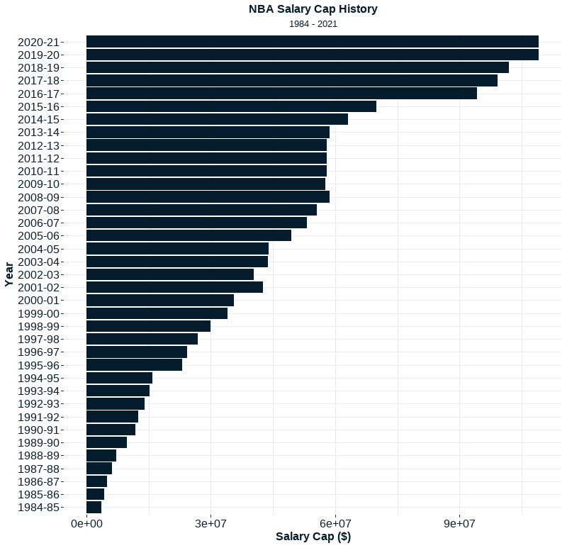
Salary Cap
Salary Cap: the NBA salary cap is the limit to the total amount of money that each NBA team is allowed to pay their players every season. Teams whose payroll exceeds the salary cap by a certain amount are required to pay luxury tax for each dollar by which their payroll exceeds the tax level
Under normal circumstances, teams will not break the salary cap to sign players because of luxury tax

Slide 4
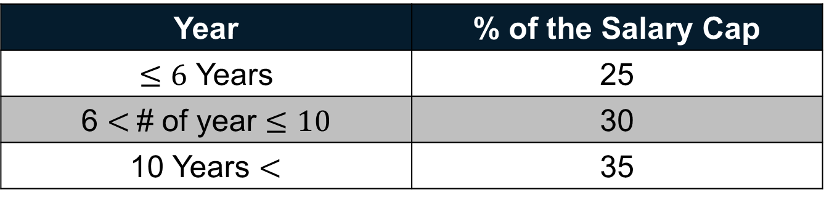
Maximum Salary Contract
Maximum Salary Contract is the maximum amount of money a player can sign is based on two factors: based on the number of years that player has played and the total of the salary cap
Year | % of the Salary Cap
$≤6$ Years | 25
6 $<$# of year $≤10$ | 30
10 Years $<$ | 35

Slide 5
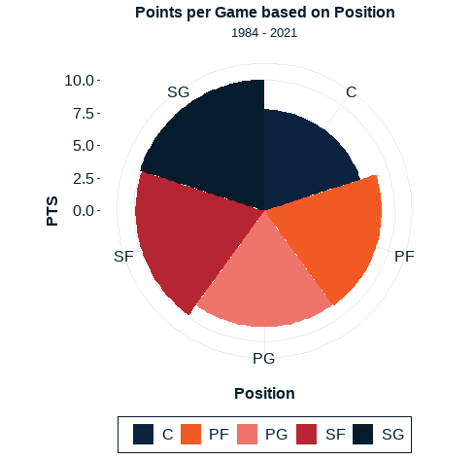
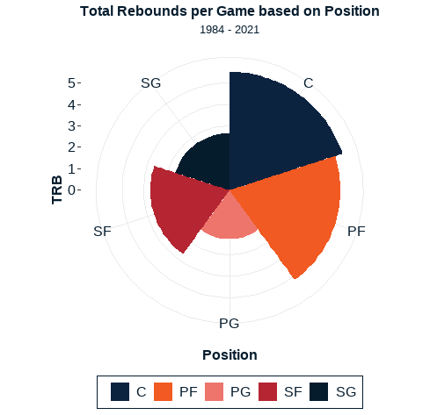
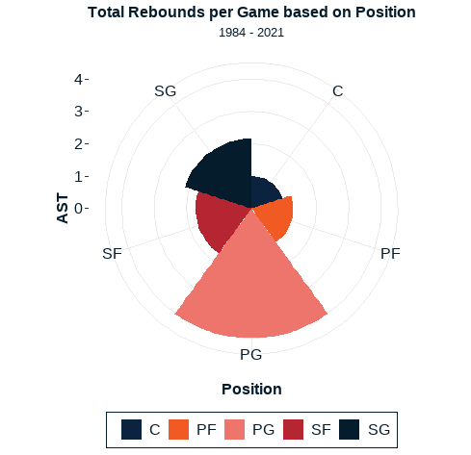
Basketball Positions
Traditionally, there are five different positions on the basketball court: Small Forward (SF), Power Forward (PF), Center(C), Point Guard(PG), and Shooting Guard(SG). They are all equally important in a professional basketball team. The graphs below demonstrate their own unique roles on the court:

Slide 6
Position-Based Valuation Model
Choose six target stats as performance metrics based on each position
Three from seasonal basic per-game stats (Production Level)
Three from seasonal advanced stats (Efficiency)
All six metrics are chosen empirically
Performance Metrics Selection
Calculate the historical average (1984 – 2021 ) seasonal stats that are used as the performance metrics of all maximum contract players as benchmark player
Calculate Historical Average
Comparing the current seasonal stats to the benchmark player
Current Season Valuation

Slide 7
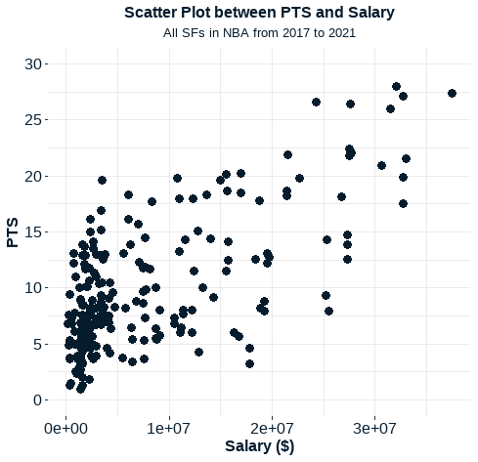
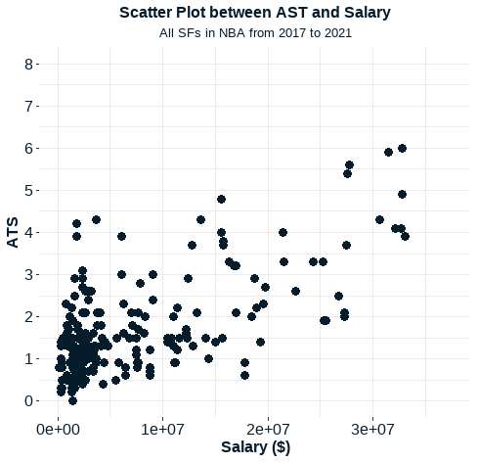
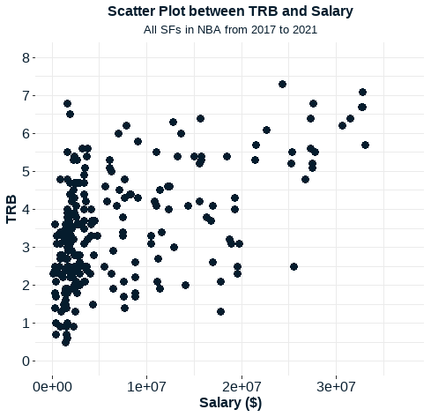
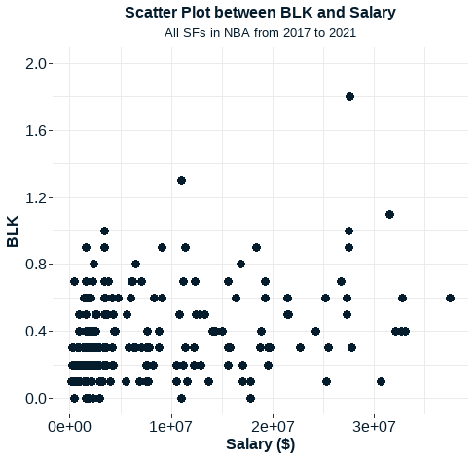
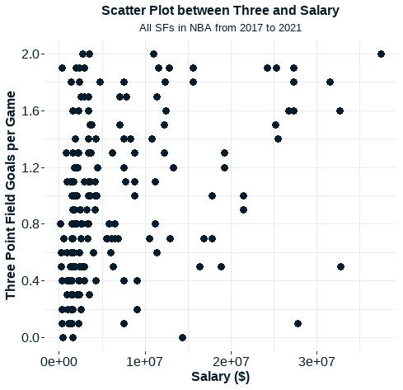
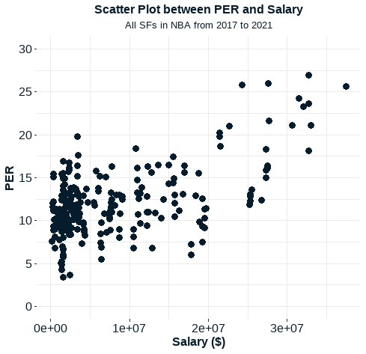
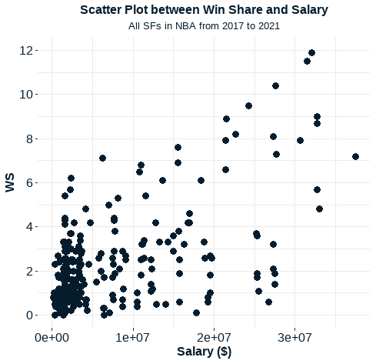
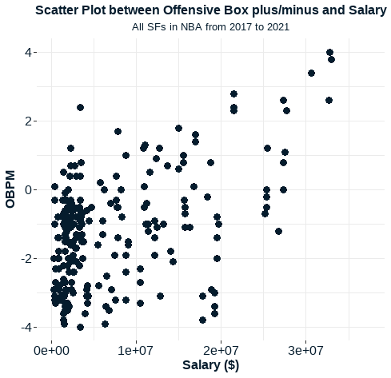
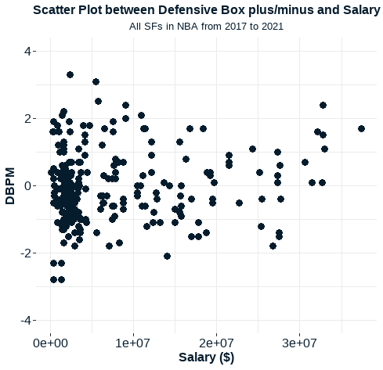
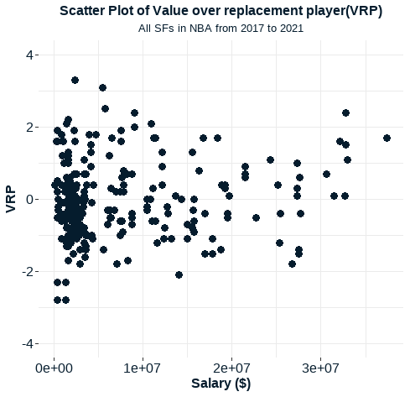
Case Study: Small Forward

Slide 8
Case Study: LeBron James (SF)
Stats | Player Benchmark | King
PTS | 18.3 | 25.8
AST | 3.4 | 8.0
TRB | 5.9 | 8.1
PER | 18.2 | 24.7
WS | 5.5 | 5.7
OBPM | 2.2 | 6.0
*
* Red color implies target player outperform player benchmark

Slide 9
Summary
This general descriptive statistical analysis is easy to use and very intuitive for people who are not coming from the field of statistics. It can provide a manager a general and quick idea if his or her franchise player’s performance beat the expectation or not based the player’s maximum contract
However, this method can only analyze a maximum salary player’s performance. It failed to categorize out other NBA players as the league only defined a hard line in terms of percentage for maximum contract
Moving forward, I am planning to implement machine learning models to train a model to predict the money value of all NBA players’ performance in current season and then

