Slide 1

PowerEnJoy
By
Prasanth R
Fathima B
Lipika L

Slide 2
DOMAIN ASSUMPTIONS
User’s device should transmit its location either using a Bluetooth or infrared channel which restricts the distance between the car and the user to be limited. This is when car will be unlocked.
We need the information about the car, optimal locations where the car be parked by the user.
All the discount prices are fixed and may not be changed.
Penalties are also fixed in case of breaking any rules.
Phone number verification for the guest user are required to avoid unnecessary requests.
We have fixed formula for the price calculator which takes distance time and peak hours into consideration.
User may be notified with the list of entries of other users who are having their requests as per the matching a ride. It is up to the user to chose the option of sharing the drive.
All the parking slots have recharging facilities and they don’t run out of charge.
We may have to restrict the users who don’t break the rules more often.
User will be provided a pin which is useful to unlock the car every time he gets out. Pin expires once he stops the ride.
Car will be containing enough charge at the time of pickup.

Slide 3
FUNCTIONAL REQUIREMENTS
[G1] Allowing the guest users to enter the app.
The system should take user name and phone number as input.
The system should let the guests enter only if they enter a valid phone number.
[G2] Allowing the users to find all nearby available cars and their locations.
The system must request the user for his GPS location.
The system must use the GPS location to find the nearest car hubs where the user can find the car.
The system must provide the user with appropriate results.
[G3] Allowing the users to register into the application by providing their credentials and payment information.
The system should take user name, password, and email id for registration.
The system should verify the email id by sending a confirmation mail.
The system should take the payment details when the email gets verified.
[G4] Allowing registered users to book car in a selected geographical area.
With the proper login credentials the system should show the user with all nearby available cars.
The system should let the user to select the car chosen by the user if it is available.
The chosen car should be made available for this user and make it blocked for others.
[G5] Allowing registered users to reserve only a single car and make it available for up to one hour before they pick it up.
The system should not allow user to book another car if there is already the user blocks one car.
The system should keep track of time of when the reservation was made.
If the difference between current time and the time of reservation is more than an hour the system must cancel the reservation.
In case of cancellation of the cars by the system or by the user, a penalty of 1 euro.
[G6] Allowing admin users to keep track of the cars are current locations.
The system should keep track of all the information about every car in the data base.
In case of any request the tracked data should be shown to the admin.

Slide 4
FUNCTIONAL REQUIREMENTS
[G7] Allowing admin users to send notifications or alerts to some cars accordingly.
The system should make sure that admin is connected to every individual.
The system should take care of sending notifications or alerts to an individual by the admin.
[G8] Allowing registered users to choose option in sharing other passengers.
When the user blocks a car, the system should ask the user if they are interested in sharing the ride.
If the user is interested, the car should be shown to others who are willing to have a shared ride.
In case of shared rides, the system should take user’s discount of 10% into consideration and calculate the price accordingly.
[G9] Allowing registered users to choose on money saving option by letting them enter their destination.
The system should keep track of all the information like the parking slots, more densely booked areas.
The system should use all the above stored information and calculate the optimal fare and show the user on how to proceed to the destination to achieve the optimal fare.
[G10] Allowing registered users to check the percentage of battery left in the car.
The system should provide an interface to the user where the battery percentage of the car is shown whenever requested by the user.
[G11] Allowing registered users to check the price charged till that moment of time.
The system must calculate the fare of the ride by using the ride statistics and should be shown whenever requested by the user.
The system must make sure that tracking the data of the ride should never be interrupted through the ride.
[G12] Allowing registered users to find the safe areas for parking the car after their use.
The system must provide the proper parking slots which is advantageous for both user and the car.
The system should also let the user know about special parking areas and the which he can claim a discount of around 30% on his last ride if he parks the car in one of the special parking areas.
[G13] Allowing registered users to send the information of their current location for the car to get unlocked and ready for the drive.
The system should keep listening to the user’s location ping and make sure that the car gets unlocked by the time of the user’s arrival.

Slide 5
FUNCTIONAL REQUIREMENTS
[G14] Allowing registered users to receive a confirmation SMS or an email stating that the car has been booked, location of the car and threshold time to collect the car.
The system should send a confirmation message to the user in any form either as a text message or a mail stating that the car has been booked for him and the details of the care should be provided.
[G15] Allowing registered users to know the estimated price of the ride and optimal statistics.
The system should be transparent with the users by letting him know the estimated price of the ride whenever requested by the user.
The system should also provide the user the optimal statistics on how he can reduce the fare, how he can claim the discount and all such related things.
[G16] Allowing registered users to show the nearby charging points.
The system should help the user in knowing nearby charging points so that user can park the car or use the charging point near that location.
This also helps the user to claim for the discount of 20% on his last ride if the car is left with no more than 50% of the battery.
[G17] Allowing registered users to unlock the car whenever needed.
The system should allow the user to unlock the car and allow him to do his work, then use the car again.
During the time of unlock, the system should not be shut down and the price should be kept on calculating. User should be informed the wait down charge.
[G18] Allowing registered users to stop the ride whenever needed.
The system should provide the user with the freedom to stop the ride when the user wants to or when the destination has arrived.
The final price should be deducted from the user’s card and notify him the amount.
The system should also consider the discounts applied for the ride and update the user’s profile accordingly.
The system should also detect the nearest power grid station from the point of the current location and the current percentage of battery. If the nearest power grid station is farther than 3km and if the battery is less than 80%, the user should be charged with a penalty of extra 30% on his ride.
The system should make sure that the car is available for the new ride and should be shown in the available list of the other users.

Slide 6
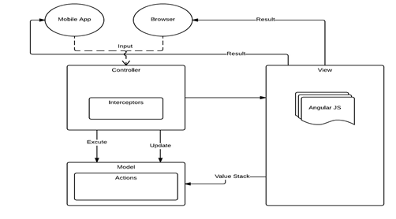
HIGH LEVEL COMPONENTS

Slide 7
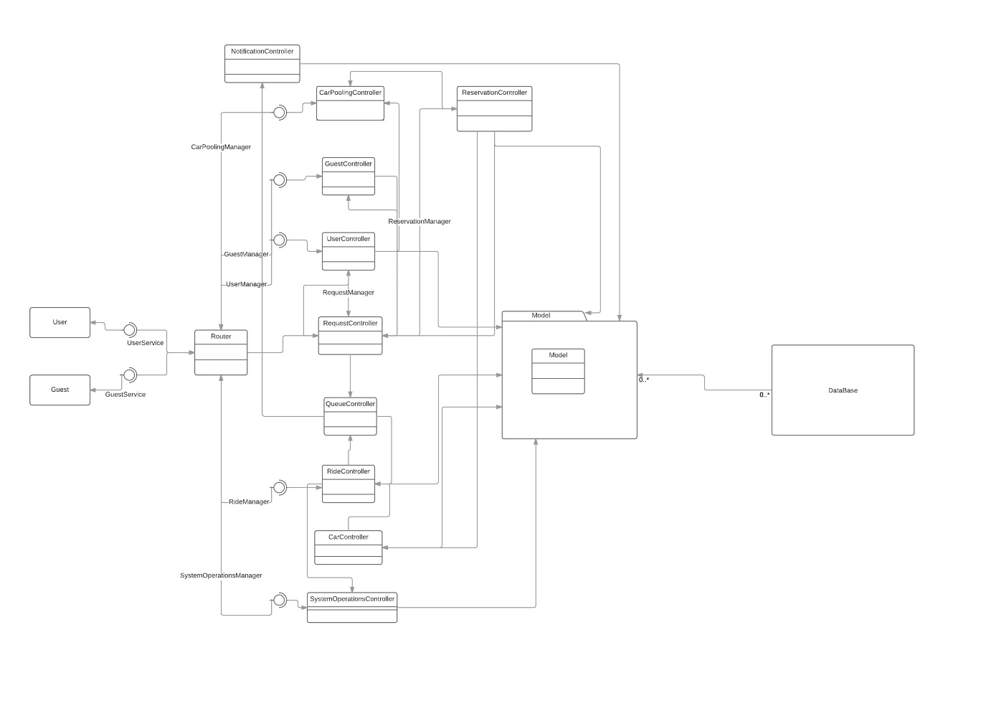
COMPONENT VIEW

Slide 8
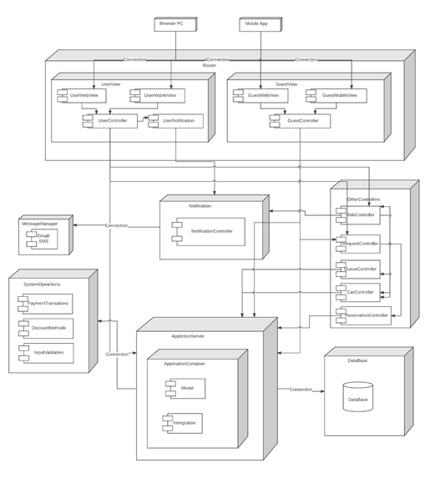
DEPLOYMENT VIEW

Slide 9
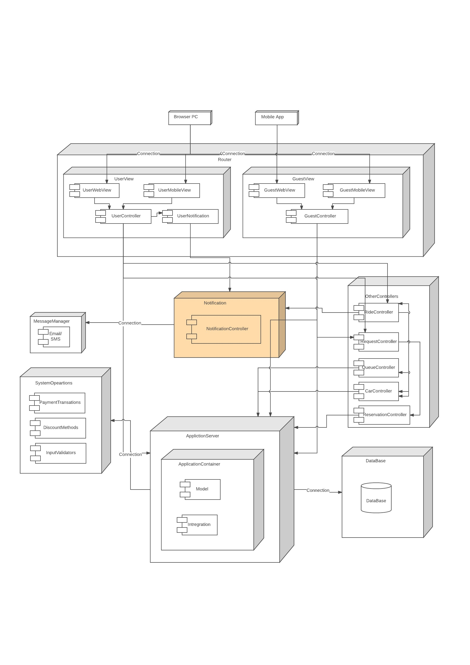
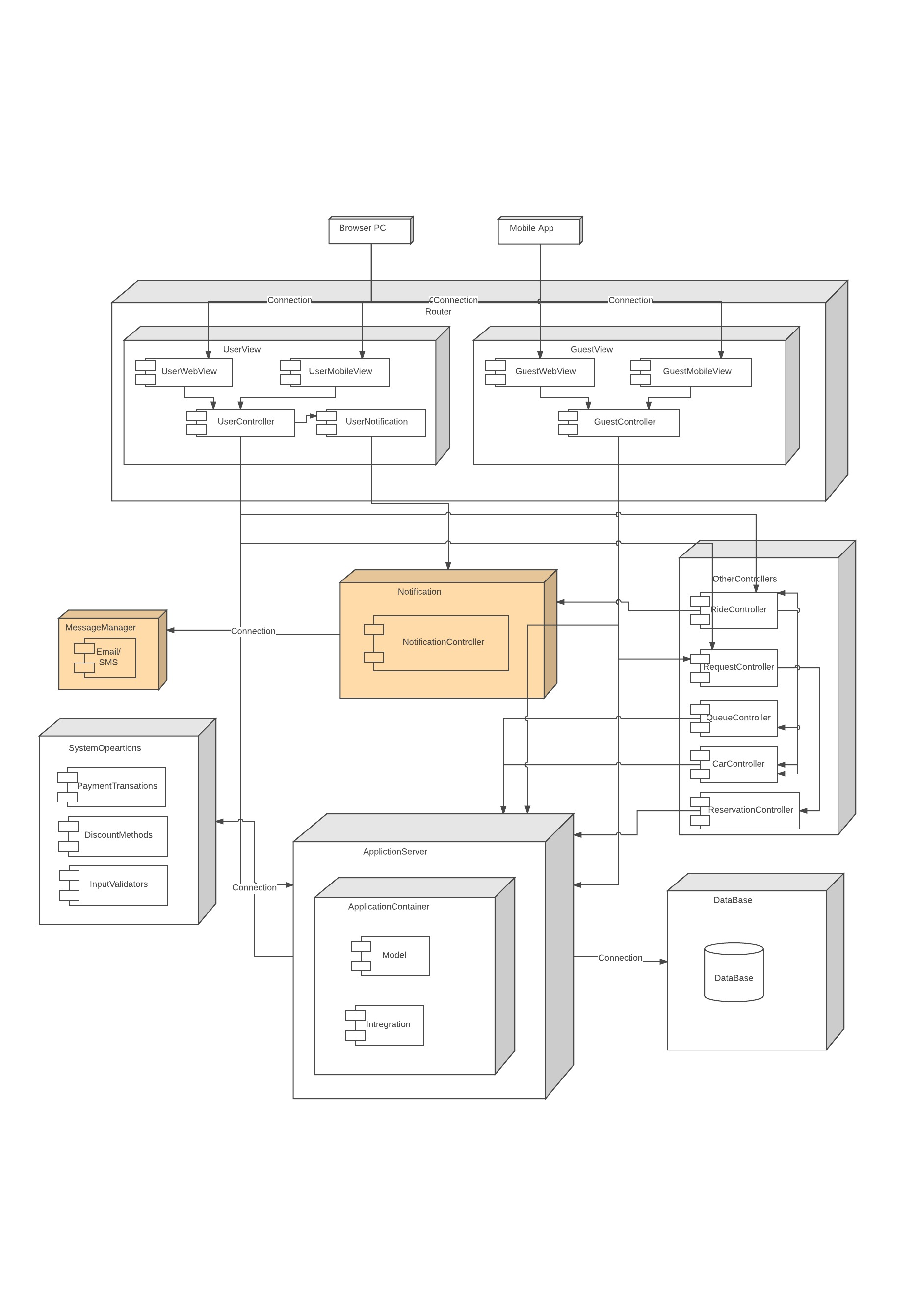
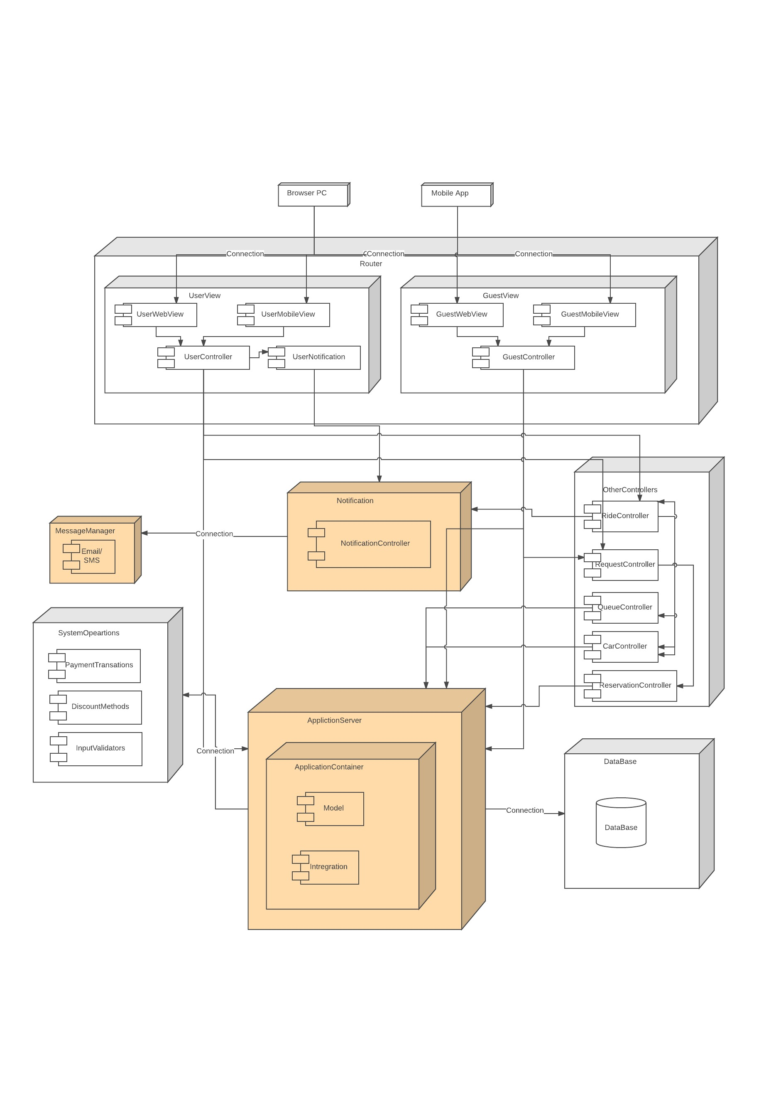
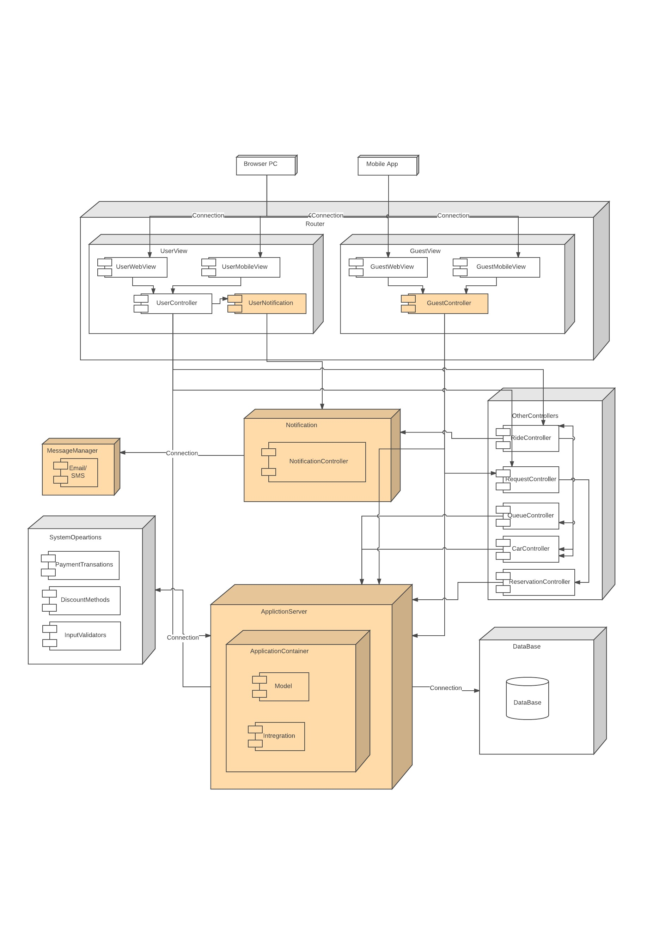
INTEGRATION TEST
Bottom-up approach

Slide 10
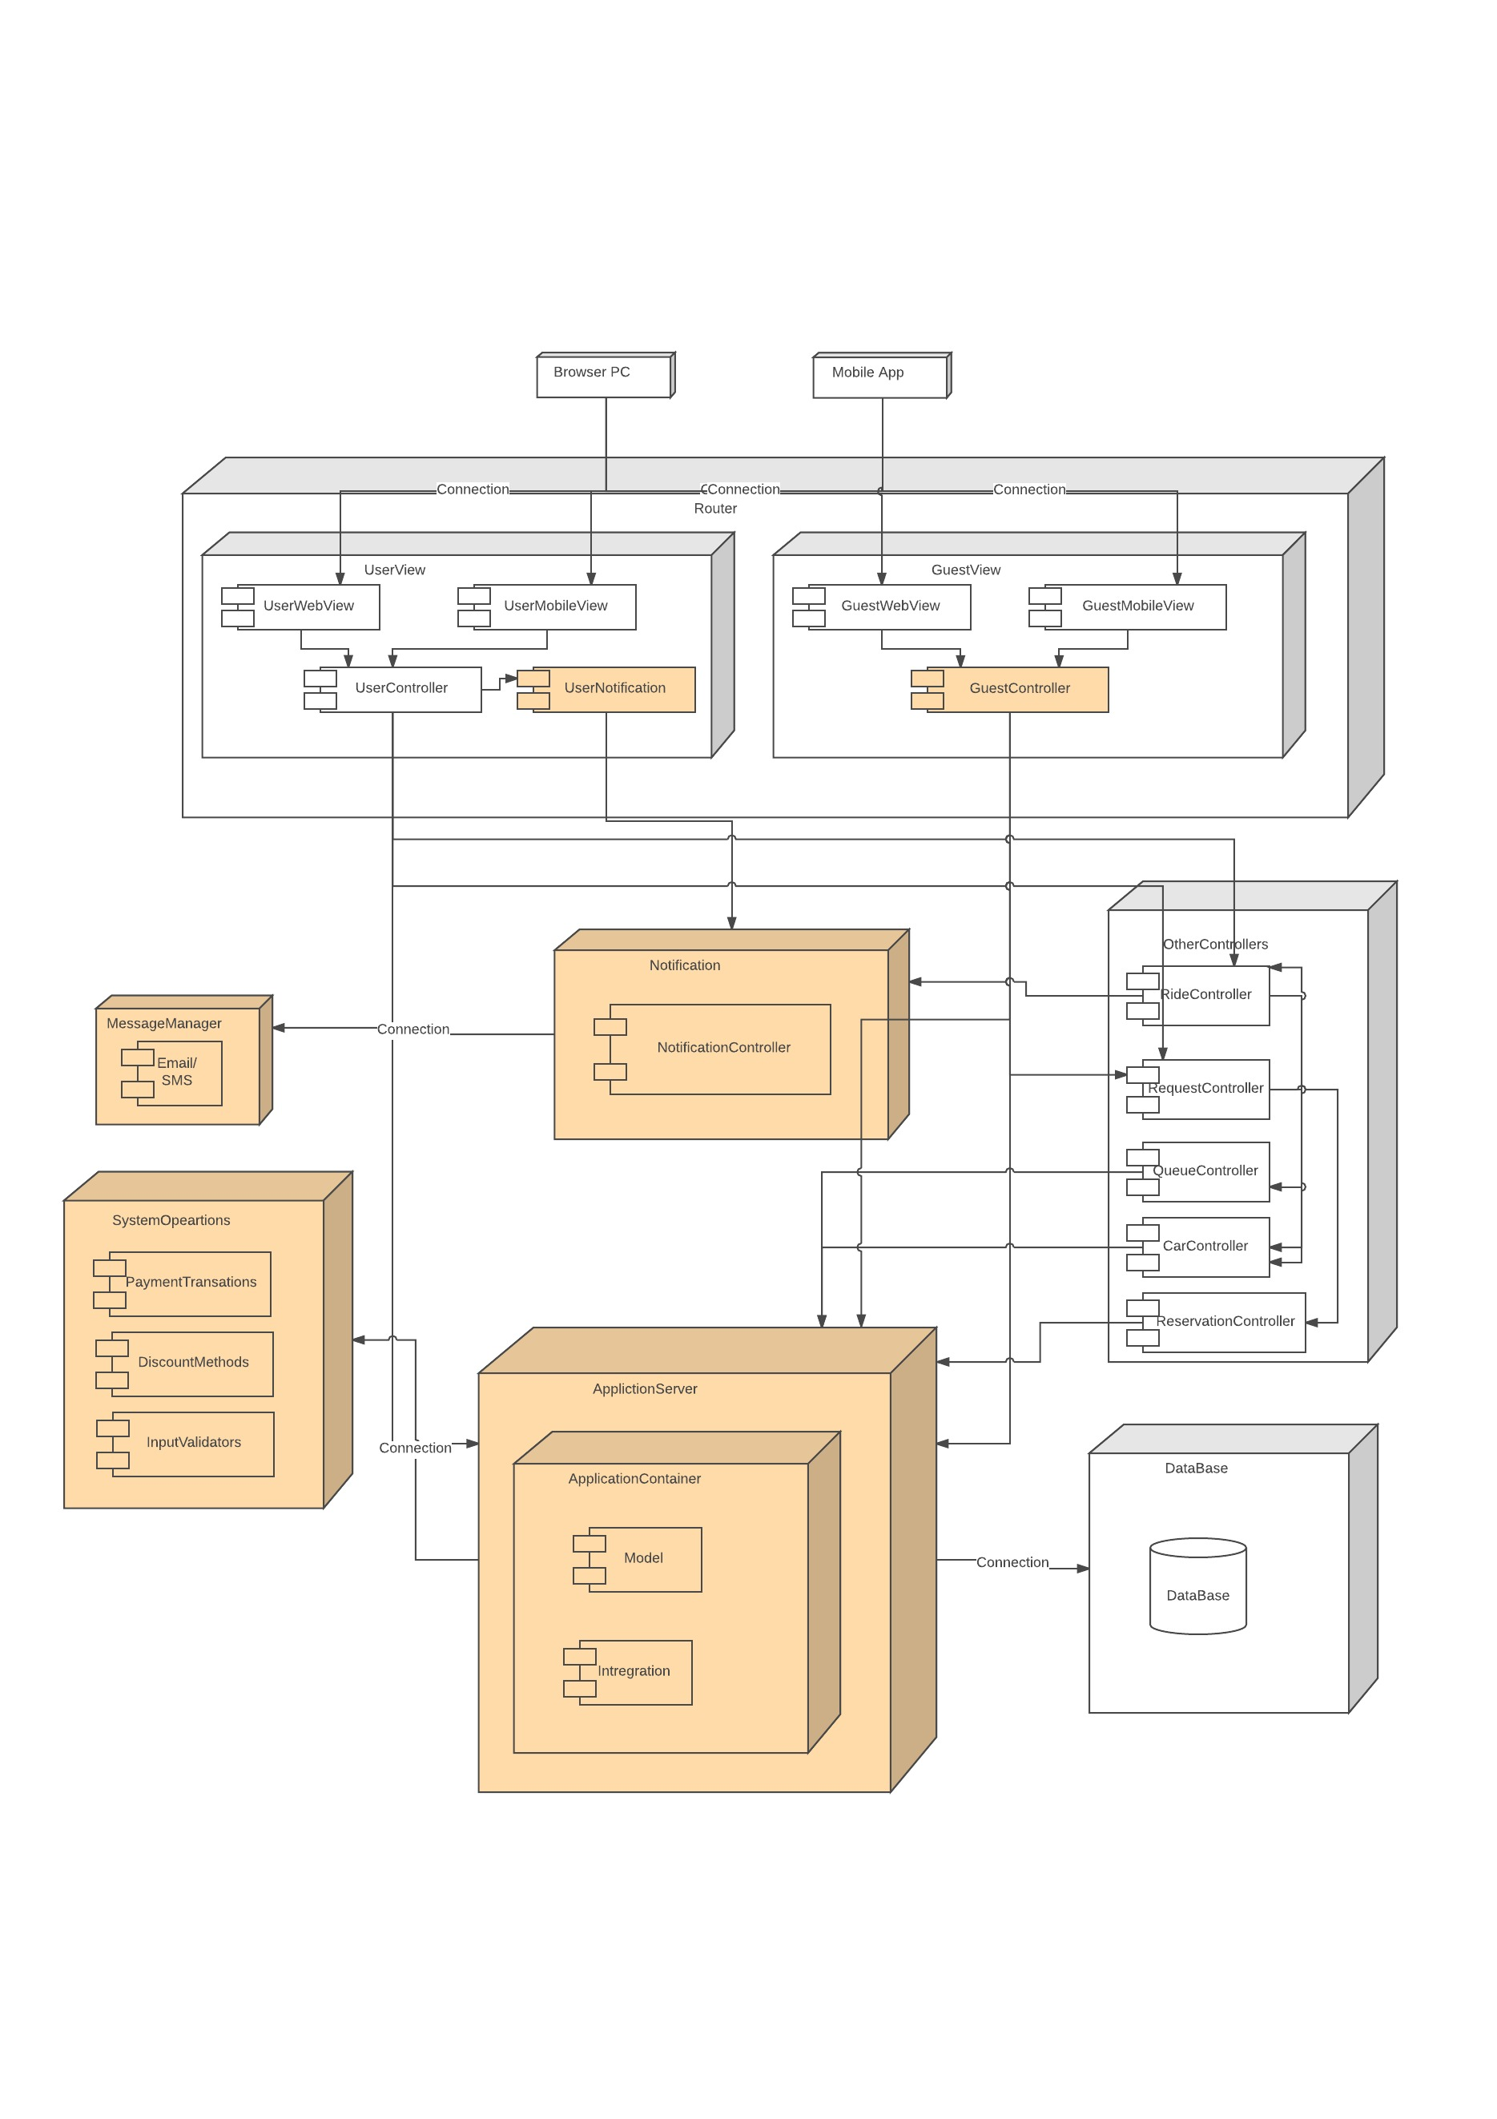
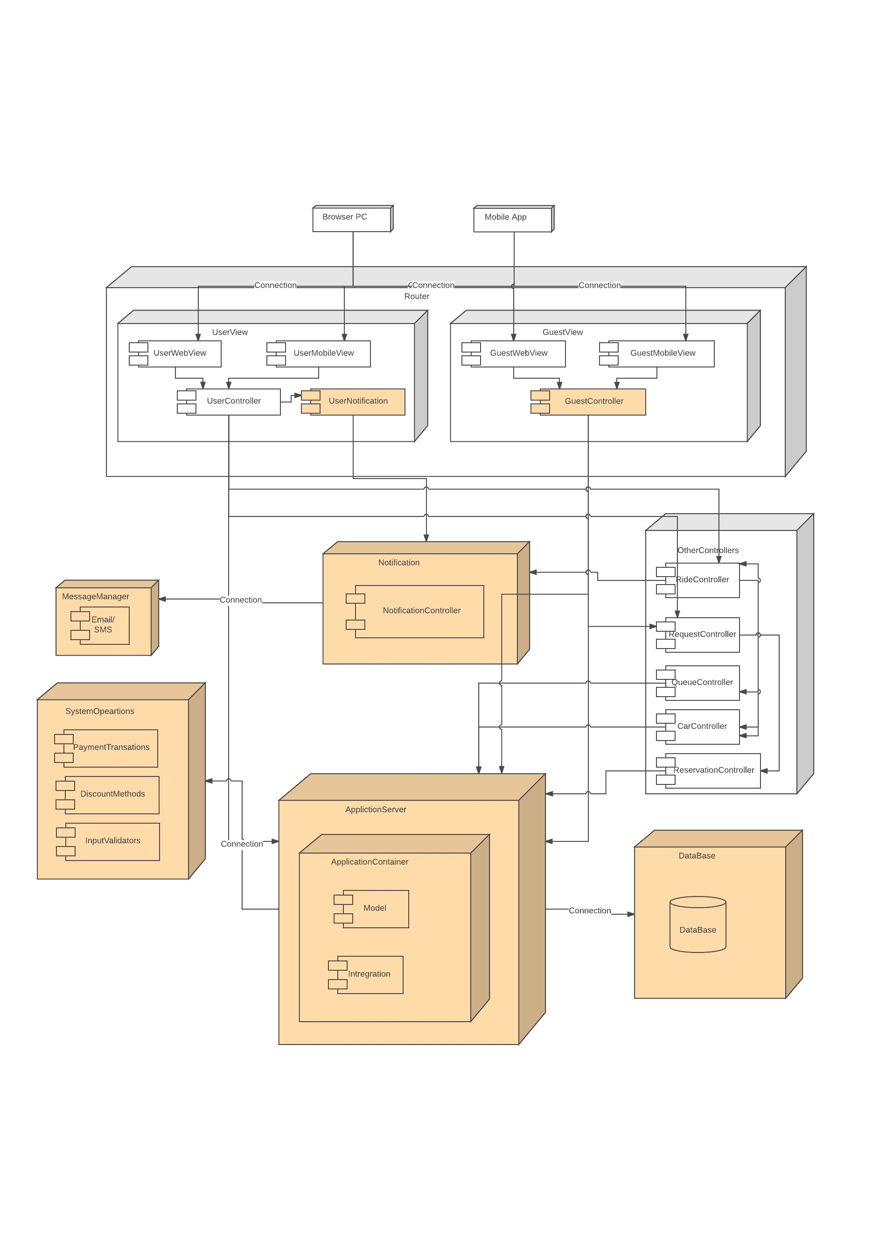
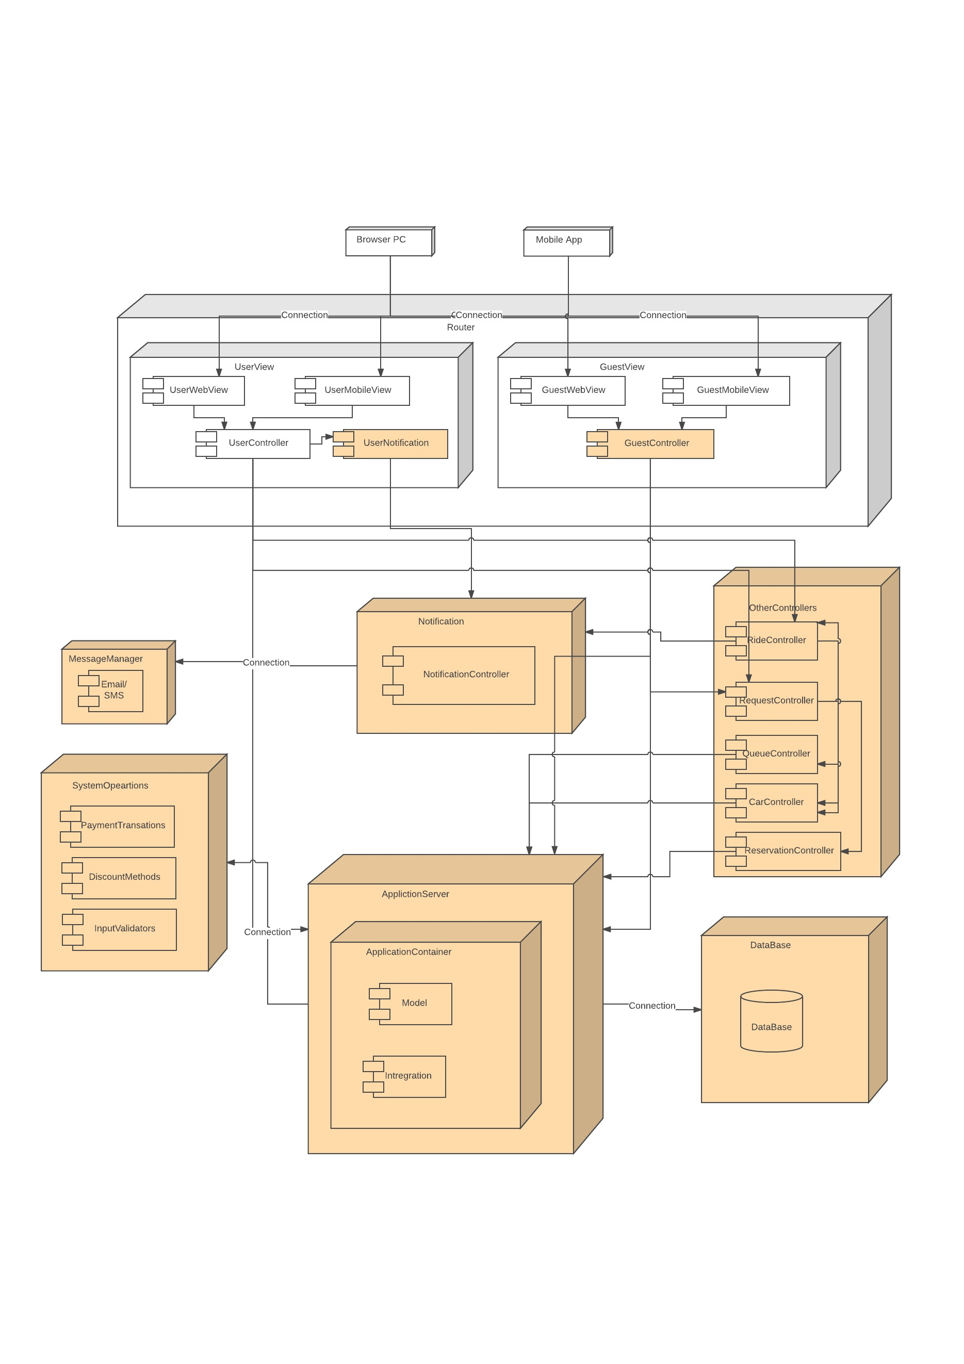
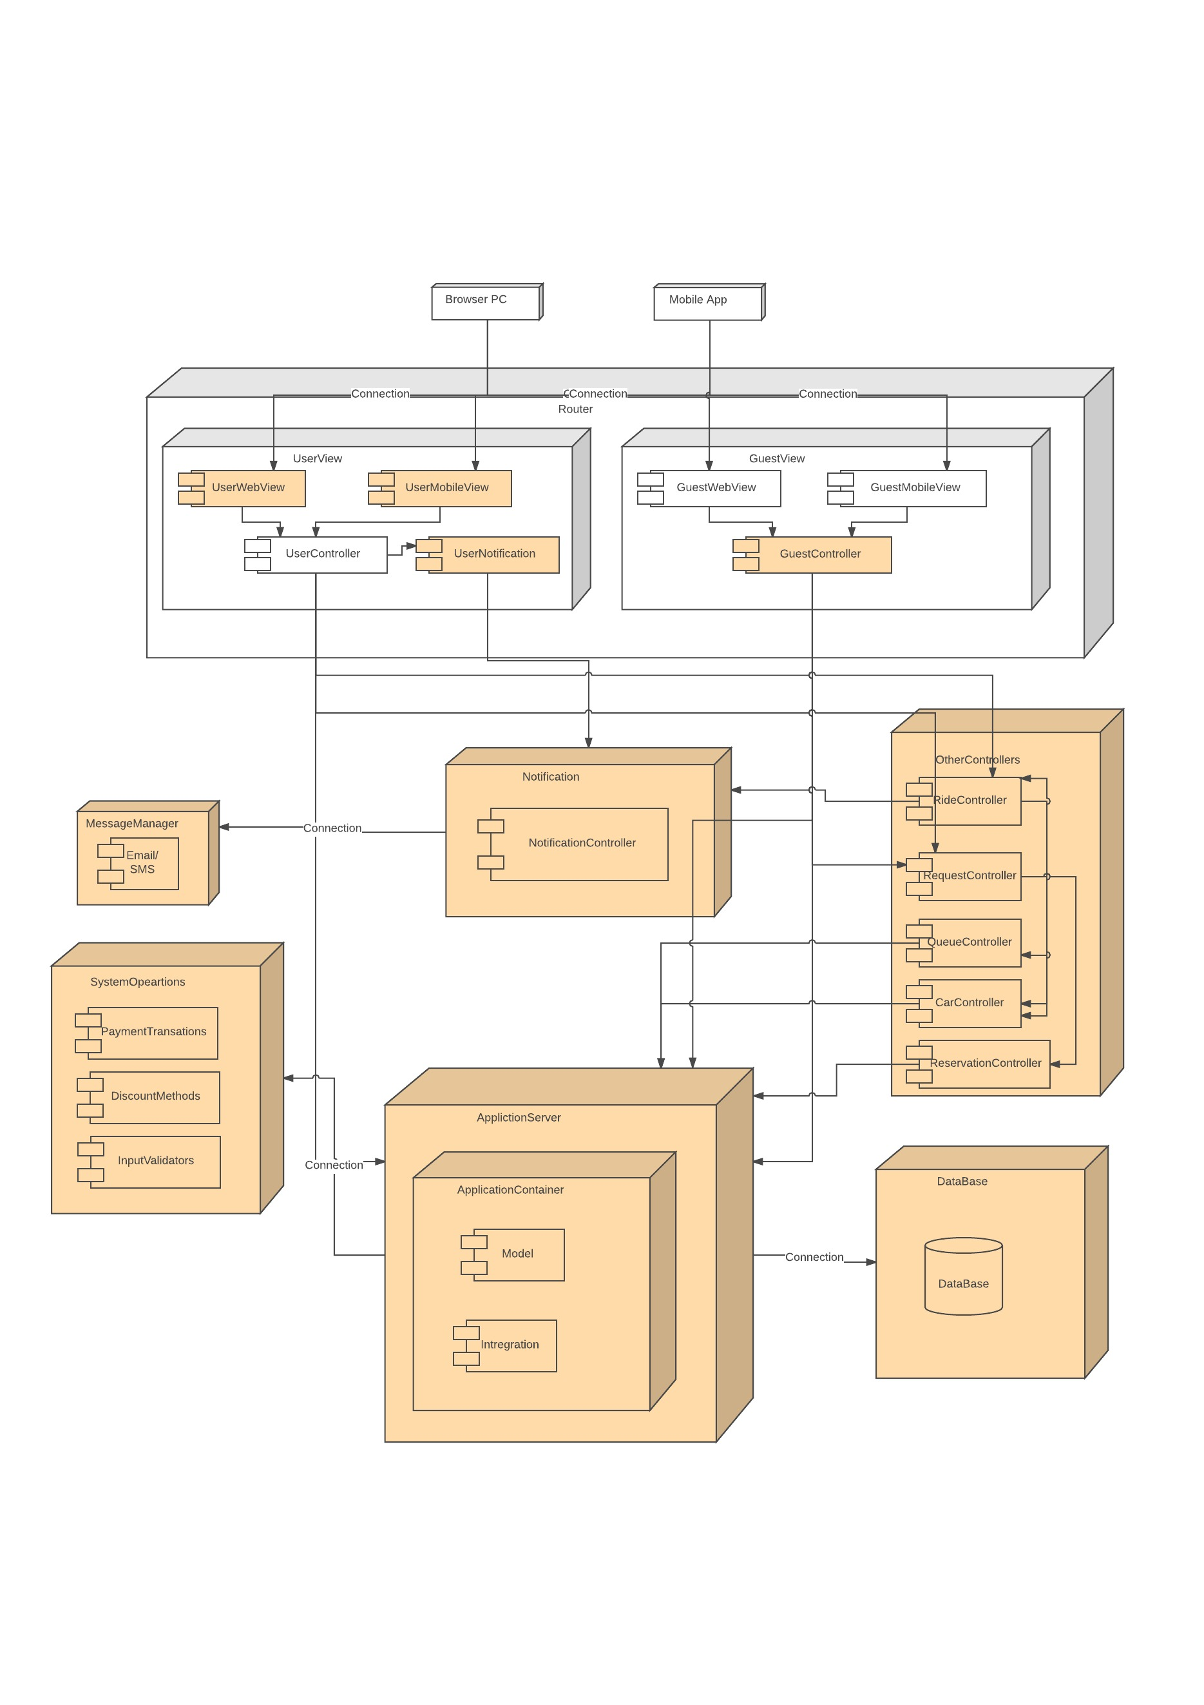
INTEGRATION TEST
Bottom-up approach

Slide 11
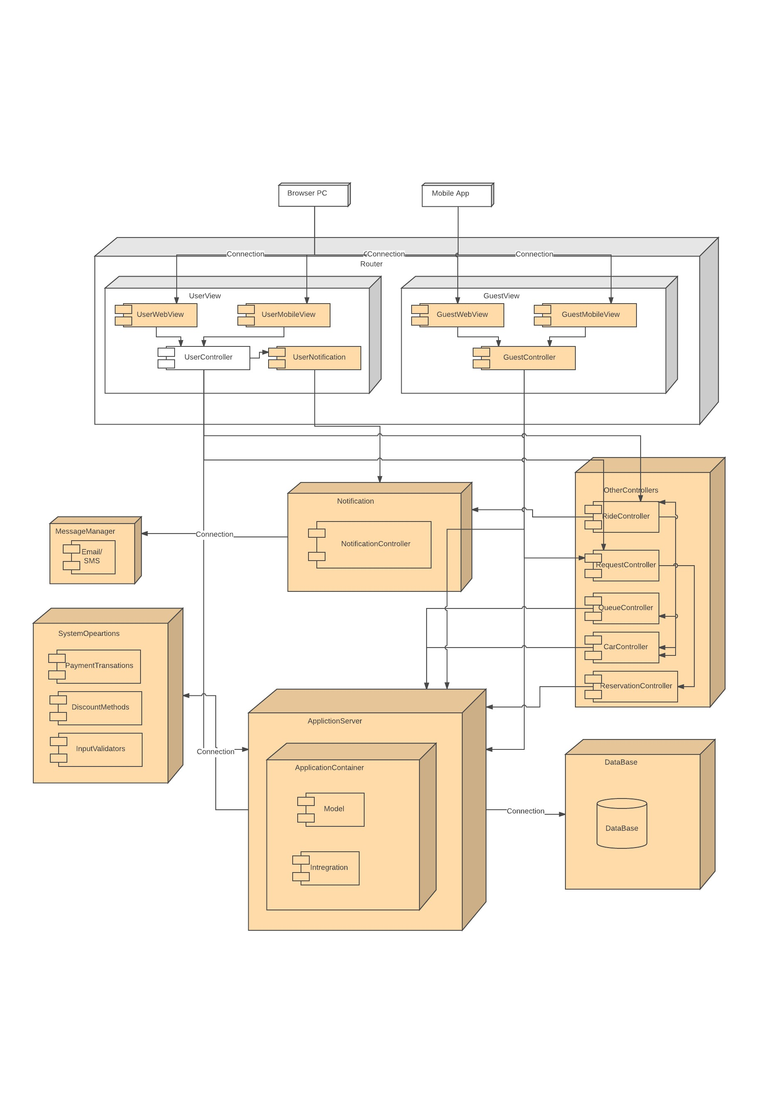
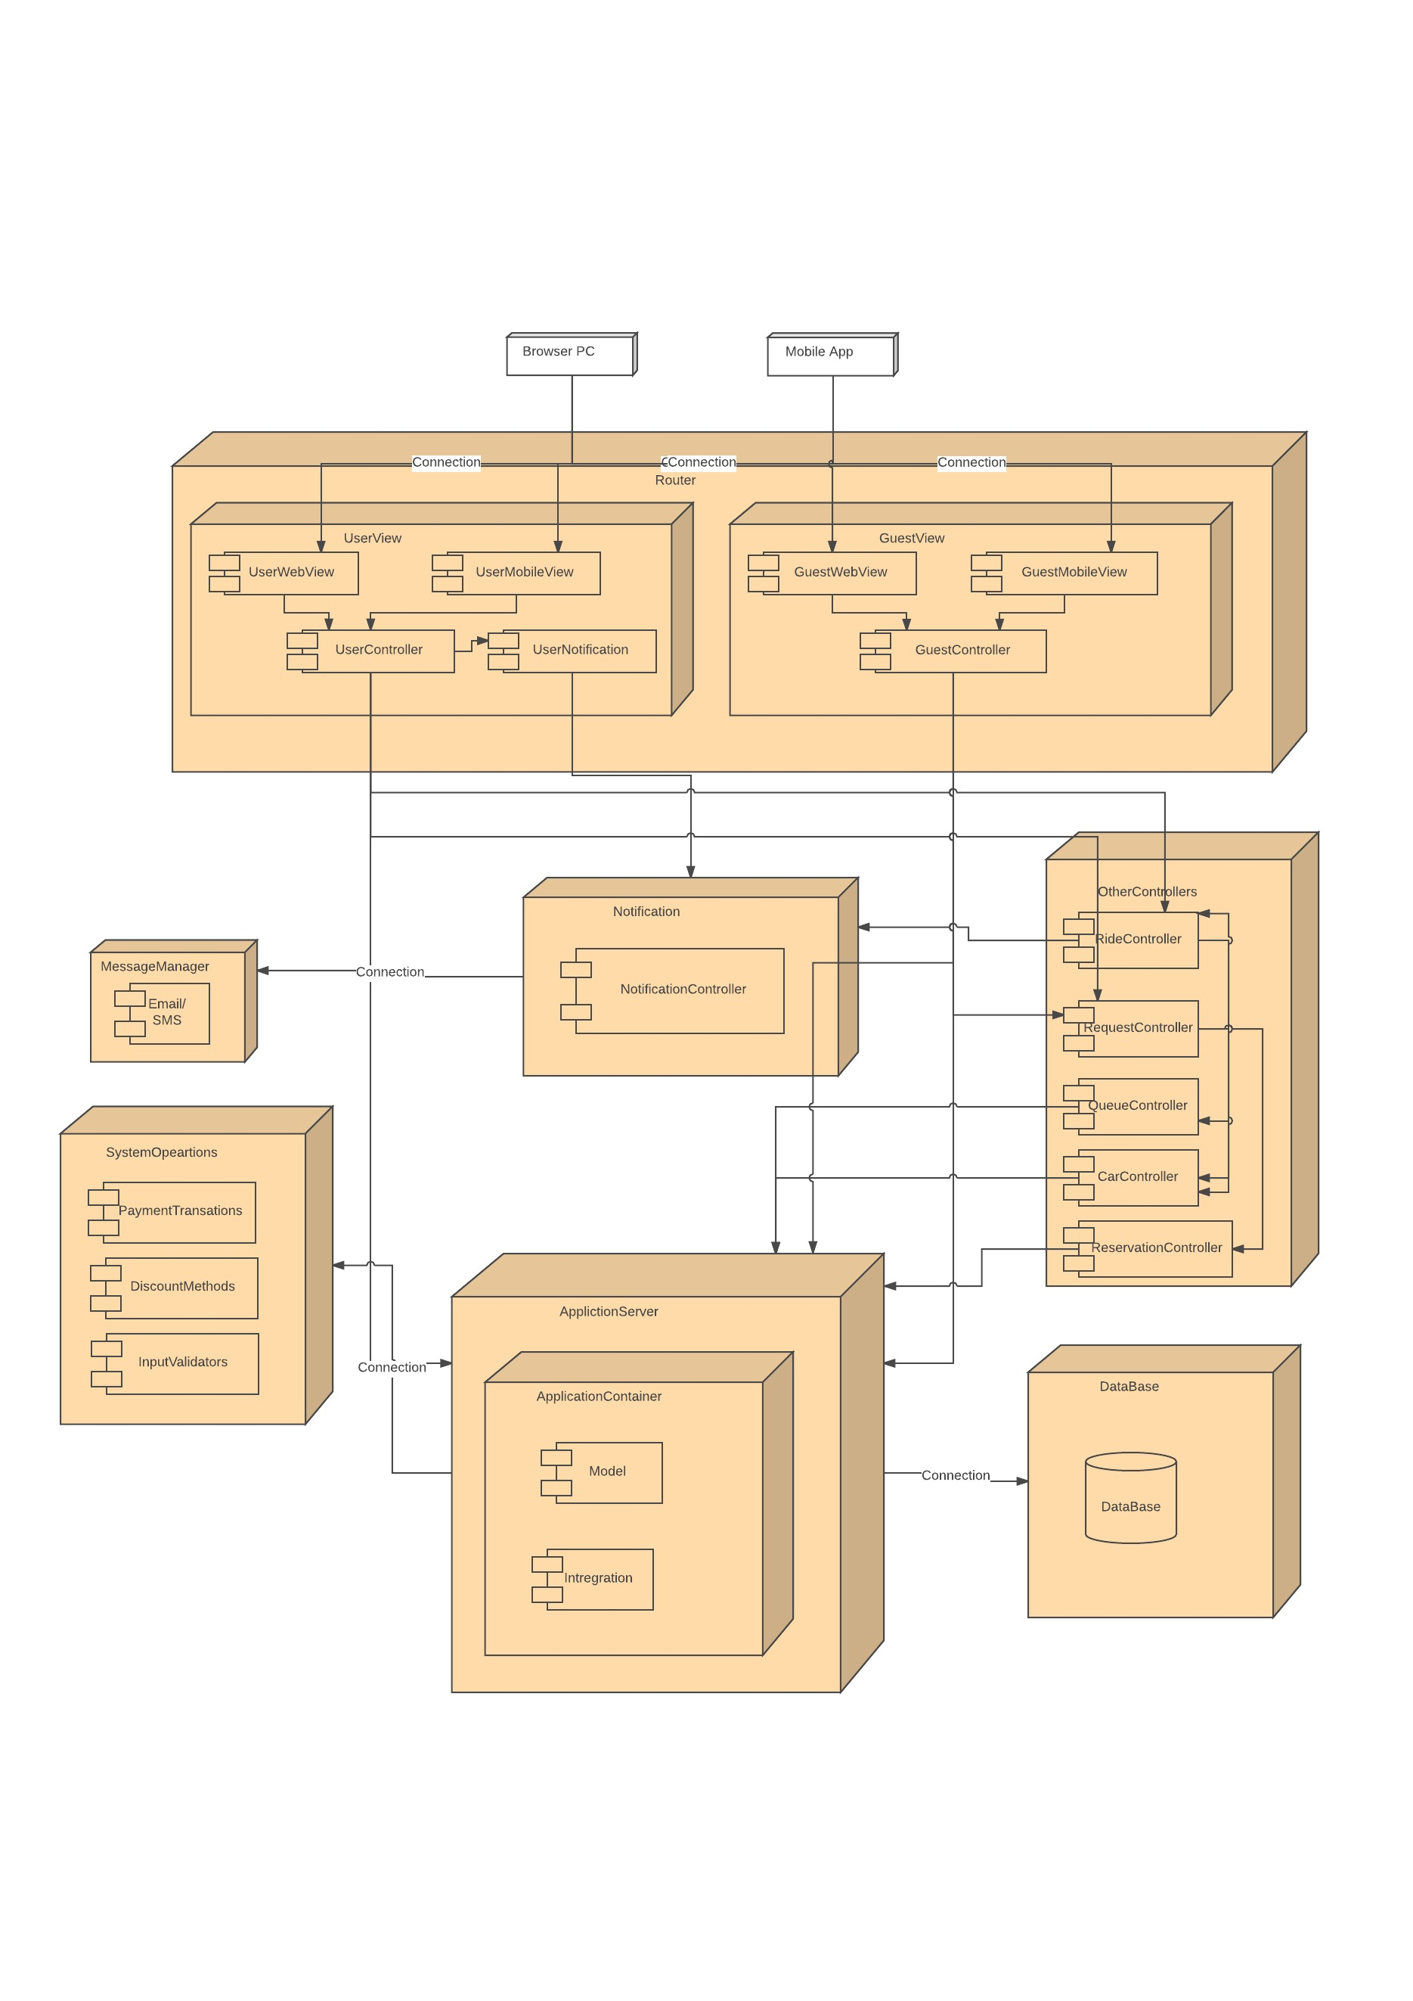
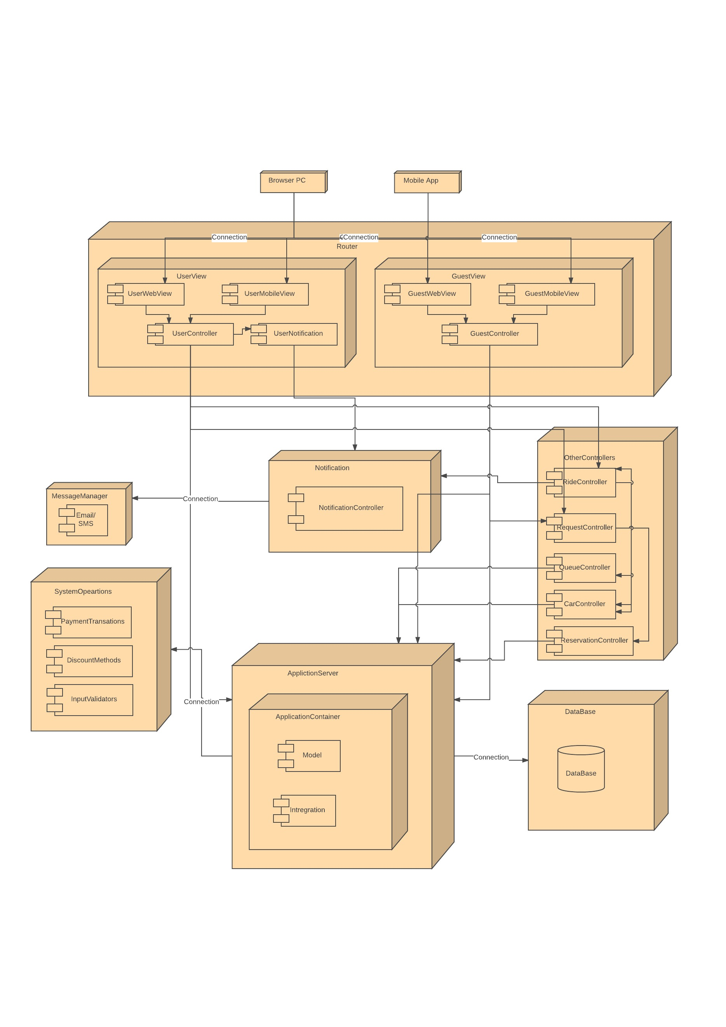
INTEGRATION TEST
Bottom-up approach

Slide 12
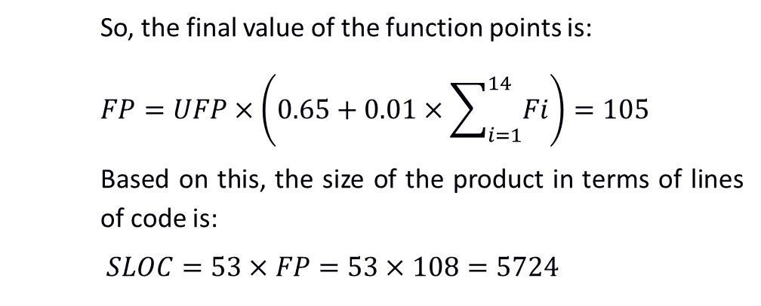
SIZE AND EFFORT ESTIMATION
 | Simple | Medium | Complex | Total
EI | 4 | 4 |  | 28
EO |  | 3 |  | 15
EQ | 5 | 1 |  | 19
ILF | 8 |  |  | 32
EIF | 4 |  |  | 12
 |  |  | UFP | 108
Does the system require reliable backup and recovery? | 2
Are data communications required? | 5
Are there distributed processing functions? | 0
Is performance critical? | 4
Will the system run in an existing, heavily utilized operational environment? | 0
Does the system require on-line data entry? | 4
Does the on-line data entry require the input transaction to be built over multiple screens or operations? | 0
Are the master files updated on-line? | 0
Are the inputs, outputs, files, or inquiries complex? | 1
Are the start-up, back-up and recovery procedures effective and/or automated ? | 4
Is the code designed to be reusable? | 4
Are conversion and installation included in the design? | 3
Is the system designed for multiple installations in different organizations? | 3
Is the application designed to facilitate change and ease of use by the user? | 2
Total | 32
So, the final value of the function points is:
$$FP=UFP×\left(0.65+0.01×\sum_{i=1}^{14}{Fi}\right)=105$$
Based on this, the size of the product in terms of lines of code is:
$$SLOC=53×FP=53×108=5724$$

Slide 13
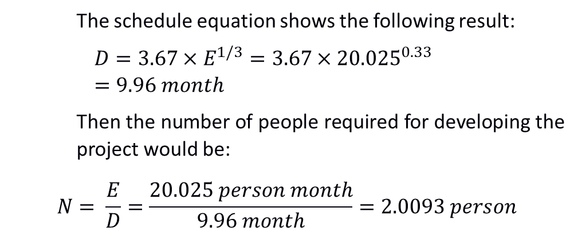
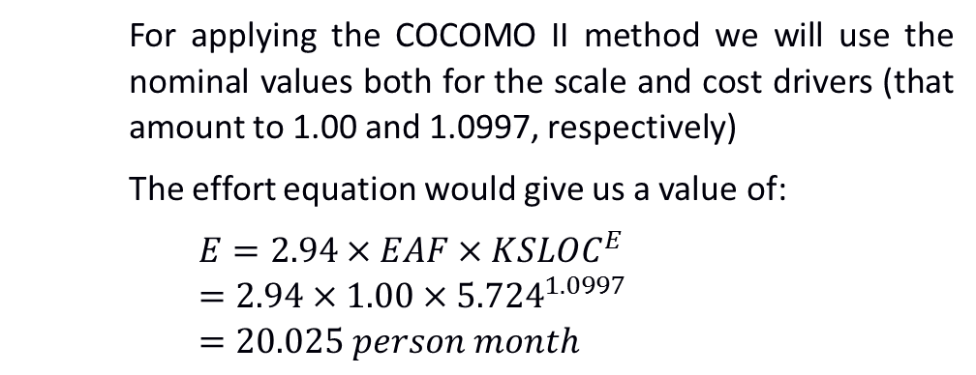
COCOMO II Calculation
For applying the COCOMO II method we will use the nominal values both for the scale and cost drivers (that amount to 1.00 and 1.0997, respectively)
The effort equation would give us a value of:
$$E=2.94×EAF×{KSLOC}^{E}=2.94×1.00×{5.724}^{1.0997}=20.025 person month$$
Effort equation (E)
Schedule equation (D)
Number of people (N)
The schedule equation shows the following result:
$$D=3.67×E^{1/3}=3.67×{20.025}^{0.33}=9.96 month$$
Then the number of people required for developing the project would be:
$$N= \frac{E}{D}=\frac{20.025 person month}{9.96 month}=2.0093 person$$
Which rounded up to prevent delays on the process will be a total of 3 people.

Slide 14
Thank You

