Slide 1
Java Programing Language
Java is a powerful general-purpose programming language. It is used to develop desktop and mobile applications, big data processing, embedded systems, and so on. According to Oracle, the company that owns Java, Java runs on 3 billion devices worldwide, which makes Java one of the most popular programming languages.
Java buzz words
1. Simple
2. Object-Oriented
3. Distributed
4. Robust
5. Secure
6. Architecture-Neutral
7. Portable
8. Interpreted
9. High-Performance
10. Multithreaded
11. Dynamic

Slide 2
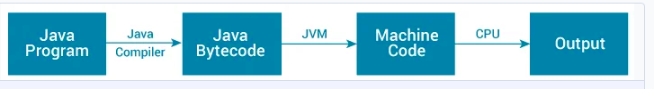
Java JDK, JRE and JVM
What is JVM?
JVM (Java Virtual Machine) is an abstract machine that enables your computer to run a Java program.
When you run the Java program, Java compiler first compiles your Java code to bytecode. Then, the JVM translates bytecode into native machine code (set of instructions that a computer's CPU executes directly).
Java is a platform-independent language. It's because when you write Java code, it's ultimately written for JVM but not your physical machine (computer). Since JVM executes the Java bytecode which is platform-independent, Java is platform-independent.

Slide 3
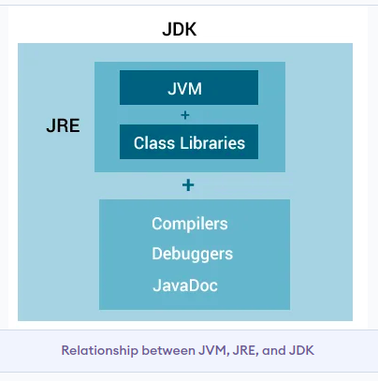
What is JRE?
JDK (Java Development Kit)
JDK (Java Development Kit) is a software development kit required to develop applications in Java. When you download JDK, JRE is also downloaded with it.
In addition to JRE, JDK also contains a number of development tools (compilers, JavaDoc, Java Debugger, etc).
JRE (Java Runtime Environment) is a software package that provides Java class libraries, Java Virtual Machine (JVM), and other components that are required to run Java applications.

Slide 4
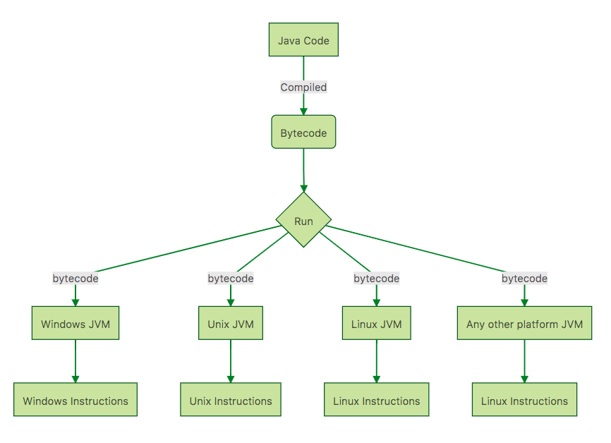
How Java code Run in deferent Platform

Slide 5
Hello world program
HelloWorld.java
public class HelloWorld { public static void main(String[] args) { System.out.println("Hello, World!"); } }
Save as HelloWorld.java
Complile and Run Java Programs
C:> Javac HelloWorld.java
Helloworld.class
C: > java HelloWorld.class
Output:
Hello, world

Slide 6
Java Basic Fundamental, Concept
Java Hello world program
Comments
Datatypes
Variables and Constance's
Operator
Array
String
Input and Output
Controle Flow and Condition and Loops
Function Method and Object and Class , Inheritance
Interface , Lamda Expression ,
Exception , log , error handling
Generic Programing
Java Collection , and Basic Algorithms
Graphic User Interface Components with swing library

Slide 7
Comments
In computer programming, comments are a portion of the program that are completely ignored by Java compilers. They are mainly used to help programmers to understand the code.
In Java Comment are define Three ways:
Inline Comments
Mulitline Comments
Document Comments
Examlple: Comments.java
/**
* This is the Comments Class it just How programs Executes
*/
public Class Comment{
Public static void main(String[] args){
// This is First Programs
System.out.println("This is comments");
System.out.print("===============================");
System.out.println(" Name \t | Address \t | Phone \t");
System.out.println("-------------------------------------");
System.out.println(" Surendra | Hetauda | 9834983");
System.out.println(" Yamen | America | 948598495");
System.out.println(" Krishna | Kathmandu | 459894859");
System.out.println(" Pankaj | Birjanja | 489548958");
/*
System.out.println(" Rista | Hetauda | 9834983");
System.out.println(" sita | America | 948598495");
System.out.println(" Reshik | Kathmandu | 459894859");
System.out.println(" Nisha | Birjanja | 489548958");
*/
}
}

Slide 8
Datatypes
Java is strongly typed language. This means every variable must have a declared type. it's define variable and methods return types. java has primitive type and Reference types
Integer Primitive types
Type | Storage | Range
Int | 4 bytes | -2,147,483648 to 2,147,843,647
short | 2 bytes | –32,768 to 32,767
long | 8 bytes | –9,223,372,036,854,775,808 to 9,223,372,036,854,775,807
byte | 1 byte | –128 to 127
Floating point types
float | 4 bytes | -±3.40282347E+38F Approximately
double | 8 bytes | ±1.79769313486231570E+308 Approximately
char type and Bolen type
char | Character letter
Boolean | True | false
string | Hellow heliwg

Slide 9
Operators
operator are manupulates the variable values . It's use for variable expresion and conditon
Arithmetic Operators
Relational Operators
Logical Operators
Assignment Operators
Bitwise Operators
Arithmetic Operators
Relational Operators
Bitwise operator
== Equal Operators
!= Not Equal
> Greater then
< Less then
<= less the Equla
>= greater then Equla
& and
| or
^ xor
+ Add
- substract
/ division
* multiple
% moduls
Unery operator
++
--
Assignment Operators
Logical Operators
= assign the value to left to right veriable
+= add assignment
-= substract assignment
*= muliply assignment
Etc..
&& Logical And
|| Or
!= Not

Slide 10
Java Variables and Literals
A variable is a location in memory (storage area) to hold data. It is defined by datatype
Example:
int speedLimit;
float ammout = 2.3; speedLimit = 9898;
Constant variable
Constant variable are once time declaration the value , second time never change the same type values. It define final key word of datatype
final int x=80;
float float xy= 2.3;
Character and String Literals
A string literal is a sequence of characters enclosed inside double-quotes
Example :
String str = "Welcome to world"
char leter="A"

Slide 11
Array
An array is a data structure that stores a collection of values of the same type. type of array is single dimension & multiple dimension, array can use in class and function parameter and block, Arry structure value access by using Index. Index start from 0 to nth.
Syntax:
type array­name[ ] = new type[size];
//array declare
Int [2] ab;
or
Int ab = new int [4];
Float [] xy;
Or
Int a[] = new int[10];
String x[] = new String[10];
// set array value
A= new int[] { 34, 56, 67 ,67, 67};
Printtin value
System.out.println( A[0])
System.out.println( xy[2])
// Inline array define and assigned the value
String[] cars = {"Volvo", "BMW", "Ford", "Mazda"};
int[] myNum = {10, 20, 30, 40};
// show array value
System.out.println(cars[0]);
System.out.println(cars.length);
Memory block
ab[0]=5
ab[1]=4
ab[2]=5
ab[3]=5

Slide 12
Input Reading and Output
Multidimensional Arrays
Syntax : int x[][]= new int [size][size];
int[][] x= {
{1, 2, 3},
{4,5, 6}
};
Int x[][] = new int [][]{ {1,2,2}, {3,4,5}, {6,6,7} };
int x = x[1][2];
System.out.println(x); //
X[0][0]=1 | X[0][1]=2 | X[0][2]=3
X[1][0]=4 | X[1][1]=4 | X[1][2]=6
X[2][0]=3 | X[2][1]=7 | X[2][2]=8
Java programming can do Read data and output the data on screen. 'System.out.println()' object method will output the screen content and value . 'System.in.read()' or Scanner Object method can Read the data from user. its' capture value form user input data
Public class kbinput{
public static void main (String args[]) throws Java.IO.Exceptions {
char ch;
System.out.print("Enter the text");
ch = (char) System.in.read();
System.out.println("You Enter value is ",ch);
}
}

Slide 13
Program Control Statements
If ..condition
If ..else
If .. if else … else
For loop
Switch case
while(condion) { // statments} loop
do{ // statements . i++ ; } while(condition)
It's controle the program flow & direction of coursore. Computer understands the prorams sequencials top to buttom Step by step staments. If you want to change the program flow or direction courses we use conditional block statment syntax. It's call program logic and technique .
If ..else condion flow concept
Syntax:
If ( conditon ) block of stament code .. ;
Or
If(<conditon> ){ //block of statement code
} else {
// block of statement code
}
X=3
true
false
X>4
True statmet print
Sf
False Result stamet
end

Slide 14
If ..if else ...if else ..else
Program Flow
Syntax:
If(<condition exp>) {
//Statment book;
} if else(<condition exp>) {
//stament block_2;
} if else(<condition exp>) {
// sttament block_3;
} else {
// Not conditon stament block;
}
Y='M'
True
Y=='A'
False
Stament Apple group computer
True
Y=='M'
False
Stament Microsoft grup computer
True
Y=='L'
False
Stament Linux Group Computer
Customize local computer
End

Slide 15
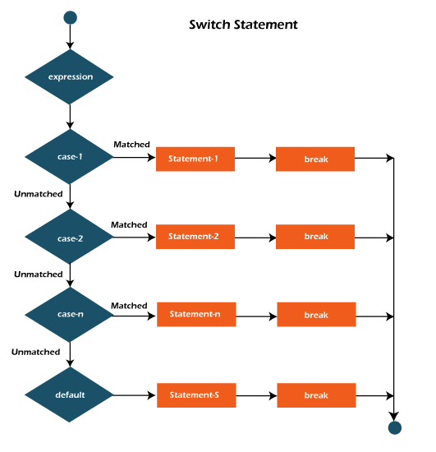
Switch Case Staments
Syntax:
switch(expression vlaue)
{
case '<matched value':
// staments block;
break;
case '<matched value>':
// statements block
break;
case '<matched value>":
//statment block;
break;
default:
// default statment block;
}

Slide 16
Loop controle or a program Iteration
For ...loop
Syntax:
for(<initialize> ; <condition> ; <increment / decrement> ) {
// black of statement
}
Expression
I <=10
true
Do .. loop
syntax:
do {
/ / black of statement
I++;
} while( <condition>)
Stament Apple group computer
False
I++
While ...loop
Syncax:
While( <condition>) {
// black of statement
// Expression
}
End

Slide 17
Example:
class ifelse{
public static void main(String[] args) {
int number = 10;
// checks if number is less than 0
if (number < 0) {
System.out.println("The number is negative.");
} else {
System.out.println("Statement outside if block");
}
}
Class switchCase{
public static void main(String[] args) {
int number = 44; String size; // switch statement to check size switch (number) { case 29: size = "Small"; break; case 42: size = "Medium"; break; // match the value of week case 44: size = "Large"; break; case 48: size = "Extra Large"; break; default: size = "Unknown"; break; } System.out.println("Size: " + size);
}
}
Class ifelsecondition{
public static void main(String[] args) {
int number = 10;
// checks if number is greater than 0 if (number < 4) { System.out.println("Less the 4 nuer"); } if else( number < 10) {
System.out.println("Less the 10 nuber");
} if else(number < 15) {
System.out.println("Less then fitteen nuber");
} else{System.out.println(" all nuber oare greather then 15");
}}

Slide 18
public class itemDetails {
public static void main(String[] args) {
String itemName[]= new String[]{"Pen", "Pencil","book","Net","ball","Eraser","copy","ink" };
int price[]= new int[]{50,10,30,150,350,4,30,20};
int unit[]= new int[]{2,3,4,3,6,8,9,4};
System.out.println("------------------------------------------------------");
System.out.printf("%s \t %s \t %s \t %s %n", "ItemName", "Price", "Unit", "Total");
System.out.println("------------------------------------------------------");
int unitTotal=0;
int gradTotal=0;
for(int i=0; i<itemName.length; i++) {
System.out.printf("%s \t\t %s \t\t %s \t\t %s%n", itemName[i], price[i], unit[i],price[i]*unit[i]);
unitTotal+=unit[i];
gradTotal+=price[i] * unit[i];
}
System.out.println("-----------------------------------------------------");
System.out.printf("\t\t Unit Total %s Grand Total %s %n",unitTotal, gradTotal);
}
}

Slide 19
String Interpolation
String Interpolation is process in which a string placeholder replace by veiable value. It macke compact string from defferent string placeholder variable values.
String a = "Democracy";
// String 2
String b = "people";
// Print and display the interpolated string
System.out.println( a +" is Rule by " +b+" selected Leader!.");
String a = "Democracy";
// String 2
String b = "people";
// Print and display the interpolated string
System.out.println(String.format("%s is a government of the %s ",a, b));
String a = "Democracy";
// String 2
String b = "people";
// Print and display the interpolated string
System.out.println(MessageFormat.format("{0} is a government of the {1}, for the {1} and by the {1}.",a, b));
or
StringBuilder mesg =new StringBuilder(a).append(" is the best portal to learn ").append(b).append(".");
System.out.println( mesg);

