Slide 1
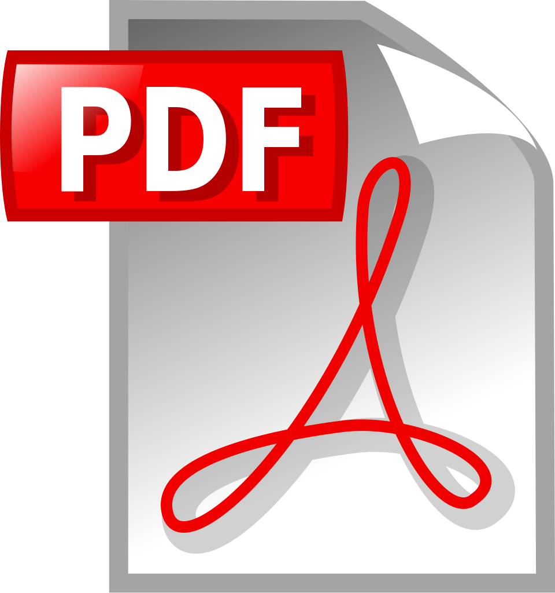

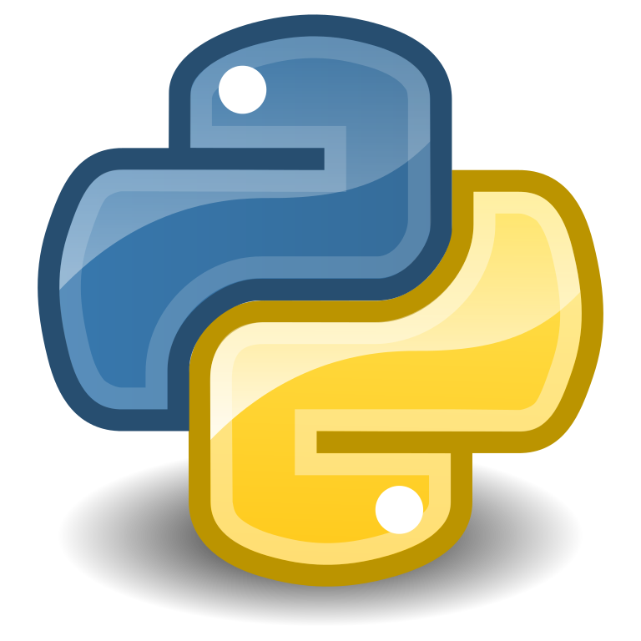
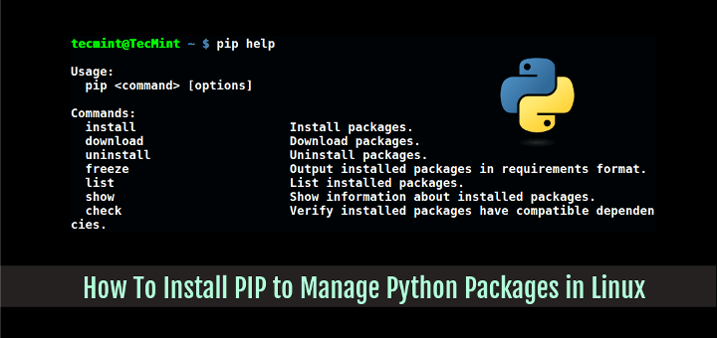
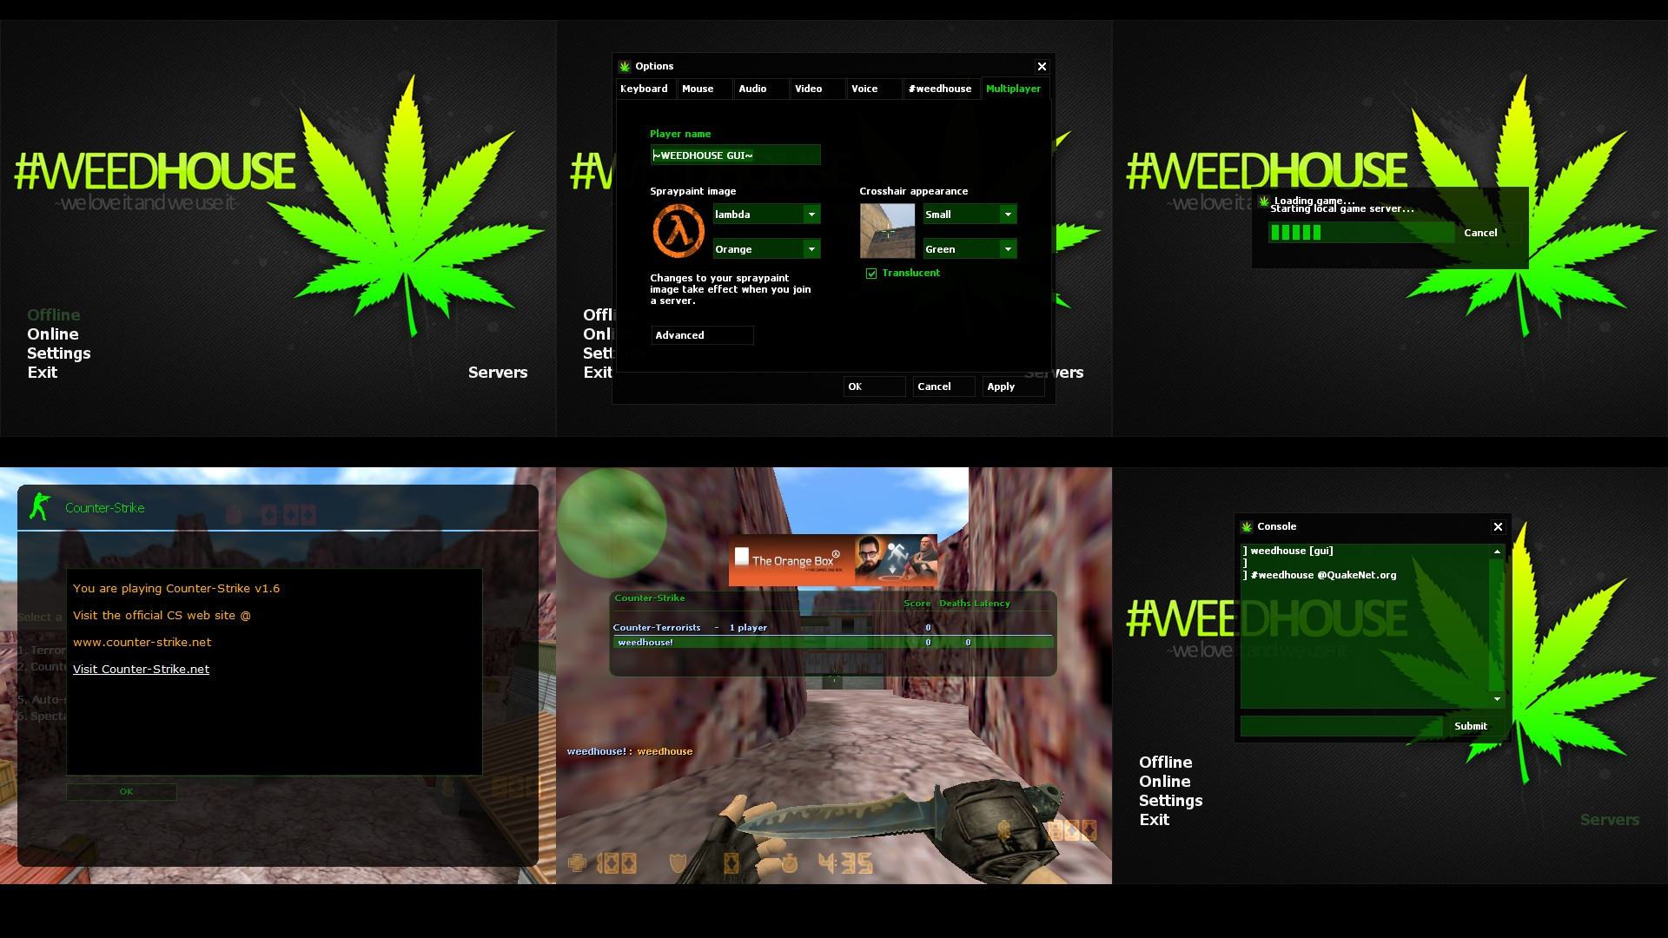
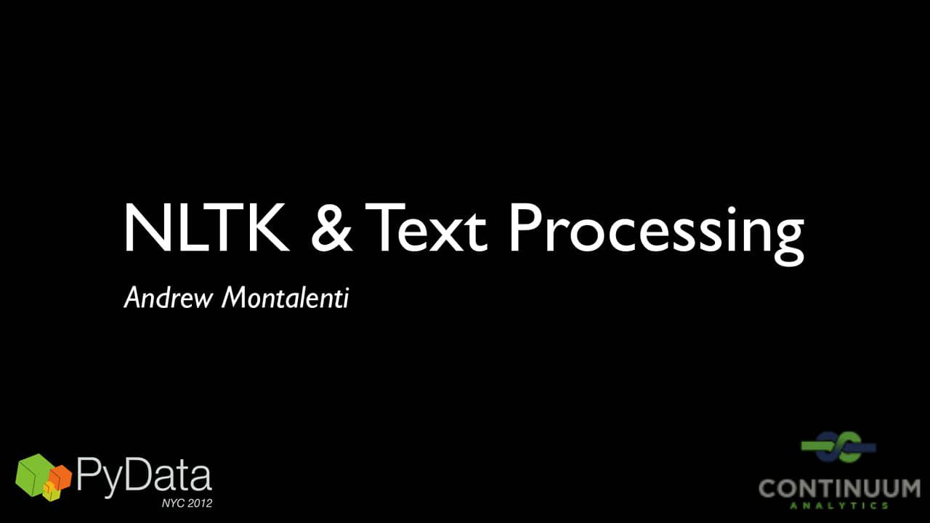
API
Image to Text
Display output
Text Input to python
Tesseract OCR
Python Package
GUI
Text Extraction and
Matching Algorithm
API Layer
Input image and
Text Documents

