Slide 1
OTW: MAJ DEVENDRA KUMAR

Slide 2
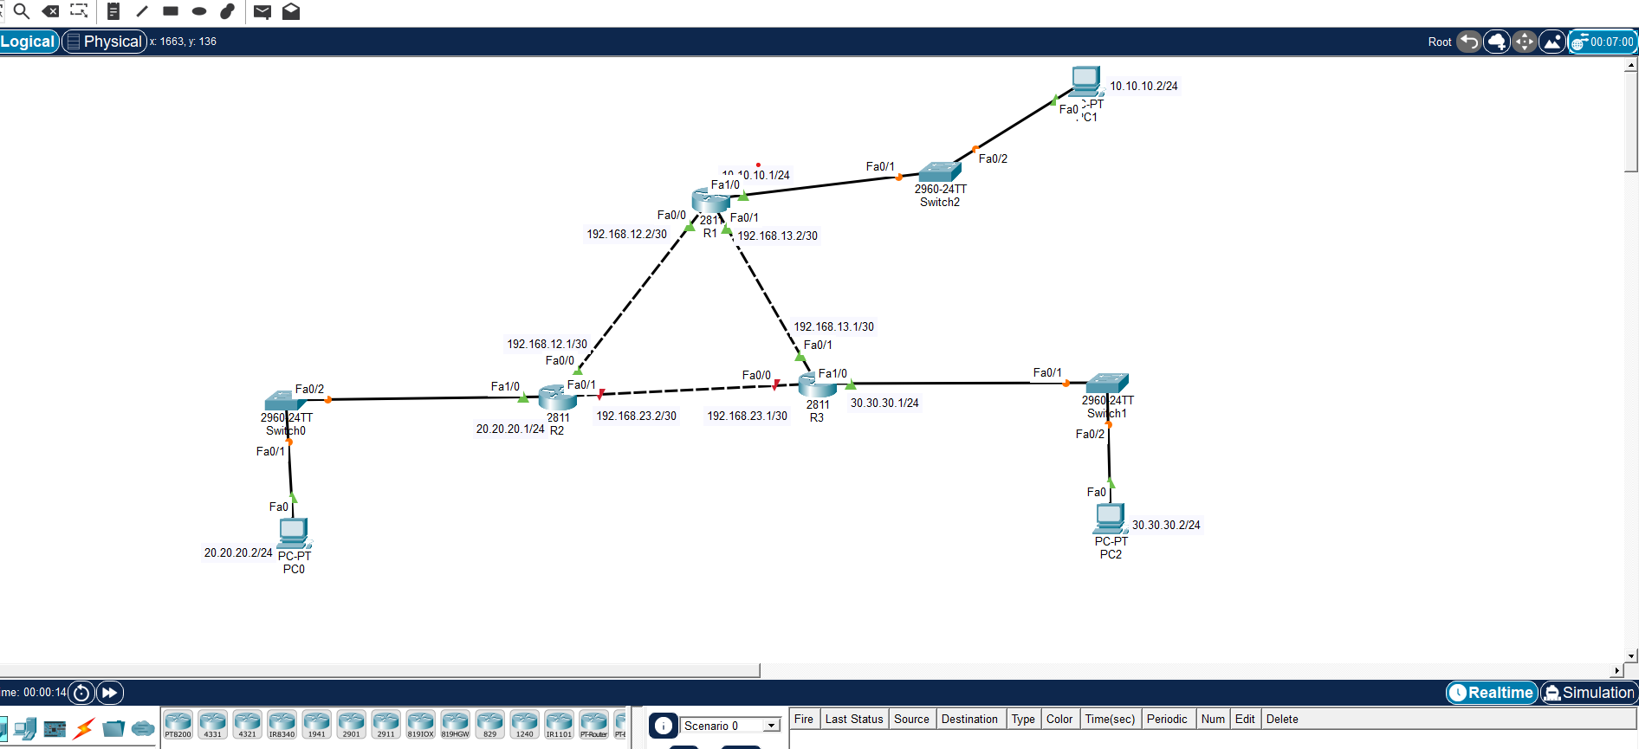
CISCO PACKET: TOPOLOGY
Wireshark Topology:
Three Router (R1,R2,R3)
Three LANs
State: Working

Slide 3
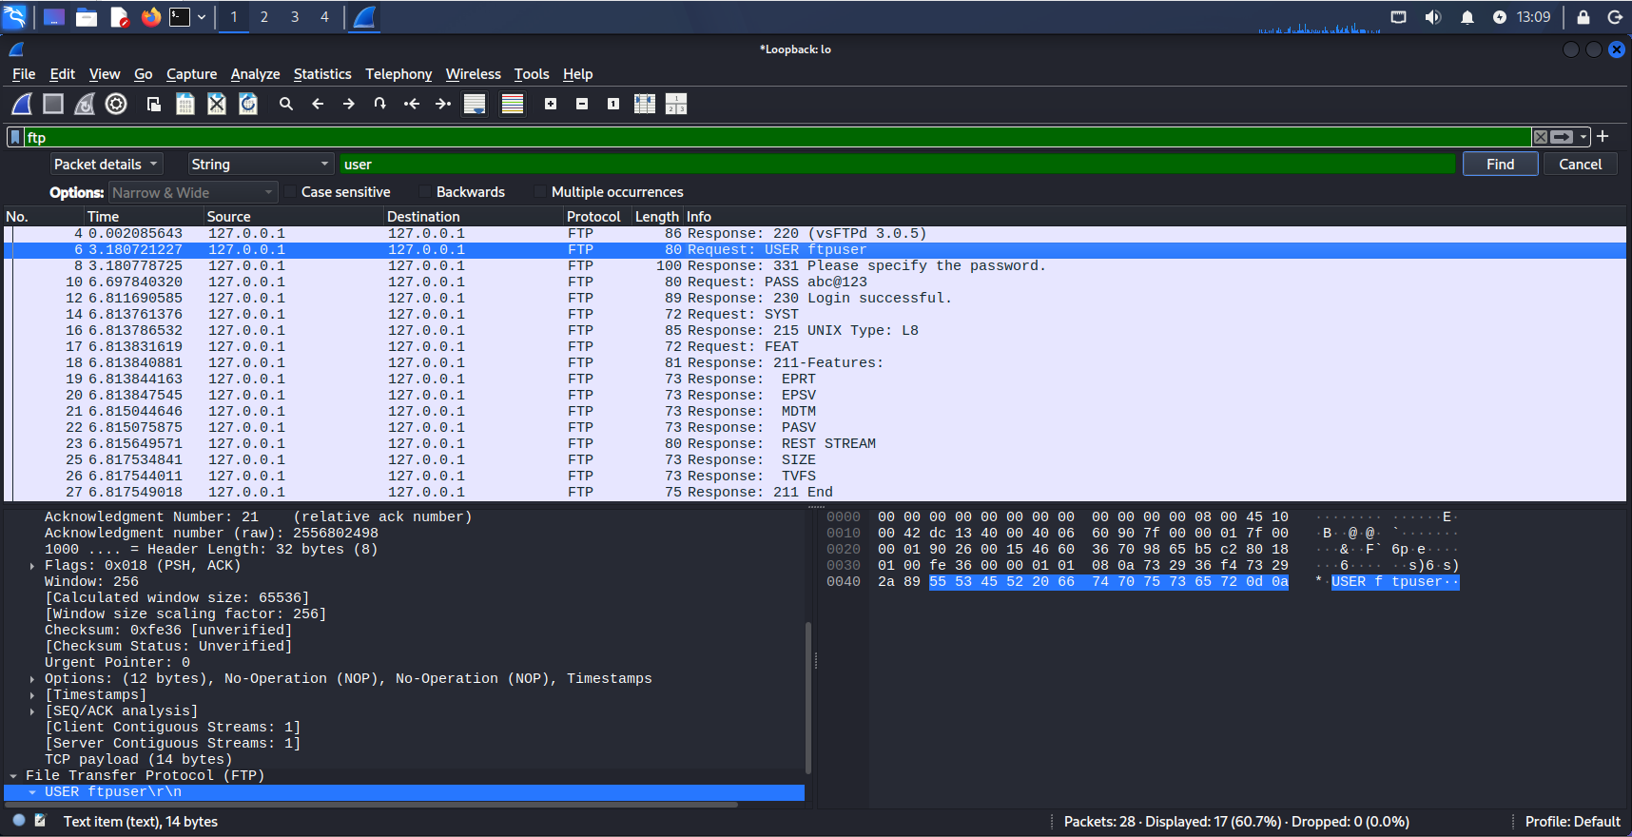
WIRESHARK: FTP SERVER

Slide 4
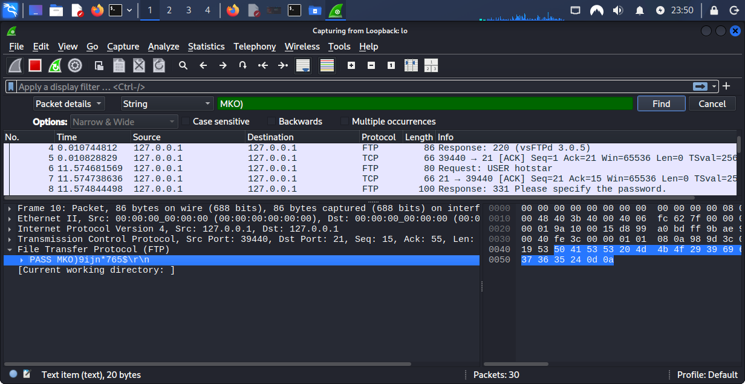
WIRESHARK: TELNET

Slide 5
SURICATA

Slide 6
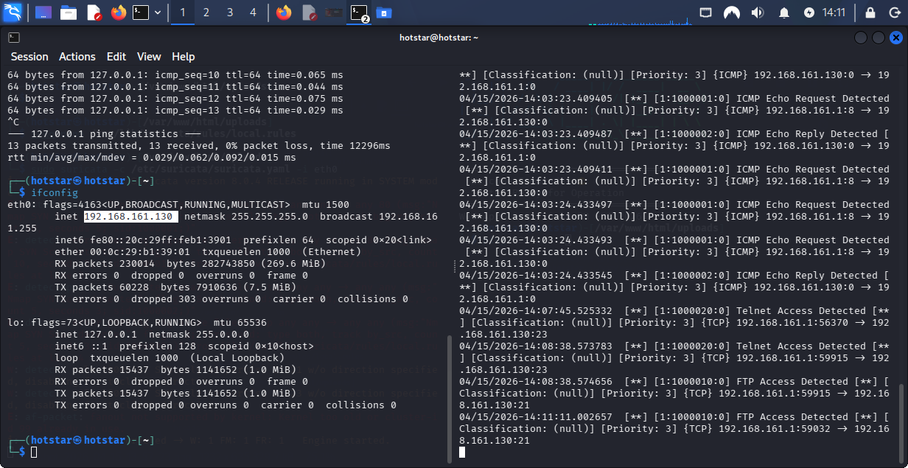
SURICATA IDS DETECTION
Suricata IDS Detection
Telnet

Slide 7
SURICATA IDS DETECTION: FTP & NMAP

Slide 8
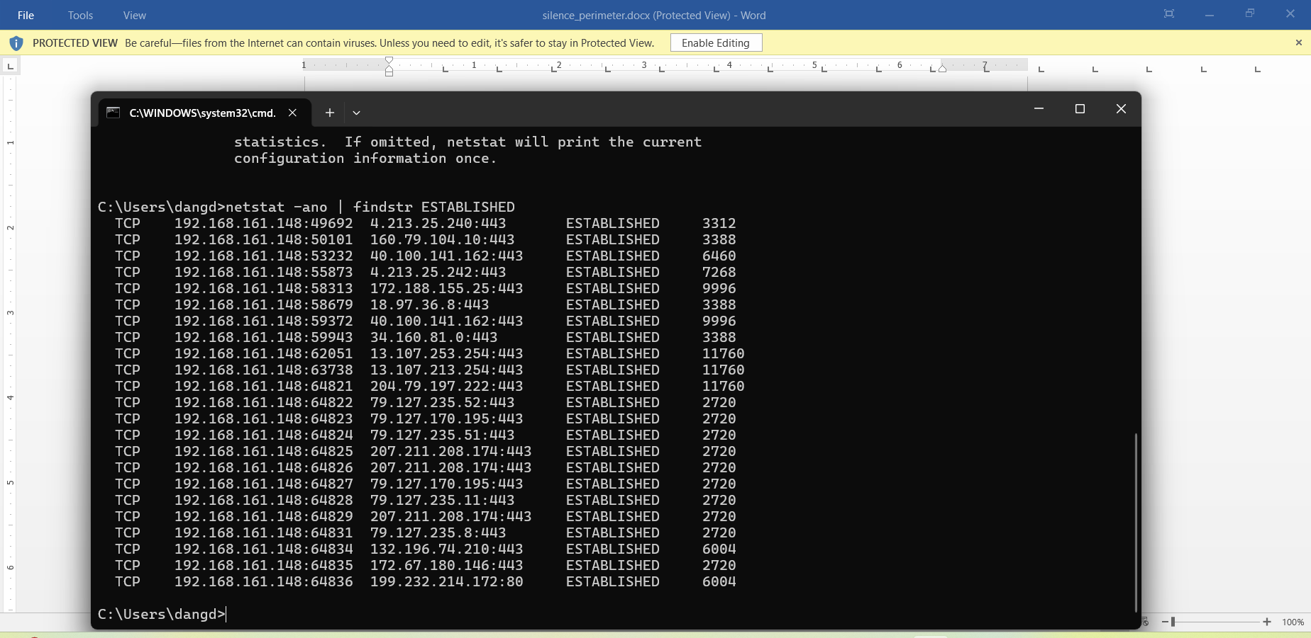
NETWORK STATE

