Slide 1
Device Clustering using Age, Price, Camera & Screen
Feb 14, 2017 – Dtac Data Science

Slide 2
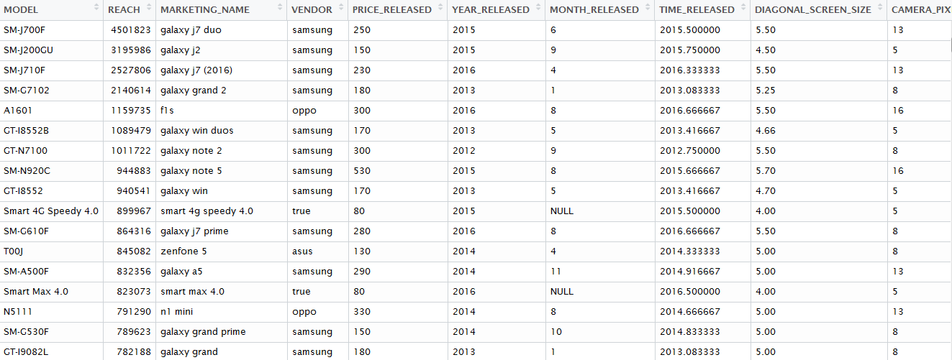
Clustering using 4 Quantitative Device Characteristics
Released price, device age in year (monthly precision), screen size and camera pixel
1
Released price
Released Time
(monthly precision)
Screen size
Camera
pixel
2
3
4
Device technical name –
to be mapped with the user agent for segmentation rule creation (both for real-time as for Pantip, Kaidee, DSP* and for fixed audience list creation as for Facebook and DSP.)
Clustering will be done using 4 quantitative device characteristics above without brand discrimination
Device age using released time: DVC AGE = 2017+2/12 – TIME_RELEASED
Released price (euros)
Camera pixel
Diagonal screen size (inch)
Device brand could be used to break down large clusters afterward.
On the DSP, we can also target visitor at the device level in real-time. However, unlike for Pantip, Kaidee and Facebook, the rule is case-sensitive and exclusion (the else segment) is not available in real-time.
Released month and price are scraped from gsmarena.com, camera pixel from Tapad data, the rest are available from both gsmarena and Tapad data.

Slide 3
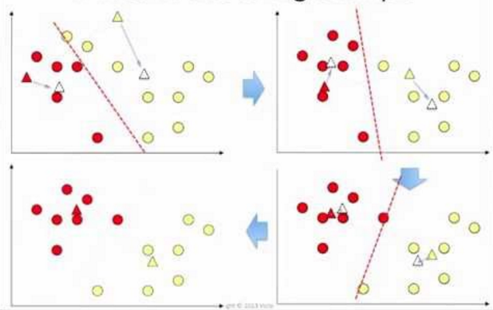
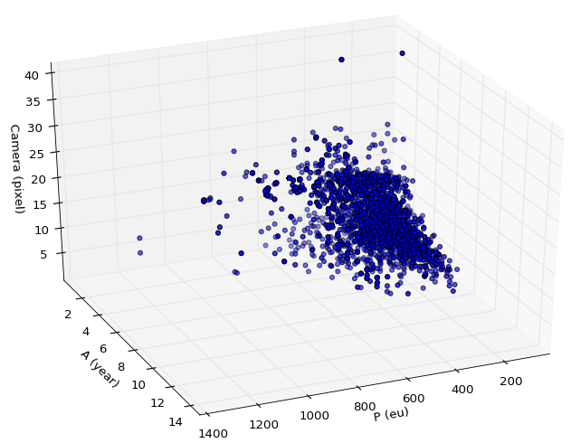
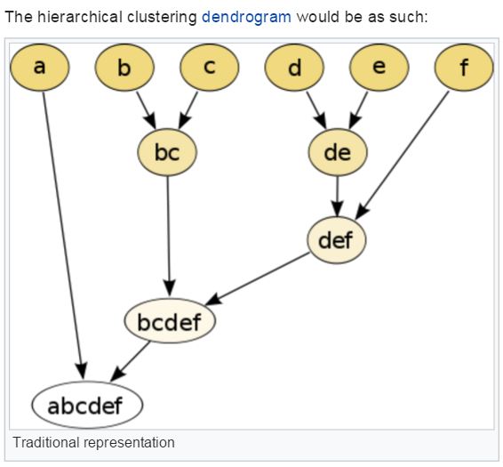
Understand the Clustering Concept
Clustering is grouping devices with closed characteristics together
K-means clustering
3461 different android model detected on Tapad
1 point = 1 device
2. New centroids for each cluster are computed
1. Random centroids are chosen, points are assigned to the nearest centroid
4. The clustering stop when the centroids are stable
Source: Lavrenko V.
3. Points are assigned to the new centroids
Hierachical agglomerative clustering (HAC)
Tested clustering methods
K-means clustering : partition a dataset into a fixed number of clusters by minimizing the distance between each data point and the center of the clusters
Hierachical agglomerative clustering (HAC) : grouping nearest point together until reaching a fixed number of cluster
Nearest points are grouped together.
The grouping level is cut off when the group numbers is equal to the chosen number of cluster.
Tested choices of variables used for clustering
Released price, device age, camera pixel
Released price, device age, screen size
Released price, device age, camera pixel and screen size
Number of clusters: 7 as suggested from the elbow method
Source: wikipedia
Technical remarks
DBScan clustering method is not adapted to the problem seeing that the points of device characteristics are grouping together.
We have also tested the number of clusters of 8 and 12

Slide 4
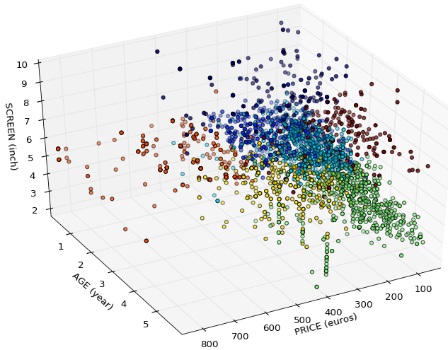
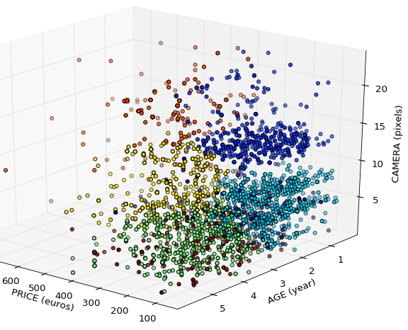
Clustering Results
3461 Android models are grouped into 7 clusters based on their price, screen, camera and age
0: New to mid-age tablet
5: New, high-end, large screen, high-quality camera
6: Old, low-end tablet
2: New, low-end, small screen, low-quality camera
1: New, mid-end, large screen, high-quality camera
3: Old, low-end, small screen, low-quality camera
4: Old, mid-end, large screen, mid-quality camera
0 & 6: All tablets has low camera quality
0: New to mid-age tablet
1: New, mid-end, large screen, high-q camera
2: New, low-end, small screen, low-q camera
3: Old, low-end, small screen, low-q camera
4: Old, mid-end, large screen, mid-q camera
5: New, high-end, large screen, hi-q camera
6: Old low-end tablet

Slide 5
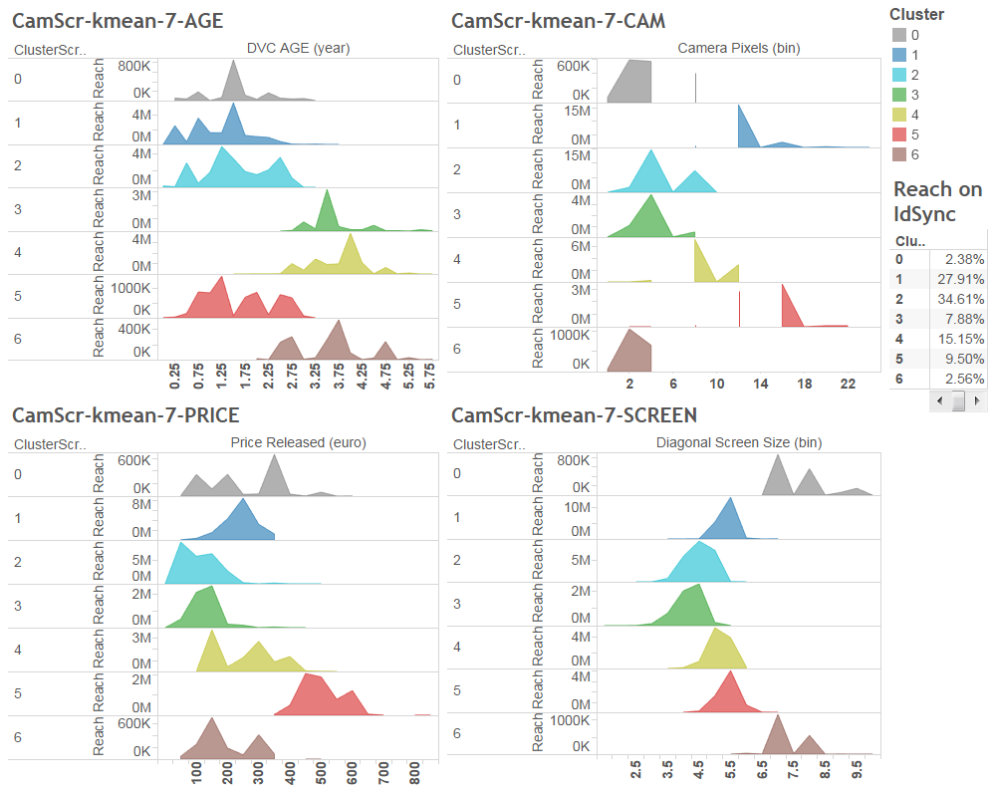
Distribution of Device Characteristics by Cluster
Clear trend can be observed on age, price, camera and screen
0: New to mid-age tablet
1: New, mid-end, large screen, high-q camera
2: New, low-end, small screen, low-q camera
3: Old, low-end, small screen, low-q camera
4: Old, mid-end, large screen, mid-q camera
5: New, high-end, large screen, hi-q camera
6: Old low-end tablet

Slide 6
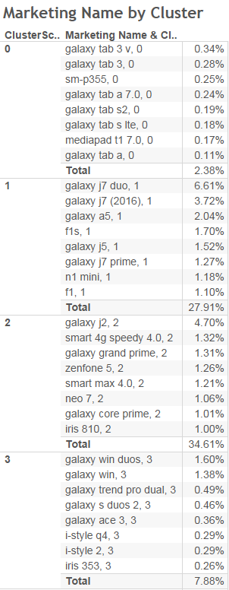
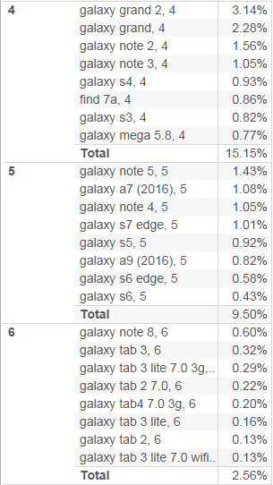
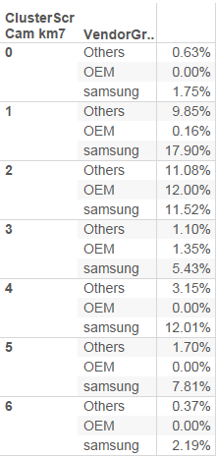
Top Models for the 7 Clusters
Clear trend can be observed on age, price, camera and screen
0: New to mid-age tablet
1: New, mid-end, large screen, high-q camera
2: New, low-end, small screen, low-q camera
3: Old, low-end, small screen, low-q camera
4: Old, mid-end, large screen, mid-q camera
5: New, high-end, large screen, hi-q camera
6: Old low-end tablet
Seeing the reach of cluster 1 & 2 are high (28 & 34 %), we could try to break down these 2 clusters using the vendor.
We could for example, break down
1 -> 1_SS & 1_OTH
2 -> 2_SS, 2_OEM and 2_OTH

Slide 7
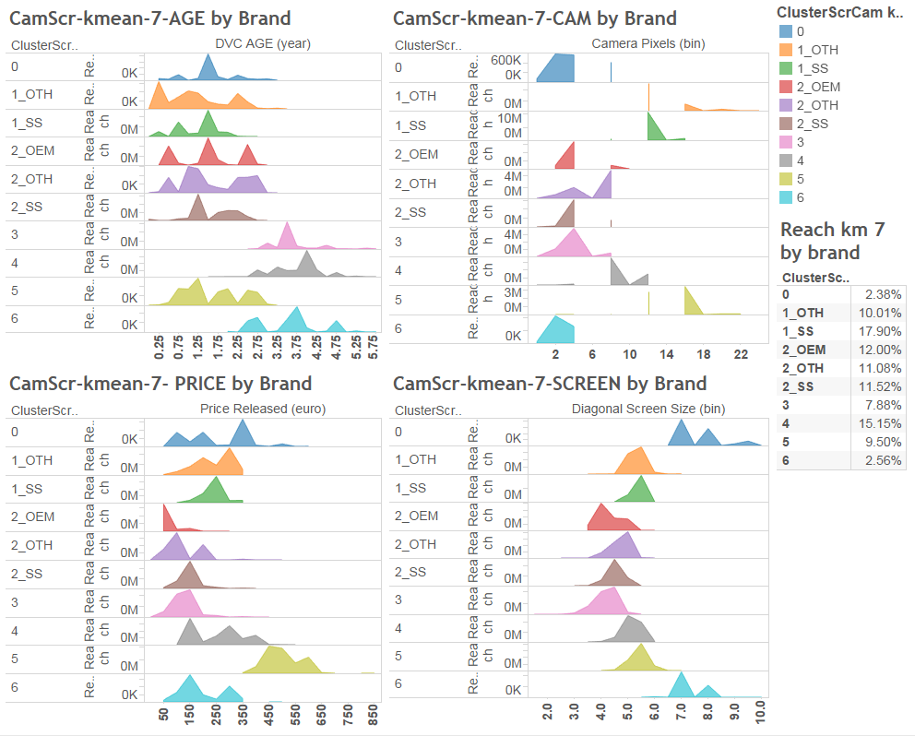
Distribution of Device Characteristics by Brand Augmented Cluster
Clearer trend on camera and screen size, the reach by cluster is more distributed
Remark that different ways can be used to breakdown the cluster,
For example, by using the price as 1_lt1year, 1_gt250eu, etc.
0: New to mid-age tablet
1: New, mid-end, large screen, high-q camera
2: New, low-end, small screen, low-q camera
3: Old, low-end, small screen, low-q camera
4: Old, mid-end, large screen, mid-q camera
5: New, high-end, large screen, hi-q camera
6: Old low-end tablet

Slide 8
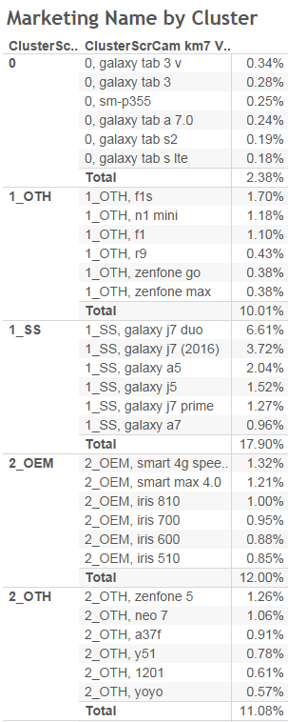
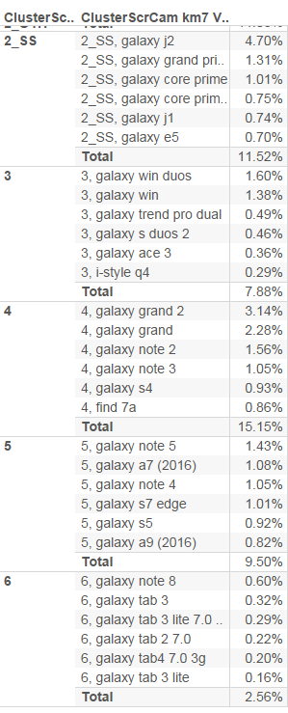
Top models for the 10 Brand-Augmented Clusters & Reach on Facebook
Note that different ways to augment the clusters could be used
0: New to mid-age tablet
1: New, mid-end, large screen, high-q camera
2: New, low-end, small screen, low-q camera
3: Old, low-end, small screen, low-q camera
4: Old, mid-end, large screen, mid-q camera
5: New, high-end, large screen, hi-q camera
6: Old low-end tablet
Number of distinct Omo non Dtac ad ids detected by Tapad (The actual reach on FB will be less)
cluster | Distinct actual omo ad ids | % of Androids
0 | 19,438 | 1.0%
1_OTH | 576,940 | 30.5%
1_SS | 162,870 | 8.6%
2_OEM | 51,222 | 2.7%
2_OTH | 149,499 | 7.9%
2_SS | 89,400 | 4.7%
3 | 319,279 | 16.9%
4 | 186,841 | 9.9%
5 | 192,367 | 10.2%
6 | 144,874 | 7.7%
Total | 1,892,730

