Slide 1
Automate Segmentation Rules using Feedback
Feb 2017 – Dtac Data Science

Slide 2

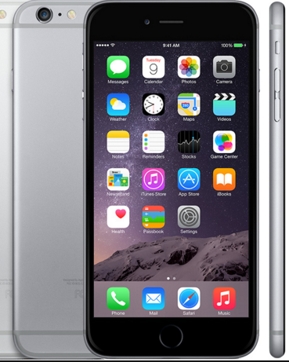





Self-Learning Segmentation Ecosystem (Apollo)
Closed-Loop Scheme
BOX #1
Automated device properties retrieval from webs
Release price, month, year
Screen size
Camera spec, 4G capability
Device clustering
SUPPORTING
Web market studies
Self-learning segments
Dtac’s device model
BOX #2
Lifestyle segments from webs
Subject of interests from forums on Pantip as travelling,investment, etc.
Detailed visiting topics as iPhone, travelling in Tokyo, etc.
Models based on lifestyle and device to be used on OMO
ARPU, churn, device
SUPPORTING
Web market studies
Self-learning segments
Mobile
Atlas
Lifestyle
from webs
Dtac scores/ models
1
2
Rules
Rule Generator
Target
3
Target Feedback
BOX #3
Automated self-learning segmentation rules
SUPPORTING Apollo
CTR, number of submits/ landing, cost per submit etc.
By device and/or lifestlye

Slide 3

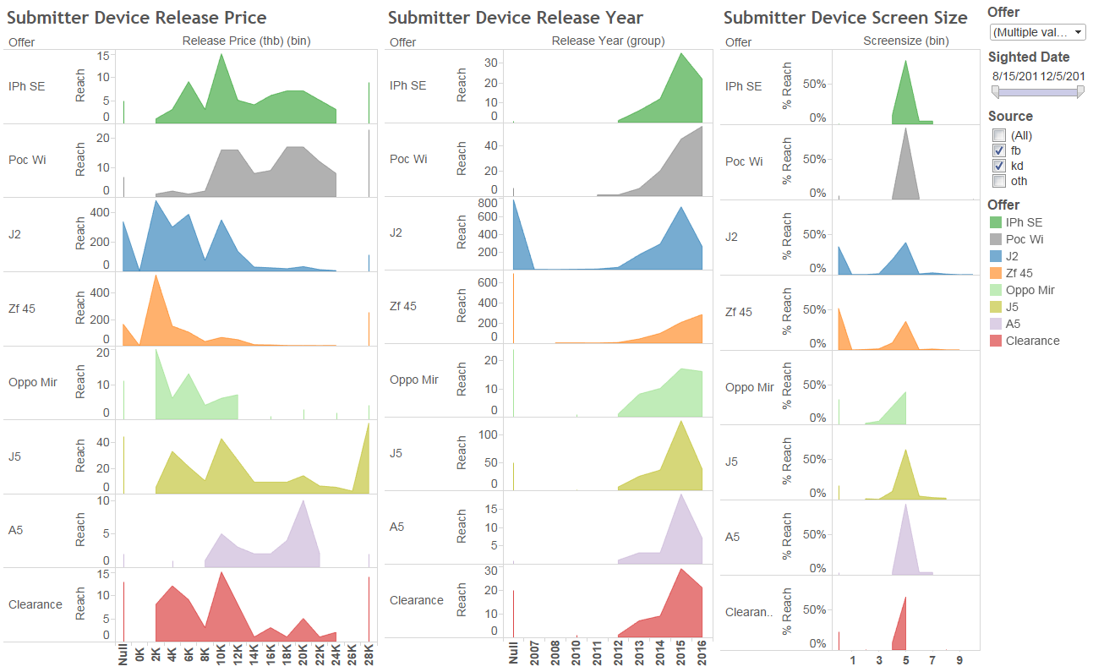
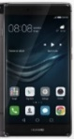
Automated Segmentation Logic (Apollo)
For each offer
Key variables
Device properties
# phone models that click
# phone models that submit
CTR by phone model
#Submits by phone model
Cost per submit by phone model
#Landings by phone model
Target phone models
whose release price <3x
N
Offer properties
(with full price x)
x >= 10k
thb
Y
Target phone models
whose release price > x/2
Huawei P9 Plus
2016, 24k, 5.5”
Logic based on the statistics of the release price of the submitters’ phones from past offers
Initial rules for new offers
Same target phone models as day k
N
# landing models >= c
Y
Use landing models
as targets for day k+1
Most relevant unsuccessful models
From other offers
N
N
For Day 0
N
#models with (submit >= 1 & CTR >= 0.5% & CPS <30 USD)
>= b
Models in target list of another offer with higher priority
Target phone models
at day k
Offer A Launch >= 3 days
Y
#models that click on the ads >=a
Y
Y
Use successful models
as targets for day k+1
Target phone models
at day k+1
For Day >= 1
Use of feedback

