Slide 1
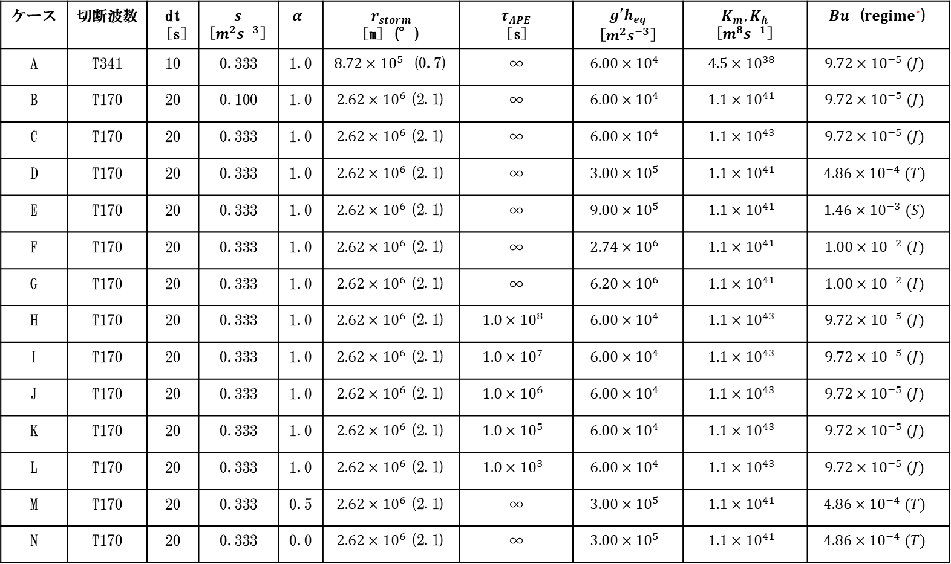
ケース | 切断波数 | dt [s] | $$s$$ [$m^{2}s^{−3}$] | $$α$$ | $$r_{storm}$$ [m] (°) | $$τ_{APE}$$ [s] | $$g^{′}h_{eq}$$ [$m^{2}s^{−3}$] | $$K_{m}, K_{h}$$ [$m^{8}s^{−1}$] | $Bu$ ($regime^{∗}$)
A | T341 | 10 | 0.333 | 1.0 | $8.72×{10}^{5}$ (0.7) | ∞ | $$6.00×{10}^{4}$$ | $$4.5×{10}^{38}$$ | $$9.72×{10}^{−5} (J)$$
B | T170 | 20 | 0.100 | 1.0 | $2.62×{10}^{6}$(2.1) | ∞ | $$6.00×{10}^{4}$$ | $$1.1×{10}^{41}$$ | $$9.72×{10}^{−5} (J)$$
C | T170 | 20 | 0.333 | 1.0 | $2.62×{10}^{6}$(2.1) | ∞ | $$6.00×{10}^{4}$$ | $$1.1×{10}^{43}$$ | $$9.72×{10}^{−5} (J)$$
D | T170 | 20 | 0.333 | 1.0 | $2.62×{10}^{6}$(2.1) | ∞ | $$3.00×{10}^{5}$$ | $$1.1×{10}^{41}$$ | $$4.86×{10}^{−4} (T)$$
E | T170 | 20 | 0.333 | 1.0 | $2.62×{10}^{6}$(2.1) | ∞ | $$9.00×{10}^{5}$$ | $$1.1×{10}^{41}$$ | $$1.46×{10}^{−3} (S)$$
F | T170 | 20 | 0.333 | 1.0 | $2.62×{10}^{6}$(2.1) | ∞ | $$2.74×{10}^{6}$$ | $$1.1×{10}^{41}$$ | $$1.00×{10}^{−2} (I)$$
G | T170 | 20 | 0.333 | 1.0 | $2.62×{10}^{6}$(2.1) | ∞ | $$6.20×{10}^{6}$$ | $$1.1×{10}^{41}$$ | $$1.00×{10}^{−2} (I)$$
H | T170 | 20 | 0.333 | 1.0 | $2.62×{10}^{6}$(2.1) | $$1.0×{10}^{8}$$ | $$6.00×{10}^{4}$$ | $$1.1×{10}^{43}$$ | $$9.72×{10}^{−5} (J)$$
I | T170 | 20 | 0.333 | 1.0 | $2.62×{10}^{6}$(2.1) | $$1.0×{10}^{7}$$ | $$6.00×{10}^{4}$$ | $$1.1×{10}^{43}$$ | $$9.72×{10}^{−5} (J)$$
J | T170 | 20 | 0.333 | 1.0 | $2.62×{10}^{6}$(2.1) | $$1.0×{10}^{6}$$ | $$6.00×{10}^{4}$$ | $$1.1×{10}^{43}$$ | $$9.72×{10}^{−5} (J)$$
K | T170 | 20 | 0.333 | 1.0 | $2.62×{10}^{6}$(2.1) | $$1.0×{10}^{5}$$ | $$6.00×{10}^{4}$$ | $$1.1×{10}^{43}$$ | $$9.72×{10}^{−5} (J)$$
L | T170 | 20 | 0.333 | 1.0 | $2.62×{10}^{6}$(2.1) | $$1.0×{10}^{3}$$ | $$6.00×{10}^{4}$$ | $$1.1×{10}^{43}$$ | $$9.72×{10}^{−5} (J)$$
M | T170 | 20 | 0.333 | 0.5 | $2.62×{10}^{6}$(2.1) | ∞ | $$3.00×{10}^{5}$$ | $$1.1×{10}^{41}$$ | $$4.86×{10}^{−4} (T)$$
N | T170 | 20 | 0.333 | 0.0 | $2.62×{10}^{6}$(2.1) | ∞ | $$3.00×{10}^{5}$$ | $$1.1×{10}^{41}$$ | $$4.86×{10}^{−4} (T)$$
* Brueshaber et al. (2019) で Burger 数の値で分類したレジーム

Slide 2
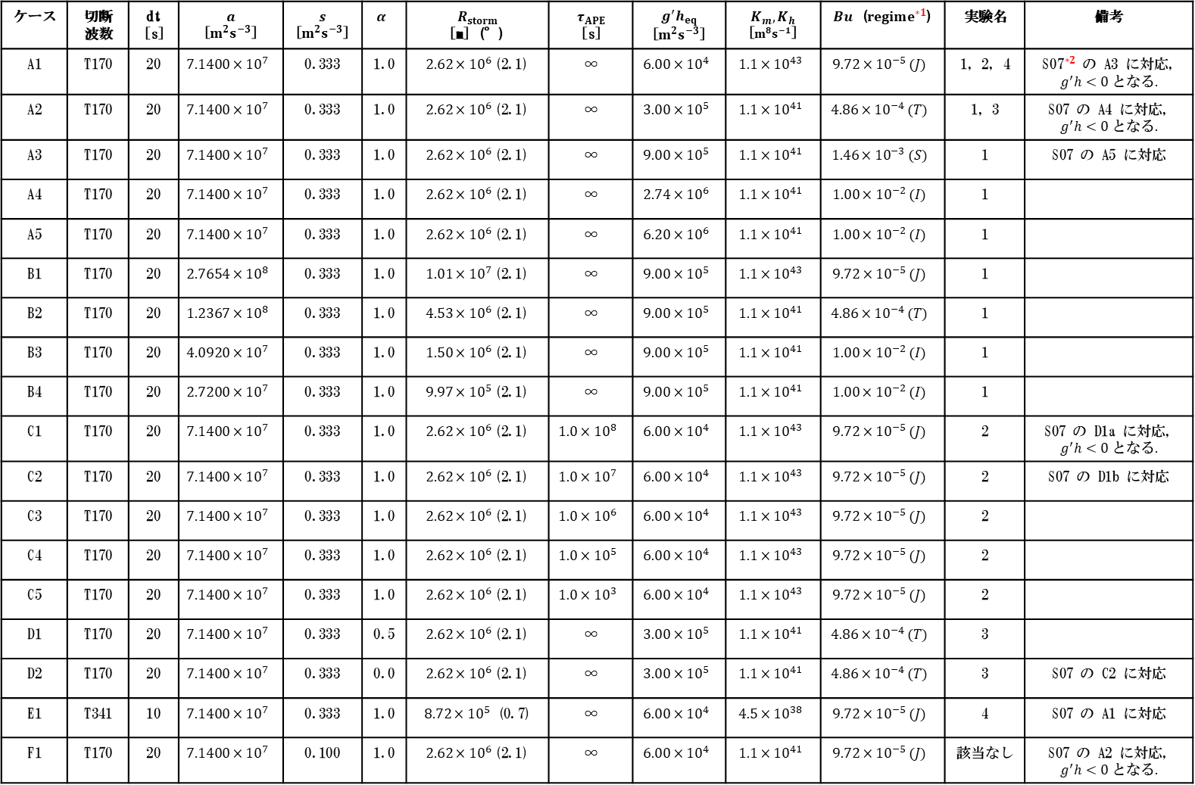
ケース | 切断波数 | dt [s] | $$a$$ [$m^{2}s^{−3}$] | $$s$$ [$m^{2}s^{−3}$] | $$α$$ | $$R_{storm}$$ [m] (°) | $$τ_{APE}$$ [s] | $$g^{′}h_{eq}$$ [$m^{2}s^{−3}$] | $$K_{m}, K_{h}$$ [$m^{8}s^{−1}$] | $Bu$ ($regime^{∗1}$) | 実験名 | 備考
A1 | T170 | 20 | $$7.1400×{10}^{7}$$ | 0.333 | 1.0 | $2.62×{10}^{6}$(2.1) | ∞ | $$6.00×{10}^{4}$$ | $$1.1×{10}^{43}$$ | $$9.72×{10}^{−5} (J)$$ | 1, 2, 4 | ${\text{S}\text{07}}^{∗2}$ の A3 に対応, $$g^{′}h<0 となる.$$
A2 | T170 | 20 | $$7.1400×{10}^{7}$$ | 0.333 | 1.0 | $2.62×{10}^{6}$(2.1) | ∞ | $$3.00×{10}^{5}$$ | $$1.1×{10}^{41}$$ | $$4.86×{10}^{−4} (T)$$ | 1, 3 | S07 の A4 に対応, $$g^{′}h<0 となる.$$
A3 | T170 | 20 | $$7.1400×{10}^{7}$$ | 0.333 | 1.0 | $2.62×{10}^{6}$(2.1) | ∞ | $$9.00×{10}^{5}$$ | $$1.1×{10}^{41}$$ | $$1.46×{10}^{−3} (S)$$ | 1 | S07 の A5 に対応
A4 | T170 | 20 | $$7.1400×{10}^{7}$$ | 0.333 | 1.0 | $2.62×{10}^{6}$(2.1) | ∞ | $$2.74×{10}^{6}$$ | $$1.1×{10}^{41}$$ | $$1.00×{10}^{−2} (I)$$ | 1
A5 | T170 | 20 | $$7.1400×{10}^{7}$$ | 0.333 | 1.0 | $2.62×{10}^{6}$(2.1) | ∞ | $$6.20×{10}^{6}$$ | $$1.1×{10}^{41}$$ | $$1.00×{10}^{−2} (I)$$ | 1
B1 | T170 | 20 | $$2.7654×{10}^{8}$$ | 0.333 | 1.0 | $1.01×{10}^{7}$(2.1) | ∞ | $$9.00×{10}^{5}$$ | $$1.1×{10}^{43}$$ | $$9.72×{10}^{−5} (J)$$ | 1
B2 | T170 | 20 | $$1.2367×{10}^{8}$$ | 0.333 | 1.0 | $4.53×{10}^{6}$(2.1) | ∞ | $$9.00×{10}^{5}$$ | $$1.1×{10}^{41}$$ | $$4.86×{10}^{−4} (T)$$ | 1
B3 | T170 | 20 | $$4.0920×{10}^{7}$$ | 0.333 | 1.0 | $1.50×{10}^{6}$(2.1) | ∞ | $$9.00×{10}^{5}$$ | $$1.1×{10}^{41}$$ | $$1.00×{10}^{−2} (I)$$ | 1
B4 | T170 | 20 | $$2.7200×{10}^{7}$$ | 0.333 | 1.0 | $9.97×{10}^{5}$(2.1) | ∞ | $$9.00×{10}^{5}$$ | $$1.1×{10}^{41}$$ | $$1.00×{10}^{−2} (I)$$ | 1
C1 | T170 | 20 | $$7.1400×{10}^{7}$$ | 0.333 | 1.0 | $2.62×{10}^{6}$(2.1) | $$1.0×{10}^{8}$$ | $$6.00×{10}^{4}$$ | $$1.1×{10}^{43}$$ | $$9.72×{10}^{−5} (J)$$ | 2 | S07 の D1a に対応, $$g^{′}h<0 となる.$$
C2 | T170 | 20 | $$7.1400×{10}^{7}$$ | 0.333 | 1.0 | $2.62×{10}^{6}$(2.1) | $$1.0×{10}^{7}$$ | $$6.00×{10}^{4}$$ | $$1.1×{10}^{43}$$ | $$9.72×{10}^{−5} (J)$$ | 2 | S07 の D1b に対応
C3 | T170 | 20 | $$7.1400×{10}^{7}$$ | 0.333 | 1.0 | $2.62×{10}^{6}$(2.1) | $$1.0×{10}^{6}$$ | $$6.00×{10}^{4}$$ | $$1.1×{10}^{43}$$ | $$9.72×{10}^{−5} (J)$$ | 2
C4 | T170 | 20 | $$7.1400×{10}^{7}$$ | 0.333 | 1.0 | $2.62×{10}^{6}$(2.1) | $$1.0×{10}^{5}$$ | $$6.00×{10}^{4}$$ | $$1.1×{10}^{43}$$ | $$9.72×{10}^{−5} (J)$$ | 2
C5 | T170 | 20 | $$7.1400×{10}^{7}$$ | 0.333 | 1.0 | $2.62×{10}^{6}$(2.1) | $$1.0×{10}^{3}$$ | $$6.00×{10}^{4}$$ | $$1.1×{10}^{43}$$ | $$9.72×{10}^{−5} (J)$$ | 2
D1 | T170 | 20 | $$7.1400×{10}^{7}$$ | 0.333 | 0.5 | $2.62×{10}^{6}$(2.1) | ∞ | $$3.00×{10}^{5}$$ | $$1.1×{10}^{41}$$ | $$4.86×{10}^{−4} (T)$$ | 3
D2 | T170 | 20 | $$7.1400×{10}^{7}$$ | 0.333 | 0.0 | $2.62×{10}^{6}$(2.1) | ∞ | $$3.00×{10}^{5}$$ | $$1.1×{10}^{41}$$ | $$4.86×{10}^{−4} (T)$$ | 3 | S07 の C2 に対応
E1 | T341 | 10 | $$7.1400×{10}^{7}$$ | 0.333 | 1.0 | $8.72×{10}^{5}$ (0.7) | ∞ | $$6.00×{10}^{4}$$ | $$4.5×{10}^{38}$$ | $$9.72×{10}^{−5} (J)$$ | 4 | S07 の A1 に対応
F1 | T170 | 20 | $$7.1400×{10}^{7}$$ | 0.100 | 1.0 | $2.62×{10}^{6}$(2.1) | ∞ | $$6.00×{10}^{4}$$ | $$1.1×{10}^{41}$$ | $$9.72×{10}^{−5} (J)$$ | 該当なし | S07 の A2 に対応, $$g^{′}h<0 となる.$$
*¹ Brueshaber et al. (2019) で Burger 数の値で分類したレジーム
*² Showman (2007)

