Slide 1
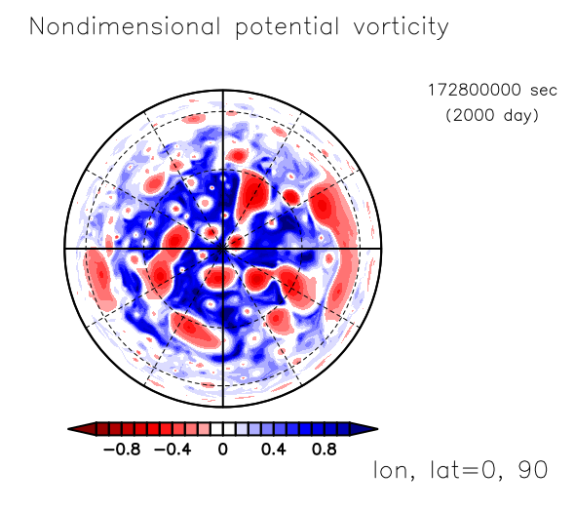


$τ_{APE}=∞$ (A1)
$τ_{APE}=∞$ (T341)

Slide 2
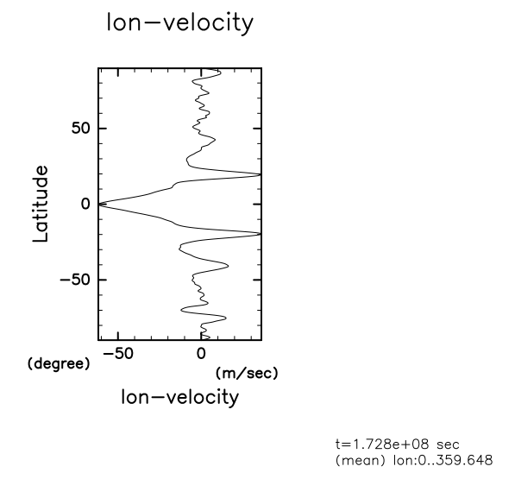
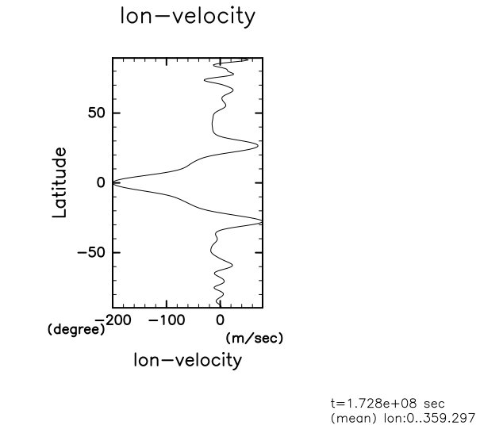


$τ_{APE}=∞$ (A1)
$τ_{APE}={10}^{6}$ (C3)

