Slide 1
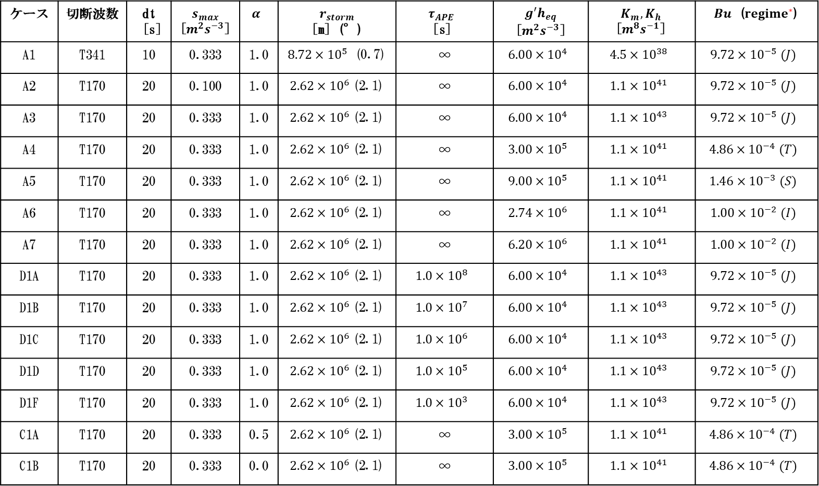
ケース | 切断波数 | dt [s] | $$s_{max}$$ [$m^{2}s^{−3}$] | $$α$$ | $$r_{storm}$$ [m] (°) | $$τ_{APE}$$ [s] | $$g^{′}h_{eq}$$ [$m^{2}s^{−3}$] | $$K_{m}, K_{h}$$ [$m^{8}s^{−1}$] | $Bu$ ($regime^{∗}$)
A1 | T341 | 10 | 0.333 | 1.0 | $8.72×{10}^{5}$ (0.7) | ∞ | $$6.00×{10}^{4}$$ | $$4.5×{10}^{38}$$ | $$9.72×{10}^{−5} (J)$$
A2 | T170 | 20 | 0.100 | 1.0 | $2.62×{10}^{6}$(2.1) | ∞ | $$6.00×{10}^{4}$$ | $$1.1×{10}^{41}$$ | $$9.72×{10}^{−5} (J)$$
A3 | T170 | 20 | 0.333 | 1.0 | $2.62×{10}^{6}$(2.1) | ∞ | $$6.00×{10}^{4}$$ | $$1.1×{10}^{43}$$ | $$9.72×{10}^{−5} (J)$$
A4 | T170 | 20 | 0.333 | 1.0 | $2.62×{10}^{6}$(2.1) | ∞ | $$3.00×{10}^{5}$$ | $$1.1×{10}^{41}$$ | $$4.86×{10}^{−4} (T)$$
A5 | T170 | 20 | 0.333 | 1.0 | $2.62×{10}^{6}$(2.1) | ∞ | $$9.00×{10}^{5}$$ | $$1.1×{10}^{41}$$ | $$1.46×{10}^{−3} (S)$$
A6 | T170 | 20 | 0.333 | 1.0 | $2.62×{10}^{6}$(2.1) | ∞ | $$2.74×{10}^{6}$$ | $$1.1×{10}^{41}$$ | $$1.00×{10}^{−2} (I)$$
A7 | T170 | 20 | 0.333 | 1.0 | $2.62×{10}^{6}$(2.1) | ∞ | $$6.20×{10}^{6}$$ | $$1.1×{10}^{41}$$ | $$1.00×{10}^{−2} (I)$$
D1A | T170 | 20 | 0.333 | 1.0 | $2.62×{10}^{6}$(2.1) | $$1.0×{10}^{8}$$ | $$6.00×{10}^{4}$$ | $$1.1×{10}^{43}$$ | $$9.72×{10}^{−5} (J)$$
D1B | T170 | 20 | 0.333 | 1.0 | $2.62×{10}^{6}$(2.1) | $$1.0×{10}^{7}$$ | $$6.00×{10}^{4}$$ | $$1.1×{10}^{43}$$ | $$9.72×{10}^{−5} (J)$$
D1C | T170 | 20 | 0.333 | 1.0 | $2.62×{10}^{6}$(2.1) | $$1.0×{10}^{6}$$ | $$6.00×{10}^{4}$$ | $$1.1×{10}^{43}$$ | $$9.72×{10}^{−5} (J)$$
D1D | T170 | 20 | 0.333 | 1.0 | $2.62×{10}^{6}$(2.1) | $$1.0×{10}^{5}$$ | $$6.00×{10}^{4}$$ | $$1.1×{10}^{43}$$ | $$9.72×{10}^{−5} (J)$$
D1F | T170 | 20 | 0.333 | 1.0 | $2.62×{10}^{6}$(2.1) | $$1.0×{10}^{3}$$ | $$6.00×{10}^{4}$$ | $$1.1×{10}^{43}$$ | $$9.72×{10}^{−5} (J)$$
C1A | T170 | 20 | 0.333 | 0.5 | $2.62×{10}^{6}$(2.1) | ∞ | $$3.00×{10}^{5}$$ | $$1.1×{10}^{41}$$ | $$4.86×{10}^{−4} (T)$$
C1B | T170 | 20 | 0.333 | 0.0 | $2.62×{10}^{6}$(2.1) | ∞ | $$3.00×{10}^{5}$$ | $$1.1×{10}^{41}$$ | $$4.86×{10}^{−4} (T)$$
* Brueshaber et al. (2019) で Burger 数の値で分類したレジーム

