Slide 1
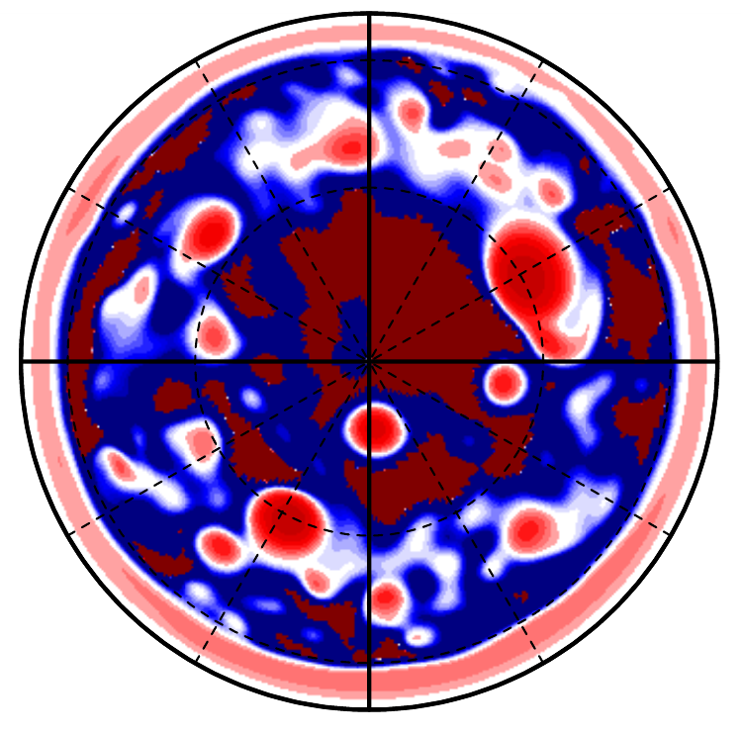
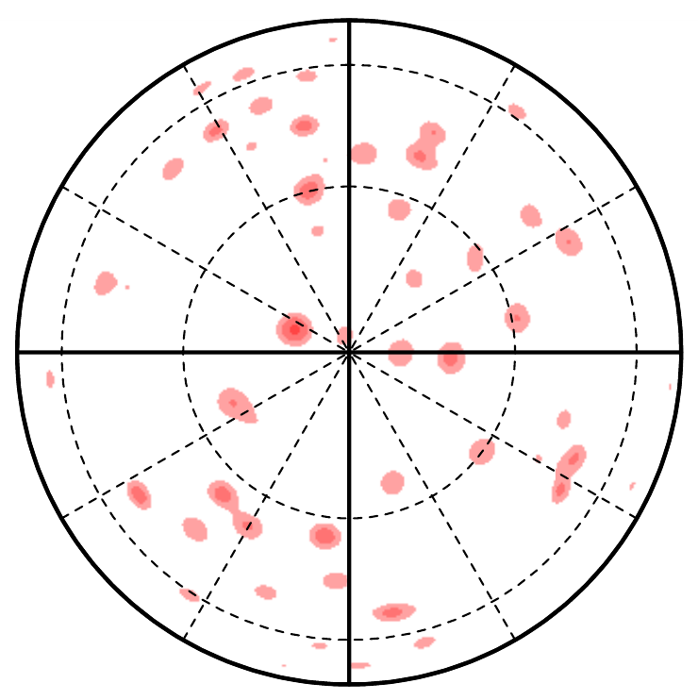
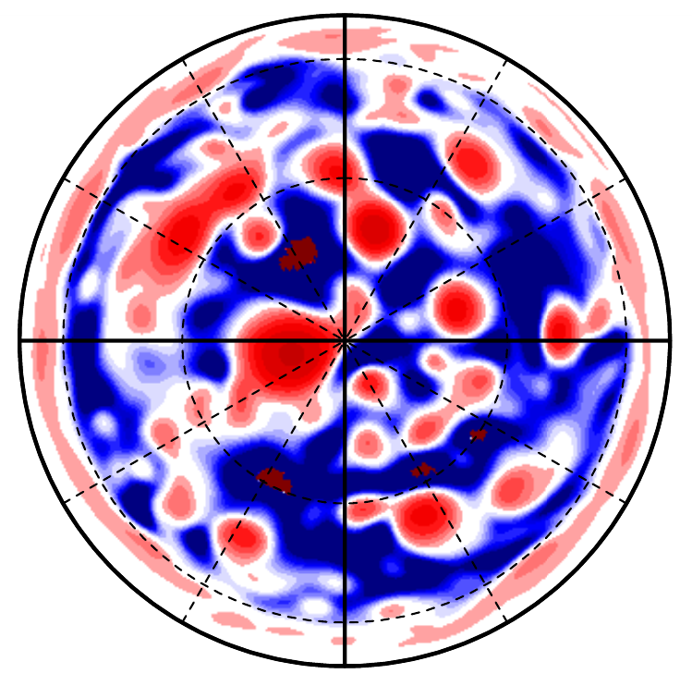
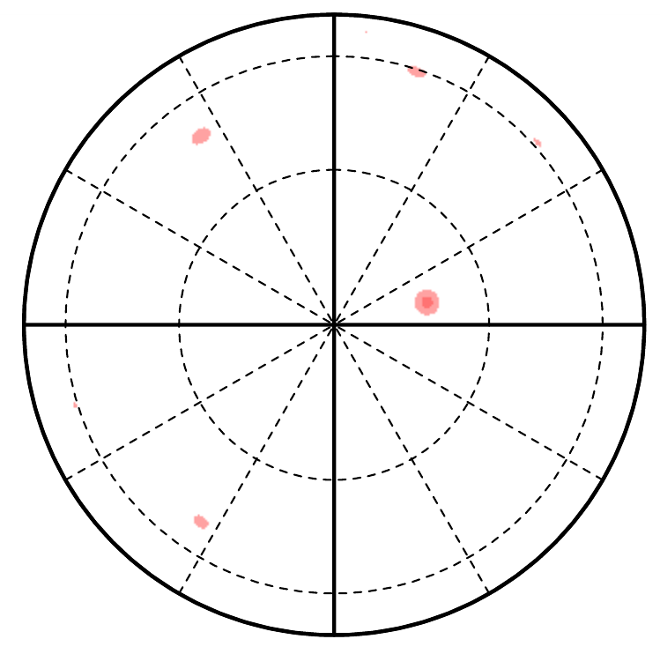
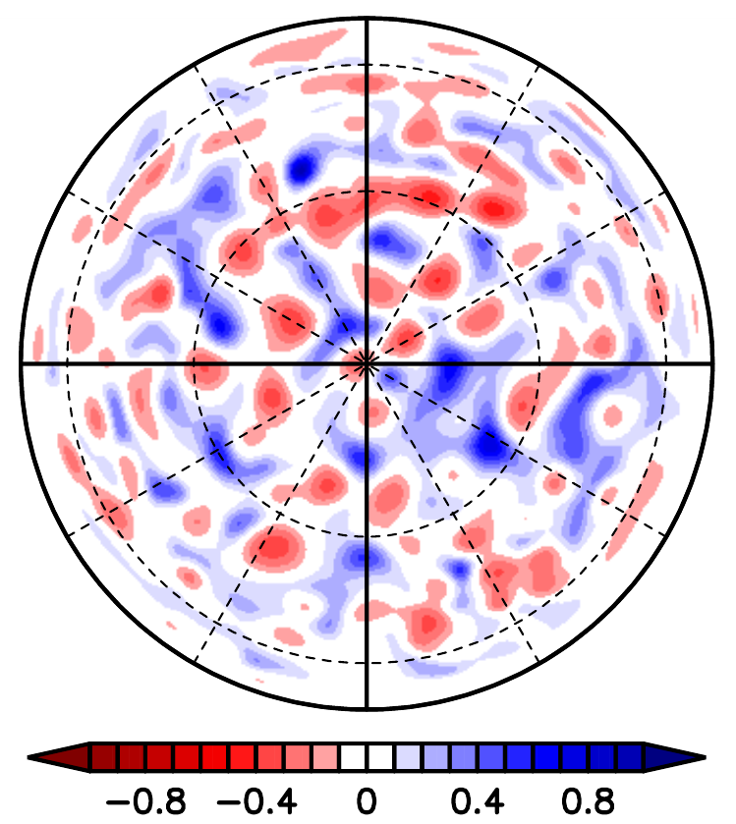







$τ_{APE}=∞$ (A1)
$τ_{APE}={10}^{6}$ (C3)
$τ_{APE}={10}^{8}$ (C1)
$τ_{APE}={10}^{5}$ (C4)
$τ_{APE}={10}^{7}$ (C2)
$τ_{APE}={10}^{3}$ (C5)

Slide 2
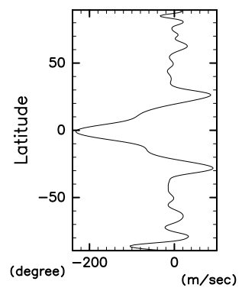
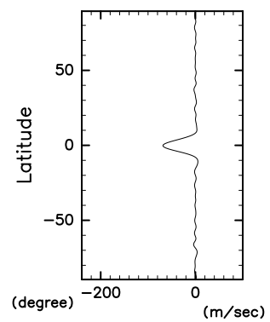
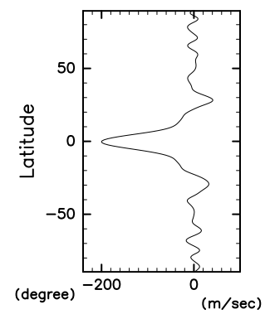
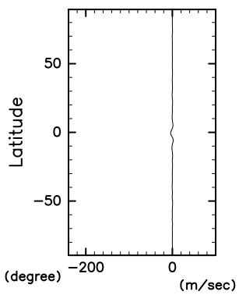
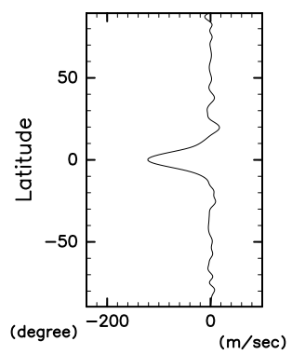








$τ_{APE}=∞$ (A1)
$τ_{APE}={10}^{6}$ (C3)
$τ_{APE}={10}^{8}$ (C1)
$τ_{APE}={10}^{5}$ (C4)
$τ_{APE}={10}^{7}$ (C2)
$τ_{APE}={10}^{3}$ (C5)

Slide 3
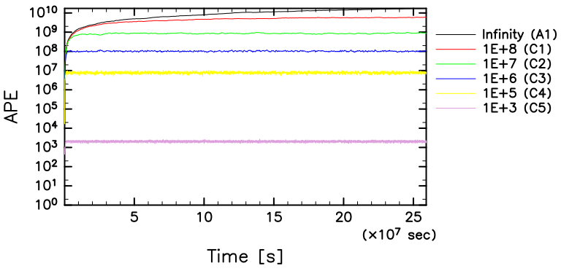
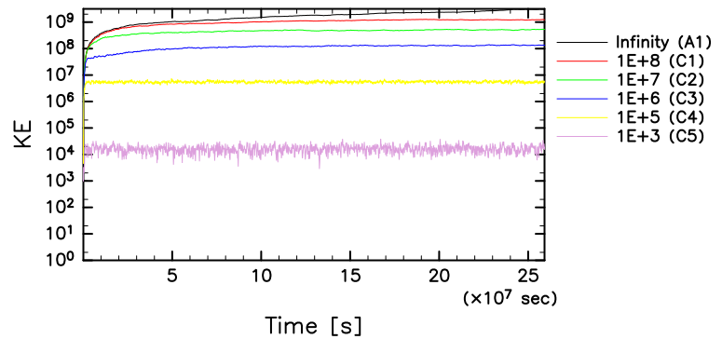
Available Potential Energy
[m⁶/s⁴]
Kinetic Energy
[m⁶/s⁴]

