Slide 1
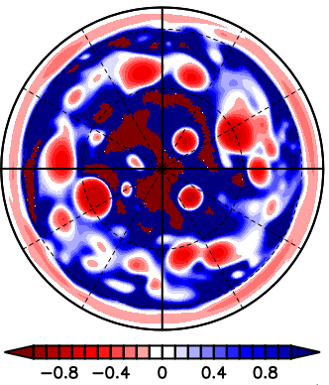
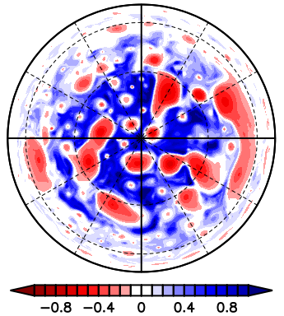
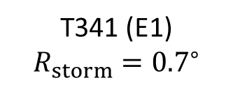
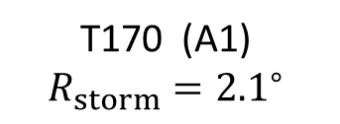
T170 (A1)
$$R_{storm}={2.1}^{∘}$$
T341 (E1)
$$R_{storm}={0.7}^{∘}$$

Slide 2
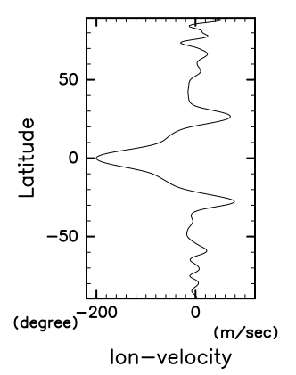
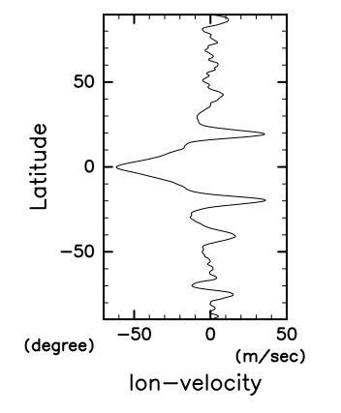
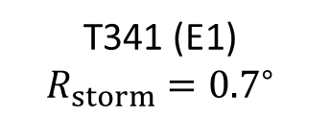
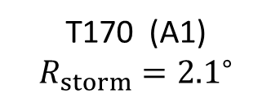
T170 (A1)
$$R_{storm}={2.1}^{∘}$$
T341 (E1)
$$R_{storm}={0.7}^{∘}$$

