Slide 1
Churchill College Mathematics Open Day Friday 21st September 2018
Dr Alison Ming (DAMTP & Churchill College)
Dr Roberto Svaldi (DPMMS & Churchill College)

Slide 2
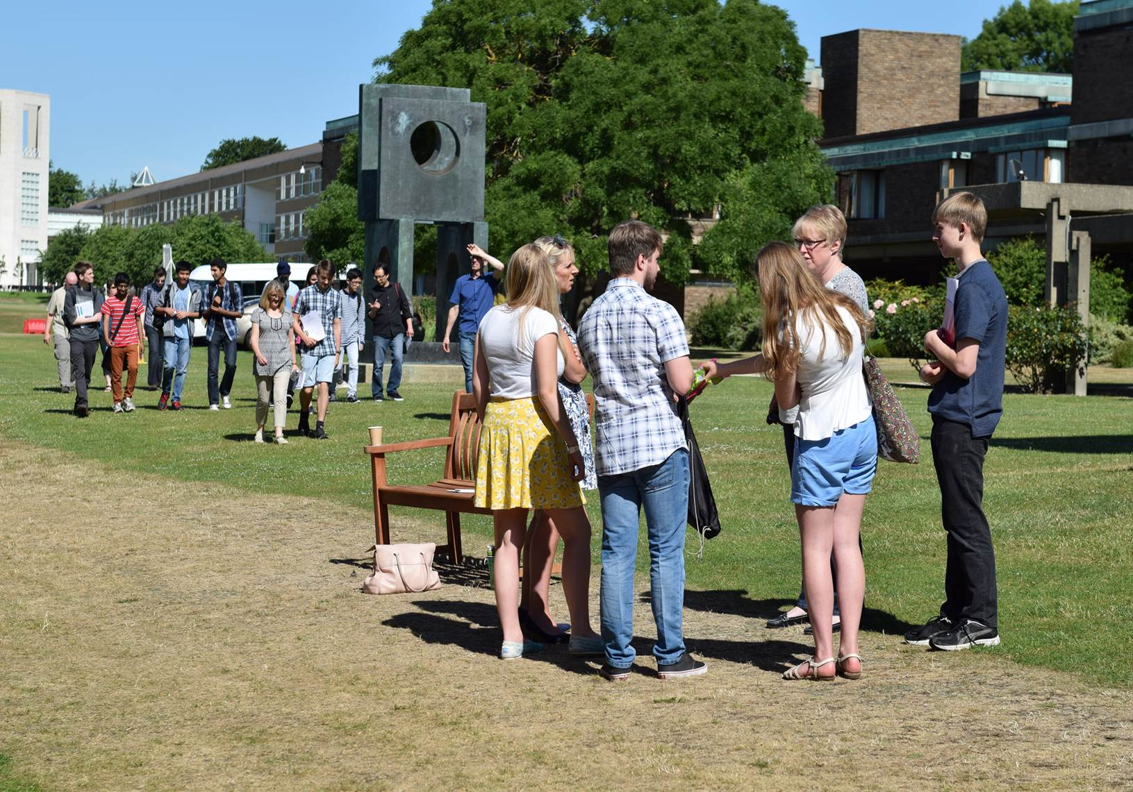
Welcome!

Slide 3
Churchill College Mathematics Open Day
An opportunity to:
Find out about Mathematics in Cambridge and in Churchill
Meet a Maths Supervisor/visit Centre for Mathematical Sciences
Talk to our students
Ask questions
Notes:
3

Slide 4
What makes Cambridge stand out?
Collegiate
Exceptional teaching
Innovative and challenging courses, inspired by cutting-edge research
Superb facilities
Diverse communities
Low costs and outstanding financial support
Excellent career opportunities
Notes:
4

Slide 5
What makes Cambridge Mathematics stand out?
Apart from Newton/Stokes/Cartwright/Maxwell/Kelvin/Ramanujan/Rayleigh/Dirac/Turing/Taylor/Hawking/Fawcett?
The jewel in the crown of one of the world’s great universities
An astounding array of courses in breadth and depth
Taught by leaders: Birkar, Gowers, Cates, Gog, Leader etc
Beautiful, intense intellectual challenge
A large cohort of inspiring fellow students
Unsurpassed academic/pastoral/financial support
Unparalleled preparation for research ~45% do!
Mathematics…or Mathematics with Physics…
Notes:
5

Slide 6
What makes Cambridge Mathematics stand out?
Uniquely challenging course: no limit to study!
Enormous cohort: ~ 250 each year: incredible collection of talent
Opportunity to study 4 years to Part III: brings you up to research
Collegiate system breaks down large lecture group
Director of Studies for course: Tutor for personal issues
College: Provide accommodation for 3/4 years
Bursaries etc at both university & college level: low drop-out rates
Supervisions (1 fellow/grad student: 2 students): Individual attention
Short terms/Very little continual assessment: Exams very important
Notes:
6

Slide 7
What makes Cambridge Mathematics stand out?
Astounding level of choice: ~ 110 faculty
Lectures fast and demanding: supported by s/v
Short teaching terms (16-20 weeks): Virtually everything on exams
Bedrock in first year: 8 compulsory courses (6 for maths with physics)
Choice introduced in second year
~35 courses in 3rd year (Part II): typically choose 8+
>70(!) courses in 4th year (Part III aka MMath world-famous, can switch to astrophysics)
(4) Examinations essential part of Cambridge experience
No maximum mark. Full answers rewarded far more than partial answers
Notes:
7

Slide 8
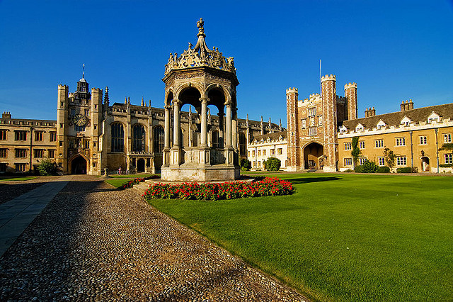
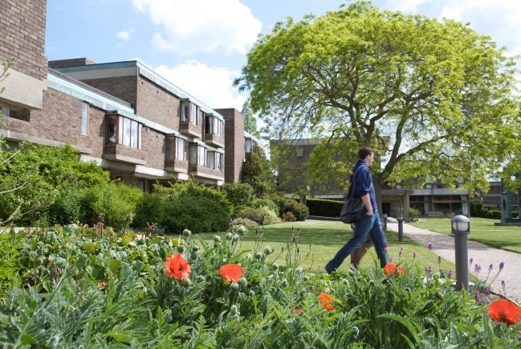
Colleges…Churchill or…?
College choice
Most applicants indicate a preference
College choice will not affect:
Chances of admission
Degree awarded

Slide 9
What makes Churchill stand out?
Our profile
Academically successful
Average ranking of 5th in Tompkins Table
~30% of our students achieve a First Class degree
Large & diverse undergraduate body
High standard of accommodation
Excellent facilities
Large, handily-located site (5 min cycle to Eddington which has doctors, shops, large Sainsbury’s)
Notes:
9

Slide 10
What makes Churchill stand out?
2017 admissions stats
719 applications, 216 offers
Interviewed ~75% of applicants
76.5% of UK students admitted from maintained sector
Reflects applicant field
Diverse intake
68% Home, 15% Overseas, 17% EU
In line with the profile of our overall undergraduate population
Notes:
10

Slide 11
Churchill Mathematics Admissions
Mathematics Statistics:
Year of entry 2015 2016 2017
No. applications 89 87 99
No. direct offers 28 32 37
No. offers from Pool 16 14 5
No. admissions 12 11 16
Notes:
11

Slide 12
What do we look for?
Passionate about mathematics: REALLY keen
Strong performance in examinations with natural curiosity
Ability to think and learn independently with a capacity for hard work
Sound core knowledge and technical fluency
Clarity of thought/analytical ability
Intellectual flexibility/enthusiasm for complexity and challenge
Good spoken and written English
Notes:
12

Slide 13
Timeline
15th October
Early November
Mid-November
UCAS form
Reference
Personal statement
Pre-interview assessments
Interview shortlisting
Exam results
(inc STEP)
(Summer Pool)
Decisions: Offers to ~1 in 3
Pool: ~1 in 2
Interviews
Test night before
1 interview 25mins
Mid-August
Early January
Early December

Slide 14
What do we look for?
Assessment is holistic
Results, predicted grades in public exams
Appropriately contextualised
Academic reference
Admissions assessment results
Interview scores
STEP results

Slide 15
Public examinations
Conditional offers
University’s ‘normal’ offer in sciences: A*A*A
Most successful applicants exceed this level
Achieved A Level grades | Proportion of A Level entrants (%)
A*A*A* | 59.7
A*A*A | 23.4
A*AA | 12.6
A Level Students admitted to Cambridge (2016-17 cycle)

Slide 16
Sixth Term Examination Papers (STEP)
STEP are additional mathematics exams requested by all colleges
Conditional offers typically 1,1 in STEP II and III
STEP support available
Online: https://maths.org/step
One-day workshop for state-school offer holders in March
STEP takes practice – now is a good time to start

Slide 17
UCAS form
Personal statement
Should cover:
Your interest in the course
Relevant subjects studied
Super-curricular activities:
Reading: Not just Simon Singh!
Other wider exploration: Olympiads ok but definitely not essential
Extra-curricular activities do not figure in our assessments
Notes:
17

Slide 18
Tests and submitted work
Tests are primarily an adjunct to interviews
Sat in Cambridge at time of interview
1 hour night before multiple choice questions: Pure/Mechanics/Probability
Scores between 5/10 and 10/10 can get offers
Some weak correlation with early years
No evidence of correlation with Part II results
Unlike STEP which is a very good indicator

Slide 19
Interviews
Typically 2 interviews of 25 minutes in College
Conducted by subject specialists: Fellow + one other
Interactive tests: Interest/Aptitude/Core knowledge
Problem-solving scenarios and discussion
No hidden agenda and no trick questions
Just be yourself, there is no dress code

Slide 20
Interviews
What to expect
Focused and challenging questions
We might talk about:
Academic work/Test questions/Subject-related awareness
Prompt material: new elementary material
New approaches to existing knowledge
Prompting from interviewers
Questions to interviewers (no need to have one prepared)
Challenging: but we want you to succeed

Slide 21
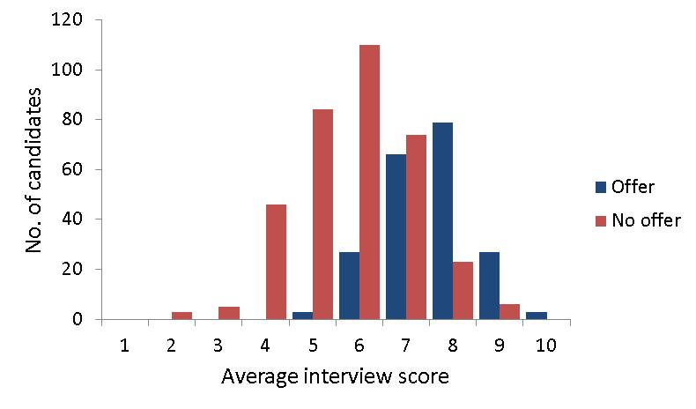
Interviews
Most people do well and Maths gives lots of offers: 1450/550/250

Slide 22
Pitfalls
Pitfalls can occur at different stages
Wrong course: chosen Mathematics by default
Flaws in academic track record
Little or no super-curricular involvement: not keen on challenges
Poor interview performance
Subject knowledge insecure
Insufficient analytical ability
Intellectual inflexibility

Slide 23
Summary & Questions
Critical to a strong application
Talent : You’ve got to be good at maths (and quick-thinking)
Interest: You’ve got to want to do lots of maths
Performance: Recent excellent exam results or extenuating circumstances
Sweat: You have to be happy to work VERY hard
www.study.cam.ac.uk/undergraduate
www.maths.cam.ac.uk/undergrad/admissions/
www.chu.cam.ac.uk/admissions

Slide 24
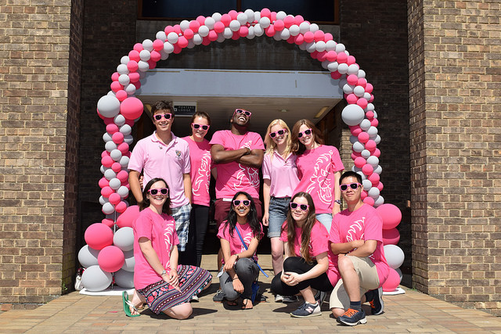
Questions ?
Questions ?
Notes:
24

