Slide 1


DEPARTMENT OF COMPUTER SCIENCE AND ENGINEERING
20CS8504 & PROJECT WORK
END SEMESTER PRACTICAL EXAMINATION- APRIL / MAY – 2026
Batch No.: 12
Date : 30/03/2026
Session : AN

Slide 2
AN EXPLAINABLE ATTENTION-BASED MULTIMODAL
DEEP LEARNING FRAMEWORK FOR ACTIVE AND
LATENT TUBERCULOSIS DETECTION
Guide Name:
Mrs.R. Deepa ,
Assisstant Professor,CSE
Team Members:
SANTHOSH T(811722104134)
SWATHI R (811722104165)
VIGNESH V (811722104180)
VIGNESHWARAN R (811722104181)

Slide 3
OBJECTIVE OF THE PROJECT
To develop a robust multimodal AI system that integrates medical imaging, clinical data, and biomarker information for accurate tuberculosis detection.
To distinguish between active tuberculosis and latent tuberculosis using attention-based multimodal learning techniques.
To design an explainable AI framework that provides interpretable predictions through image, feature, and modality-level explanations.
To handle missing and imbalanced multimodal data effectively, ensuring reliable performance in real-world clinical scenarios.
To support clinical decision-making by predicting the risk of progression from latent TB to active TB with transparent and trustworthy outputs.

Slide 4
INTRODUCTION
Tuberculosis (TB) is a major infectious disease that continues to pose a serious global health challenge.
Accurate and early diagnosis is essential for effective treatment and prevention of disease spread.
Conventional diagnostic approaches often depend on medical imaging and laboratory tests, which may be insufficient for identifying latent TB cases.
Recent advances in artificial intelligence have enabled automated TB detection using deep learning models.
This project proposes an explainable multimodal AI framework that integrates imaging, clinical, and biomarker data to improve diagnostic accuracy and support transparent clinical decision-making.

Slide 5
LITERATURE SURVEY
TITLE OF PAPER | AUTHOR(S) | PAPER GIST | TECHNOLOGY USED
A Systematic Review on Application of Multimodal Learning and Explainable AI in Tuberculosis Detection (2025) | Barbara Nansamba et al. | IEEE Access | Multimodal Learning, Explainable AI (Grad-CAM, SHAP, LIME)
Enhanced Tuberculosis Detection using Vision Transformers and Explainable AI (2025) | K. Vanitha et al. | Elsevier | Vision Transformer (ViT), Grad-CAM
Lightweight Hybrid Deep Learning Model for Tuberculosis Detection (2025) | M. Owda et al. | Scientific Reports | Hybrid CNN Model, Deep Learning
Multimodal Integration Pipeline for TB and Pneumonia Differentiation (2024) | Shao et al. | IEEE Access | Swin Transformer, BERT, Attention Fusion

Slide 6
TITLE OF PAPER | AUTHOR(S) | PAPER GIST | TECHNOLOGY USED
Deep Learning–based Diagnosis of Pulmonary Tuberculosis using Chest X-ray Images (2024) | C.H. Wang et al. | Springer | CNN, Image Classification
Explainable Artificial Intelligence Model for Lung Disease Detection (2024) | E. Mahamud et al. | Elsevier | DenseNet201, Transfer Learning, XAI
Multimodal Deep Learning for Pulmonary Abnormality Prediction (2023) | Shetty & Mahale | Elsevier | CNN, DNN, Multimodal Fusion
Drug Resistance Classification using Radiological and Genomic Features (2023) | Bui et al. | Scientific Reports | Random Forest, Gradient Boosting

Slide 7
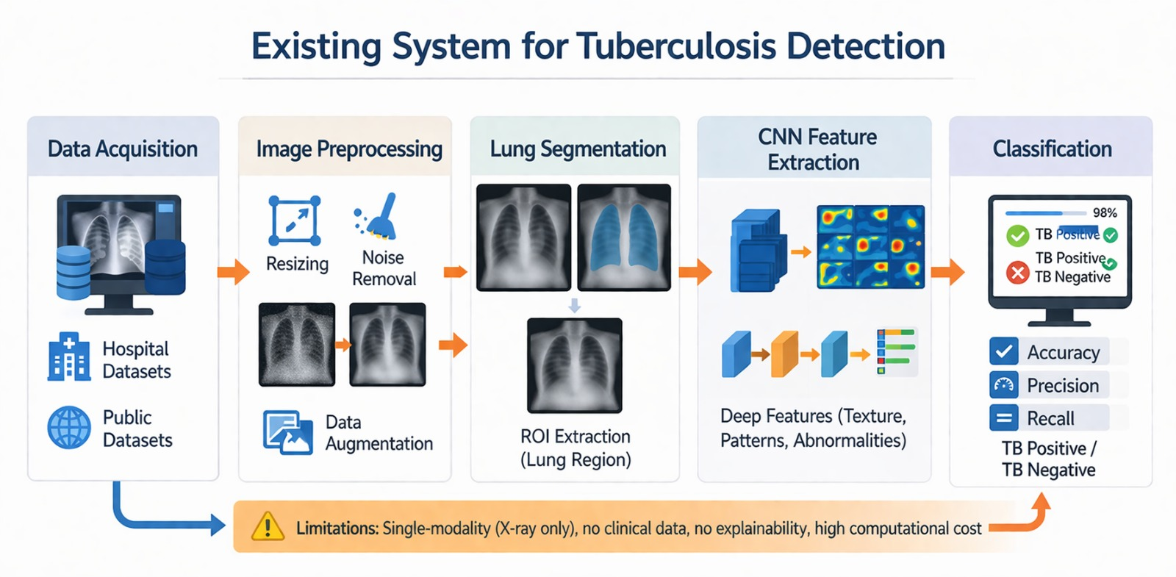
EXISTING SYSTEM ARCHITECTURE

Slide 8
PROBLEM IDENTIFICAITON
Existing TB detection systems mainly rely on single-modal data such as chest X-ray images.This limits the ability to capture complete patient health information.
Detecting latent tuberculosis is difficult using traditional diagnostic methods. Many systems focus only on identifying active TB cases.
Most deep learning models act as black-box systems.This makes it hard for doctors to understand how predictions are made.
Medical datasets often contain missing values and imbalanced data.This can reduce the reliability and accuracy of AI models.
Current systems provide limited support for clinical decision-making.Doctors require more transparent and interpretable AI-based tools.

Slide 9
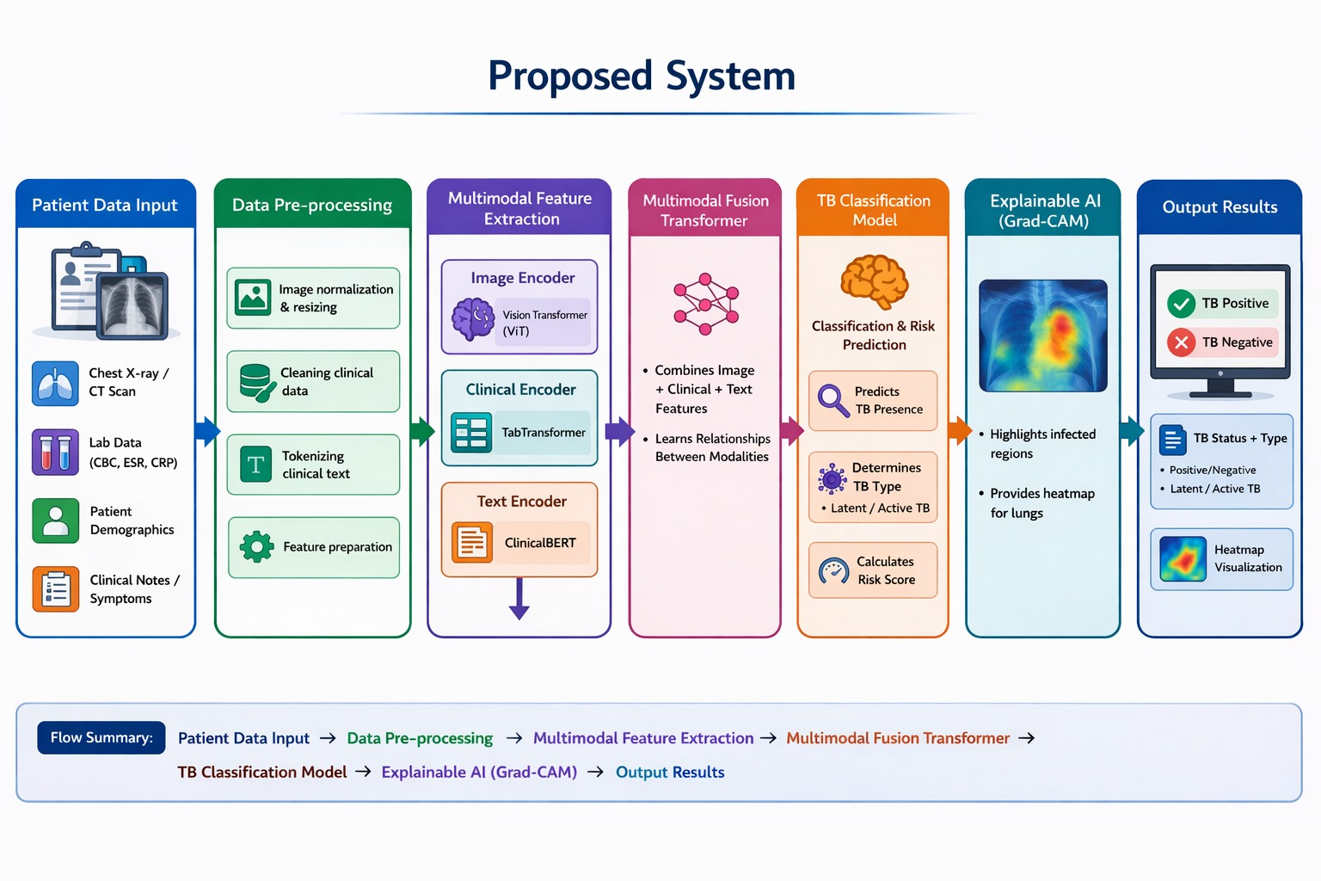
PROPOSED SYSTEM ARCHITECTURE

Slide 10
SOFTWARE AND HARDWARE REQUIREMENTS
HARDWARE
Processor: Intel Core i5 or higher
RAM: Minimum 8 GB (16 GB recommended)
Storage: Minimum 256 GB SSD
GPU: NVIDIA GPU with CUDA support (recommended for deep learning)
Display: Standard monitorInput
SOFTWARE
Operating System: Windows / Linux
Programming Language: Python 3.x
Development Environment: Jupyter Notebook / VS Code / PyCharm
Deep Learning Frameworks: TensorFlow / PyTorch
Libraries: NumPy, Pandas, Scikit-learn, OpenCV, Matplotlib
Explainable AI Tools: SHAP, Grad-CAM

Slide 11
MODULES
User Authentication Module.
Patient Data Entry Module.
TB Detection and Explainable AI Module.
Report Generation Module.
Patient History and Admin Monitoring Module

Slide 12

IMPLEMENTATION OF MODULE-1
This module allows users to securely access the system through registration and login.
New users can create an account by providing their name, email, and password.
After authentication, users are redirected to the dashboard to use the TB detection system.

Slide 13
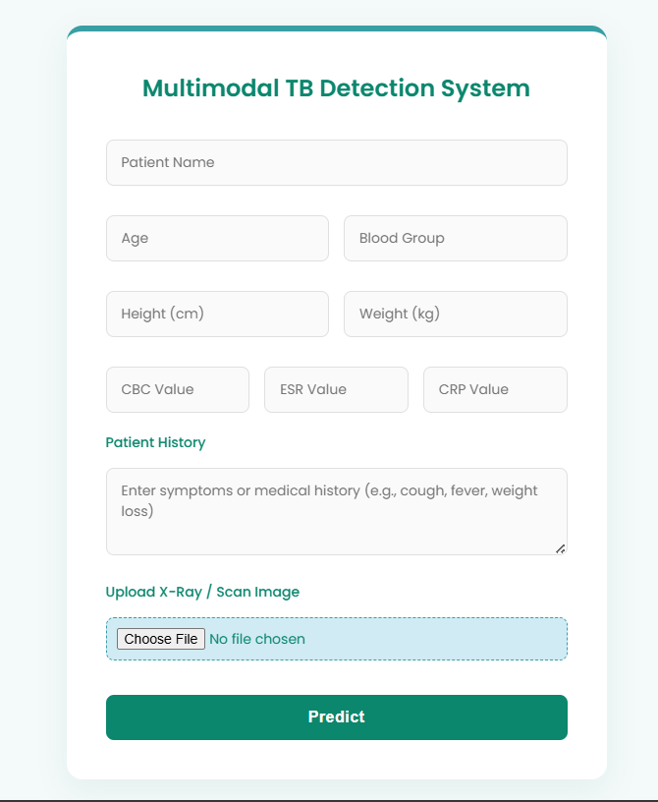
IMPLEMENTATION OF MODULE-2
This module collects patient information required for TB prediction.
Users enter clinical data such as age, blood group, CBC, ESR, CRP, and patient symptoms.
The system also allows uploading chest X-ray or scan images for analysis.

Slide 14
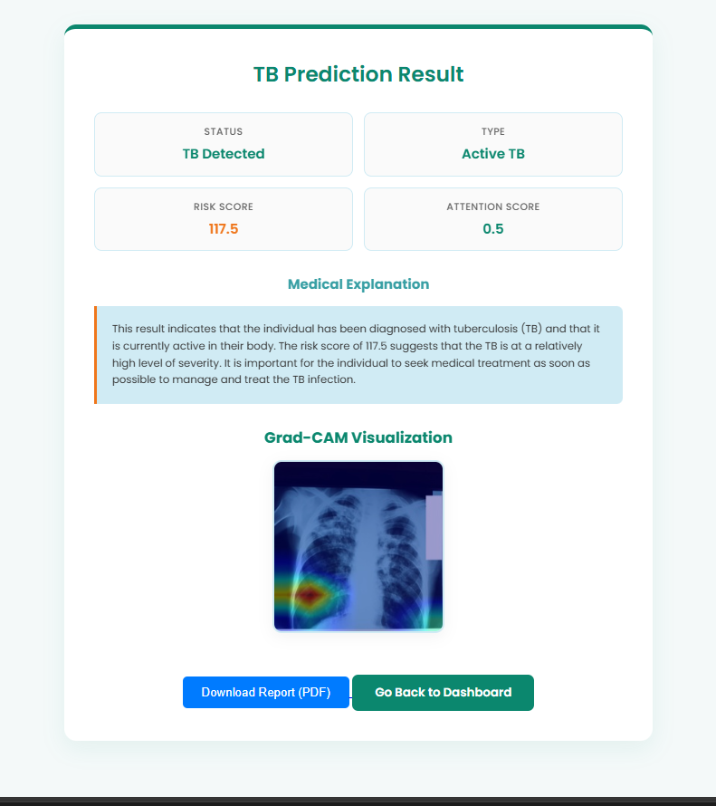
IMPLEMENTATION OF MODULE-3
This module processes the patient data and medical images using the trained CNN model.
The system predicts whether tuberculosis is detected and identifies the TB type.
Grad-CAM visualization highlights important regions in the X-ray image for explanation.

Slide 15
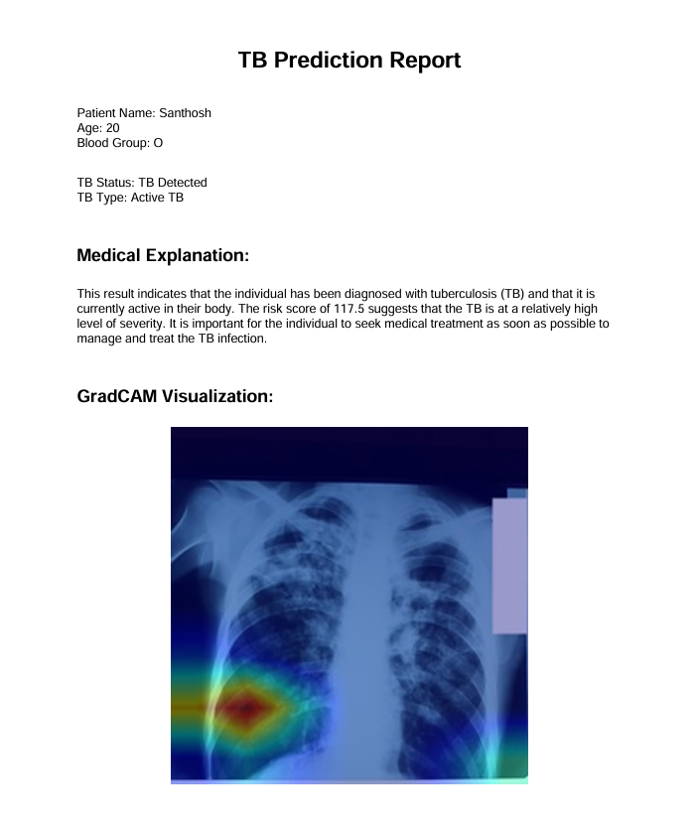
IMPLEMENTATION OF MODULE-4
This module generates a detailed medical report based on the prediction results.
The report includes patient details, TB status, risk score, and medical explanation.
Users can download the report in PDF format for medical reference.

Slide 16
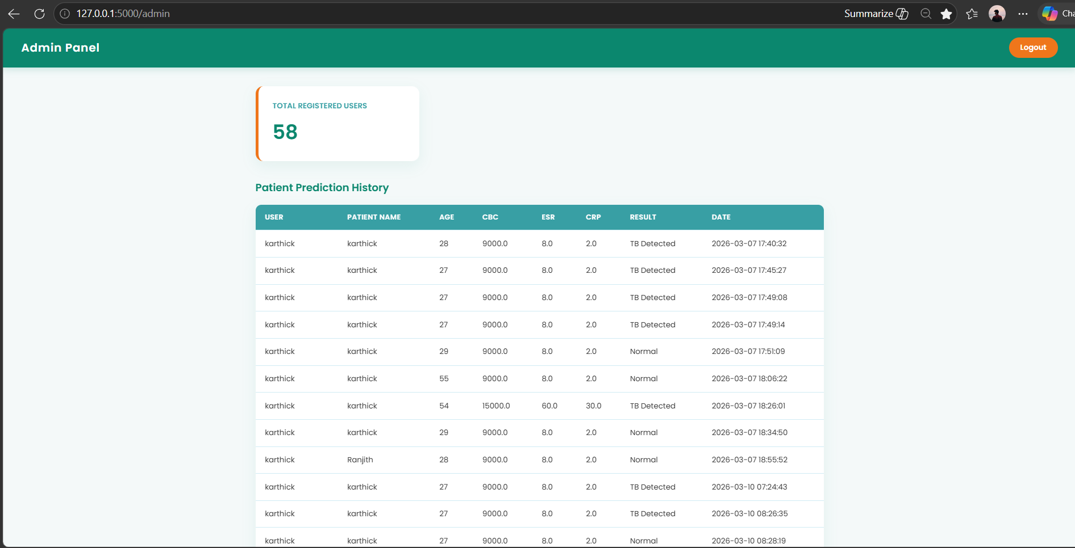
IMPLEMENTATION OF MODULE-5
This module stores previous prediction records for monitoring and analysis.
The admin panel displays registered users and patient prediction history.
It helps administrators track system usage and manage patient data effectively.

Slide 17
CONCLUSION
This project presented an explainable multimodal AI framework for tuberculosis detection and classification.
By integrating medical imaging, clinical data, and biomarker information, the proposed system improves diagnostic accuracy and effectively differentiates between active and latent tuberculosis.
The use of attention-based multimodal learning enables robust handling of missing data, while explainable AI techniques provide transparent and interpretable predictions.
Overall, the system supports reliable clinical decision-making and addresses key limitations of existing TB detection approaches, demonstrating its potential for real-world healthcare applications.

Slide 18
FUTURE ENHANCEMENTS
Improve prediction accuracy by integrating advanced deep learning models like Vision Transformers and 3D CNNs.
Integrate the system with hospital information systems and electronic health records for better clinical workflow.
Develop a mobile application to allow healthcare workers to upload and analyze X-ray images from remote areas.
Perform clinical validation and obtain regulatory approvals to deploy the system in real healthcare environments.
Extend the system to detect multiple lung diseases such as pneumonia, lung cancer, COVID-19, and pleural effusion.

