Slide 1
Cyclistic Data Analysis
Rithvik Vinekar

Slide 2
Agenda
Data Sources
Daily trends
Timelines
Weekday trends
Commutes
Conclusion
Next Steps

Slide 3
Aims
Cyclistic is a bike-hiring service
It has historical trip data which may be used for analysis. There are two types of riders : annual members and casual riders. Cyclistic would like to increase annual membership. The question that needs answering is
The difference in usage of Cyclistic bikes by members and casual riders

Slide 4
Data Sources
The data was obtained online https://divvy-tripdata.s3.amazonaws.com/index.html
The license is permissible¹ for the purpose of this analysis
Data pertaining to 12 months from 2022-01 to 2022-12 was used for this study
Data is in the form of csv files
Documentation for the process of analysis is provided as a markdown document with this presentation
https://ride.divvybikes.com/data-license-agreement

Slide 5
Analysis
The data from csv files were read into a single R dataframe
New variables were derived from those in the raw data, such as duration of hire
The member_casual variable is the key variable for all analysis
The following analysis starts with weekday trends, i.e. usage on different days of the week
It is assumed that weekend consists of Saturday and Sunday, while weekday consists of Monday to Friday.
Public holidays are not taken into consideration. These may fall on weekdays, but may follow the tendencies of weekends

Slide 6
Weekday trends

Slide 7
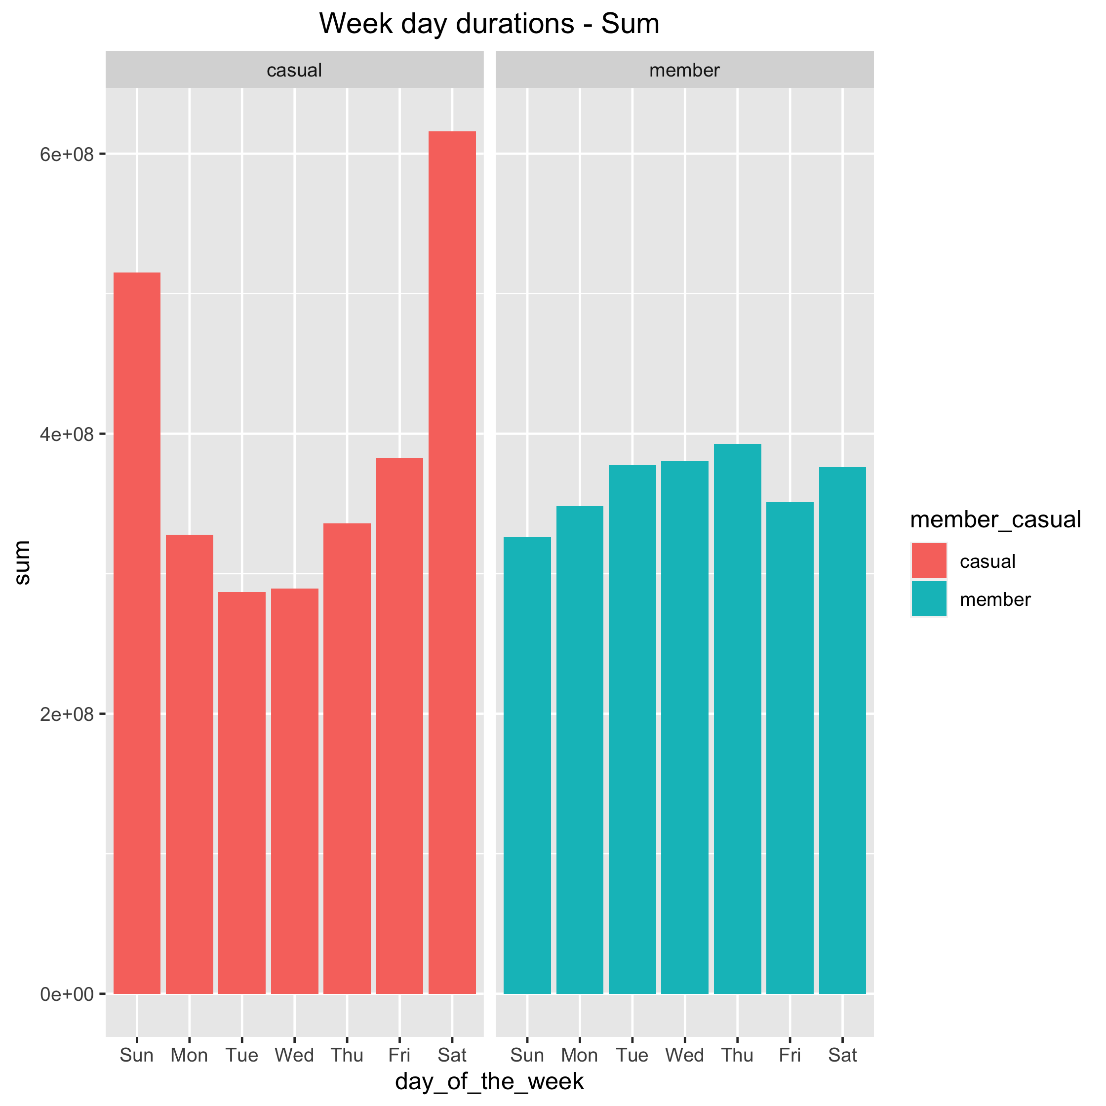
Weekends for casual riders
Taking the sum of durations, weekends seem to be preferred by casual riders
Members have no clear preference

Slide 8
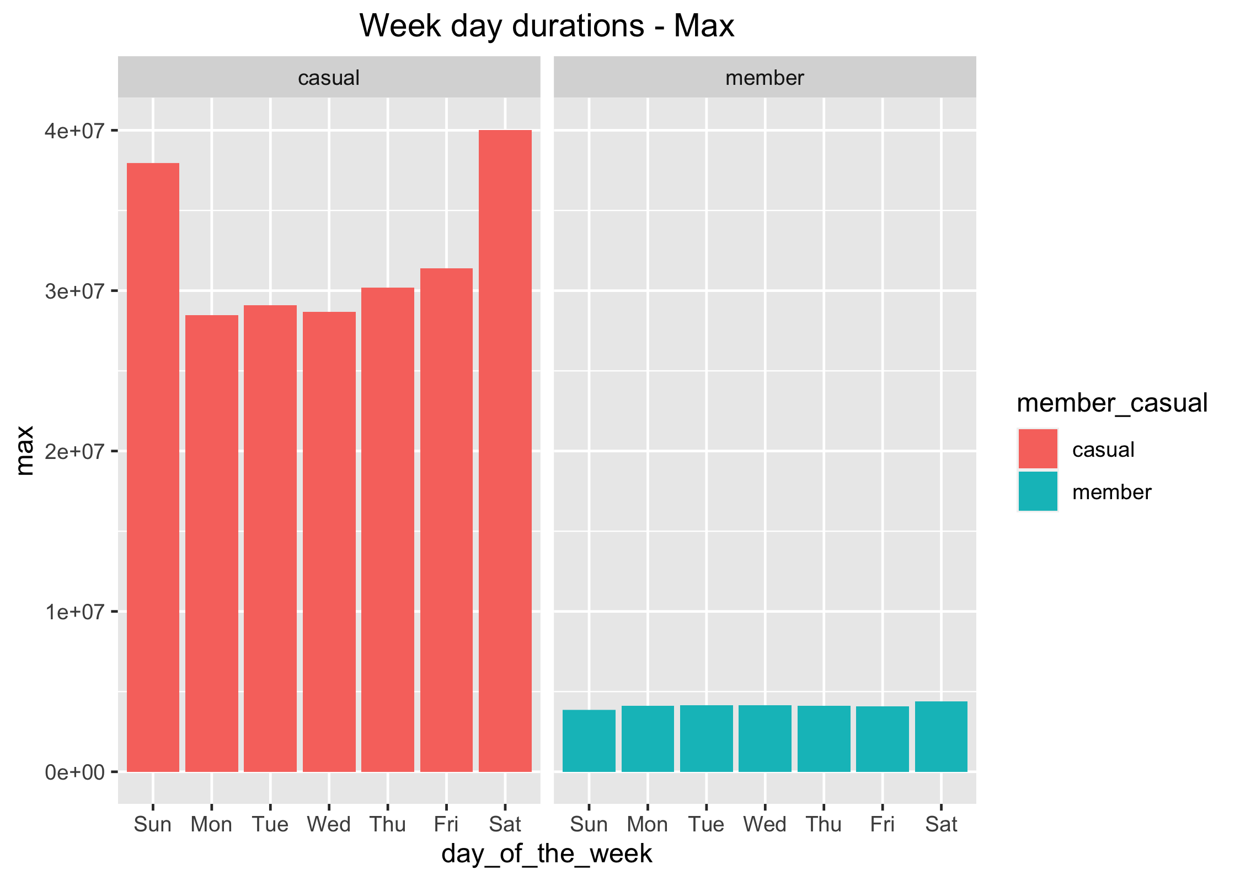
Weekends for casual riders
Casual riders love longer rides
This graph shows that very long duration hires – >24 hrs, are present on every day of the week for casual riders
Is this really the picture?
It is observed that users of docked bikes have registered durations upto 28 days, while all others have a 24 hr cutoff.
This data is most certainly skewed

Slide 9
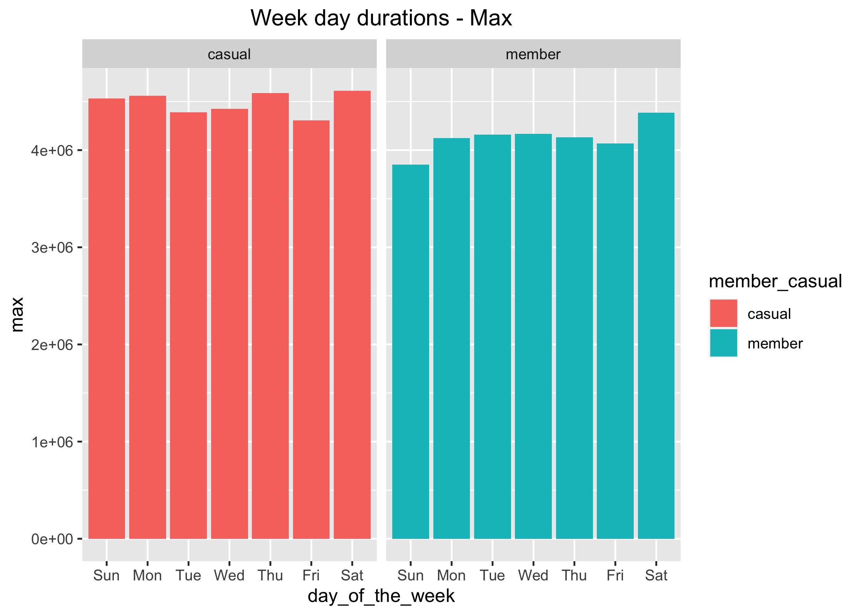
Weekends for casual riders
There is a general trend for greater ridership in weekends
However, with docked_bike data removed, the data is now much more comparable

Slide 10
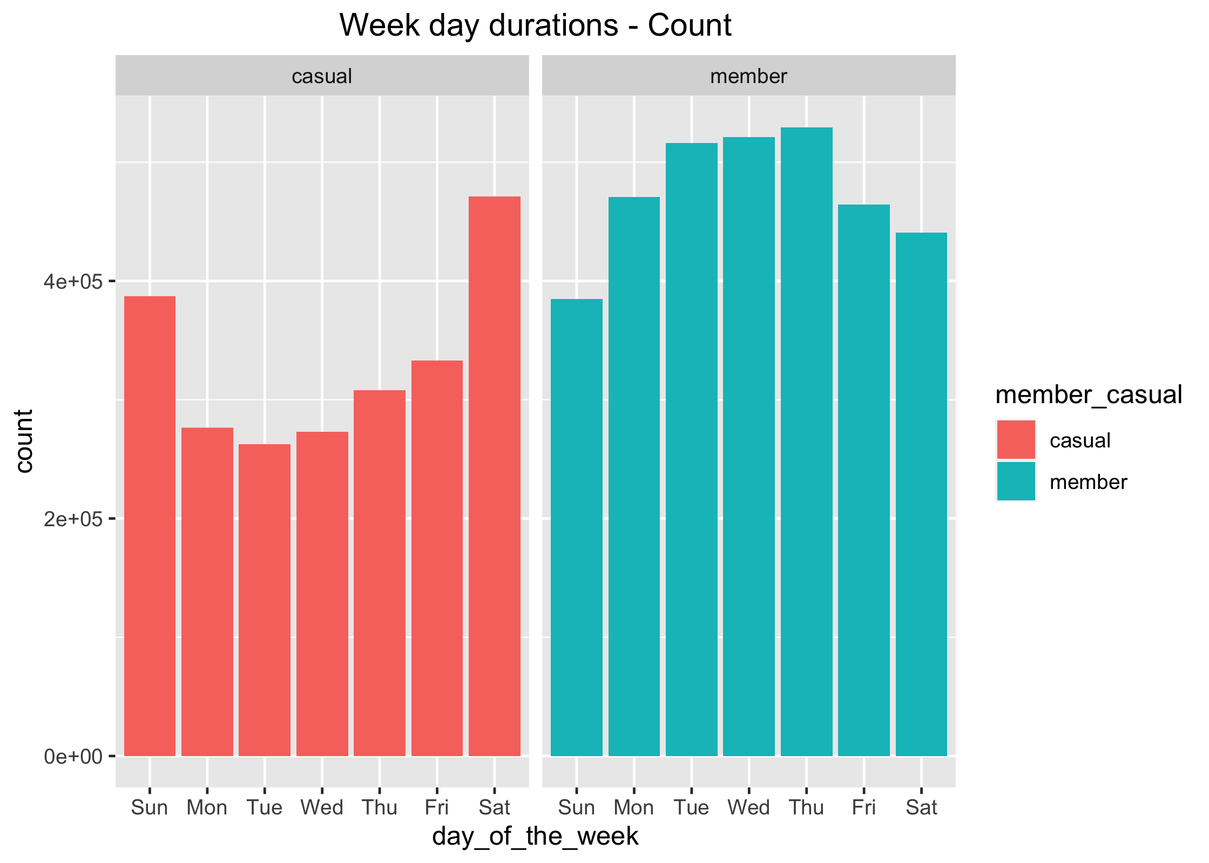
Weekdays for members
Members take many more rides during the weekdays
This graph shows that as far as number of rides are concerned, members beat casual users, especially in weekdays

Slide 11
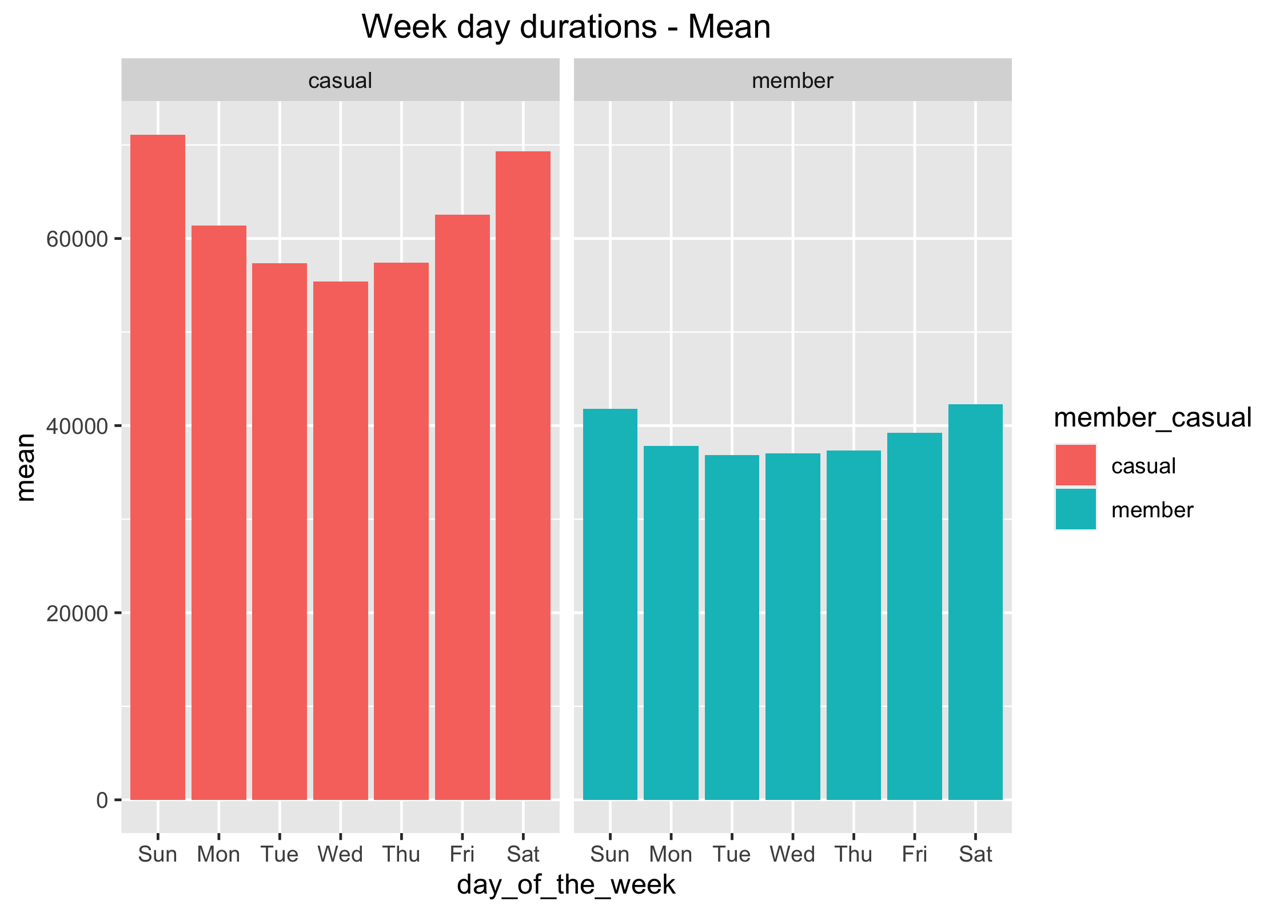
Casual users spend more time on rides
Overall, the mean values repeat the trend seen in duration sums

Slide 12
Timelines

Slide 13
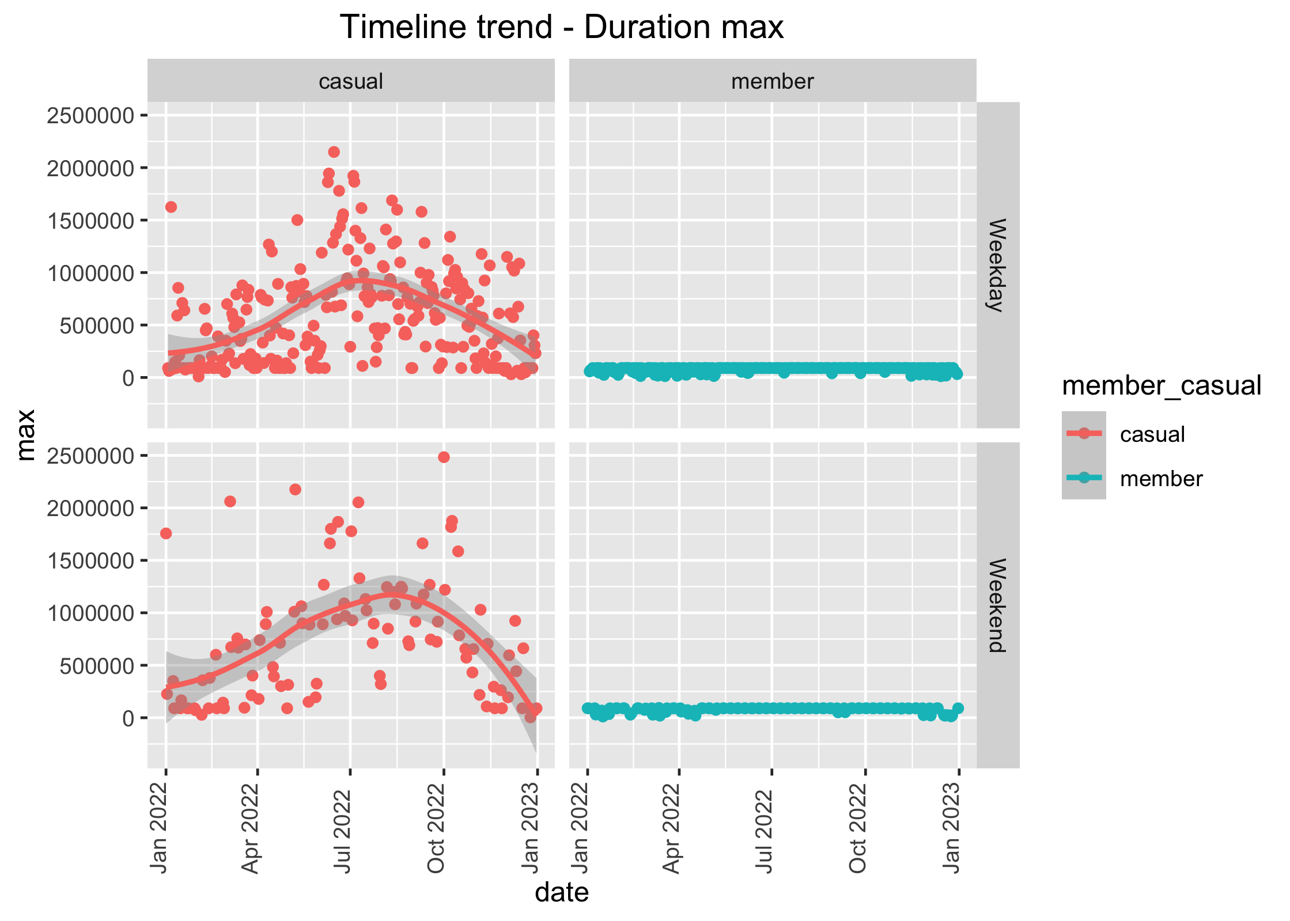
Data skew
Docked bikes are bikes which are manually docked by users without intervention
Some docked bikes have been hired for up to 28 days
However, all other bikes do not exceed 24 hrs, which is often the deadline
The member data here flatlines at 24 hrs.
This graph shows how docked bike data skews mean and max measurements

Slide 14
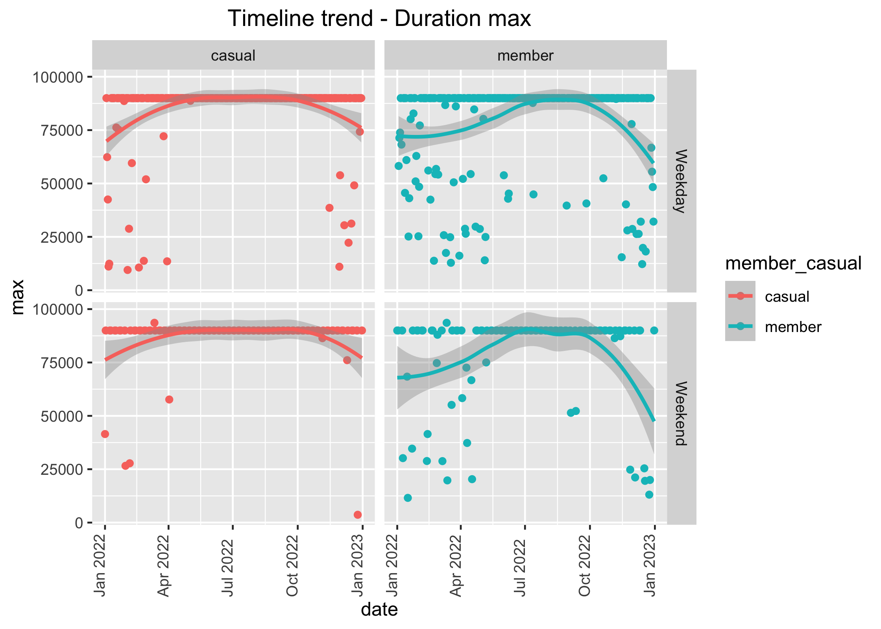
Skew corrected
gg_week_max.png
Removing the docked_bike data shows a flatline at 24 hrs as it should be
The trend still shows casual users use the bike to the max

Slide 15
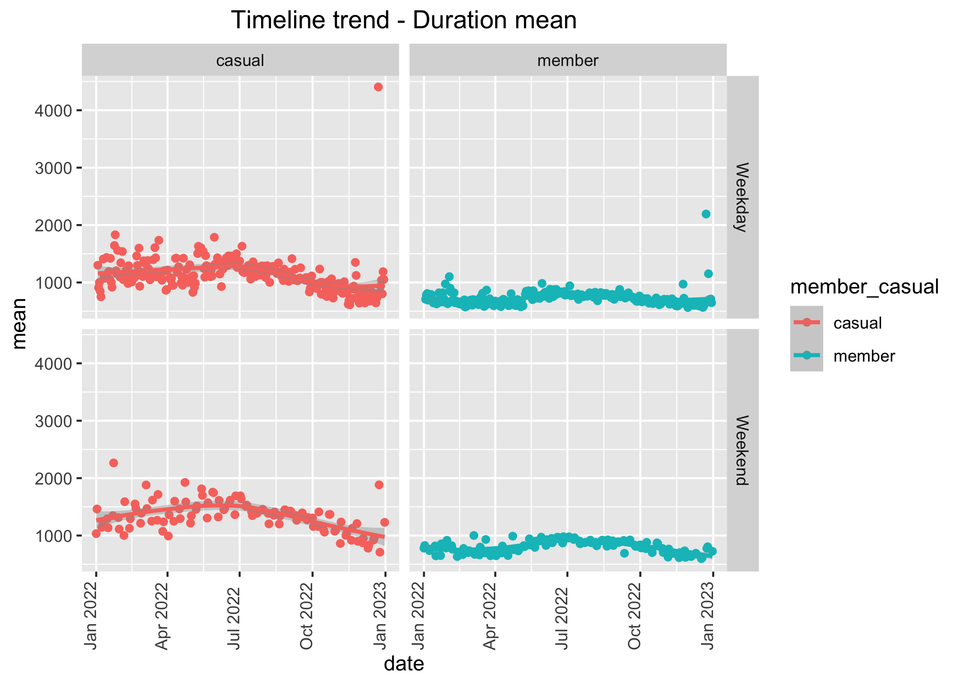
Casual users on average ride longer in weekends
Most rides are during the summer months, while spring and autumn have lesser ridership
Members are consistent throughout the year
Some very long drives on weekdays towards the end and start of the year – holiday season
These may be weekdays, but are most likely holidays
The trend lines show much more spread in casual usage than by members

Slide 16
Weekday-Weekend trends

Slide 17
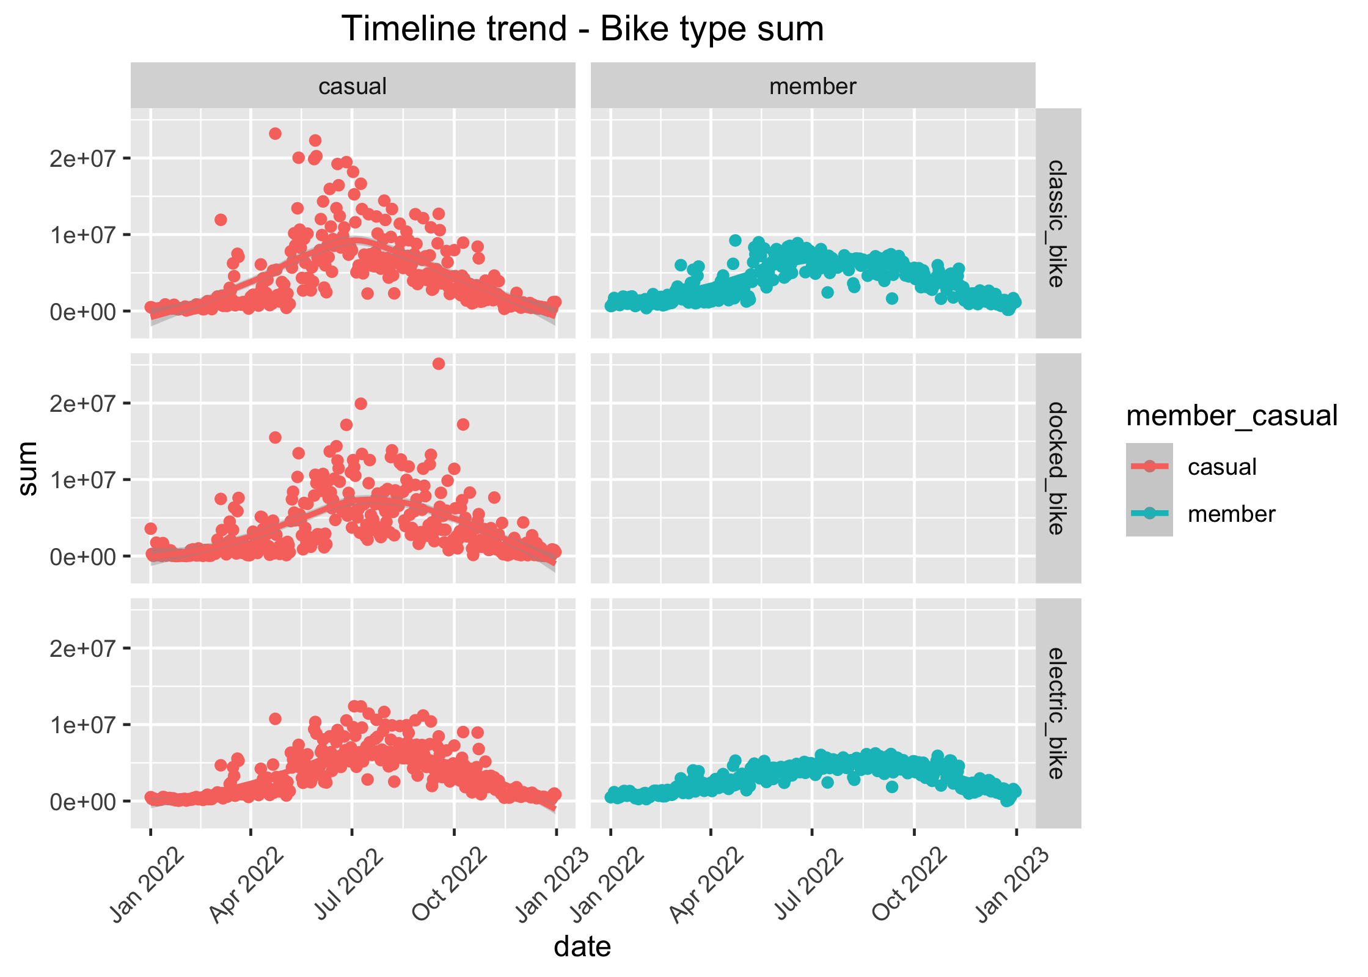
Docked bikes
Casual riders use docked bikes. There is no data on members using docked bikes
The docked_bike data had to be removed as it is a source of skew due to its complete absence of member usage
Classic bikes are preferred for casual users, especially for longer duration
Electric bikes are also often used

Slide 18
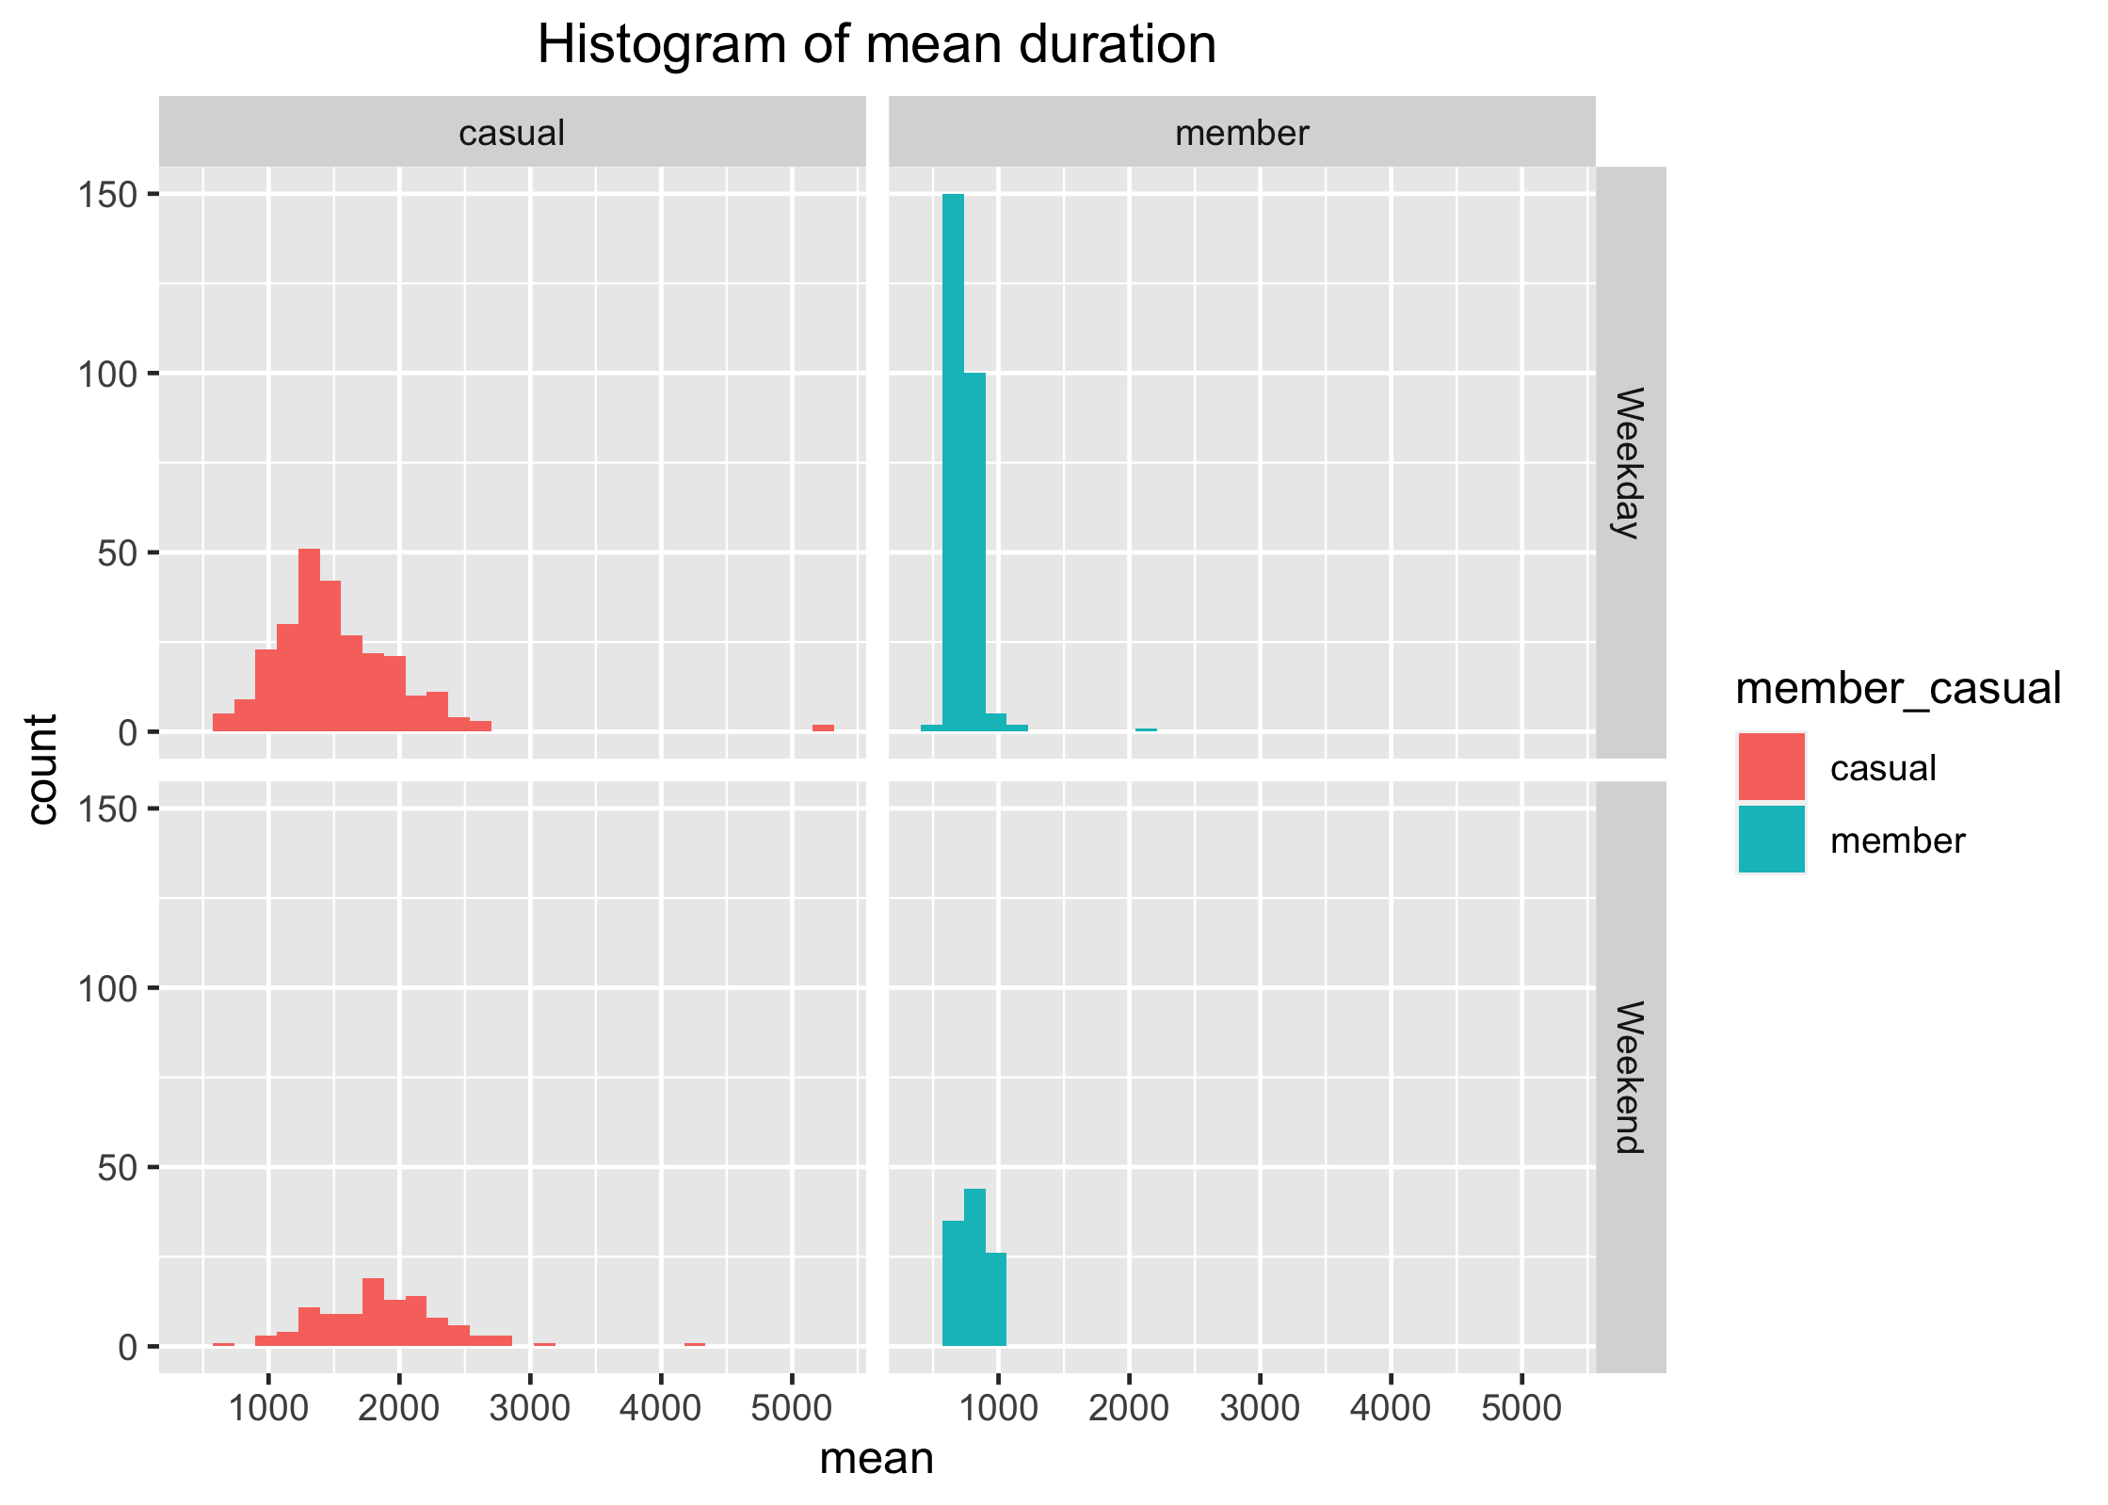
How long are the rides?
The histograms show that most members have rides under 1000 sec (15 min rides), while casual riders ride longer more often.
Weekend usage of casual riders is more

Slide 19
Commutes

Slide 20
Casual commuters often do round trips
commuteid_from_to <fctr> | member_casual <fctr> | roundtrip <lgl> | count <int>
13022_-_13022 | casual | TRUE | 10447
13300_-_13300 | casual | TRUE | 6527
13300_-_13022 | casual | FALSE | 5100
13042_-_13042 | casual | TRUE | 4523
13008_-_13008 | casual | TRUE | 3987
TA1308000012_-_TA1308000012 | casual | TRUE | 2904
13022_-_13300 | casual | FALSE | 2854
13022_-_13008 | casual | FALSE | 2735
15544_-_15544 | casual | TRUE | 2423
15544_-_13022 | casual | FALSE | 2397
KA1503000014_-_KA1503000071 | member | FALSE | 5848
KA1503000071_-_KA1503000014 | member | FALSE | 5544
KA1503000014_-_KA1504000076 | member | FALSE | 5278
KA1504000076_-_KA1503000014 | member | FALSE | 4745
13216_-_13217 | member | FALSE | 3268
13217_-_13216 | member | FALSE | 3215
13332_-_TA1307000130 | member | FALSE | 2891
TA1307000130_-_13332 | member | FALSE | 2876
KA1503000071_-_TA1309000037 | member | FALSE | 2267
13332_-_TA1307000121 | member | FALSE | 2091
The top 10 commutes for casual riders show 6/10 times a round trip
In contrast, members do not show round trips in the top ten.
In fact, the top two are commutes to and fro from the same pair of stations
The same is true for the next two pairs of commutes

Slide 21
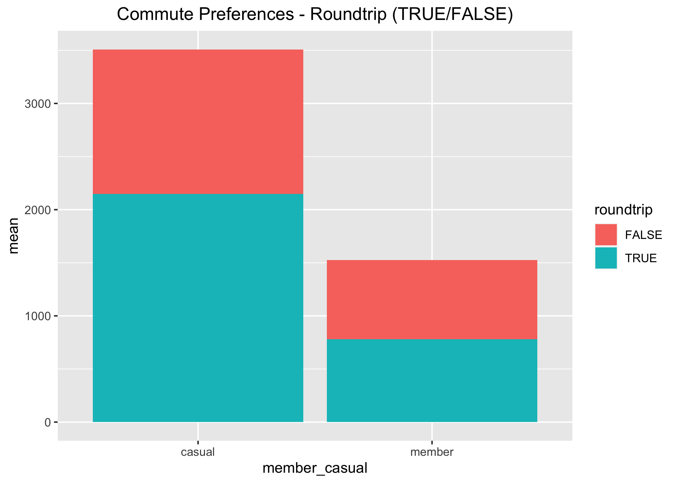
Round trips
It would be wrong to suggest that members do not do round trips
However, the proportion of these is lower than casual riders
To-and-Fro commutes dominate member rides
Round trips for members are short, and may represent errands run during their job

Slide 22
Conclusions
All these graphs seem to emphasize similar theme
Casual riders prefer long trips during the weekends
Classic bikes may be preferred due to their nostalgia during casual drives
Docked bikes are used often, perhaps for quick transit
Casual riders show a wide variety in duration of rides, from very short to very long rides
Member riders generally use the trips for commuting to and fro from home to work
Round trips may represent errands during the job work, and they are less frequent than casual users
Docked bikes are not used, or there is absence of data
Members show much more consistency in time duration of hire, with most hires being for around 15 min

Slide 23
Next Steps
Frequently used starting points for Casual users like station_id 13022 (Streeter Dr & Grand Ave) or 13300 (DuSable Lake Shore Dr & Monroe St ) should have campaigns targeted at regular users frequenting these stations
Casual users who may use rides for daily commute should be made aware of the benefits of membership, and easy way to obtain the same
Weekday casual users should be made aware of the benefits of membership

