Slide 1
Using Neural Nets to Create Beer Recipes (part 1)
Paul Chong

Slide 2
Table of Contents
Motivation
Understanding of Beer making
Data Collection
Data Analysis

Slide 3


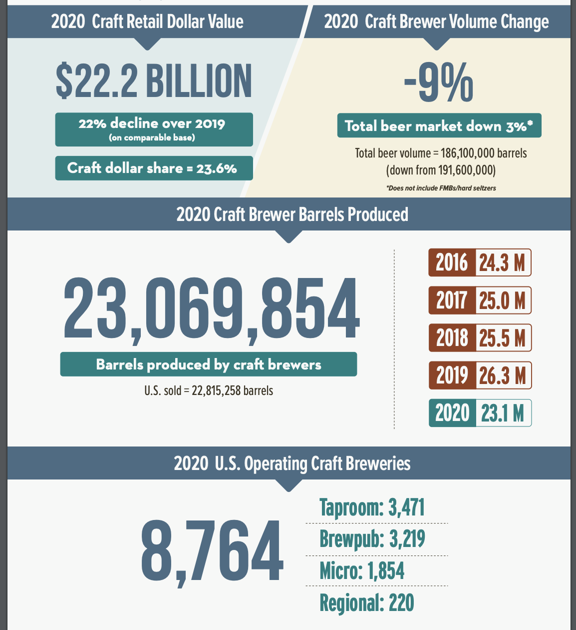
Extensive World of Beer
Craft brewers collectively produce around 25 million barrels of beer a year
The US is home to more than 8,000 craft breweries (400 of them being in Colorado).
Retail value over $22.2 billion

Slide 4
Problem Formulation
Too many beers
20 different types with 100,000s recipes each
Reduce noise
Can we make one perfect beer?

Slide 5
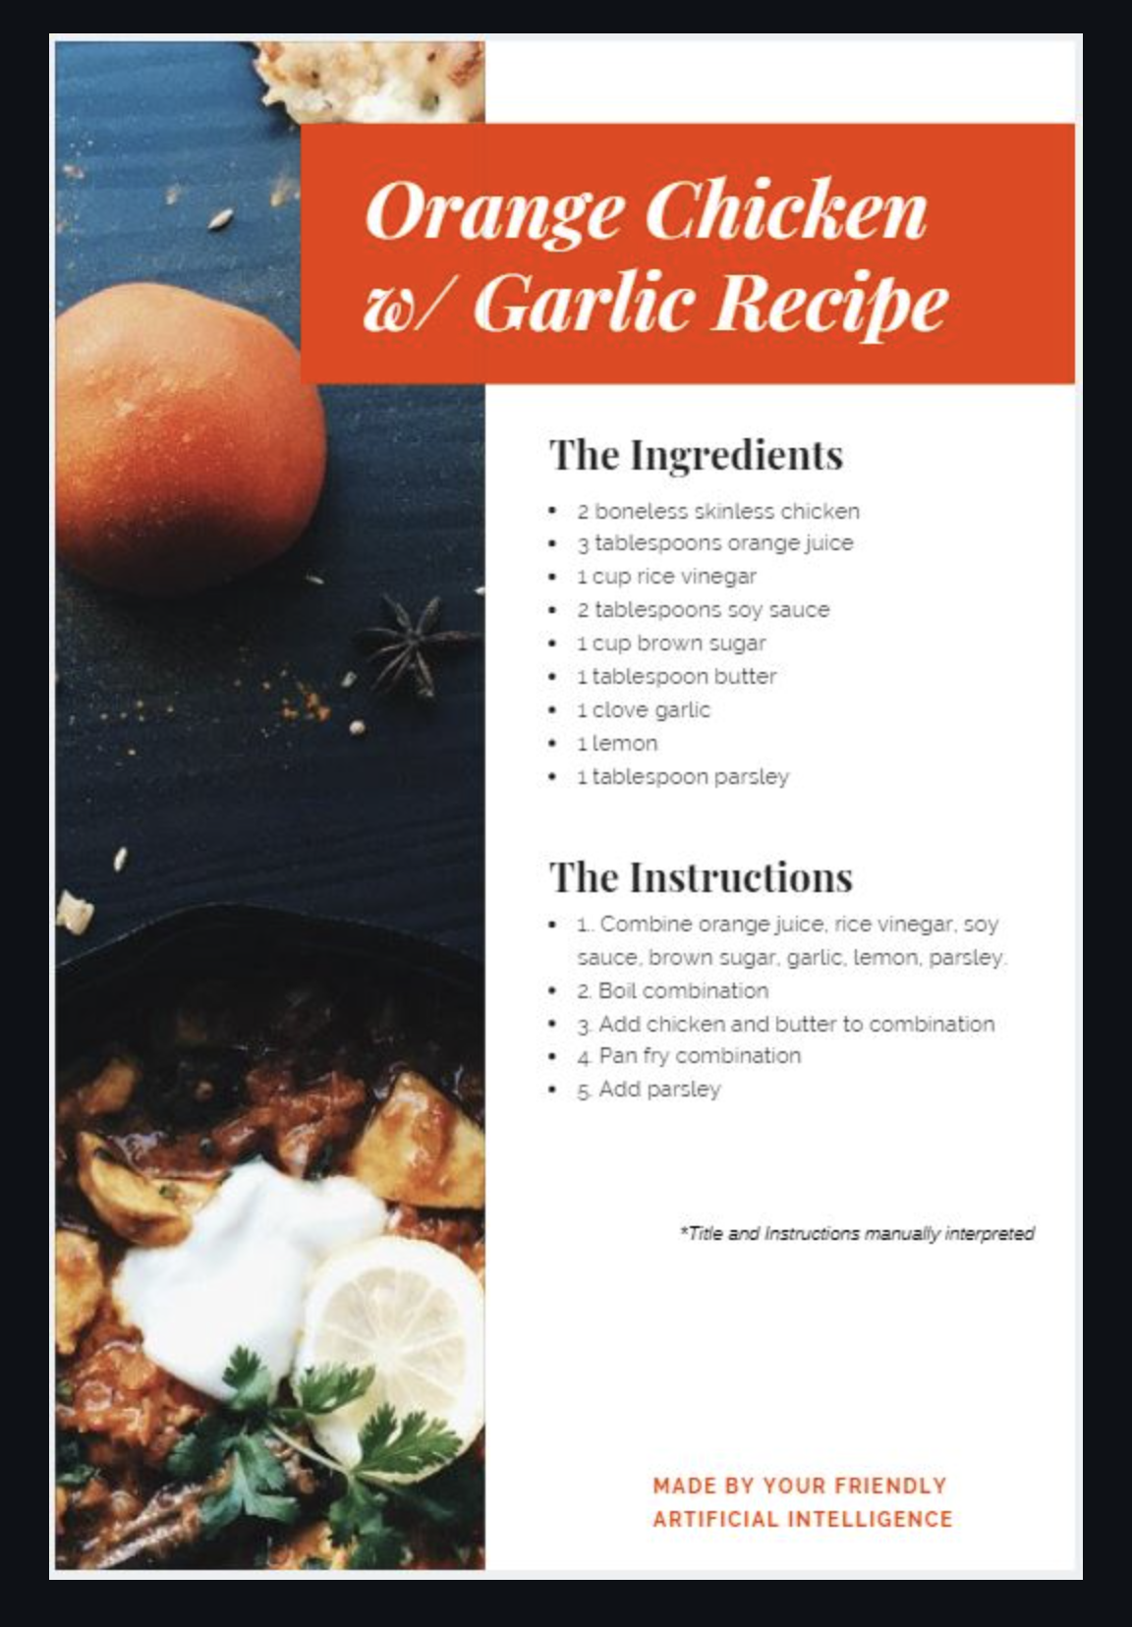
Inspiration
Derek Jia
Capstone project on AI generated recipes.
Created recipe on orange chicken with garlic, complete with ingredients and directions.
Other recipes

Slide 6
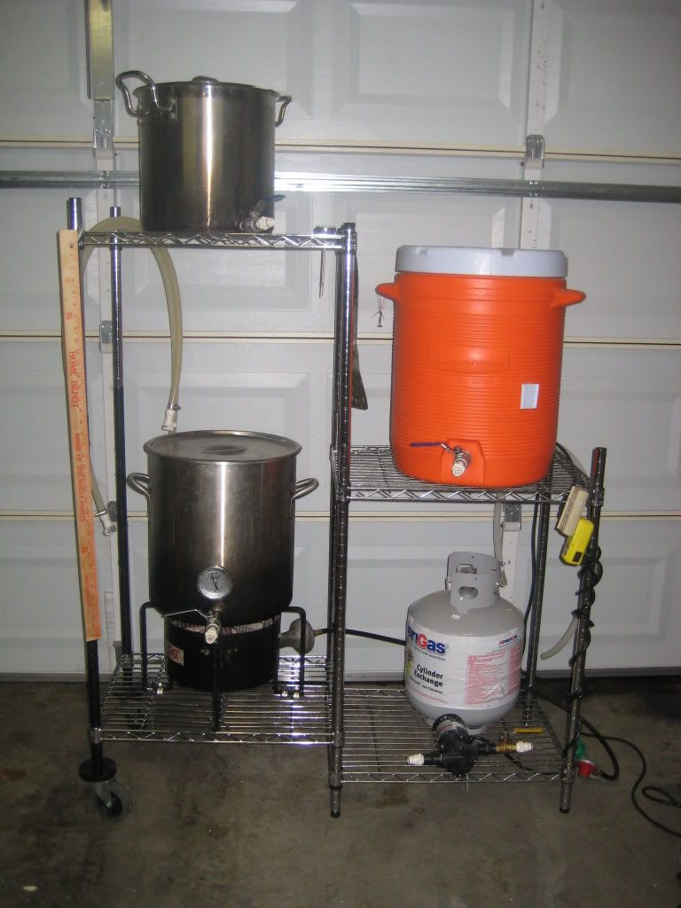
Brewing Beers
Several methods of brewing
Each types of beers have different methods
Malt into water, boiling to add hops, fermenting for a number of weeks, etc.
All grain brewing, brewing in a bag (BIAB)
Present in our data

Slide 7
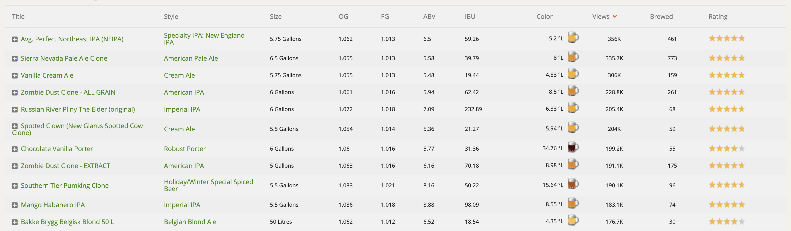
Data Scraping
No available/useful data from professors
Brewer’s Friend
Over 217,000 recipes.
Data Scraper
Data scraped from website
Python
Pandas, json, re, Request, BeautifulSoup
https://www.brewersfriend.com/homebrew-recipes/page/

Slide 8
Data scraping (cont.)
100 MB of initial data
Too large for us
Remove recipes w/ <1 reviews
13 MB in our second run
Just enough to train our model
Took days to scrape

Slide 9
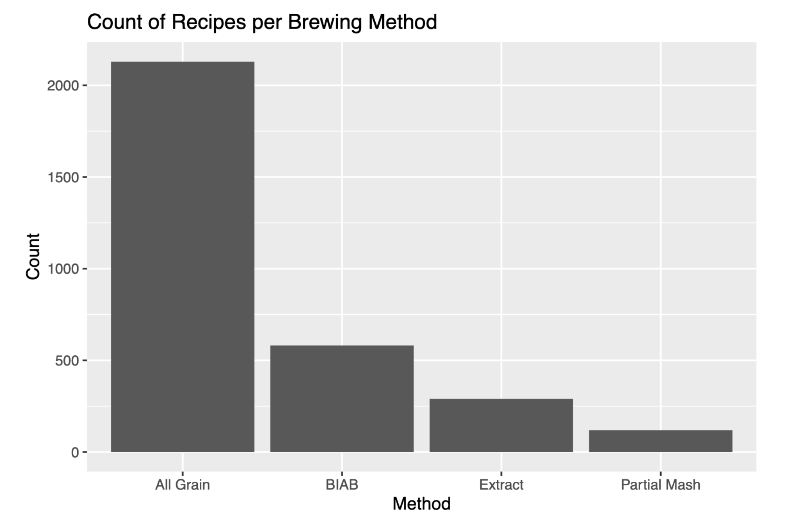
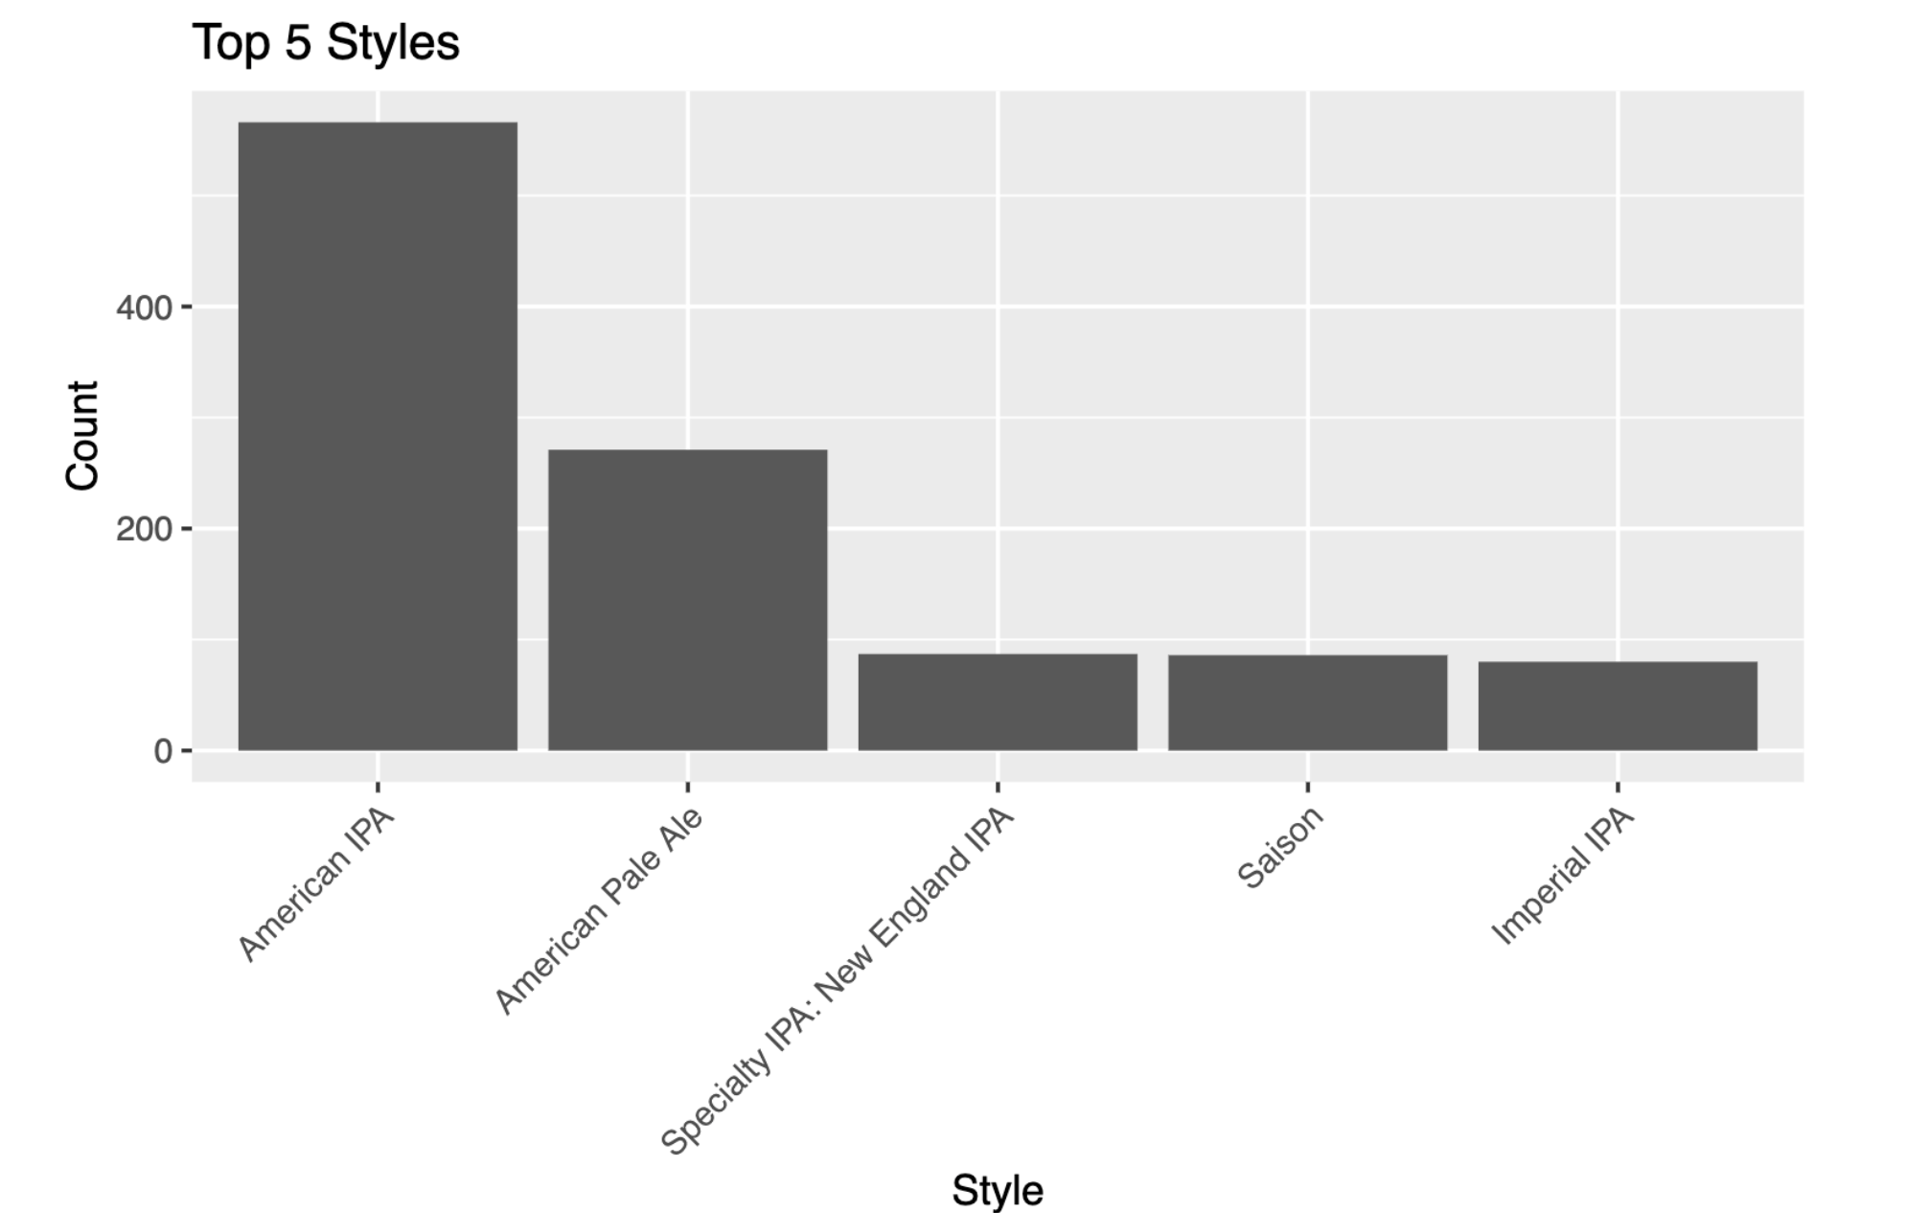
Data Analysis
Sizable portion of brews are American IPAs
4 of 5 top styles are some type of pale ale.
A large majority of recipes are done with All Grain method
Problem for neural nets
Figure 1. Distribution of 4 most popular brewing methods
Figure 2. Top 5 brewing styles

Slide 10
Conclusions/Next part
Data skewed more to all grain American IPA
Training Recurrent Neural Nets
Complete Recipe
Conclusions

Slide 11
References
Brewing For Beginners - Brewer's Friend. Brewer's Friend | Brewer's Friend is a complete homebrew beer recipe designer with brewing calculators, brew day planner, journal &amp; more. Helping you brew your best, every time! (2019, September 18). https://www.brewersfriend.com/brewing-for-beginners/
Homebrew Beer Recipes: Browse 200,000+ at Brewer's Friend. Brewer's Friend Beer Brewing Software. (2021). https://www.brewersfriend.com/homebrew-recipes/
Bojar, D. (2019, January 5). Generating Novel Cocktail Recipes with a Specific Style through Recurrent Neural Networks. Medium. https://towardsdatascience.com/generating-novel-cocktail-recipes-with-a-specific-style-through-recurrent-neural-networks-4339e9168404.
https://github.com/derekdjia/AI_Generated_Recipes#6-other

