Slide 1
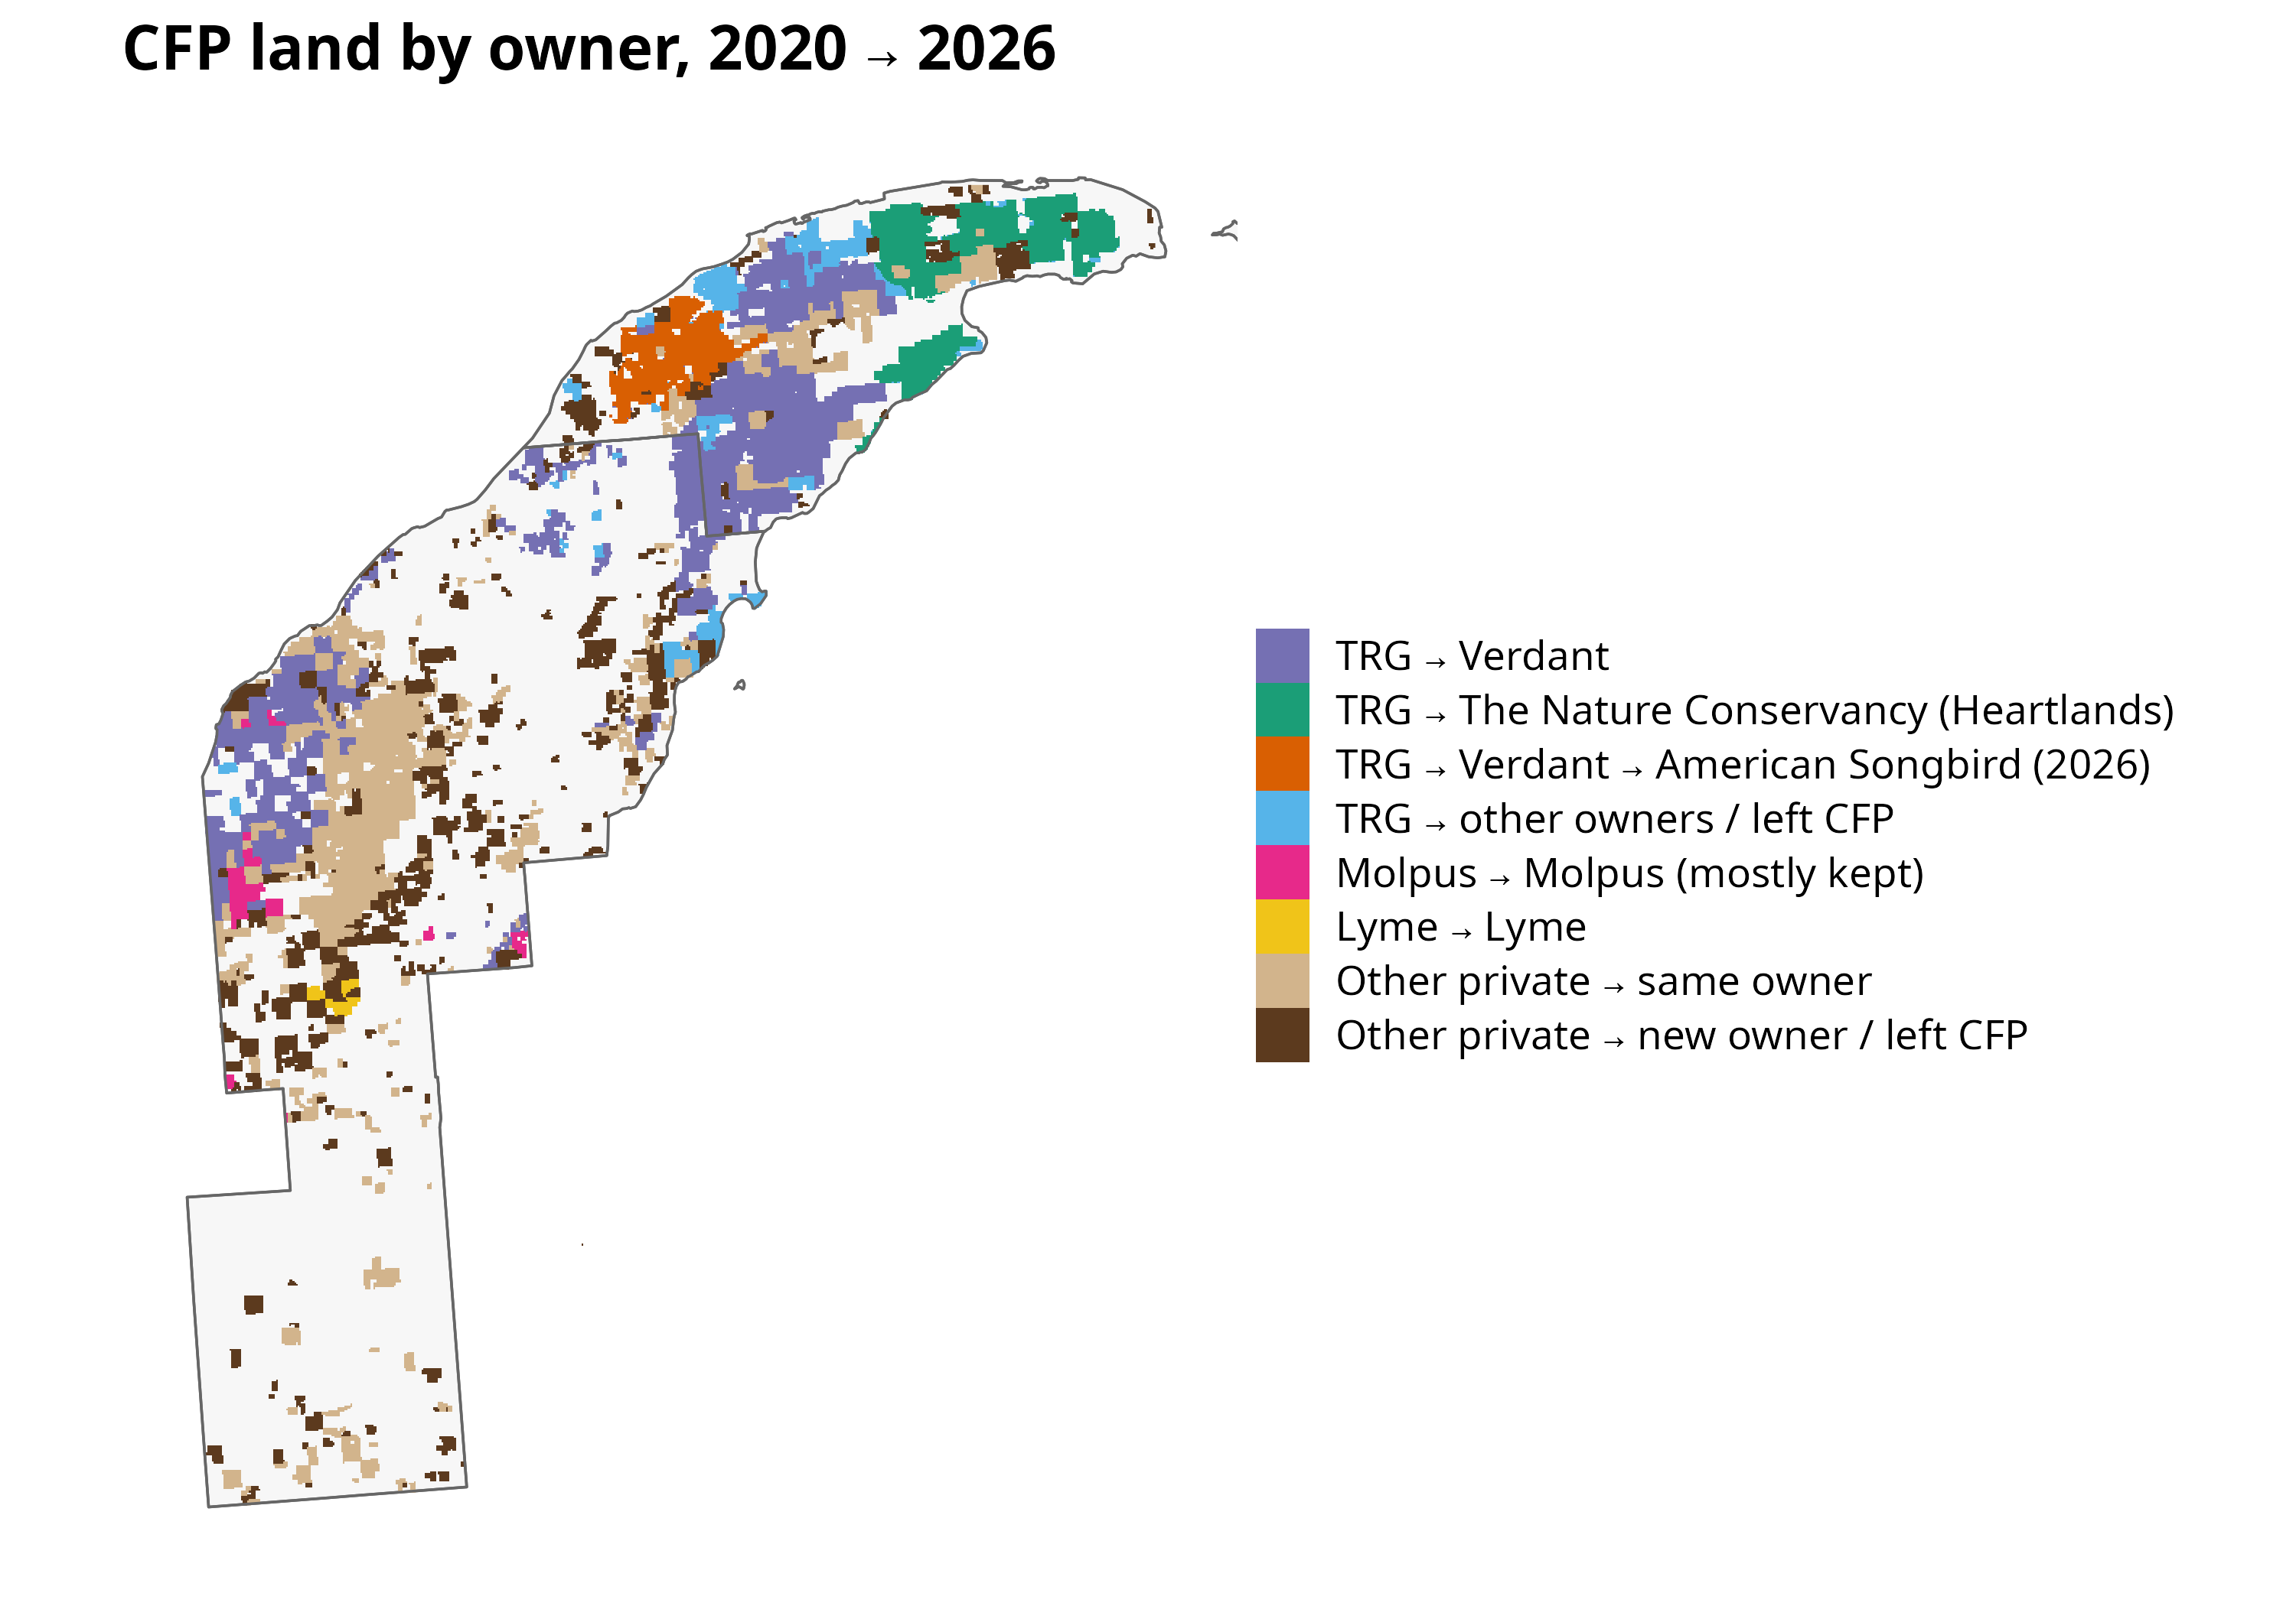

Slide 2
Share of acres heavily cut, 2020–2025
Acres in parcels whose average canopy fell more than 20 points
Molpus → Molpus (kept)
1,160 of 4,579 acres
TRG → Verdant → American Songbird (2026)
3,097 of 15,350 acres
TRG → Verdant
6,837 of 101,301 acres
Lyme → Lyme
40 of 1,686 acres
Other private → new owner / left CFP
609 of 67,380 acres
Other private → same owner
310 of 90,823 acres
TRG → other owners / left CFP
46 of 17,361 acres
TRG → The Nature Conservancy (Heartlands)
0 of 30,813 acres
0%
10%
20%
30%

Slide 3
Average tree canopy cover, by group
USFS Tree Canopy Cover, all 30 m cells in each group's land
85
80
75
TRG → Verdant
Canopy cover (%)
TRG → The Nature Conservancy (Heartlands)
TRG → Verdant → American Songbird (2026)
70
Other private → same owner
65
60
2010
2012
2014
2016
2018
2020
2022
2024

Slide 4
Share of each group's land cleared each year
Hansen Global Forest Change (heavy clearing only)
2.5
2.0
1.5
TRG → Verdant
% of area cleared
TRG → The Nature Conservancy (Heartlands)
TRG → Verdant → American Songbird (2026)
1.0
Other private → same owner
0.5
0.0
2015
2016
2017
2018
2019
2020
2021
2022
2023
2024

Slide 5
Share of each group's land disturbed each year
LANDFIRE Annual Disturbance, all types
10
TRG → Verdant
% of area disturbed
TRG → The Nature Conservancy (Heartlands)
TRG → Verdant → American Songbird (2026)
5
Other private → same owner
0
2010
2012
2014
2016
2018
2020
2022
2024

Slide 6
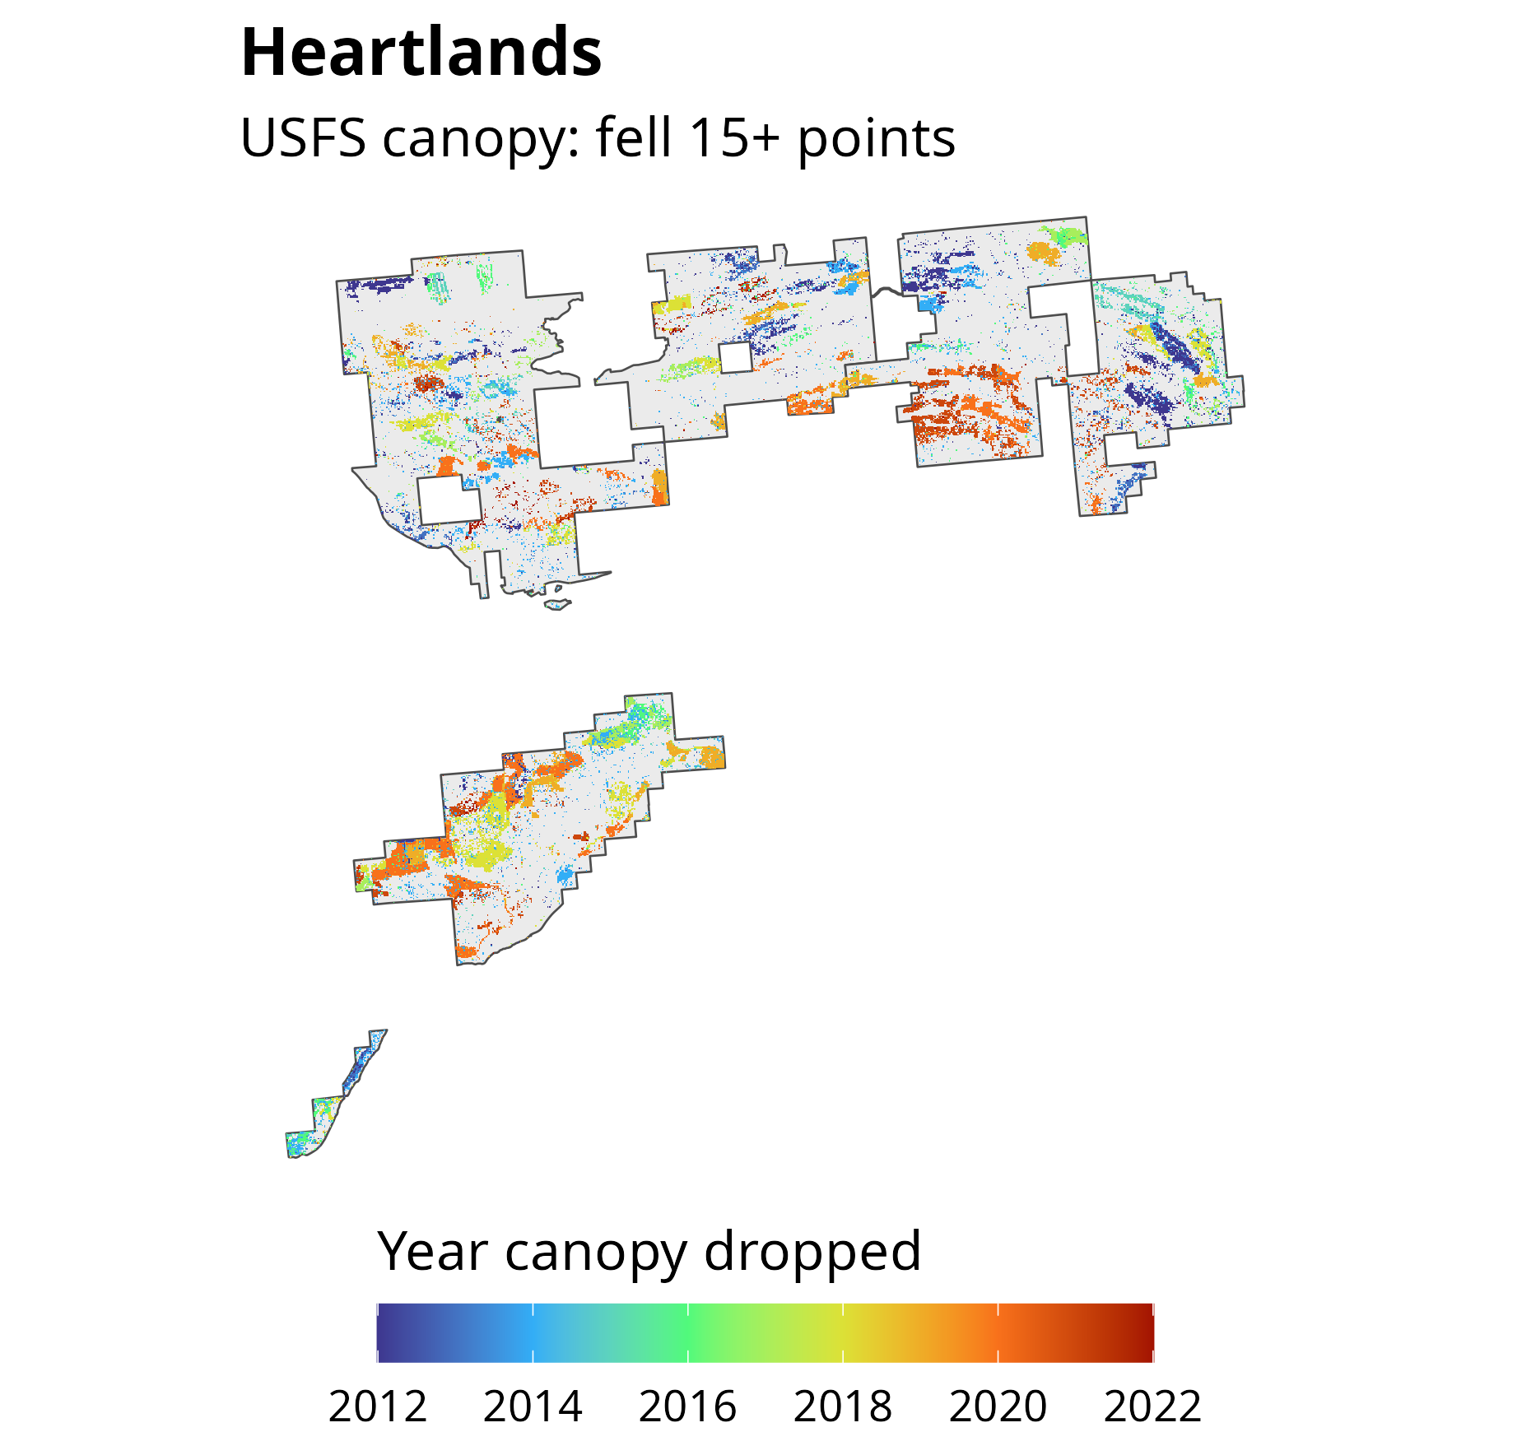

Slide 7
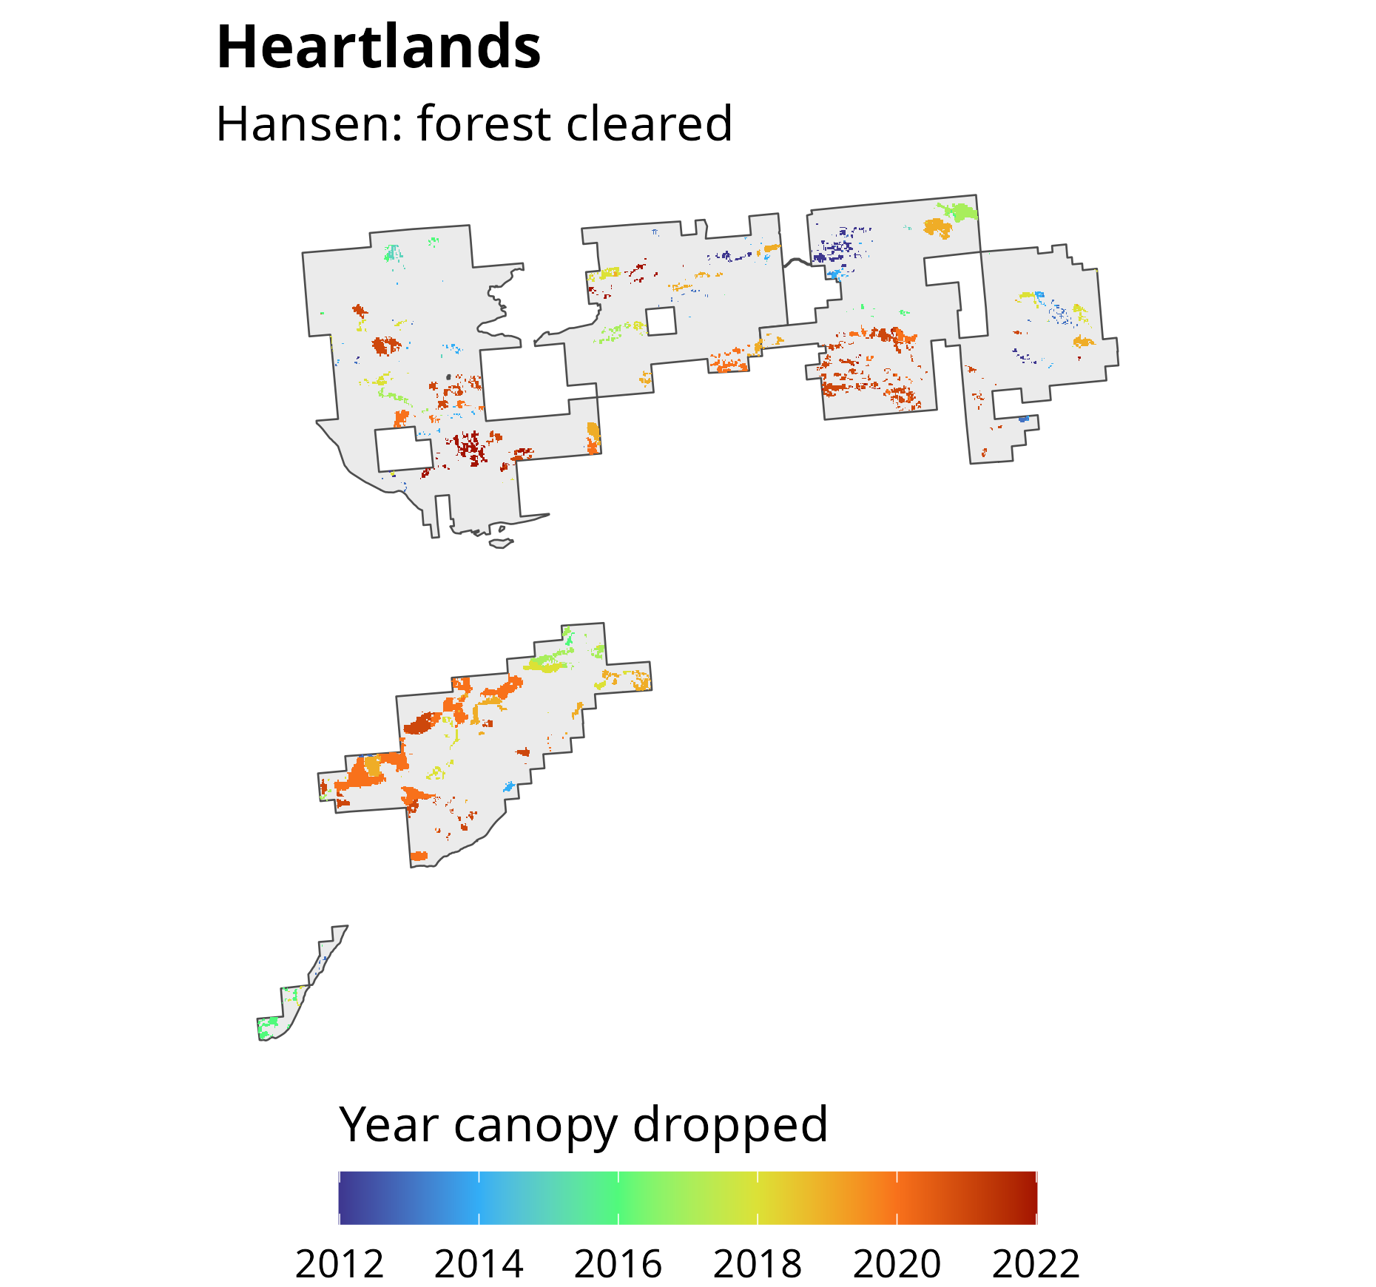

Slide 8
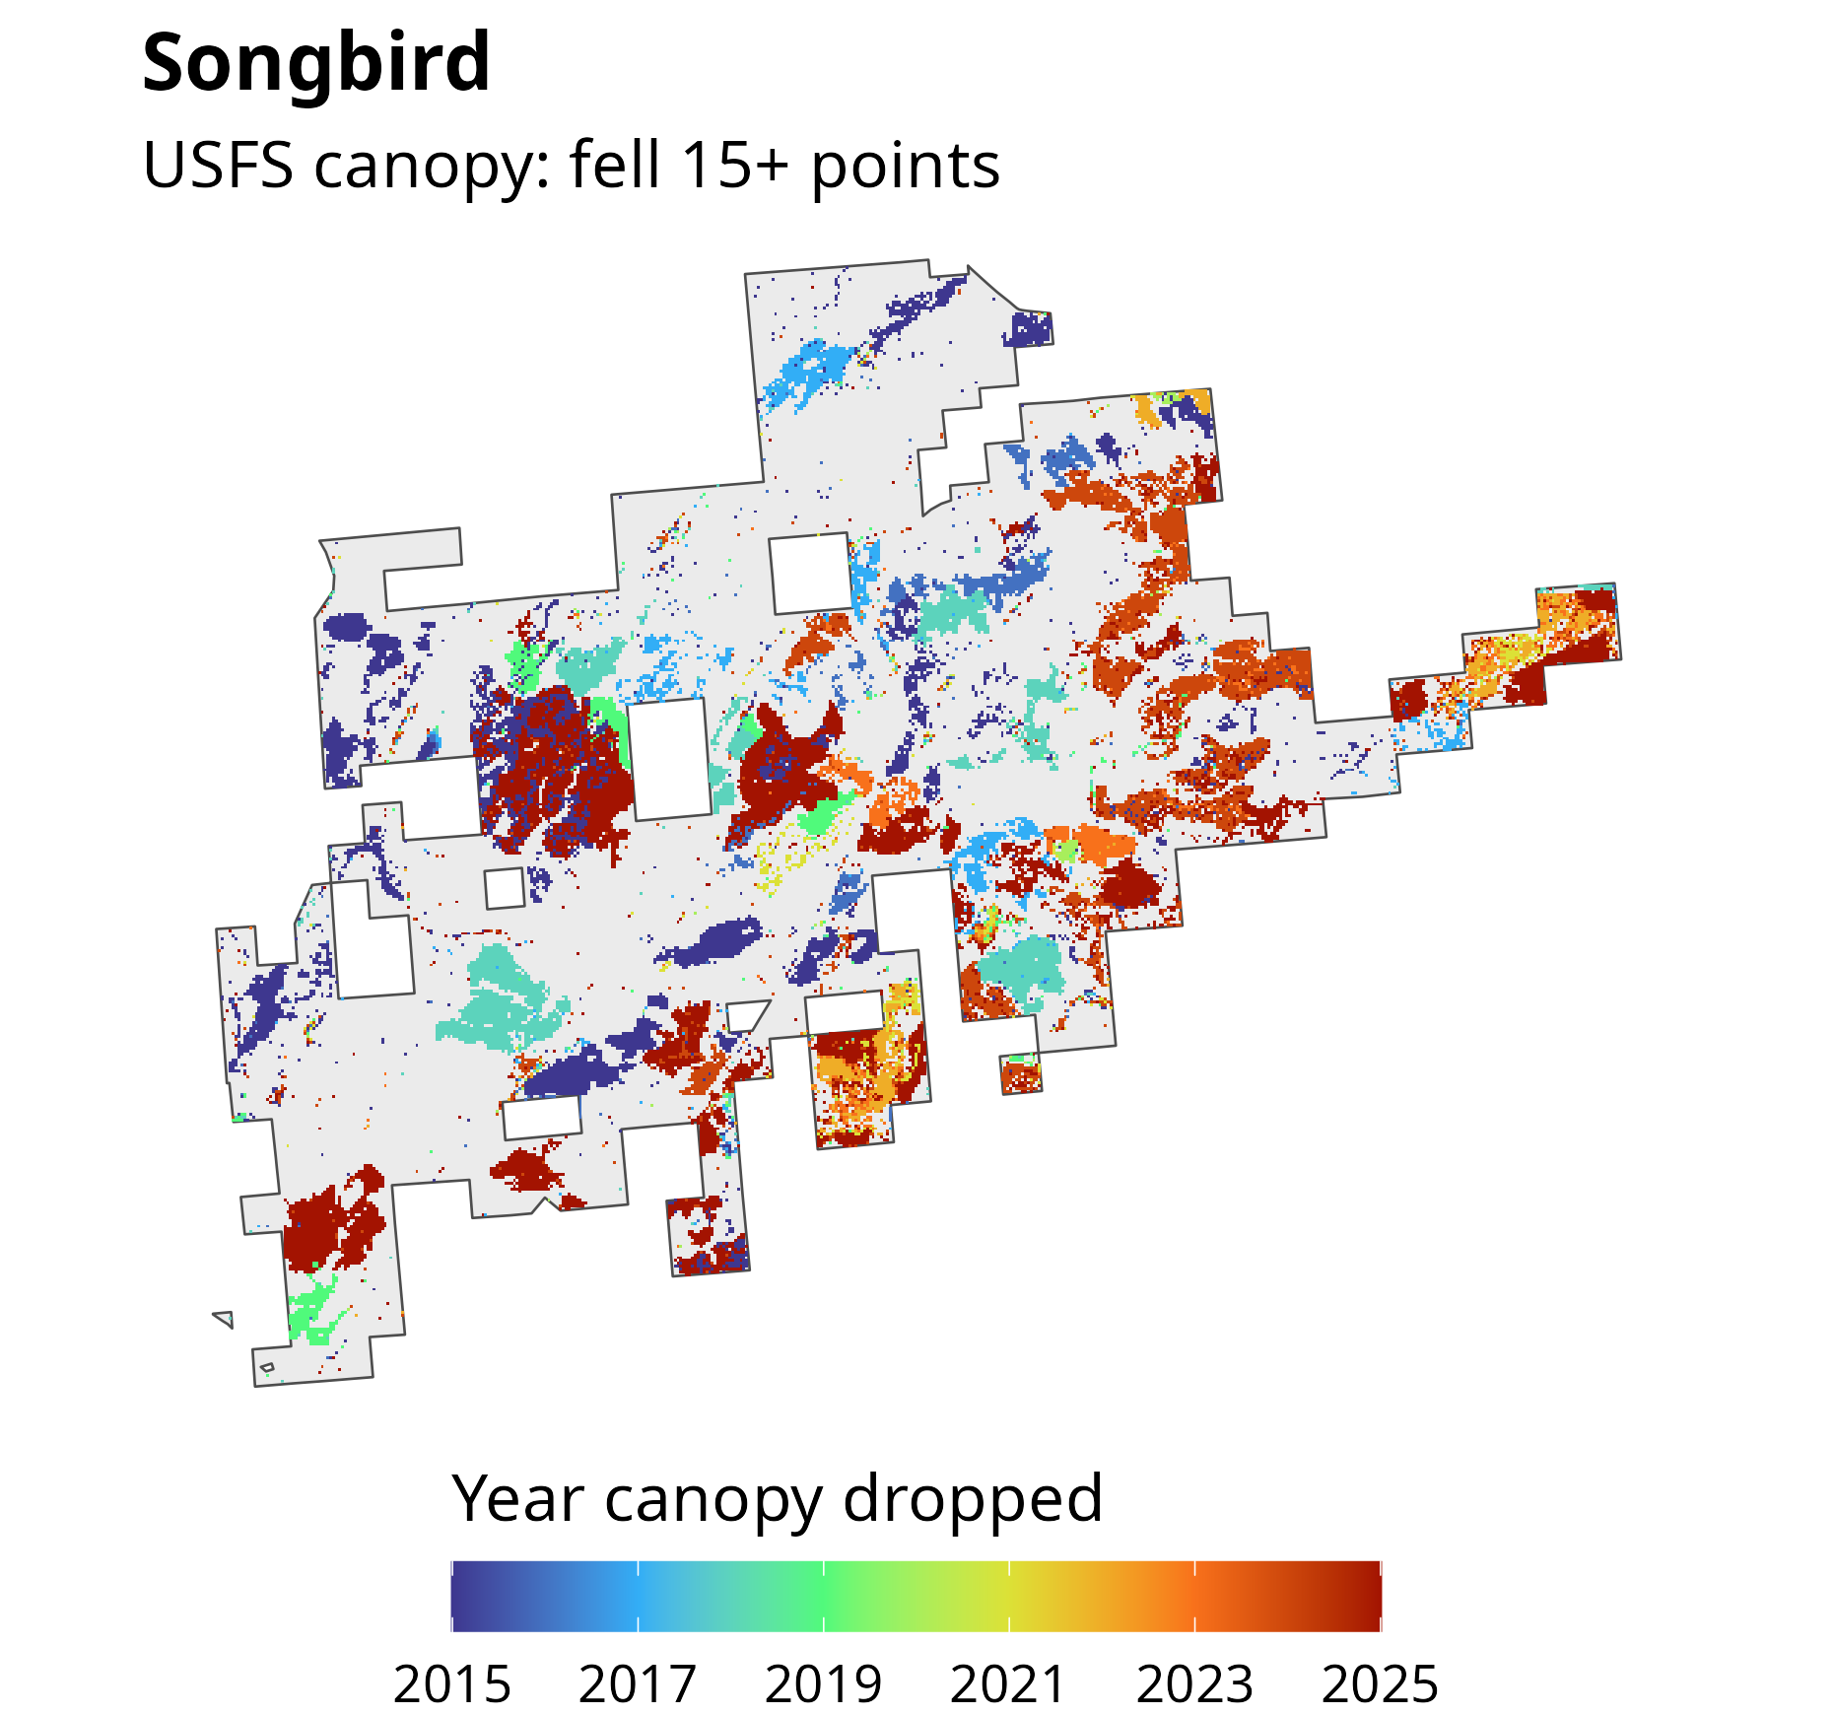

Slide 9
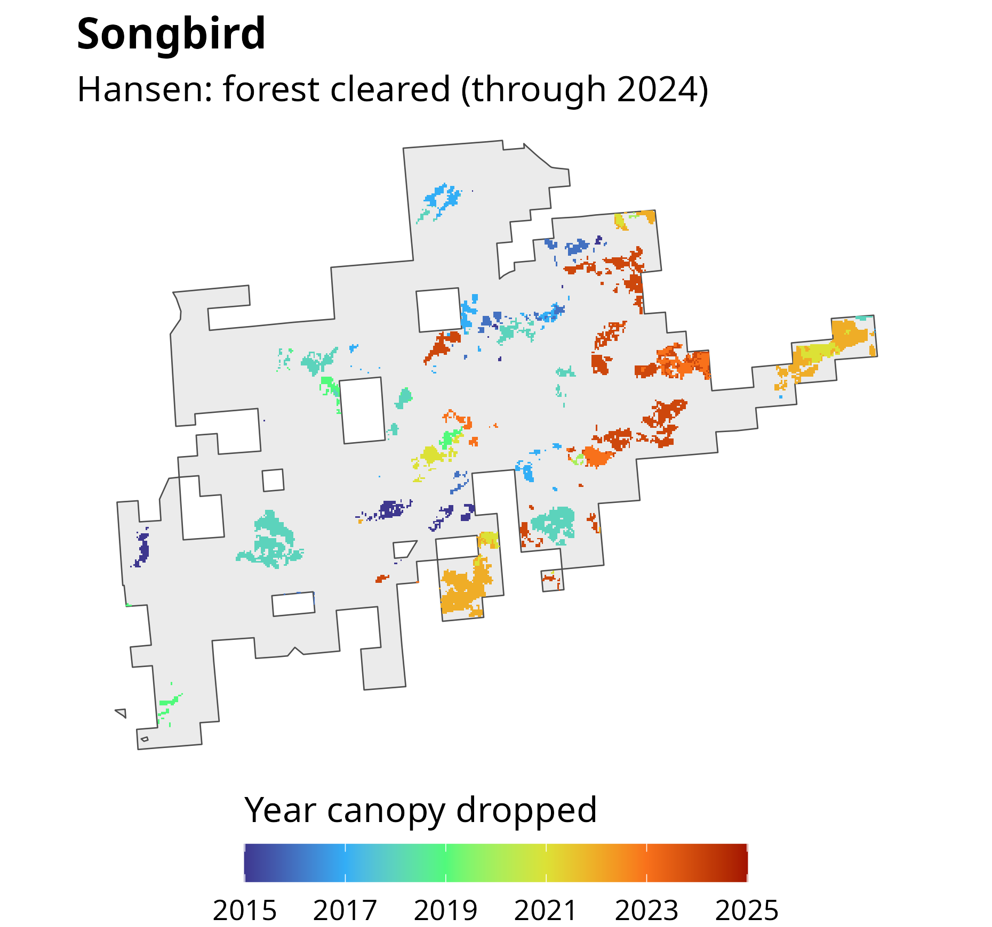

Slide 10
Acres where canopy dropped, by year and source
Heartlands (2012–2022)
Songbird (2015–2025)
1,500
1,000
Acres
500
0
2012
2014
2016
2018
2020
2022
2015
2017
2019
2021
2023
2025
Hansen forest cleared
USFS canopy fell 15+ points

Slide 11
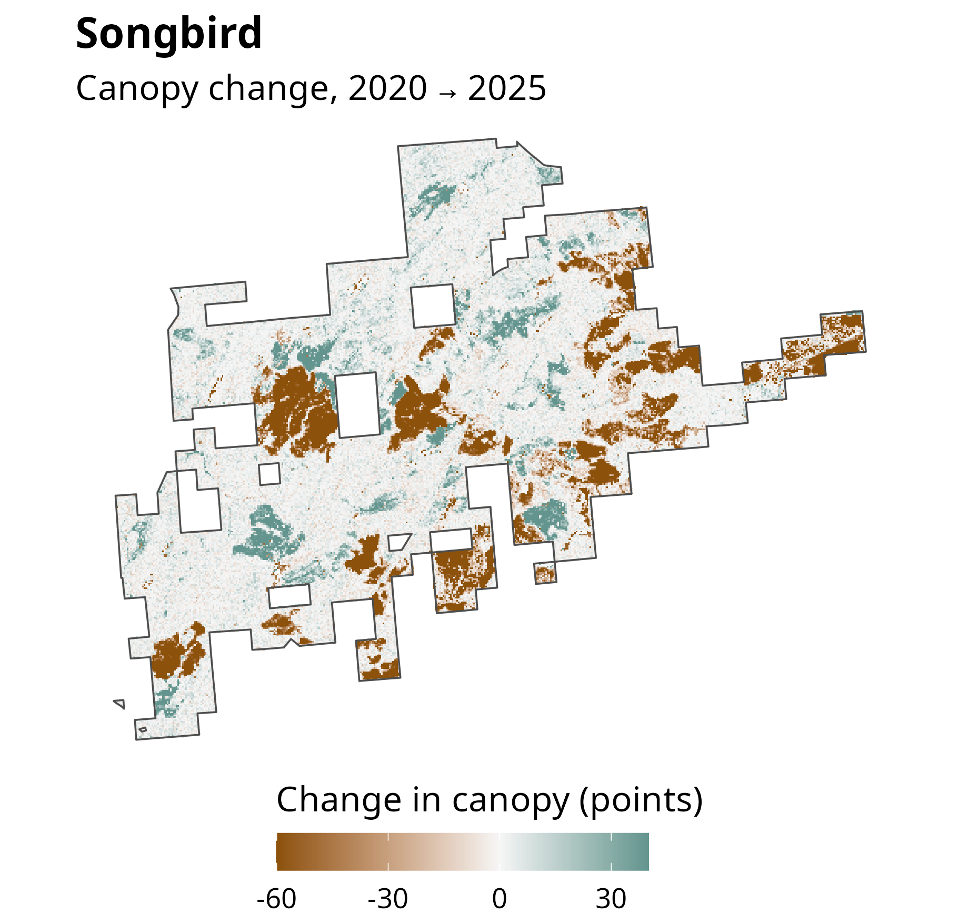

Slide 12
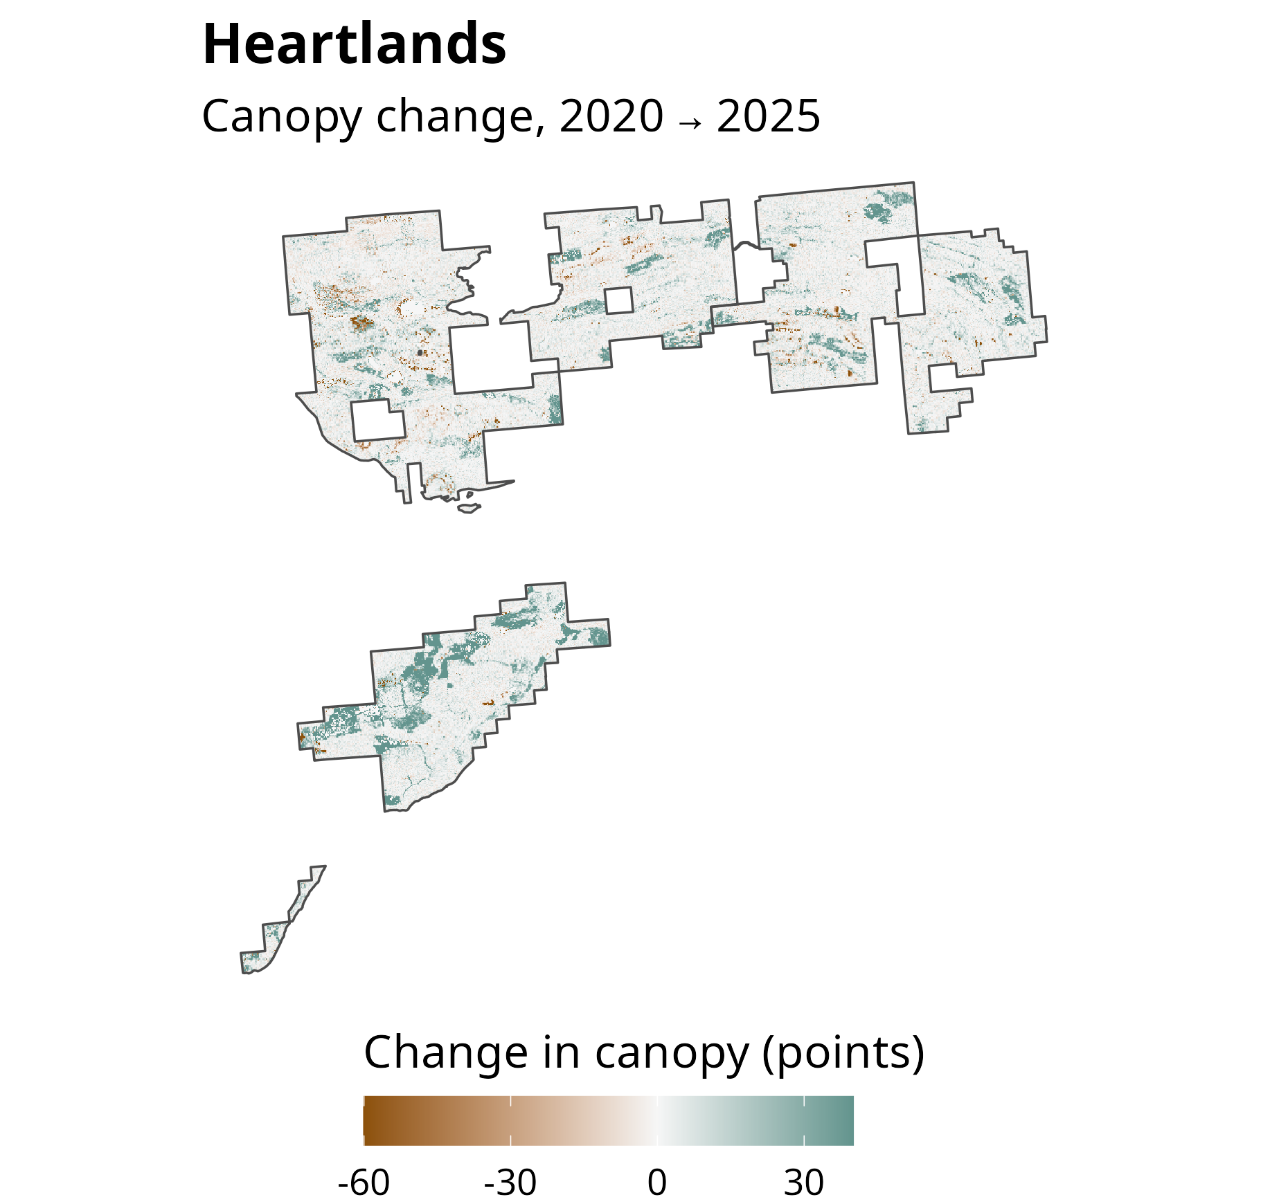

Slide 13
Acres in each canopy cover bin, 2020 vs. 2025
USFS Tree Canopy Cover, 30 m cells inside each sale footprint
2020
2025
American Songbird
Keweenaw Heartlands
6,000
15,000
4,000
10,000
Acres
2,000
5,000
0
0
0–10%
10–20%
20–30%
30–40%
40–50%
50–60%
60–70%
70–80%
80–90%
0–10%
10–20%
20–30%
30–40%
40–50%
50–60%
60–70%
70–80%
80–90%
90–100%
90–100%
Canopy cover

Slide 14
What the land would naturally support
Top 10 LANDFIRE Biophysical Settings (2020), percent of land area
Laurentian-Acadian Northern Hardwoods
54.6%
Forest-Hemlock
Laurentian-Acadian Alkaline Conifer-Hardwood
13.3%
Swamp
Boreal White Spruce-Fir-Hardwood
9.1%
Forest-Inland
Boreal White Spruce-Fir-Hardwood
6%
Forest-Coastal
Laurentian-Acadian Pine-Hemlock-Hardwood
5.6%
Forest
Boreal Acidic Peatland Systems
4.4%
Laurentian-Acadian Northern Hardwoods
3.2%
Forest-Northern Sugar Maple-Basswood
Laurentian-Acadian Northern Pine(-Oak) Forest
1.3%
Boreal Jack Pine-Black Spruce Forest-Pine
0.9%
Barrens
Laurentian-Acadian Floodplain Systems
0.8%
0
100,000
200,000
300,000
400,000
500,000
Acres
Conifer
Hardwood
Hardwood-Conifer
Riparian

Slide 15
What's there now
Top 10 LANDFIRE Existing Vegetation Types (2024), percent of land area
Laurentian-Acadian Northern Hardwoods Forest
52.3%
Laurentian-Acadian Alkaline Conifer-Hardwood
9.7%
Swamp
Laurentian-Acadian Pine-Hemlock Forest
5.4%
Laurentian-Acadian Pine-Hemlock-Hardwood
5.4%
Forest
Laurentian-Acadian Sub-boreal Mesic Balsam
4.6%
Fir-Spruce Forest
Laurentian-Acadian Sub-boreal Aspen-Birch
3.4%
Forest
Boreal-Laurentian Conifer Acidic Swamp and
2.9%
Treed Poor Fen
Developed-Roads
2.7%
Eastern Cool Temperate Pasture and Hayland
2.6%
Laurentian Jack Pine-Red Pine Forest
2.6%
0
100,000
200,000
300,000
400,000
500,000
Acres
Agricultural
Conifer-Hardwood
Hardwood
Conifer
Developed-Roads
Riparian

Slide 16
Disturbance per year: historical vs. current
All land, Houghton and Keweenaw counties. Historical: BpS models; current: LANDFIRE.
16,000
13,238 acres/yr
(1.54% of land)
12,000
10,735 acres/yr
(1.25% of land)
Fire
Wind, weather or stress
Acres disturbed per year
Insects or disease
8,000
Harvest or mechanical
Unknown cause
Other
4,000
2,495 acres/yr
(0.29% of land)
0
Historical: all
Historical:
Current (LANDFIRE
disturbances
structure-changing
average, 2010–2025)
only

Slide 17
Acres disturbed each year vs. the historical expectation
LANDFIRE Annual Disturbance, all land, Houghton and Keweenaw counties
15,000
Historical, all disturbances: 13,238 acres/yr
Fire
10,000
Insects or disease
Acres disturbed
Harvest or mechanical
Unknown cause
Other
5,000
Historical, structure-changing: 2,495 acres/yr
0
2010
2011
2012
2013
2014
2015
2016
2017
2018
2019
2020
2021
2022
2023
2024
2025

Slide 18
Where TRG's land went
2020 → 2026 | Parcels | Acres | Canopy 2020 | Canopy 2025 | Acres heavily cut
TRG → Verdant | 476 | 101,301 | 75.0% | 73.4% | 6,837 (6.7%)
TRG → The Nature Conservancy (Heartlands) | 151 | 30,813 | 70.5% | 75.3% | 0 (0.0%)
TRG → Verdant → American Songbird (2026) | 91 | 15,350 | 72.7% | 65.8% | 3,097 (20.2%)
TRG → other owners / left CFP | 120 | 17,361 | 71.3% | 73.9% | 46 (0.3%)

Slide 19
Big companies vs. other private owners
 | Acres | Acres heavily cut | Share
Institutional owners | 171,890 | 11,300 | 6.6%
Other private owners | 158,203 | 920 | 0.6%

