Slide 1
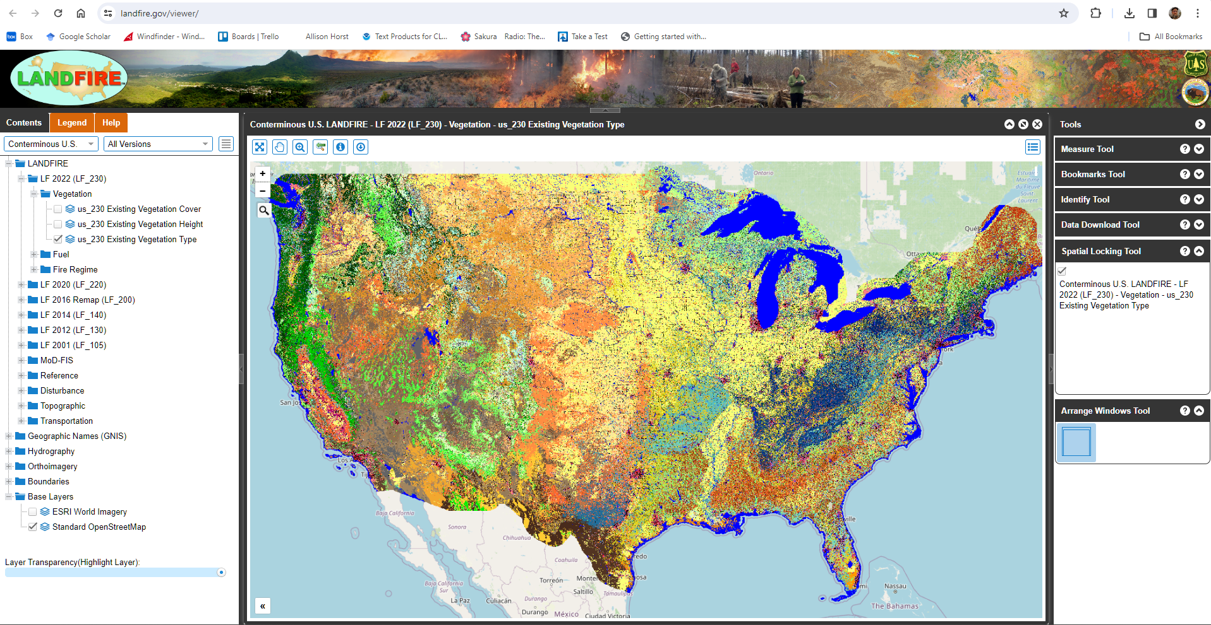
Uncheck this box for easier orientation

Slide 2
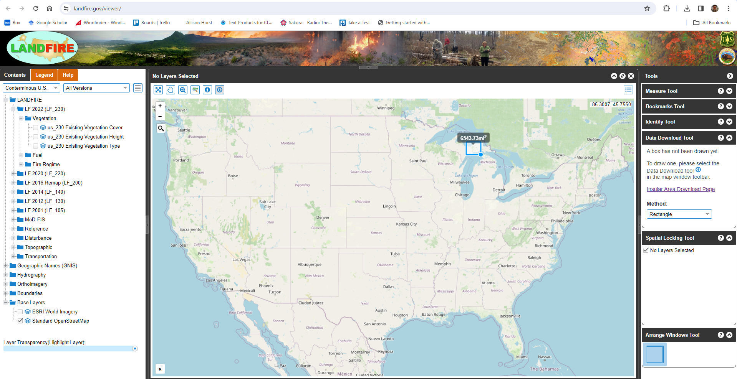
FIRST:
Click this button to start Data Download Tool
THIRD:
Draw rectangle. Click once on first corner to start drawing, click on opposite corner to stop.
SECOND:
Click Method and Select from list. We selected ‘Rectangle’.

