Slide 1
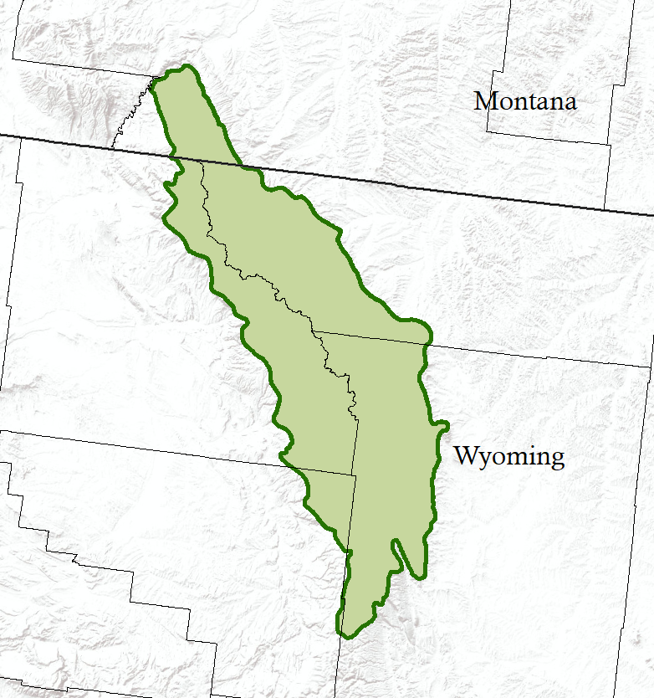
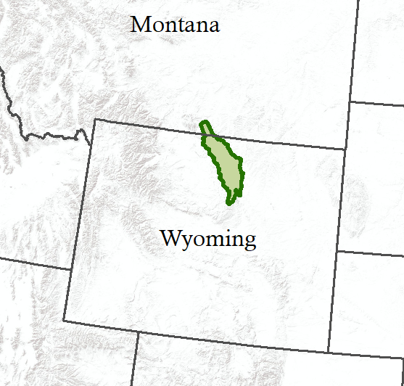
Cousin Paula
X

Slide 2
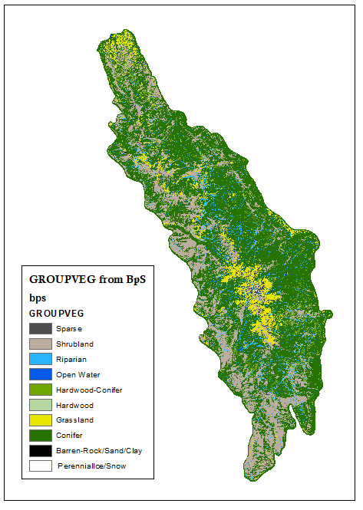
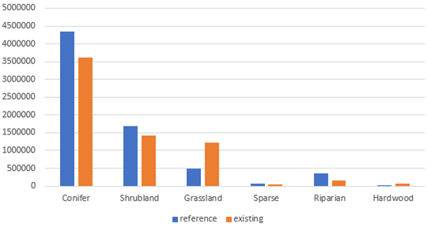
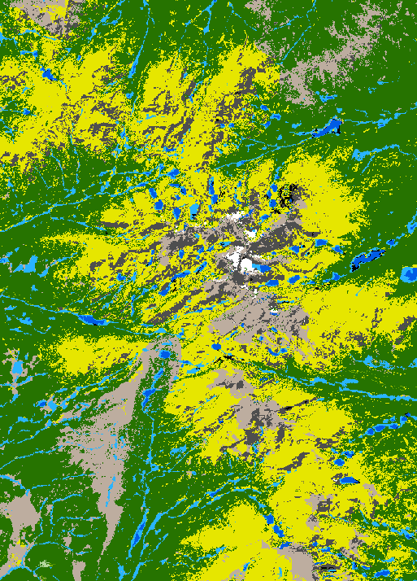
Maps depict the blue lines
in your chart

Slide 3
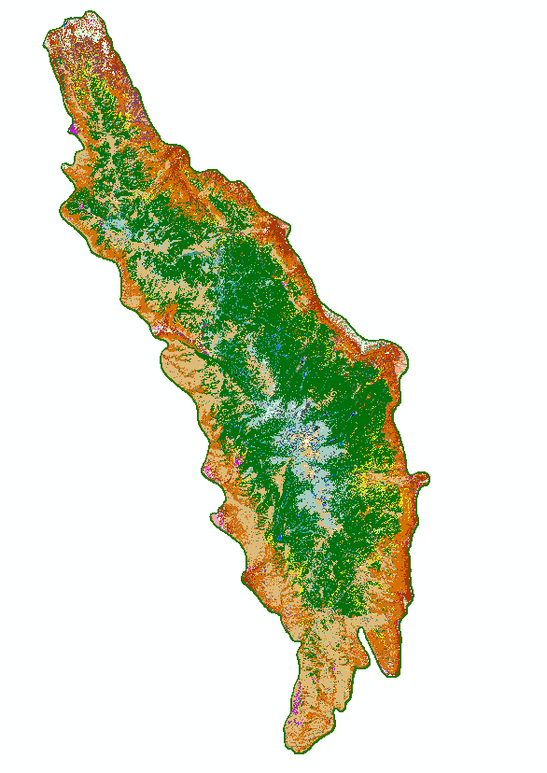
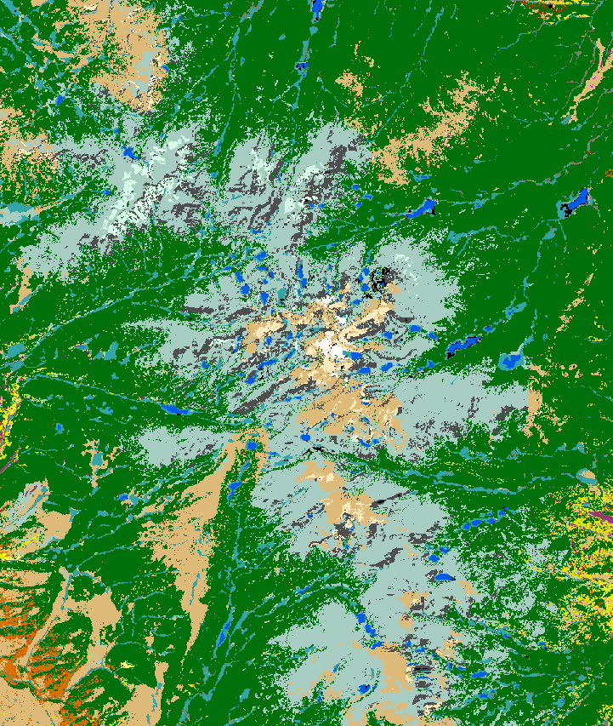
Map of BpSs (by name-note each name may have multiple due to Map Zone variations). There are 47 of them for the Ten Sleep landscape! Succession classes are defined for BpSs, with each MZ potentially having different definitions.

Slide 4
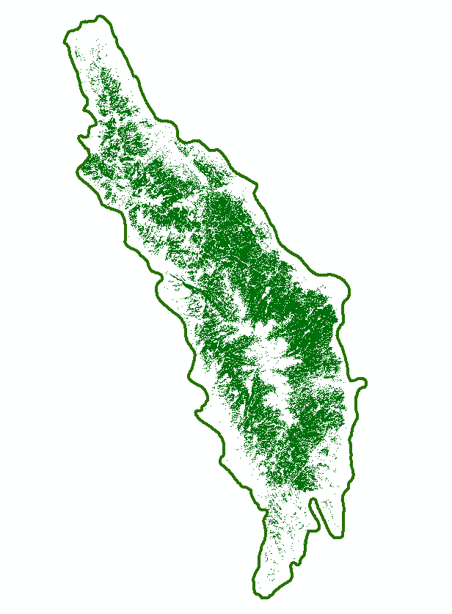
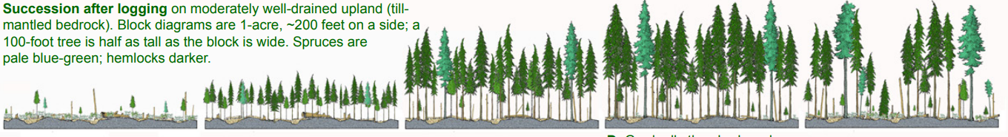
Map of the Rocky Mountain Subalpine Dry-Mesic Spruce-Fir Forest and Woodland BpS, essentially where its habitat is. There were ~600k acres of this historically. Questions include:
How much of this is there today? Use LANDFIRE EVT data for this.
Has any of it been converted to other vegetation types? Use LANDFIRE EVT data for this.
How much of each succession class where there on the landscape historically? Today? Which ones are underrepresented today? Overrepresented? Use LANDFIRE BpS descriptions to get historical amounts/Succession class data to get current amounts.
Illustration below is one Greasy got from internet to depict succession classes…may or may not be ecologically correct for this BpS.

Slide 5
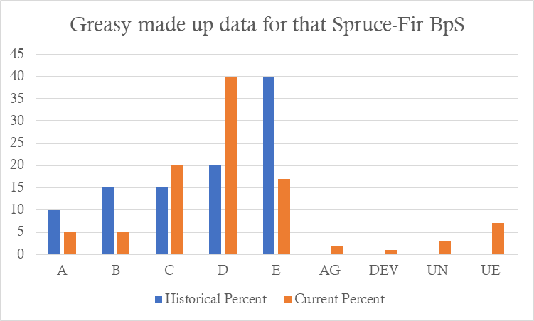
We want this for the 5 (?) most dominant BpSs, along with an understanding of what each succession class is in terms of % cover, height and species.
OMG this is a problem! I hate this! We gotta fix this sh*t!
Interpretation and value judgements are critical.

