Slide 1
Advanced Programming in the UNIX Environment
Advanced Programming in the UNIX
Environment
–
Introduction, UNIX history, UNIX Programming Basics
Department of Software Engineering
International School of Software
Chen Gang
chenzuolin@whu.edu.cn
http://iss.whu.edu.cn/blog.html?author=chengang
Lecture 01: Introduction, UNIX history, UNIX Programming Basics

Slide 2
Advanced Programming in the UNIX Environment
Advice
You can lead a horse to water, but you cannot make him drink !
Listen and then practice!
Lecture 01: Introduction, UNIX history, UNIX Programming Basics

Slide 3
Advanced Programming in the UNIX Environment
Advice
Close your laptops!
Open your eyes!
Keep it simple, stupid!
Lecture 01: Introduction, UNIX history, UNIX Programming Basics

Slide 4
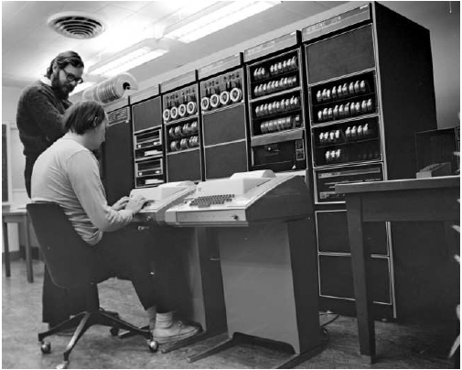
Advanced Programming in the UNIX Environment
What is this about?
http://cm.bell-labs.com/who/dmr/chist.html
Lecture 01: Introduction, UNIX history, UNIX Programming Basics

Slide 5
Advanced Programming in the UNIX Environment
In a nutshell: the ”what”
$ ls /bin
[
cat
chio
chmod
cp
cpio
csh
date
dd
df
domainname
echo
ed
expr
hostname
kill
ksh
ln
ls
mkdir
mt
mv
pax
ps
pwd
rcmd
rcp
rm
rmdir
sh
sleep
stty
sync
systrace
tar
test
$
See also:
$ ssh linux-lab.cs.stevens.edu
$ cd ~jschauma/apue/src/
Lecture 01: Introduction, UNIX history, UNIX Programming Basics

Slide 6
Advanced Programming in the UNIX Environment
In a nutshell: the ”what”
$ grep "(int" /usr/include/sys/socket.h
int accept(int, struct sockaddr * __restrict, socklen_t * __restrict);
int bind(int, const struct sockaddr *, socklen_t);
int connect(int, const struct sockaddr *, socklen_t);
int getsockopt(int, int, int, void * __restrict, socklen_t * __restrict);
int listen(int, int);
ssize_t recv(int, void *, size_t, int);
ssize_t recvfrom(int, void * __restrict, size_t, int,
ssize_t recvmsg(int, struct msghdr *, int);
ssize_t send(int, const void *, size_t, int);
ssize_t sendto(int, const void *,
ssize_t sendmsg(int, const struct msghdr *, int);
int setsockopt(int, int, int, const void *, socklen_t);
int socket(int, int, int);
int socketpair(int, int, int, int *);
$
Lecture 01: Introduction, UNIX history, UNIX Programming Basics

Slide 7
Advanced Programming in the UNIX Environment
In a nutshell: the ”what”
gain an understanding of the UNIX operating systems
gain (systems) programming experience
understand fundamental OS concepts (with focus on UNIX family):
multi-user concepts
basic and advanced I/O
process relationships
interprocess communication
basic network programming using a client/server model
Lecture 01: Introduction, UNIX history, UNIX Programming Basics

Slide 8
Advanced Programming in the UNIX Environment
In a nutshell
The ”why”:
understanding how UNIX works gives you insights in other OS
concepts
system level programming experience is invaluable as it forms the
basis for most other programming and even use of the system
system level programming in C helps you understand general
programming concepts
most higher level programming languages (eventually) call (or
implement themselves) standard C library functions
Lecture 01: Introduction, UNIX history, UNIX Programming Basics

Slide 9
Advanced Programming in the UNIX Environment
In a nutshell: the ”how”
static char dot[] = ".", *dotav[] = { dot, NULL };
struct winsize win;
int ch, fts_options;
int kflag = 0;
const char *p;
setprogname(argv[0]);
setlocale(LC_ALL, "");
/* Terminal defaults to -Cq, non-terminal defaults to -1. */
if (isatty(STDOUT_FILENO)) {
if (ioctl(STDOUT_FILENO, TIOCGWINSZ, &win) == 0 &&
win.ws_col > 0)
termwidth = win.ws_col;
f_column = f_nonprint = 1;
} else
f_singlecol = 1;
/* Root is -A automatically. */
if (!getuid())
f_listdot = 1;
fts_options = FTS_PHYSICAL;
while ((ch = getopt(argc, argv, "1ABCFLRSTWabcdfghiklmnopqrstuwx")) != -1) {
switch (ch) {
/*
* The -1, -C, -l, -m and -x options all override each other so
* shell aliasing works correctly.
*/
case '1':
f_singlecol = 1;
Lecture 01: Introduction, UNIX history, UNIX Programming Basics

Slide 10
Advanced Programming in the UNIX Environment
In a nutshell: the ”how”
$ $EDITOR cmd.c
$ cc -Wall -g -o cmd cmd.c
$ ./cmd
$ echo "Hooray!"
Hooray!
$
Lecture 01: Introduction, UNIX history, UNIX Programming Basics

Slide 11
Advanced Programming in the UNIX Environment
In a nutshell: the ”how”
Open your laptops!
$ ssh linux-lab.cs.stevens.edu
$ mkdir apue
$ cp ~jschauma/apue/01/welcome.c apue/
Now compile and run the program.
Lecture 01: Introduction, UNIX history, UNIX Programming Basics

Slide 12
Advanced Programming in the UNIX Environment
In a nutshell: the ”how”
$ $EDITOR cmd.c
$ cc -Wall -g -o cmd cmd.c
$ ./cmd
$ echo "Hooray!"
Hooray!
$
Lecture 01: Introduction, UNIX history, UNIX Programming Basics

Slide 13
Advanced Programming in the UNIX Environment
In a nutshell: the ”how”
$ $EDITOR cmd.c
$ cc -Wall -g -o cmd cmd.c
cmd.c: In function `main':
cmd.c:19: error: parse error before "return"
$
Lecture 01: Introduction, UNIX history, UNIX Programming Basics

Slide 14
Advanced Programming in the UNIX Environment
In a nutshell: the ”how”
$ $EDITOR cmd.c
$ cc -Wall -g -o cmd cmd.c
cmd.c: In function `main':
cmd.c:19: error: parse error before "return"
$ $EDITOR cmd.c
$ cc -Wall -g -o cmd cmd.c
$ ./cmd
Memory fault (core dumped)
$
Lecture 01: Introduction, UNIX history, UNIX Programming Basics

Slide 15
Advanced Programming in the UNIX Environment
In a nutshell: the ”how”
$ $EDITOR cmd.c
$ cc -Wall -g -o cmd cmd.c
cmd.c: In function `main':
cmd.c:19: error: parse error before "return"
$ $EDITOR cmd.c
$ cc -Wall -g -o cmd cmd.c
$ ./cmd
Memory fault (core dumped)
$ echo "!@#!@!!!??#@!"
!@#!@!!!??#@!
$ gdb ./cmd cmd.core
Program terminated with signal 11, Segmentation fault.
Loaded symbols for /usr/libexec/ld.elf_so
#0 0xbbbc676a in __findenv () from /usr/lib/libc.so.12
(gdb)
Lecture 01: Introduction, UNIX history, UNIX Programming Basics

Slide 16
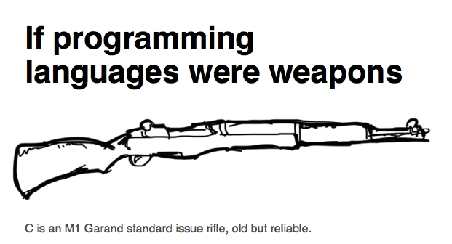
Advanced Programming in the UNIX Environment
Programming
http://is.gd/6aidgb
https://i.imgur.com/ZyeCO.jpg
Lecture 01: Introduction, UNIX history, UNIX Programming Basics

Slide 17
Advanced Programming in the UNIX Environment
About this class
Textbook:
“Advanced Programming in the UNIX Environment”, by W. Richard
Stevens, Stephen A. Rago (3rd Edition)
Help:
http://linuxcommand.org/
http://linux.cn/
//http://www.spinics.net/linux/
Grading:
1 group project, worth 100 points
1 midterm project(individual), worth 100 points
1 ﬁnal project, worth 300 points
Lecture 01: Introduction, UNIX history, UNIX Programming Basics

Slide 18
Advanced Programming in the UNIX Environment
Syllabus
02/22: Introduction, UNIX history, UNIX Programming Basics
03/07: File I/O, File Sharing
03/14: Files and Directories, Filesystems
03/21: System Data Files, Time & Date, Process Environment
03/28: Process Control, Signals
04/04: Process Groups, Signals
04/11: Interprocess Communication
04/18: Advanced I/O: Nonblocking I/O, Polling, and Record Locking
04/25: Daemon Processes, ﬁnal project discussion
05/02: No Class
05/09: UNIX tools: make(1), gdb(1), revision control, etc.
05/23: Code reading and discussions
06/06: Encryption
06/20: Review
Lecture 01: Introduction, UNIX history, UNIX Programming Basics

Slide 19
Advanced Programming in the UNIX Environment
UNIX History
Lecture 01: Introduction, UNIX history, UNIX Programming Basics

Slide 20
Advanced Programming in the UNIX Environment
UNIX history
http://www.unix.org/what_is_unix/history_timeline.html
Originally developed in 1969 at Bell Labs by Ken Thompson and
Dennis Ritchie.
1973, Rewritten in C. This made it portable and changed the history
of OS
1974: Thompson, Joy, Haley and students at Berkeley develop the
Berkeley Software Distribution (BSD) of UNIX
two main directions emerge: BSD and what was to become “System V”
Lecture 01: Introduction, UNIX history, UNIX Programming Basics

Slide 21
Advanced Programming in the UNIX Environment
Notable dates in UNIX history
1984 4.2BSD released (TCP/IP)
1986 4.3BSD released (NFS)
1991 Linus Torvalds starts working on the Linux kernel
1993 Settlement of USL vs. BSDi; NetBSD, then FreeBSD are
created
1994 Single UNIX Speciﬁcation introduced
1995 4.4BSD-Lite Release 2 (last CSRG release); OpenBSD forked
off NetBSD
2000 Darwin created (derived from NeXT, FreeBSD, NetBSD)
2003 Xen; SELinux
2005 Hadoop; DTrace; ZFS; Solaris Containers
2006 AWS (”Cloud Computing” comes full circle)
2007 iOS; KVM appears in Linux
2008 Android; Solaris open sourced as OpenSolaris
Lecture 01: Introduction, UNIX history, UNIX Programming Basics

Slide 22
Advanced Programming in the UNIX Environment
Some UNIX versions
More UNIX (some generic, some trademark, some just unix-like):
1BSD
4.4BSD Lite 2
AIX PS/2
AMiX
Atari Unix
BSD/386
Coherent
Digital Unix
FreeBSD
HP-UX BLS
IRIX
Mac OS X Server
Minix
Monterey
NeXTSTEP
OpenServer
PC/IX
QNX RTOS
RISC iX
SCO Xenix System V/386
SPIX
Trusted Xenix
Ultrix 32M
UNICS
UNIX System V
UNIX System V/386
Venix
2BSD
386 BSD
AIX/370
AOS Lite
BOS
BSD/OS
CTIX
DragonFly BSD
GNU
IBM AOS
Linux
Mach
Minix-VMD
more/BSD
NonStop-UX
OPENSTEP
Plan 9
QNX/Neutrino
RT
Security-Enhanced Linux
SunOS
TS
Ultrix-11
UNIX 32V
UNIX System V Release 2
UNIX Time-Sharing System
Wollogong
3BSD
A/UX
AIX/6000
AOS Reno
BRL Unix
CB Unix
Darwin
Dynix
GNU-Darwin
IBM IX/370
Lites
MERT
MIPS OS
mt Xinu
Open Desktop
OS/390 OpenEdition
PWB
QUNIX
SCO UNIX
Sinix
Tru64 Unix
UCLA Locus
Unicos
UNIX Interactive
UNIX System V Release 3
UnixWare
Xenix OS
4BSD
Acorn RISC iX
AIX/ESA
ArchBSD
BSD Net/1
Chorus
Debian GNU/Hurd
Dynix/ptx
HPBSD
Interactive 386/ix
LSX
MicroBSD
MirBSD
MVS/ESA OpenEdition
Open UNIX
OS/390 Unix
PWB/UNIX
ReliantUnix
SCO UnixWare
Sinix ReliantUnix
Trusted IRIX/B
UCLA Secure Unix
Unicos/mk
UNIX System III
UNIX System V Release 4
UNSW
Xinu
4.4BSD Lite 1
AIX
AIX/RT
ASV
BSD Net/2
Chorus/MiX
DEC OSF/1 ACP
ekkoBSD
HP-UX
Interactive IS
Mac OS X
Mini Unix
Mk Linux
NetBSD
OpenBSD
OSF/1
QNX
Rhapsody
SCO Xenix
Solaris
Trusted Solaris
Ultrix
Unicox-max
UNIX System IV
UNIX System V/286
USG
xMach
Lecture 01: Introduction, UNIX history, UNIX Programming Basics

Slide 23
Advanced Programming in the UNIX Environment
UNIX Timeline
unix.png : http://www.levenez.com/unix/
linux.png : http://futurist.se/gldt/
Lecture 01: Introduction, UNIX history, UNIX Programming Basics

Slide 24
Advanced Programming in the UNIX Environment
UNIX Everywhere
Today, your desktop, server, cloud, TV, phone,
watch, stereo, car navigation system, thermostat,
door lock, etc. all run a Unix-like OS...
Lecture 01: Introduction, UNIX history, UNIX Programming Basics

Slide 25
Advanced Programming in the UNIX Environment
UNIX Everywhere
Today, your desktop, server, cloud, TV, phone,
watch, stereo, car navigation system, thermostat,
door lock, etc. all run a Unix-like OS...
...with all the risks that entails.
Lecture 01: Introduction, UNIX history, UNIX Programming Basics

Slide 26
Advanced Programming in the UNIX Environment
UNIX Basics
Lecture 01: Introduction, UNIX history, UNIX Programming Basics

Slide 27
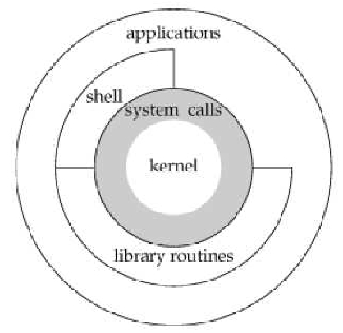
Advanced Programming in the UNIX Environment
UNIX Basics: Architecture
Lecture 01: Introduction, UNIX history, UNIX Programming Basics

Slide 28
Advanced Programming in the UNIX Environment
System Calls and Library Functions, Standards
System Calls and Library Functions
System calls are entry points into kernel code where their functions
are implemented. Documented in section 2 of the manual (e.g.
write(2)).
Library calls are transfers to user code which performs the desired
functions. Documented in section 3 of the manual (e.g. printf(3)).
Standards
ANSI C (X3.159-1989) C89, C9X/C99 (ISO/IEC 9899), C11 (ISO/IEC
9899:2011)
IEEE POSIX (1003.1-2008) / SUSv4
Lecture 01: Introduction, UNIX history, UNIX Programming Basics

Slide 29
Advanced Programming in the UNIX Environment
Important ANSI C Features, Error Handling
Important ANSI C Features:
function prototypes
generic pointers (void *)
abstract data types (e.g. pid_t, size_t)
Error Handling:
meaningful return values
errno variable
look up constant error values via two functions:
#include <string.h>
char *strerror(int errnum)
#include <stdio.h>
void perror(const char *msg)
Returns: pointer to message string
Lecture 01: Introduction, UNIX history, UNIX Programming Basics

Slide 30
Advanced Programming in the UNIX Environment
UNIX Basics: Pipelines
What is the longest word found on the ten most frequently retrieved
English Wikipedia pages?
for f in $(curl -L http://is.gd/c6F2fs | zgrep -i "^en " |
sort -k3 -n | tail -10 |
sed -e 's/en \(.*\) [0-9]* [0-9]*/\1/'); do
links -dump http://en.wikipedia.org/wiki/${f}
done |
tr '[:punct:]' ' ' |
tr '[:space:]' '\n' |
tr '[:upper:]' '[:lower:]' |
egrep '^[a-z]+$' |
awk '{ print length() " " $0; }' |
sort |
uniq |
sort -n |
tail -1
Lecture 01: Introduction, UNIX history, UNIX Programming Basics

Slide 31
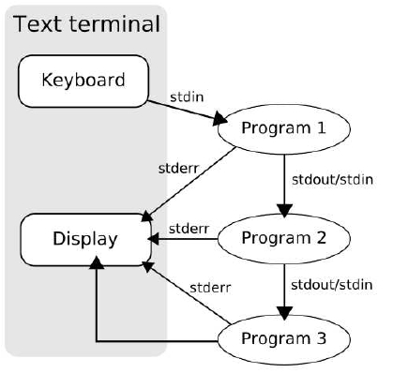
Advanced Programming in the UNIX Environment
UNIX Basics: Pipelines
Say ”Thank you, Douglas McIlroy!”
http://is.gd/vGHO9J
Lecture 01: Introduction, UNIX history, UNIX Programming Basics

Slide 32
Advanced Programming in the UNIX Environment
Program Design
”Consistency underlies all principles of quality.”
Frederick P. Brooks, Jr
Lecture 01: Introduction, UNIX history, UNIX Programming Basics

Slide 33
Advanced Programming in the UNIX Environment
Program Design
https://en.wikipedia.org/wiki/Unix_philosophy
UNIX programs...
...are simple
...follow the element of least surprise
...accept input from stdin
...generate output to stdout
...generate meaningful error messages to stderr
...have meaningful exit codes
...have a manual page
Lecture 01: Introduction, UNIX history, UNIX Programming Basics

Slide 34
Boot/Login process
[...]
total memory = 768 MB
avail memory = 732 MB
timecounter: Timecounters tick every 10.000 msec
mainbus0 (root)
[...]
boot device: xbd3
root on xbd3a dumps on xbd3b
mountroot: trying lfs...
mountroot: trying ffs...
root file system type: ffs
init: copying out path `/sbin/init' 11
[...]
Starting local daemons:.
Starting sendmail.
Starting sshd.
Starting snmpd.
Starting cron.
NetBSD/amd64 (panix.netmeister.org) (console)
login:
Advanced Programming in the UNIX Environment
Lecture 01: Introduction, UNIX history, UNIX Programming Basics

Slide 35
Advanced Programming in the UNIX Environment
Boot/Login process
[...]
total memory = 768 MB
avail memory = 732 MB
timecounter: Timecounters tick every 10.000 msec
mainbus0 (root)
[...]
boot device: xbd3
root on xbd3a dumps on xbd3b
mountroot: trying lfs...
mountroot: trying ffs...
root file system type: ffs
init: copying out path `/sbin/init' 11
[...]
Starting local daemons:.
Starting sendmail.
Starting sshd.
Starting snmpd.
Starting cron.
NetBSD/amd64 (panix.netmeister.org) (console)
login: jschauma
Password:
Lecture 01: Introduction, UNIX history, UNIX Programming Basics

Slide 36
Advanced Programming in the UNIX Environment
Boot/Login process
[...]
total memory = 768 MB
avail memory = 732 MB
timecounter: Timecounters tick every 10.000 msec
mainbus0 (root)
[...]
boot device: xbd3
root on xbd3a dumps on xbd3b
mountroot: trying lfs...
mountroot: trying ffs...
root file system type: ffs
init: copying out path `/sbin/init' 11
[...]
Starting local daemons:.
Starting sendmail.
Starting sshd.
Starting snmpd.
Starting cron.
NetBSD/amd64 (panix.netmeister.org) (console)
login: jschauma
Password:
Last login: Sat Sep 10 14:27:56 2011 on console
Copyright (c) 1982, 1986, 1989, 1991, 1993
The Regents of the University of California. All rights reserved.
NetBSD 5.0.2 (PANIX-VC) #2: Tue Oct 19 16:30:57 EDT 2010
Welcome to NetBSD!
$
Lecture 01: Introduction, UNIX history, UNIX Programming Basics

Slide 37
Advanced Programming in the UNIX Environment
Soooo... what exactly is a ”shell”?
$ wget http://www.cs.stevens.edu/~jschauma/631/simple-shell.c
$ more simple-shell.c
$ cc -Wall -o mysh simple-shell.c
$ ./mysh
$$ /bin/ls
[...]
$$ ^D
$
Lecture 01: Introduction, UNIX history, UNIX Programming Basics

Slide 38
Advanced Programming in the UNIX Environment
Files and Directories
The UNIX ﬁlesystem is a tree structure, with all partitions mounted
under the root (/). File names may consist of any character except /
and NUL as pathnames are a sequence of zero or more ﬁlenames
separated by /’s.
Lecture 01: Introduction, UNIX history, UNIX Programming Basics

Slide 39
Advanced Programming in the UNIX Environment
Files and Directories
The UNIX ﬁlesystem is a tree structure, with all partitions mounted
under the root (/). File names may consist of any character except /
and NUL as pathnames are a sequence of zero or more ﬁlenames
separated by /’s.
Directories are special ”ﬁles” that contain mappings between inodes
and ﬁlenames, called directory entries.
Lecture 01: Introduction, UNIX history, UNIX Programming Basics

Slide 40
Advanced Programming in the UNIX Environment
Files and Directories
The UNIX ﬁlesystem is a tree structure, with all partitions mounted
under the root (/). File names may consist of any character except /
and NUL as pathnames are a sequence of zero or more ﬁlenames
separated by /’s.
Directories are special ”ﬁles” that contain mappings between inodes
and ﬁlenames, called directory entries.
All processes have a current working directory from which all relative
paths are speciﬁed. (Absolute paths begin with a slash, relative paths
do not.)
Lecture 01: Introduction, UNIX history, UNIX Programming Basics

Slide 41
Advanced Programming in the UNIX Environment
Listing ﬁles in a directory
$ wget http://www.cs.stevens.edu/~jschauma/631/simple-ls.c
$ more simple-ls.c
$ cc -Wall -o myls simple-ls.c
$ ./myls .
[...]
$
Lecture 01: Introduction, UNIX history, UNIX Programming Basics

Slide 42
Advanced Programming in the UNIX Environment
User Identiﬁcation
User IDs and group IDs are numeric values used to identify users on
the system and grant permissions appropriate to them.
Group IDs come in two types; primary and secondary.
$ id
Lecture 01: Introduction, UNIX history, UNIX Programming Basics

Slide 43
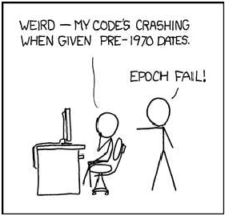
Advanced Programming in the UNIX Environment
Unix Time Values
Calendar time: measured in seconds since the UNIX epoch (Jan 1,
00:00:00, 1970, GMT). Stored in a variable of type time_t.
$ date +%s
https://www.xkcd.com/376/
https://en.wikipedia.org/wiki/Year_2038_problem
Lecture 01: Introduction, UNIX history, UNIX Programming Basics

Slide 44
Advanced Programming in the UNIX Environment
Unix Time Values
Process time: central processor resources used by a process. Measured
in clock ticks (clock t). Three values:
clock time
user CPU time
system CPU time
$ time grep -r _POSIX_SOURCE /usr/include >/dev/null
Lecture 01: Introduction, UNIX history, UNIX Programming Basics

Slide 45
Advanced Programming in the UNIX Environment
Standard I/O
Standard I/O:
ﬁle descriptors: Small, non-negative integers which identify a ﬁle
to the kernel. The shell can redirect any ﬁle descriptor.
kernel provides unbuﬀered I/O through e.g. open read write
lseek close
kernel provides buﬀered I/O through e.g. fopen fread fwrite
getc putc
$ wget http://www.cs.stevens.edu/~jschauma/631/simple-cat.c
$ wget http://www.cs.stevens.edu/~jschauma/631/simple-cat2.c
$ diff -bu simple-cat*.c
[...]
$
Lecture 01: Introduction, UNIX history, UNIX Programming Basics

Slide 46
Advanced Programming in the UNIX Environment
Processes
Programs executing in memory are called processes.
Programs are brought into memory via one of the six exec(3)
functions. Each process is identiﬁed by a guaranteed unique
non-negative integer called the processes ID. New processes can
only be created via the fork(2) system call.
process control is performed mainly by the fork(2), exec(3) and
waitpid(2) functions.
$ wget http://www.cs.stevens.edu/~jschauma/631/pid.c
$ more pid.c
$ cc -Wall -o mypid pid.c
$ ./mypid .
[...]
$ echo $$
[...]
Lecture 01: Introduction, UNIX history, UNIX Programming Basics

Slide 47
Advanced Programming in the UNIX Environment
Processes
$ pstree -hapun | more
Lecture 01: Introduction, UNIX history, UNIX Programming Basics

Slide 48
Advanced Programming in the UNIX Environment
Processes
[...]
total memory = 768 MB
avail memory = 732 MB
timecounter: Timecounters tick every 10.000 msec
mainbus0 (root)
[...]
boot device: xbd3
root on xbd3a dumps on xbd3b
mountroot: trying lfs...
mountroot: trying ffs...
root file system type: ffs
init: copying out path `/sbin/init' 11
[...]
Starting local daemons:.
Starting sendmail.
Starting sshd.
Starting snmpd.
Starting cron.
NetBSD/amd64 (panix.netmeister.org) (console)
login: jschauma
Password:
Last login: Sat Sep 10 14:27:56 2011 on console
Copyright (c) 1982, 1986, 1989, 1991, 1993
The Regents of the University of California. All rights reserved.
NetBSD 5.0.2 (PANIX-VC) #2: Tue Oct 19 16:30:57 EDT 2010
Welcome to NetBSD!
$
Lecture 01: Introduction, UNIX history, UNIX Programming Basics

Slide 49
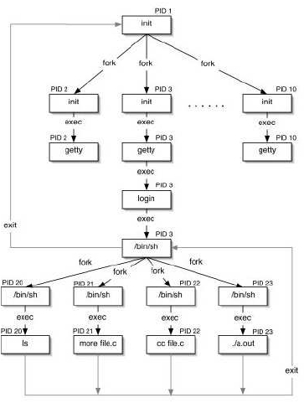
Advanced Programming in the UNIX Environment
Processes
Lecture 01: Introduction, UNIX history, UNIX Programming Basics

Slide 50
Advanced Programming in the UNIX Environment
Signals
Signals notify a process that a condition has occured. Signals may
be
ignored
allowed to cause the default action
caught and control transferred to a user deﬁned function
$ wget http://www.cs.stevens.edu/~jschauma/631/simple-shell2.c
$ more simple-shell2.c
$ cc -Wall -o mysh simple-shell2.c
$ ./mysh
$$ /bin/ls
[...]
$$ ^C
Caught SIGINT!
Lecture 01: Introduction, UNIX history, UNIX Programming Basics

Slide 51
Advanced Programming in the UNIX Environment
Homework
install at least one UNIX-like system, ubuntu, CentOS, or fedora will be OK
read introduction to Single UNIX® Specification on www.unix.org
follow, test and understand all examples from this lecture
bookmark these websites:
http://www.unixprogram.com/
http://pubs.opengroup.org/onlinepubs/9699919799/
ensure you have installed these two necessary tools:
gcc
gdb
ensure you have grasped at least one commonly-used editor: vi or gedit
know the basic grammar and principles of shell-scripts
Lecture 01: Introduction, UNIX history, UNIX Programming Basics

